Slide 1
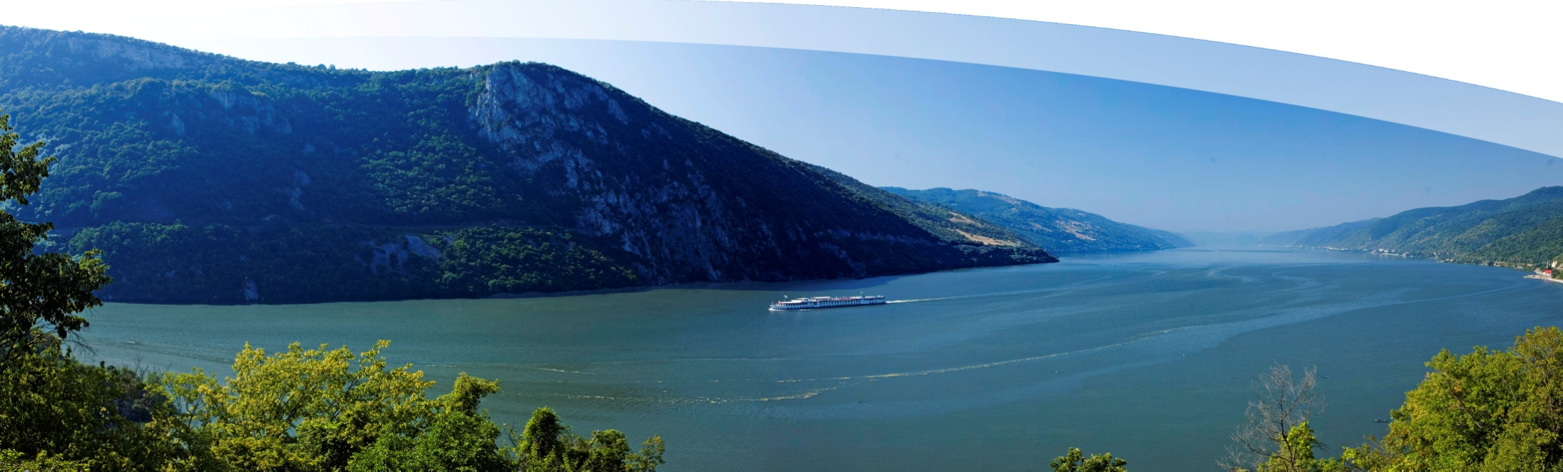

EUSDR Priority Area 4: To Restore and Maintain the Quality of Waters:
State of play and next steps
PA4 6th Steering Group Meeting, Vienna, 12 December 2013
Zsuzsanna Kocsis-Kupper
Ministry of Foreign Affairs, Hungary
DunaStrategia@mfa.gov.hu
http://groupspaces.com/WaterQuality/pages/

Slide 2
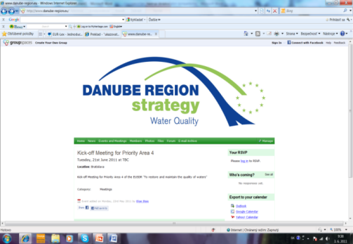
POINTS
Mandate
Guiding principles
Operation
Achievements, ADDED VALUE:
  POLICY
  INSTITUTIONAL PROGRESS
  TOPICS
  DEMONSTRATION, DISSEMINATION
Facts
Future

Slide 3

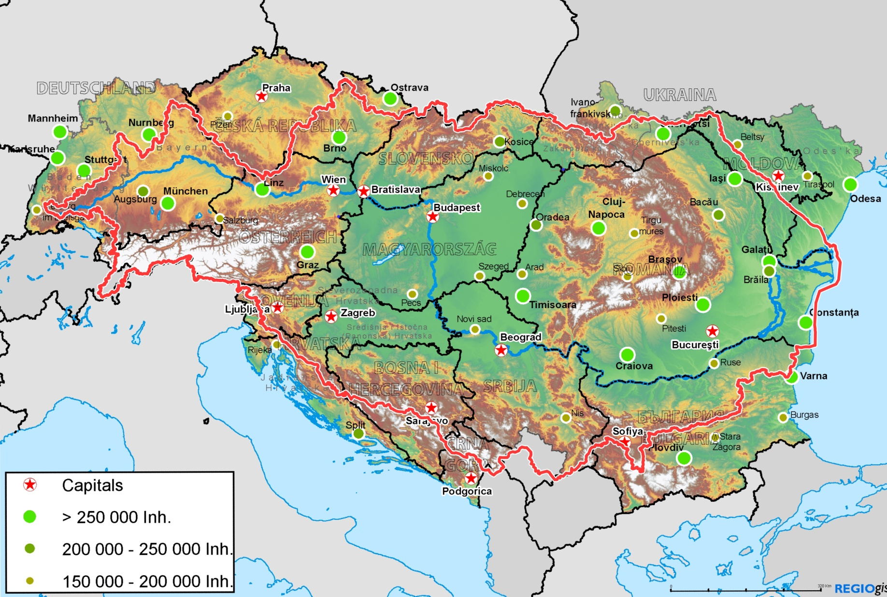
The „scene”
Notes:
Philosophy of the EUSDR
Balancing between environment, sustainability and economy
Working together for the Region development
Bringing closer the MS and countries of the Western Balkans, Moldova and Ukraine
Progress by innovative transnational projects
Dealing with transboundary issues such as typically in field of water management

Slide 4
PRINCIPLES-MANDATE
Communication from the Commission to the European Parliament, the Council, the European Economic and Social Committee and the Committee of Regions (8.12.2010., COM(2010) 715 final), and;
Accompanying Action Plan of the European Commission (8.12.2010., SEC(2010) 1489, as well as;
European Parliament Resolution of 21 January 2010 on a European Strategy for the Danube Region (P7 TA-PROV (2010) 0008;
Council Conclusions on the European Union Strategy for the Danube Region (3083rd General Affairs Council meeting, Brussels, 13 April 2011);
Guidance to the Priority Area Coordinators of the European Commission – DG REGIO;

Slide 5
The general scheme of EUSDR PA4 operation
Actions (14) set by COM
Breakdown into operational steps (roadmaps) done by SG
Our mission is the improvement of the efficiency of the implementation of roadmap items by
  Setting up an efficiency model
  Optimising the implementation by using the model and making a plan for the implementation
  Making an optimised investment and financing plan for the roadmap item

Slide 6
Types of actions/roadmaps
Measure/implementation/investment type
Legislative type
Info dissemination/public event type
Various ways of EUSDR contribution and added value to these types

Slide 7
IMPLEMENTATION-OPERATION:
The general scheme of EUSDR operation
Action
Roadmap
Interventions / Milestones
Optimization
model
Programming
Project

Slide 8
Action
Roadmap
Interventions / Milestones
Optimization
model
Programmingcalls
Project
COM after MS/ DRC / Broad stakeholder consultation
Steering groups: PAC + national administrations and COM
Steering groups: PAC + national administrations and COM
Scientific / innovation partnerships
Discussion in scientific and high level stakeholder conference
National administrations
ETC : Task Force / MA
Consortia, clusters
Facilitating support: BDCP, other institutions
National administrations
Facilitated or bottom up based on content
Expandable, heuristic

Slide 9
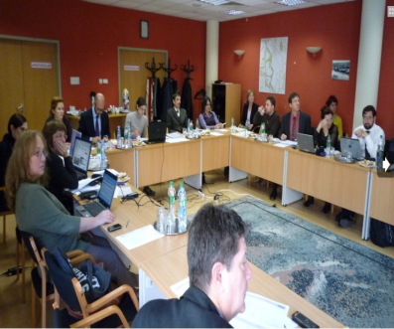
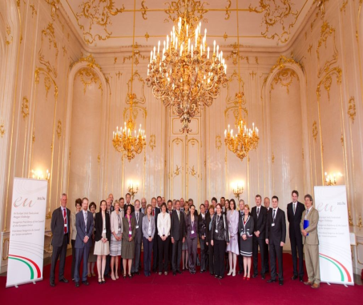
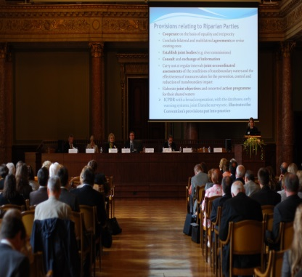
EXAMPLE : Early Warning Monitoring System
Timeline
We are here now
Action Plan endorsed by COM under HU Presidency on 13 April 2011 (8-10 May 2011, Gödöllő)
Action 2 – To Greatly Strenghten Cooperation on Sub Basin Level
Scientific input and innovation – coordination work of EUSDR staff
Discussions
Presentations on Scientific Conference
Action
Roadmap
Optimization
model
Programming
Project
3rd Steering Group Meeting in Bratislava on 4-5 June 2012
First version of Roadmaps accepted
4th Steering Group Meeting in Budapest on 5 November 2012
Refinement, current version of Roadmaps accepted
Integration of roadmap items into OPs
Cooperation with Ministry for Rural Development in this field from February 2013
Inter ministry talks on 31 May and 31 July 2013
Early warning water quality monitoring system on transboundary rivers
During the next 7 year EU financial cycle

Slide 10
POLICY is clear
Water quality is a world wide significant policy issue
AIM: to improve water policy, to reach good status under WFD
Targets: PA4: 5 targets and 14 actions
(implement the river basin and sub-basin management plans, reduce nutrient level, prepare a Danube Delta analysis report, secure species)

Slide 11
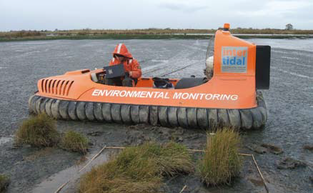
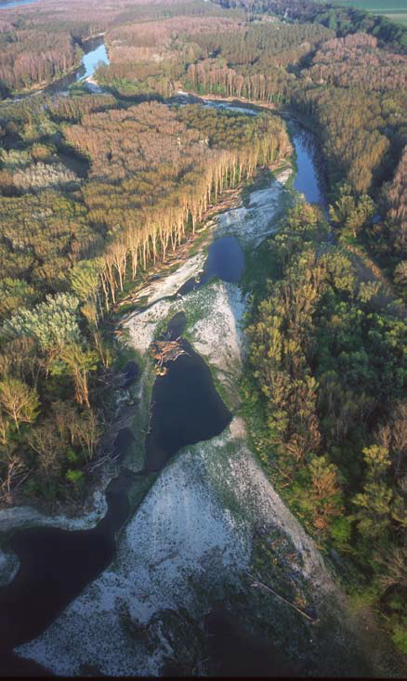
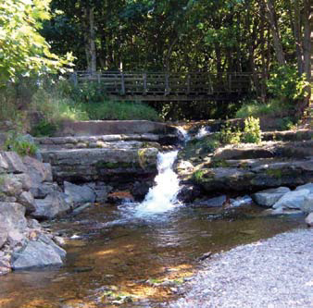
Main topics for PA4
Notes:
River basin management
Water quality monitoring, early warning systems,
Buffer zones small rural settlements, alternative waste water treatment possibilities for small settlements

Slide 12
PA4: POLICY development
Identification and discussions with the main POLICY actors concerning water quality in 2013:
UNECE- Helsinki Convention
DG Environment
ICPDR, Sava Commission, Danube Commission
Other international bodies: JRC, REC, ASEM
Water boards-bilateral commissions
Notes:
International, EU, regional, other international, bilateral

Slide 13
POLICY development
The added value of EUSDR of how the Blueprint conclusions can be implemented.
The key priority to identify those areas where there is added value are the following:
buffer strips,
priority substances,
uniform monitoring network,
early warning systems,
cooperation with services, and initiative for the UWWT, and
finally to enable non- EU countries for reasonable planning for implementation and use cohesion sources.

Slide 14
POLICY development: Cooperation with DG ENV
On-going discussions with DG ENV:
on potential areas of cooperation AGREED
to have a systematic overview of the priorities based on the Blueprint findings,
the common implementation strategy (CIS) reviews and
on exploring the potential synergies of the work of EUSDR
it would be especially helpful to have a review on the cross cutting issues.

Slide 15
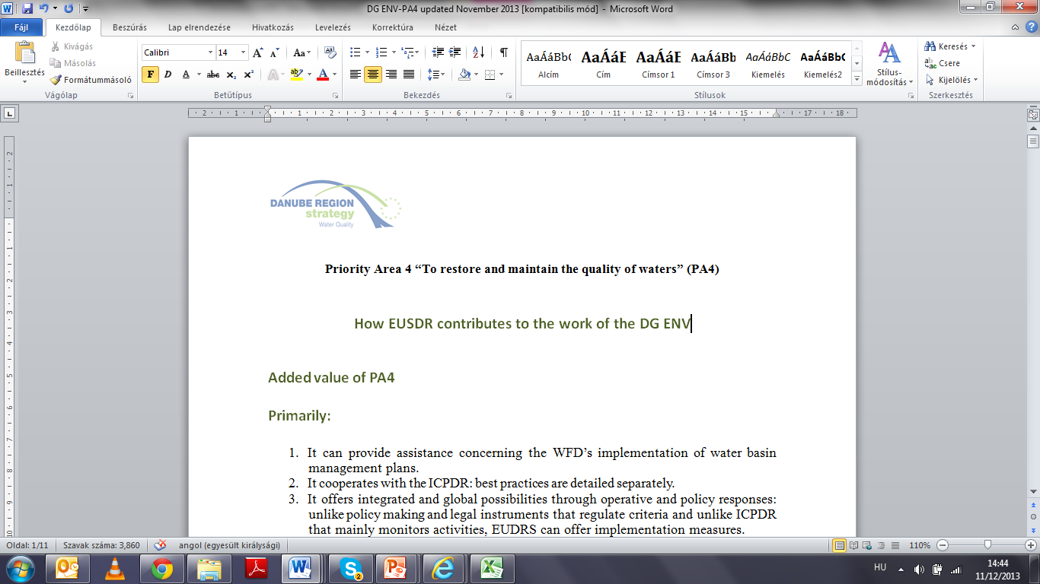
POLICY development
With regard the Blueprint the PA4 identified and screened the research and development options in 2013 and carried out wide discussion with research institutes and policy experts, resulted in the macro regional conference findings. (JRC, DG ENV, universities)

Slide 16
POLICY development
ADDED VALUE PA4:
Assist to reinforce implementation of EU Directives concerning restoration and maintenance of the quality of waters such
EU Water Framework Directive
Groundwater Daughter Directive,
Urban Waste Water Treatment Directive,
Drinking Water Directive,
Nitrate Directive and
Habitat Directive.
IMPLEMENTATION BACK UP with alignment of funding together with MS and ICPDR.

Slide 17
POLICY DEVELOPMENT
ADDED VALUE PA4:
Full spectrum inventory of the related water
organisations,
established cooperation with many partner organisations,
identified gaps and needs
RELATED MILESTONES and PROJECTS identified.

Slide 18
INSTITUTIONAL DEVELOPMENT
New international expert position on watershed-planning, at the National Institute for Environment at the beginning of October 2013. The main objective is to ensure follow up activities of the ICPDR Tisza Group work.
(Related action: A2)
Notes:
Hungary offered to ensure the ICPDR coordination activities for a transition period and the STWG reaffirmed the commitment to provide funding for the development of the project proposal from the ICPDR Danube Strategy fund. Hungary setup an international expert position on watershed-planning, at the National Institute for Environment at the beginning of October 2013. The main objective is to ensure follow up activities of the ICPDR Tisza Group work. The work will be coordinated via PAC4 (by ensuring partly the financing of the position as well as facilitating the development of a Tisza project). The next Tisza G. meeting is planned to be organised in March 2014. One of the agenda items of the meeting will focus on the update of the pro-Tisza project. The project should aim to establish the basis and framework of a long-term Tisza basin cooperation.

Slide 19
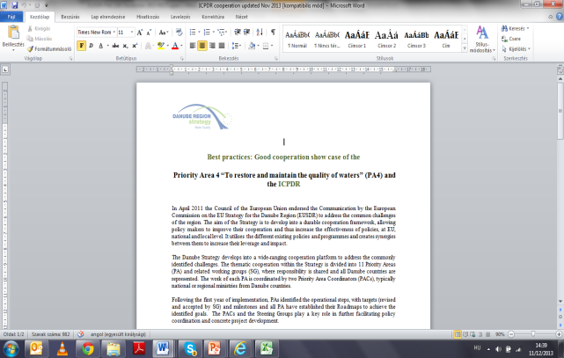
Cooperation with ICPDR
Separate show case presented
Joint experts identified
EUSDR-ICPDR demarcation analysis currently on-going (SK-HU-RO cooperation for PA4-PA5), background paper prepared, discussions on-going
Notes:
the ICPDR Secretariat as permanent observer assumes eight action leaderships of fourteen ones of PA4 and the remained actions are shared between EUSDR countries involved and committed in PA4. (
regular communication and exchange views on technical implementation and if possible, hold meetings back to back with each other.
3 SG members are also members of the RBMP WG of ICPDR (Austria, Germany and Serbia, while the EC representatives and the Sava Commission also visit both groups.) The PA4 is leading the process of concluding partnership agreements and ensures the synergies of the EUSDR with the operative programmes, while ICPDR carries out technical research and reporting activities. The close cooperation between the PA4 and ICPDR is demonstrated also that the Technical Assistance Agreement with the European Commission is now concluded also with ICPDR beside the PA coordinating countries Hungary and Slovakia. ICPDR covers many water related issues above a certain scale or level. T
he PA4 has to deal with the complete Danube river basin, including rivers and lakes with smaller catchment, wetlands below 500 ha and waste water treatment below 10000 P.E. The activity of PA4 also includes the uncovered 90% of groundwater bodies, lakes below 100 km2. PA4 also focuses on the on-line monitoring of rivers endangered by accident risk industrial sites, on the remediation of areas contaminated by hazardous chemicals. All these tasks are done by initiating and supporting projects, matching the financial needs with proper institutions thus helping the implementation of our targets in practice.

Slide 20
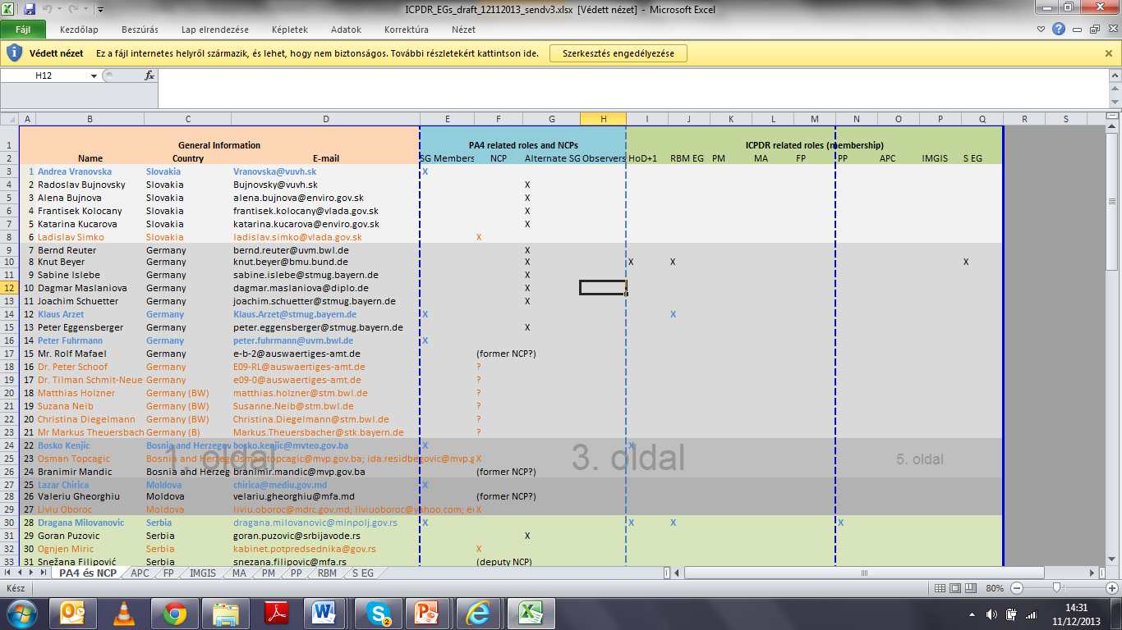

Slide 21
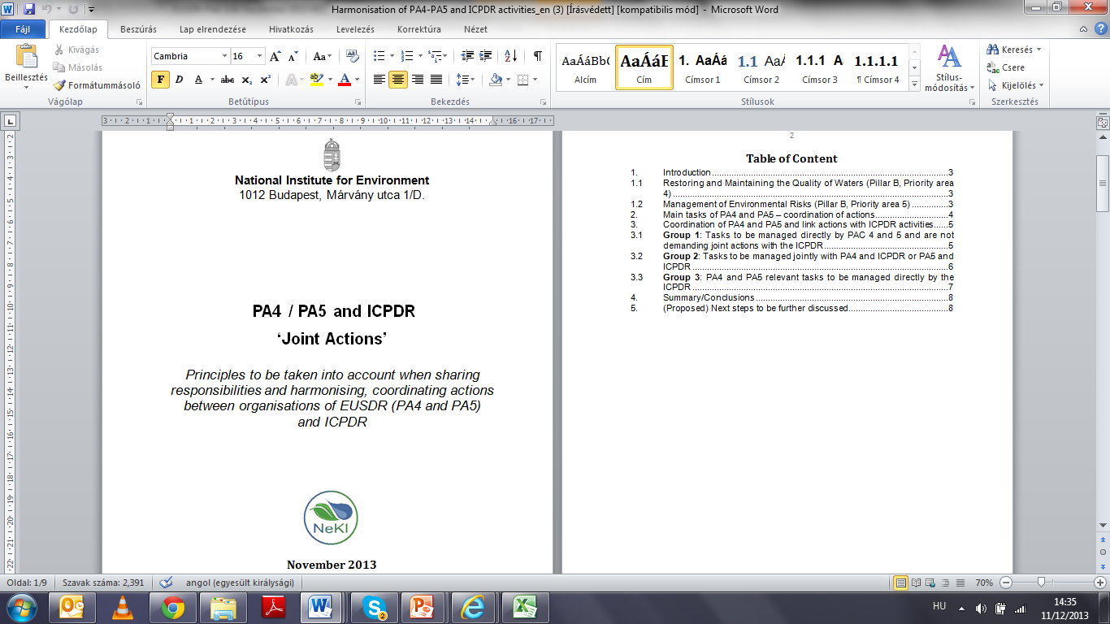

Slide 22
Cooperation with JRC
Discussions with the Joint Research Centre were on-going in 2013,
PAC participated at the different water nexus meetings
Cooperation resulted in initiating the macro regional conference in Budapest in September 2013
JRC gave a presentation on the Multi-criteria hydro-economic optimisation of water resources in Europe to support the EU Blueprint to safeguard Europe’s waters and the Danube Strategy SUPPLEMENTS POLICY DISCUSSIONS WITH DG ENV
Introduced a JRC study on challenges and solutions related water demand and supply. The aim of the study is to stimulate EU countries to increase the efficiency of water use by 2020/2030
New topics identified for EUSDR activities: ground water, retention progress started with PA5.
Notes:
e.g: Increasing irrigation water efficiency,Increasing water savings in households, Water re-use in industry/agriculture, etc) and to explore pro’s and con’s of other options of desalination, reducing leakage from water supply, large distance water transfers between basins and water pricing.

Slide 23
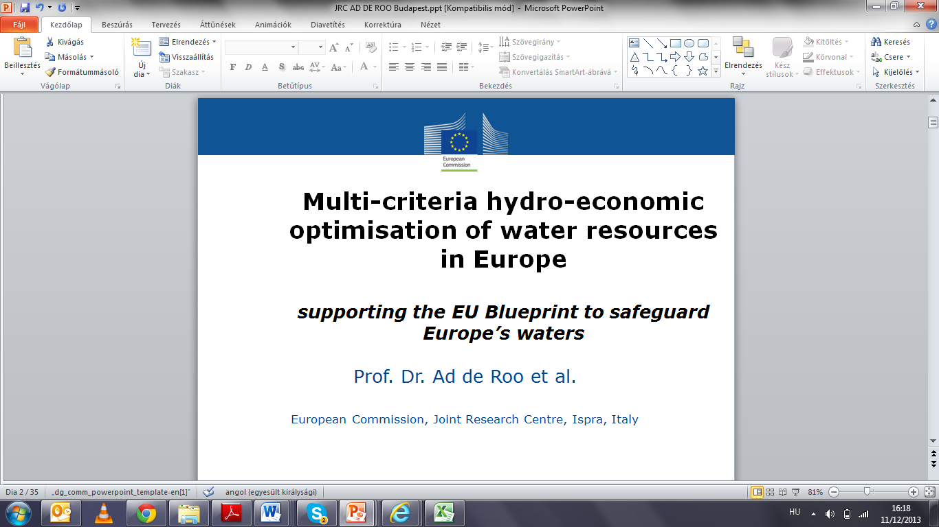

Slide 24
TOPICS:
River basin management-challenges
Sediment
Early warning and buffer strips
Sanitation and waste water improvements

Slide 25
River basin management-challenges
HOW CAN WE INTEGRATE WATER MANAGEMENT INTO OTHER SECTORS IN PRACTICE?
WHAT ARE THE NEWEST EXAMPLES OF FINANCABLE, RESULT ORIENTED METHODS?
The expert bodies of the ICPDR agreed that updating of the Danube River Basin District Management Plan (DRBMP) requires that a comprehensive study on sediment balance, on the pressures and impacts as well as on the measures needed will be performed. (Macro-regional conference, Bp)
SEDIMENT project

Slide 26
Sediment: PA4 flagship project, most important link between water and other areas that use water bodies (tourism, nature protection),
PA4 initiated supplementing partners,
PA4 will promote it through the Danube Transnational Programme. (A10, M4)
Notes:
The sediment project identified by the PA4 focuses on the Danube bed situation and its problems. The relevance of the project started decades ago, but only slow and little steps were made towards a better knowledge of the real effects caused of human interventions into the nature. The proposed project deals with the effects of the hydropower plants (78 barriers along the Danube), the works of flood protection (causing a loss of the 80% of the original floodplain area) and the navigation (2411 km navigable waterway), river bed degradation (2 cm/year) in the upper and also the middle Danube. This project was also presented to wide international audience at the macro-regional conference in September 2013.The base concept is ready for the establishment of adequate hydraulic laboratories, computer based simulations, but also field study sites for model calibration and validation are selected. With the project planning the building of cooperation between research institutions along the Danube River has already started.

Slide 27
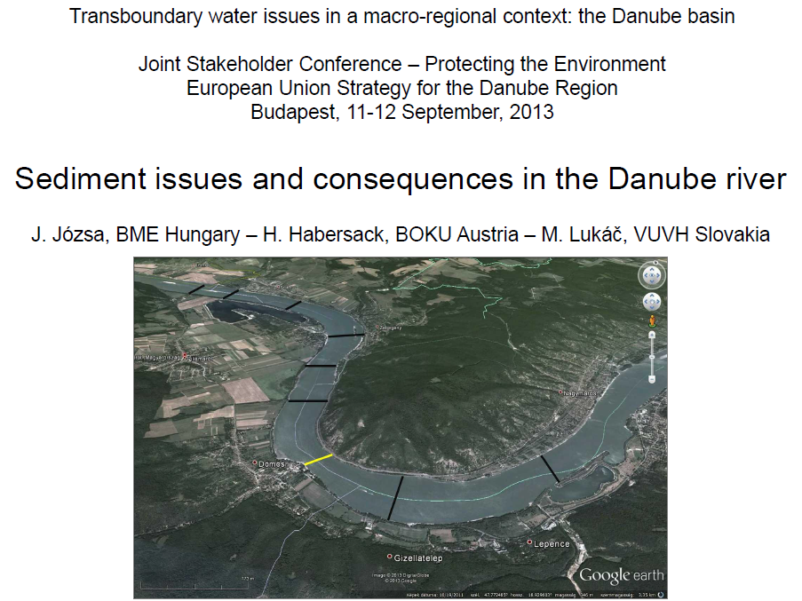

Slide 28
Early warning
Early Warning Systems and toxicology testing:
SG determined the task in A2 M1 p2
Technical elaboration of methodology happened in 2013: The base concept is ready for a unified early warning alert system for the territory of the Tisza river basin
Results were demonstrated in the macro-regional conference
Now the feasibility testing will be on-going involving an international consortium
The results will be available in 2014 and will be submitted to the SG
Notes:
Project idea for a cost effective integrated system which performs sampling, analysis and toxicity testing of surface waters.
Disscussion is needed for appropriate sampling locations
Appropriate data transmission and databases
Easy to react on varying analytical requirements, the frequency and speed of analysis results in quasi-continuous information about whole catchment areas.
The innovation helps to reduce the necessary investment and other costs by pre-classifying the samples by high-tech and top sensitivity biological-toxicological methods. As a result of such an Effect Based Monitoring only relevant samples are transported and analysed in labs.
The combination of Early Warning Systems and Effect Based Monitoring gives a new, so far unknown quality of continuous monitoring of waters.

Slide 29
Sanitation and waste water improvements
The PA4 initiated contacts with the related waste water treatment services to establish working groups and proceed developing project ideas.
A small settlement waste water treatment optimizations system was identified as a result of the cooperation with the Budapest Technical University (BME) for the integrated solutions for wastewater treatment in small settlements and rural areas (A13M2)
+ drinking water linkages in Budapest example was also presented (A5 M4, M5, M6)
Notes:
As a major contribution to the reduction of water use and waste water amount a source separation scheme was presented, defining descriptive categories of yellow, brown and grey water and their possible paths within a rural/agricultural household and environment.

Slide 30
Buffer zones
Survey of the situation on buffer zones and on management of solid waste: survey started within SG members on alternative collection and treatment wastewater in small rural settlements A5
An international consortium is being established, contracted to carry out further research and policy analysis.
The results will be available in 2014 and will be submitted to the SG

Slide 31
Events after the last SG meeting in 2013
June 5:SG 5 meeting Bratislava
June 18: ICPDR 11th Standing Working Group Meeting, Sarajevo
June: NCP programming workshop in Stuttgart
June: Flood in the area: PA4 scientific partners were in the area, measured sediment parameters
28-29 June Danube Day
Aug 27 Joint Danube Survey in Budapest: head of delegation, NCP, director of NEKI
Sept 11-12 Macro-regional conference, 300 participants
Notes:
Next steps…
For the preparation:
•Proactive approach in the preparation and conciliation
•Contribution to the priority issues
•Elaboration / integration of transboundary projects
For the implementation:
•Co-operation, public awareness and involvement
•Institutional and financial framework

Slide 32
1 Oct . Audit of the EU
8-9-10 Oct Water Summit, Budapest (PA4 had a separate dissemination desk)
9-10-11 Programming Task Force meeting, Stuttgart
18 Oct HU-SK PAC meeting, Budapest
29-30 EUSDR Annual Meeting, Bucharest –high level discussions on PA4
12 Nov. Court Of Auditors Survey
December: Buffer zones és phosphates studies, early warning project feasibility studies
10-11 December ICPDR Ordinary Meeting, Vienna
12 December SG6, Vienna

Slide 33
Challenges
  Mobilizing SG members (mainly)from third countries to participate in decision making
  Actions are moving on very broad scale in relation of water quality
  More activities need in surveying and updating of roadmaps
  Stronger commitment in implementation process from MS
Benefits
  Highly promoted proposals by EUSDR countries represented by SG members for the next MFF:
    Strengthening of cooperation in the Tisza River Basin
    Early Warning Water Quality Monitoring System on transboundary rivers
    Site specific and eco-friendly waste water treatment for less than 2000 PE settlements
    Danube Sediment Management – assessment and restoration of sediment balance
    River Modeling Centers - Hydraulic and environmental engineering labs (DREAM)
Notes:
Achievements
Milestones (64) status
41% ready (less) and on-going (more)
59% not yet started, due later
Projects status
18 project proposals submitted
13 proposals evaluated
9 (LoR)+2 (LoM) labelled
5 financed
5 running

Slide 34
Results achieved:
Identified gaps with the Blueprint options: discussion with DG Env. and Water Directors and integration of relevant EC documents in the PA4 process
Development of Best Practice document
ICPDR involvement in the PA4 activities as action leader in relation to the relevant actions
Strengthened institutional framework: new colleagues contracted, regular cooperation with ICPDR and DG ENV
First steps in sectorial discussion in the frame of the Macro-regional Conference
Wide dissemination activities
EUSDR aims included in national OPs in some countries
Concrete projects are being carried out or are under development in the topics of water quality monitoring and urban and rural waste water treatment systems and sediments.

Slide 35
Next steps:
Detailed disussions with ICPDR cooperation in 2014
Accelerate efforts to strengthen cooperation and identify new partners with non- members states, such as in the frame of twinning programmes with Moldova and Ukraine. Discussions have already been started with Bosnia and Herzegovina and Serbia on possible future co-operations
Finalise early warning and buffer strips studies
Notes:
Next steps…
For the preparation:
•Proactive approach in the preparation and conciliation
•Contribution to the priority issues
•Elaboration / integration of transboundary projects
For the implementation:
•Co-operation, public awareness and involvement
•Institutional and financial framework

Slide 36
Next steps concerning programming:
Participate in programming at national level
Include EUSDR targets into OPs
Approach PACs, SGmb with project ideas
Notes:
Next steps…
For the preparation:
•Proactive approach in the preparation and conciliation
•Contribution to the priority issues
•Elaboration / integration of transboundary projects
For the implementation:
•Co-operation, public awareness and involvement
•Institutional and financial framework

Slide 37
Can we do it?
Notes:
EC MESSAGES:
Member States must take the Danube Strategy into account as they plan the next generation of programmes under regional policy for 2014-2020 “Smart and sustainable growth for the Region is to be ensured, joint monitoring of water quality, development of common databases and common river modelling systems and other coordinated measures are needed for effective, sustainable and joint policy making” Normund Popens, DG REGIO
Strong added value of the Danube Strategy: joint responses to common challenges “Enhanced water cooperation across borders is indispensable” Those countries that are part of the Danube Strategy and that can profit from EU financial assistance should do everything to include Danube related activities into the Partnership Agreement and more specifically the operational Programmes to be adopted early 2014.
Marianne Wenning, DG ENV

Slide 38
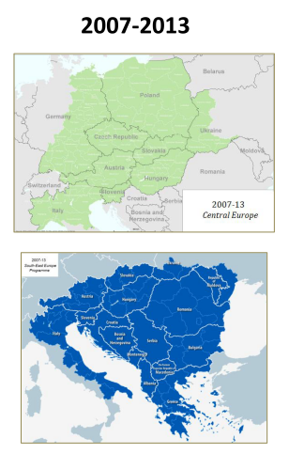
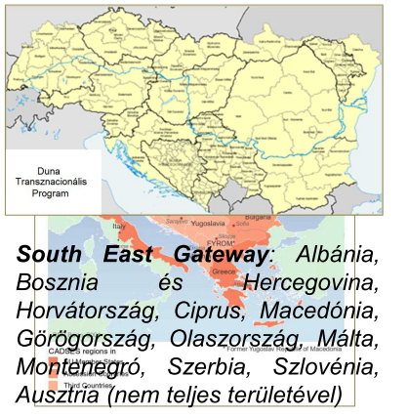

Slide 39
PROJECTS
Key expectation
- be of macro-regional importance
What kind of projects are of macro-regional importance?
- as a many of country as possible to be involved from the region to implementation region-wide already accepted targets, e.g
  less country involved in contribution, nevertheless with high definition project result/effect towards improvement of the region

Slide 40

Recommendations
How to find good partners?
How to find financial support?
BE PREPARED: good preparation is the key
COOPERATE: find the most suitable partners, network
INVEST: time for planning and preparation
INTEGRATE: partners and issues
Make a GOOD project for a good purpose, then you will find a support- CONTACT THE PACs!

Slide 41
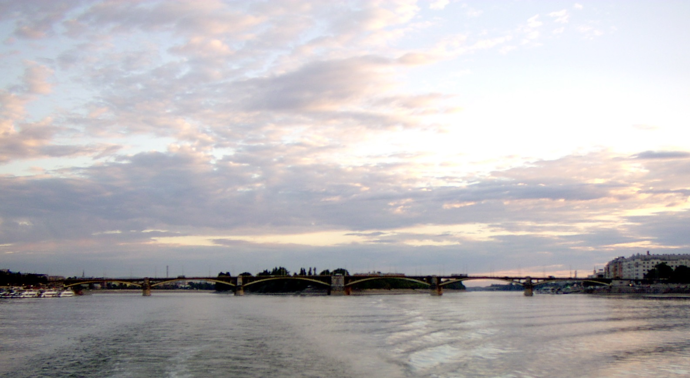

Thank you for attention
www.danube-region.eu
http://groupspaces.com/WaterQuality/
Visit www.danube-region.eu

