Slide 1

EUSDR Priority Area 4: Results of the macro-regional conference Budapest
Zsuzsanna Kocsis-Kupper
Ministry of Foreign Affairs, Hungary
DunaStrategia@mfa.gov.hu
http://groupspaces.com/WaterQuality/pages/

Slide 2
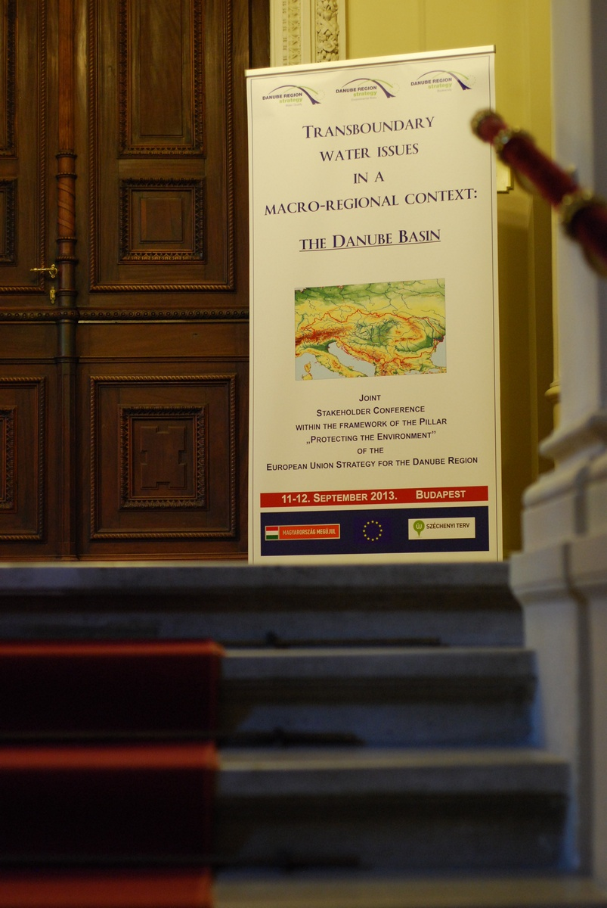

Slide 3

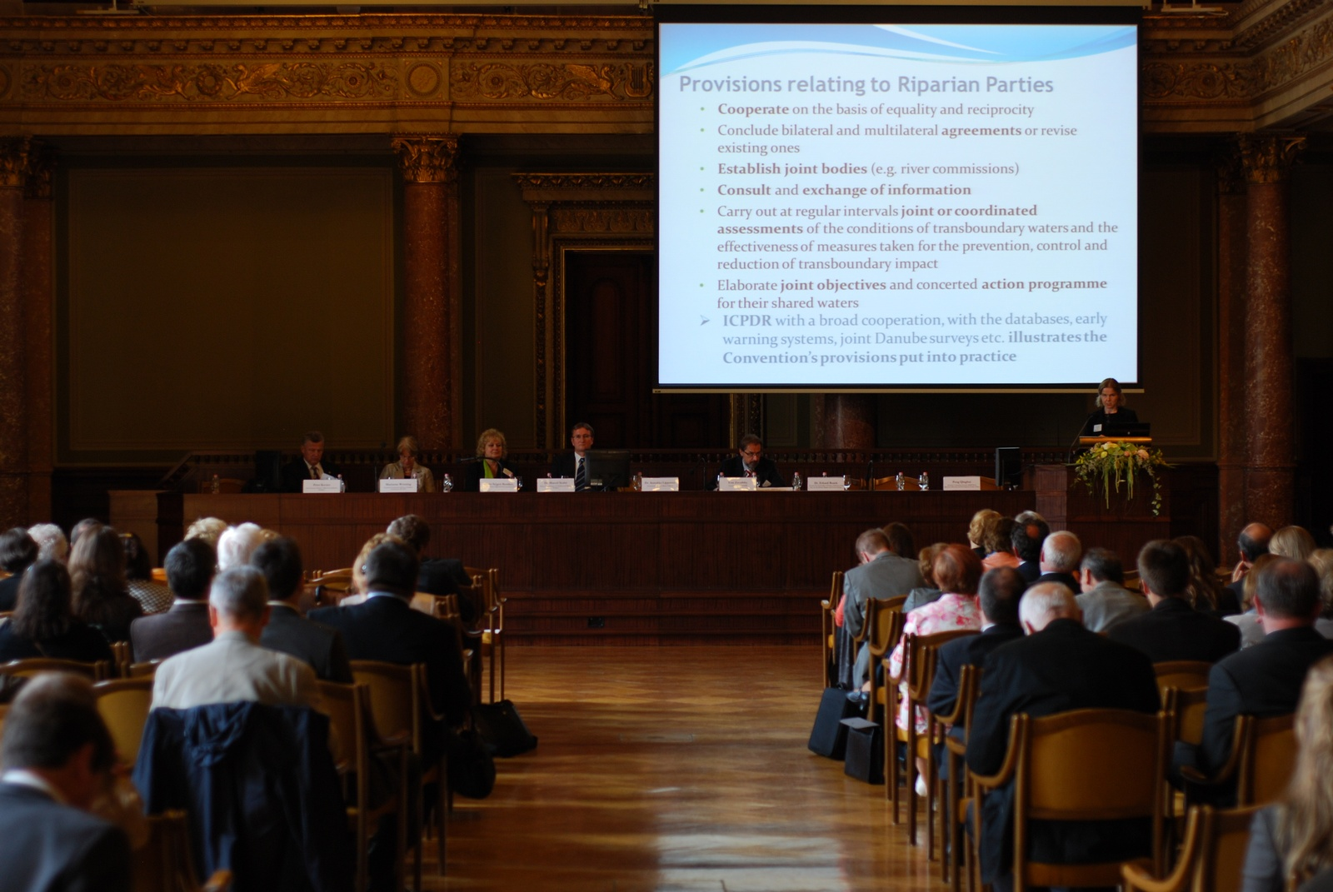
The „scene”

Slide 4
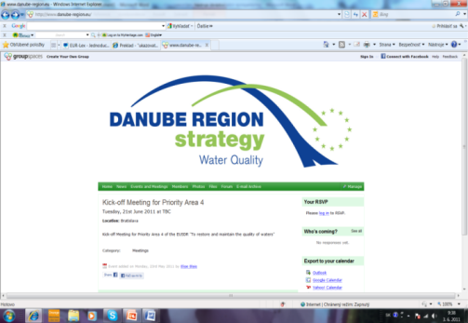
Facts of the conference:
300 participants
High level discussions:
Ministers and state secretaries:
Hungary, Slovakia, Romania, Bavaria, Bosnia and Herzegovina and the European Commission;
ICPDR President and Ex. Secretary together
Participants were coming from Slovakia, Austria, Ukraine, Moldova, Germany, Croatia, Bosnia, Italy and Hungary.

Slide 5
The representatives of major international, regional and local water and environmental organisations were also present, such as the UNECE, the European Commission, the ICPDR, the IDM, the REC, the Sava Commission, the ASEM, the Slovak Water Research Institute (VUVH) and the JRC.
Representatives of many scientific institutions as well as environmental and water consultants and experts also participated at the event.

Slide 6
The EUSDR provides a comprehensive cooperation platform for macro-regions
“Innovation, new models and new strategies, as well as methods to improve the knowledge base and incorporate the contribution of science and innovation to the Strategy”
the aim of the conference was to provide an overview about scientific results and innovative methods which are essential to the implementation of the water-related goals of the EU Strategy for the Danube Macro-region.
Balázs Medgyesy, Opening speech

Slide 7
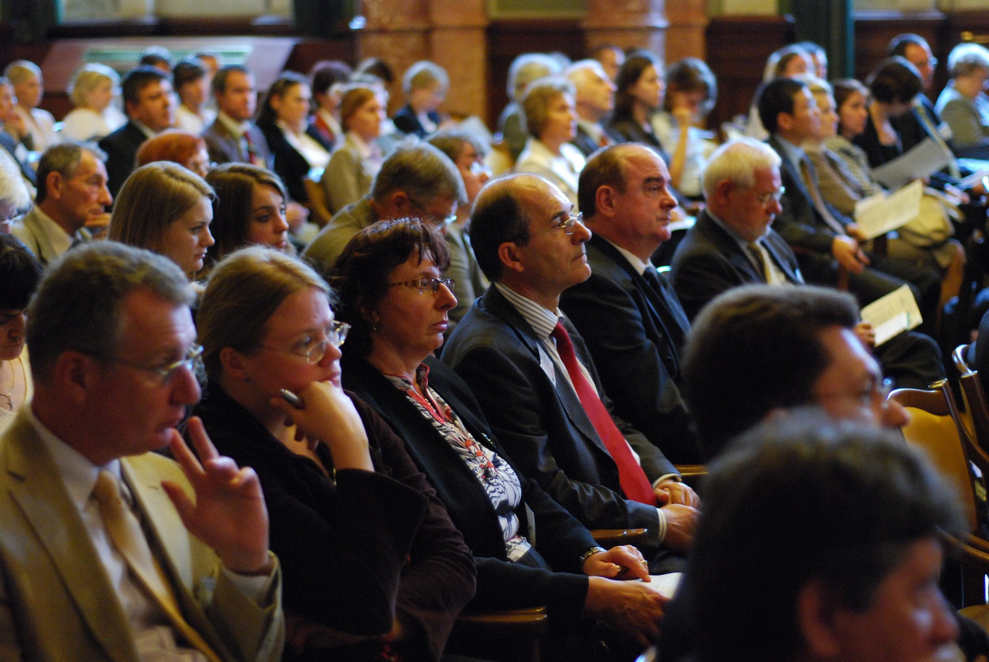

Slide 8
Our Danube Region Strategy has lead us to wider frameworks of cooperation
“This strategic cooperation conveys the message of Central European solidarity”
HE Enikő Győri, Minister of State from the Hungarian Ministry of Foreign Affairs mentioned that transboundary cooperation is necessary for the preservation and sustainable exploitation of water. She recalled that Hungary’s rivers and catchment areas extend beyond the borders of our country, so we need to develop close cooperation with our neighbouring countries in order to cope with the environmental hardships like flooding or drought, and also to find sustainable ways of water management.

Slide 9
Member States must take the Danube Strategy into account as they plan the next generation of programmes under regional policy for 2014-2020
“Smart and sustainable growth for the Region is to be ensured, joint monitoring of water quality, development of common databases and common river modelling systems and other coordinated measures are needed for effective, sustainable and joint policy making”
Mr. Normund Popens, the deputy Director General of the Directorate General Regional & Urban Policy, European Commission pointed that the Danube Strategy is demonstrating that by working together, we can have a far greater impact than if we try to tackle problems in isolation and mentioned that when dealing with water management, the macro-regional approach is self-explanatory, since water does not recognise borders and its management requires strong coordination and cooperation across the countries.

Slide 10
Strong added value of the Danube Strategy: joint responses to common challenges
“Enhanced water cooperation across borders is indispensable”
Ms. Marianne Wenning, the Director from the European Commission, Directorate General Environment welcomed the conference and noted that water is a precondition for human, animal and plant life as well as an indispensable resource for the economy and stressed that the demand for water is continuously growing in the world. She mentioned that on present trends about 40 % of global water supply is likely not be met by 2030 and that 47% of the EU water will fail to achieve good status by 2015. She called to step up our action at all levels.
Notes:
She stated that in general, water and flood management need to be better coordinated, particularly in view of the 2015 deadline for adoption of the 2nd River Basin Management plans and the 1st Flood Risks Management Plans under the Floods Directive. Finally Ms. Wenning highlighted that a strong added value of the Danube Strategy is that it brings together the EU Member States and non-EU countries in order to develop joint responses to common challenges. The good thing is that there is a golden opportunity before us with the Multiannual Financial Framework for the period 2014 – 2020 just having been adopted. Those countries that are part of the Danube Strategy and that can profit from EU financial assistance should do everything to include Danube related activities into the Partnership Agreement and more specifically the operational Programmes to be adopted early 2014.

Slide 11
Commitment of the Danube basin cooperation: need for more inter-sectoral cooperation
“If you want to walk fast, walk alone, but if you want to walk further, walk together”
HE Ermina Salkičevic- Dizdarević, Deputy Minister Bosnia and Herzegovina, President International Commission for the Protection of the Danube River noted that the ecosystems of the Danube River Basin are highly valuable in environmental, economic and social terms, and also noted that they are subject to increasing pressure and serious pollution from various sources and welcomed the cooperation among the Danube countries to overcome the environmental challenges.

Slide 12
Water is a natural resource that cannot be supplemented with anything else
“It is necessary to apply sustainable methods in order to preserve the status quo and for the sake of developing water management innovations” Zoltán Illés, State secretary
Macro regional and inter-sectoral cooperation is crucial
“Sustainable land use, efficient water and land management, protection of biodiversity and flood prevention is necessary.”
HE Vojtech Ferencz, State Secretary from the Slovak Ministry for Environment further welcomed the conference and stressed that we have to pay attention to the conservation and sustainable use of the ecosystem, including the management of riparian forests and the protection of the regional biodiversity.

Slide 13
Stakeholders will need to approach the PACs with project ideas
Mr. Wolfgang Klug from the Bavarian State Ministry of the Environment and Public Health noted the importance of cooperation in relation to the Danube and mentioned that Bavaria is also a Priority Area Coordinator (PAC) for the Danube Strategy, he specially emphasised that stakeholders will need to approach the PACs with project ideas as projects can still be financed in the upcoming financing period.

Slide 14
Science and innovation is only possible with macro-regional cooperation
The former Vice-Chancellor of Austria Dr. Erhard Busek, Chairman of the Institute for the Danube Region and Central Europe (IDM), Austria started the session with a title on Science and innovation supporting macroregional development agenda and he mentioned that throughout history the benefits that this biggest artery of Europe has offered with its waters have been equally numerous as they are today.

Slide 15
Importance of coordinated international warning systems
Mr. Ivan Zavadsky, the new Executive Secretary of the International Commission for the Protection of the Danube River presented a topic on the Danube basin cooperation and referred to the Danube River Protection Convention (1994, Sofia) highlighting the cooperation mechanisms of the ICPDR with 15 contracting parties
Water challenges in Europe and in Asia are similar
Mr. Peng Qinghui, the Assistant to Secretary General, ASEM Water Resources Research and Development Center, China presented a topic on the ASEM cooperation mechanisms and highlighted that the water challenges in Europe and in Asia are similar, such as flood, drought and pollution and that there is a similar gap between water supply and demand in both continents.

Slide 16
A constructive dialogue, identification of common interests and political willingness are necessary for development of cooperation
Dr. Annukka Lipponen, Environmental Affairs Officer, secretariat of the Convention on the Protection and Use of Transboundary Watercourses and International Lakes (Water Convention), United Nations Economic Commission for Europe (UNECE) presented on the experiences of the UNECE concerning transboundary water cooperation.

Slide 17
There is a need for a Comprehensive Groundwater Utilization Plan for the Danube River Basin
Dr. Marcel Szabó, the Deputy Commissioner for Fundamental Rights of Hungary referred to the issue of Comprehensive utilization of groundwater resources of the Danube River Basin and highlighted that groundwater is often more essential for human welfare than surface waters, serving as drinking water and means of food production and that 60% of the population in the DRB depends on groundwater sources, mainly recharged by the Danube

Slide 18
The most successful projects are cross border/regional activities, multi stakeholder approach, framework type activities, involving stakeholders and partners
Ms. Marta Szigeti Bonifert, the Executive Director of the Regional Environmental Centre spoke about the Macro regional co-operation in relation to water issues: the experiences of the REC and she highlighted the milestones of the REC operation as of 1989, noting that the most successful projects are cross border/regional activities, multi stakeholder approach, framework type activities, involving stakeholders and partners.

Slide 19
The Danube Strategy can significantly contribute to the implementation of the Blueprint policy options
Ms. Marianne Wenning, the Director from the European Commission, Directorate General Environment also presented a technical topic with a title Blueprint to Safeguard Europe's Water Resources and she stated that the Blueprint is the new strategy for the protection of Europe's water resources and also one of the priorities highlighted in the Commission Roadmap to a more Resource Efficient Europe.

Slide 20
„the Danube Strategy can significantly contribute to the implementation of the Blueprint policy options, in particular through ensuring correct implementation of the EU water legislation and facilitating the prioritisation of the required investments and channeling of funds to the identified challenges” and very much looks forward to the joint collaboration in this challenging exercise.

Slide 21
There is close connection between DG Environment policies and the EUSDR
The final speaker for the policy session was Mr. Péter Kovács, the State Secretary of the Hungarian Ministry of Rural Development, who spoke about the Context of EU water policies and the EUSDR. He highlighted the international cooperation in the water sector and described the structure of the EUSDR and its connection to EU Strategy 2020. Mr. Kovács called the attention to the fact that there is close connection to DG Environment policies as most of Pillar B Actions are covered by Directives of DG Environment and that most of the EUSDR Water Quality (PA 4) Actions refer to the Water Blueprint issues. He also pointed to the connections of EUSDR to the activities of the ICPDR activities and to the activities of the JRC as the later initiated a ‚Scientific support to the Danube Strategy’, which main objectives are to gather scientific expertise and data. Mr. Kovács emphasised that the EUSDR can efficiently contribute to reaching the relevant EU environmental objectives

Slide 22
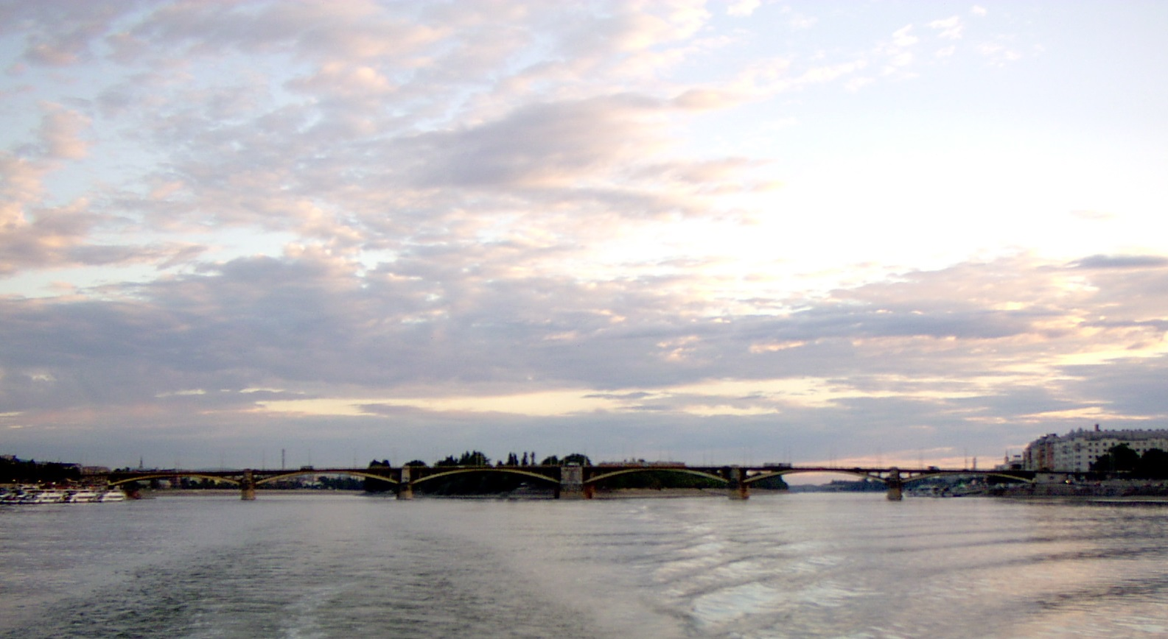

Thank you for attention
The full conference presentations are available at the website: http://groupspaces.com/WaterQuality/pages/stakeholder
Visit www.danube-region.eu

