Slide 1






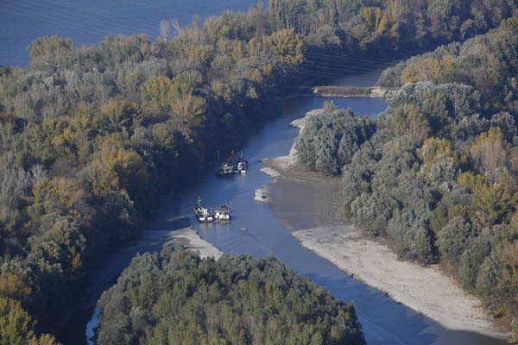
Restoration of
Liberty Island
WWF Hungary
Viktória Siposs
Project coordinator
2009 – 2013
LIFE+ NAT/H/00320, DUNASZIGETERDŐK
December 2013

Slide 2
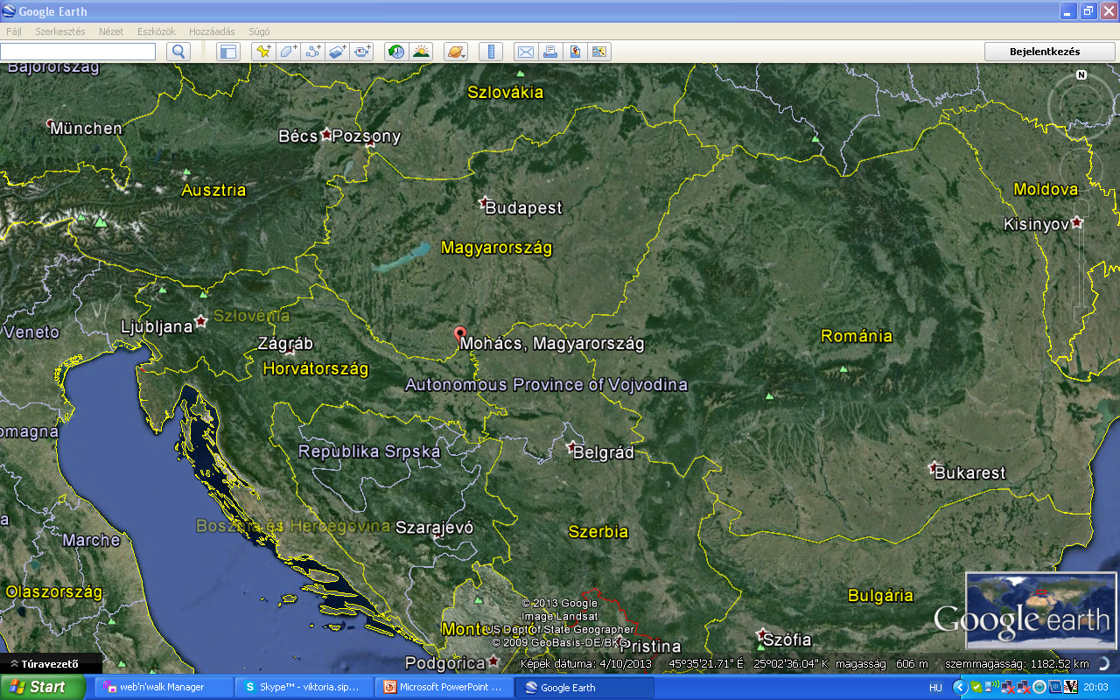
térkép

Slide 3
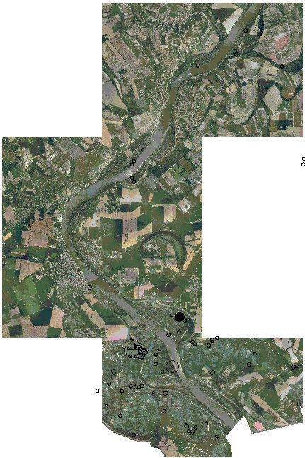
South-Hungary, Danube valley
Felső-zátony
Nagy-zátony
Bári-zátony
Liberty Island
MOHÁCS
Cigány-zátony
Debrina-zátony
Gabriella-zátony

Slide 4
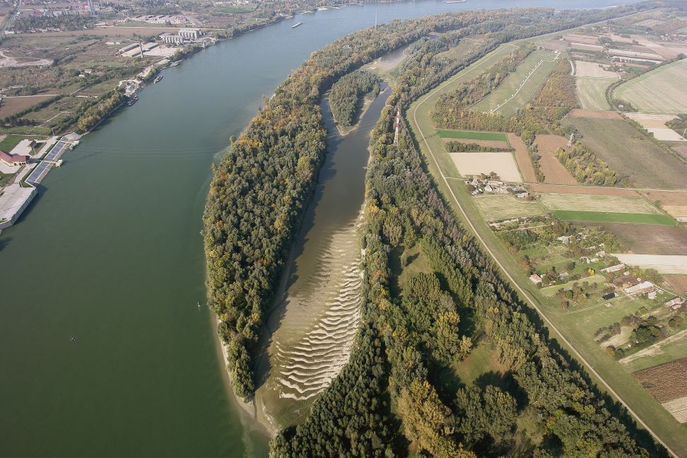
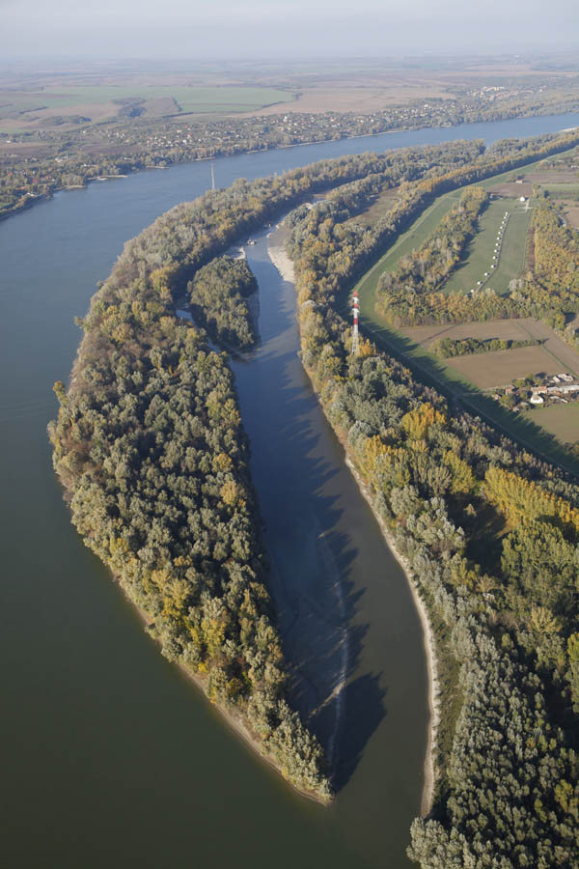
2009
rockfill-dam
water wells
2013
invasives
Restoration of the Liberty Island Hungary, Danube 2009-2013 1,795,529 Euro
sedimentation

Slide 5
Motivations
Side-arm is a protection zone of drinking water wells;
Due to regulation of the Danube stretch, no more islands and side arms formulate;
Strictly protected National Park and Natura 2000 site, size: 47 ha, side-arm: 3 km long;
Forest was under intensive mgmt till 1990;
Now: state owned, dedicated forever for nature conservation.

Slide 6
General objectives
Revitalize the side arm by providing longitudinal connectivity and restore its natural riverbed,
Strenghten social advantages:
Improve the area characteristics as natural filter for drinking water,
Restore the area for recreation ,
Provide suitable alluvial habitats on Liberty Island and its side-arm,
Restore the alluvial forests along its side-arm.

Slide 7
Relevant PA4 Actions
PA 4.01 To implement fully the Danube River Basin Management Plan;
PA 4.10 To reduce existing water continuity interruption for fish migration in the Danube river basin (Milestone 4: to carry out an assessment for restoration of the sediment balance in the Danube);
PA 4 13 To promote measures aimed at reducing knowledge deficitsm developing and transferring tools, methods and guidelines concerning the safeguaring of drinking water supply (Milestone 3: Implementation of joint actions with responsible authorities, enterprises, associations responsible for drinking water supply).

Slide 8
Relevant PA6 Action
PA 6. 03 To protect and restore most valuable ecosystems and endangered animal species.

Slide 9
Problems and solutions
Rockfill dam causing sedimentation and disconnected river stretches PA4 Action 01 and PA4 Action 10 M4 | Dam is opened 6.000 m³ stone is removed
Shallow standing water in the side-arm and poor water quality and degradation of habitats PA4 Action 10 M4 | Side-arm is dredged 160.000 m³ sediment is removed
Due to human impact , accelerated natural processes - side-arm and island would disappear - PA4 Action 10 | Longitudinal connectivity, flowing water.
Sedimented side-arm vs. living river stretch as a tool for clean and safe drinking water PA4 Action 13 M3 | Bank filtration wells provide better quality and quantity drinking water
Commercial forestry - PA 6.03 | Island is saved, area purchased conservation oriented, later no-go forestry
Invasive tree species - PA 6.03 | 80% is eliminated, maintenance will go on undisturbed floodplain forest

Slide 10
Activities: technical data
Dredging: 160 thousand m3
Waterpipe relocation 2 pipes of D700 mm + 1 pipe D160 mm, appr. 200 m length each
Opening the rockfill dam: 6000 m3 stone
These works last for 9 months
Forest conversion: 9 ha native, semi-natural forest
Forestry works: two seasons for planting and 3 years for nursery
This is the largest scale ecological dredging in the Danube main branch.

Slide 11

Partners and financial structure
EU:
LIFE+ Nature: 60%
NGO:
WWF Hungary, project lead, 15%
State bodies, together 10%
Danube-Drava National Park Directorate (DDNPI)
Lower-Danube-valley Water Management Directorate (ADUVIZIG)
Transdanubian Waterworks Company (DRV)
Mohács Municipality
Commercial corporation:
Coca-Cola Hungary, 15%

Slide 12
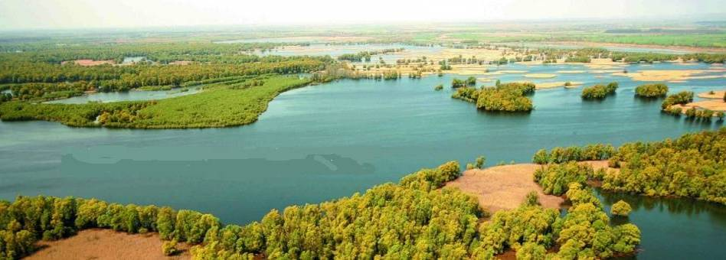
Healthy ecosystem is serving people in several ways
Natural resources available
Healthy environment
Tourism and landscape
Drinking water
Natural wetlands
Freshwater is available
Fish stock, fisheries
Climate change: adaptation
Sustainable transport
Flood safety

Slide 13
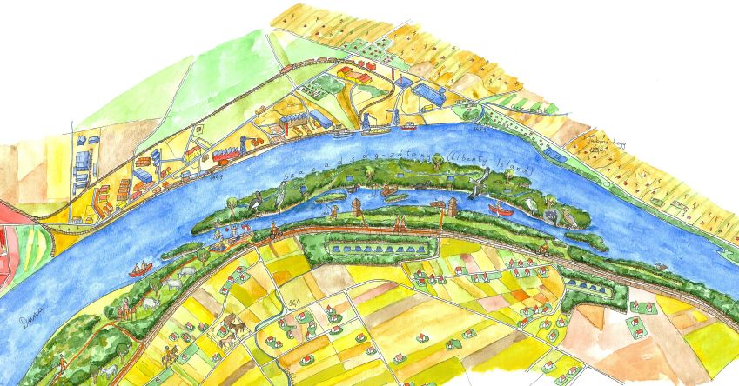
Opportunities offered by the Liberty Island
Habitat for birds
Forest: carbon sequestration
Free flowing river
Fish nursery
Safe beach
Ecotourism and water sports
Natural filtration and cleaning
Healthy environment
Groundwater source

Slide 14
Before the project

Slide 15
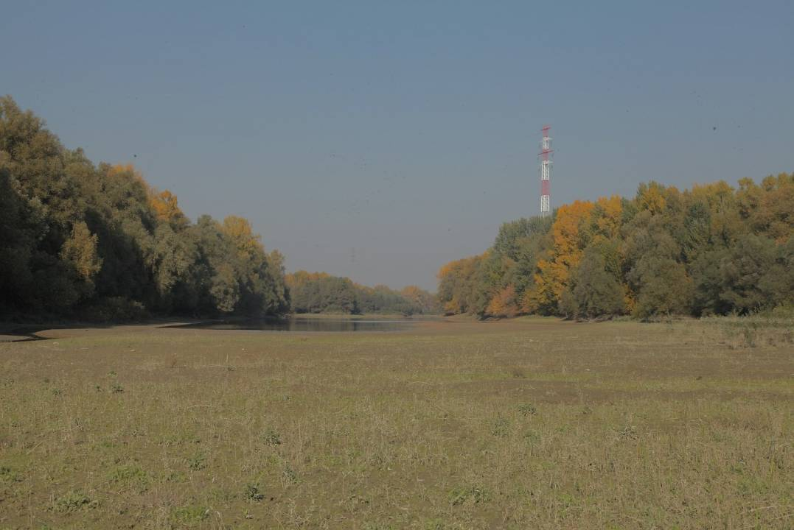

Slide 16
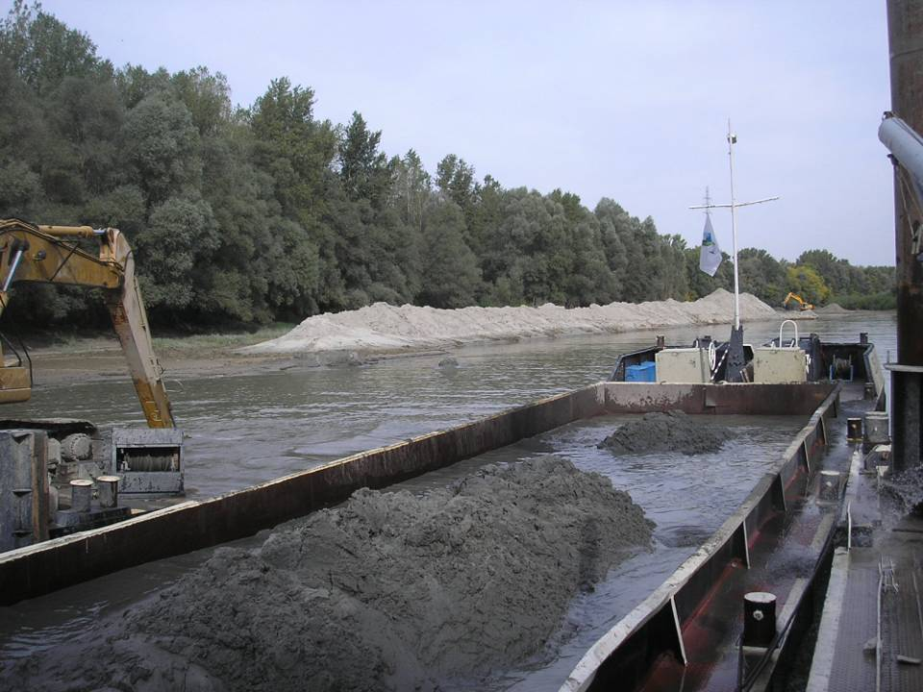

Slide 17
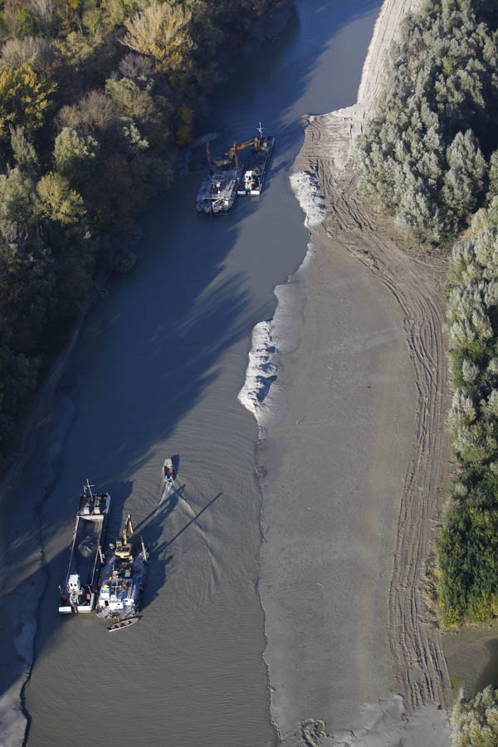

Slide 18
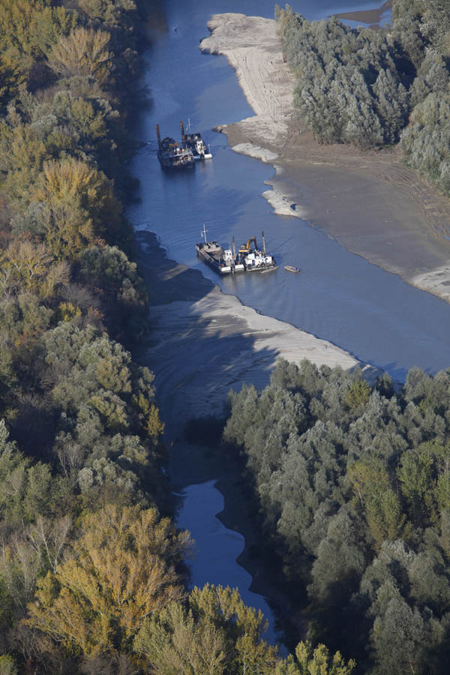

Slide 19
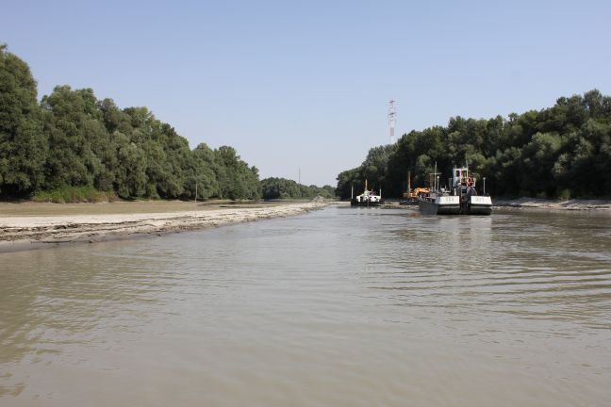

Slide 20
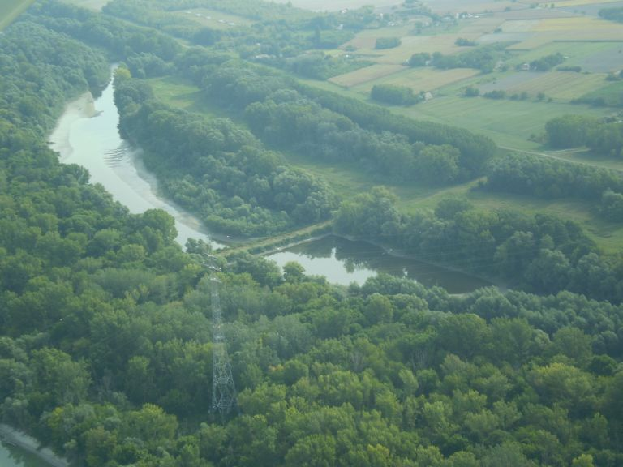

Slide 21
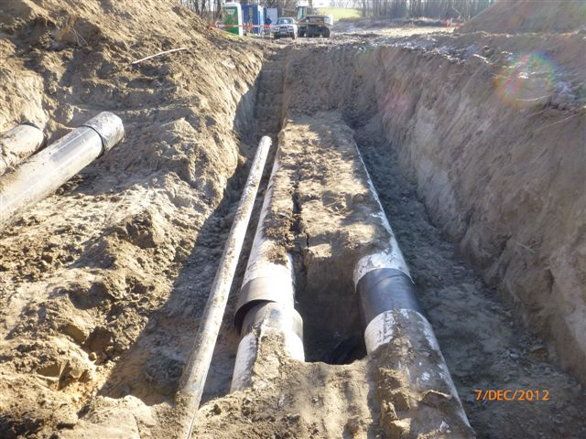

Slide 22
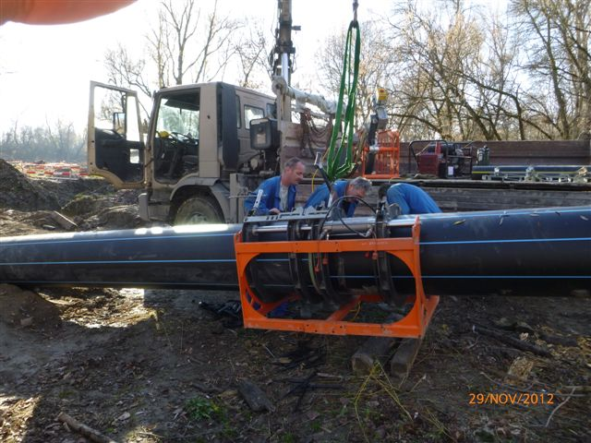

Slide 23
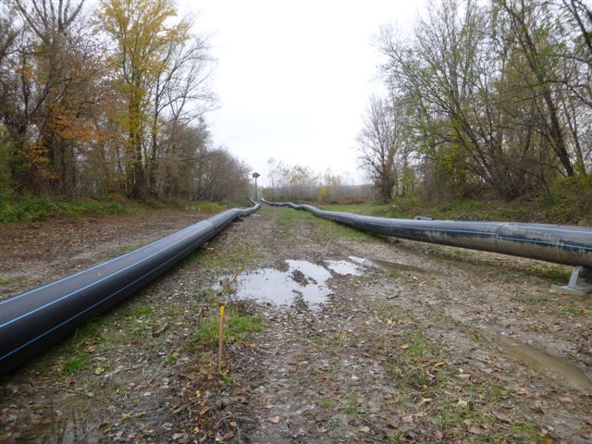

Slide 24
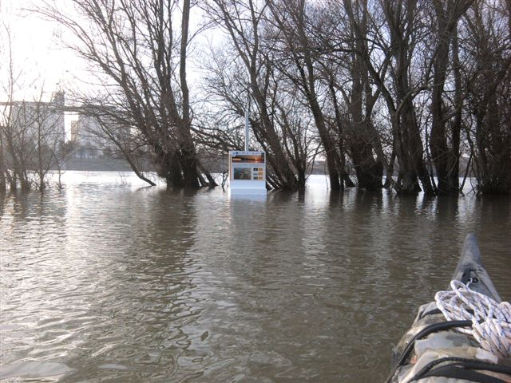

Slide 25
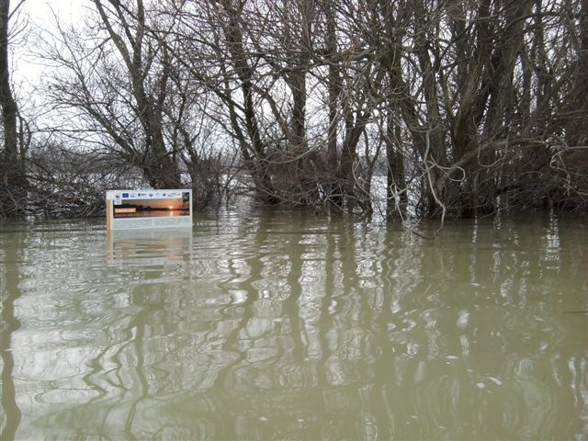

Slide 26
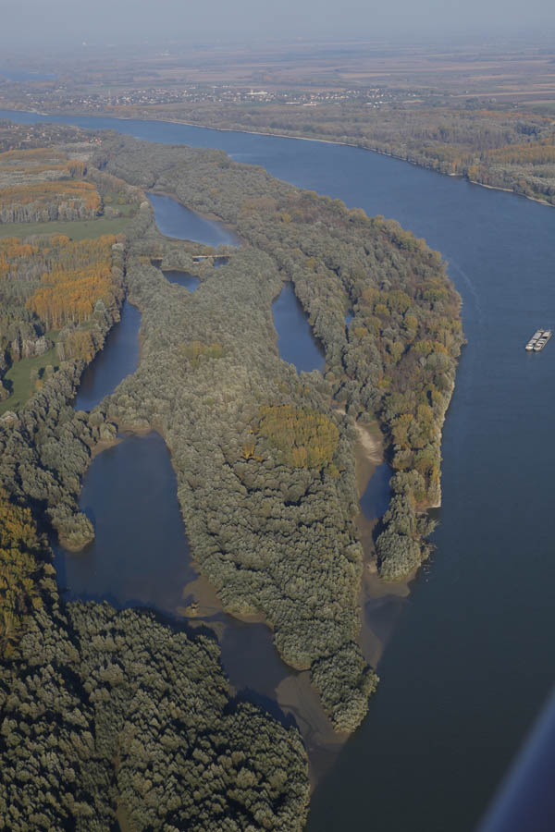
What’s next?
Multiplication of project results
Pulling together a project development team

Slide 27
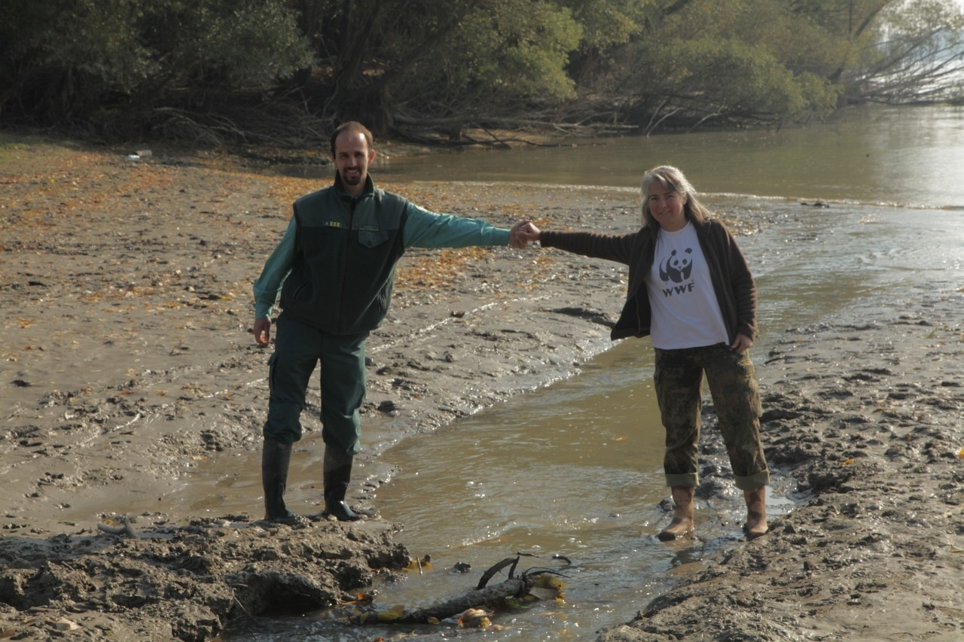
www.szabadsagsziget.hu

