Slide 1
Blueprint to Safeguard Europe's Water Resources
Dagmar BEHRENDT KALJARIKOVA
Protection of Water Resources Unit
Directorate General for Environment
European Commission
Notes:
1

Slide 2
Blueprint policy baseline
Review of WFD implementation (RBMPs)
Review of Water Scarcity and Droughts policy implementation
Review of water resources vulnerability
Fitness Check of EU fresh water policy
EEA reports & other studies
Notes:
2
2
2
Blueprint to Safeguard Europe's Water Resources
Adopted by the EC on 14 November 2012
Council conclusions adopted on 17 December 2012
Implementation as of 1 January 2013
Review of River Basin Management Plans (RBMPs) reported by MSs to EC

Slide 3
Blueprint objectives
Goal
Ensure sustainability of all activities that impact on water, thereby securing the availability of good-quality water for sustainable and equitable water use
Objectives (something better, more and new)
Better implementation
More integration
Few new legal proposals to complete current framework
Notes:
Questions:
What are the obstacles that hamper action to safeguard Europe's water resources?
Do we need to change legislation/policy to address these problems?
To answer:
Review current EU freshwater legislation and policies and their implementation by MSs

Slide 4
Blueprint impact assessment
Basic considerations:
Full ex-post WFD review not appropriate in 2012
No “one size fits all” solution – need for a toolbox
4 main problem categories in policy implementation:
Insufficient use of economic instruments
Lack of support for specific measures
Poor governance
Knowledge gaps
12 priority problems identified under the above 4 categories
57 policy options included in public consultation document

Slide 5
Blueprint impact assessment
12 priority problems
Lack of water pricing
Lack of metering
Lack of labeling of traded goods
Land use/Agricultural impacts (NWRM)
Inefficiency in buildings/appliances
Inefficient water infrastructure
Lack of water re-use
Governance
Target setting
Drought management
Understanding costs and benefits
Knowledge base
Notes:
5
5
5

Slide 6
Blueprint policy options
Enforcement of legislation will be continued
Early action is needed for uptake in 2015 RBMPs
New policy options are categorised as:
Voluntary options
Regulatory options
Conditionality
Funding priority

Slide 7
Blueprint objectives | Voluntary | Regulation | Conditionality | Funding
Efficiency incentive water pricing | CIS Guidance on trading schemes by 2014 | Enforcement of Art. 9 WFD (ongoing) | Ex-ante conditions under RD&C policy funds 2014
Metering take up |  | Enforcement of Art. 9 WFD (ongoing)
Water use reduction in agriculture |  |  | Precondition for some irrigation projects under RD as of 2014
Reduction of illegal abstraction/impoundments | Apply GMES as of 2013 | Possible EU initiative on inspections - 2013 | Cross-compliance under CAP
Awareness of water consumption | Support voluntary labeling & certific. schemes
Maximisation of the use of NWRM (Green Infr.) | CIS Guidance by 2014 |  | Greening of CAP pillar I as of 2014 | S&C Funds & EIB loans
Efficient water appliances in buildings | EU Ecolabel & GPP criteria 2013 | Eco-design Working Plan in 2012
Reduction of leakages | Best practice/tools on SELL in 2013 |  |  | S&C Funds & EIB loans
Maximisation of water reuse |  | Possible Regulation in 2015 |  | S&C Funds & EIB loans
Improvement of governance | Peer review of RBMPs (2013 – 2016)

Slide 8
Blueprint objectives | Voluntary | Regulation | Conditionality | Funding
Implementation of water accounts, e-flows & target setting | CIS Guidance on WAs / E-flows & Target setting by 2014
Reduction of flood risk | Through Green Infr. European Flood Awareness System | Flood Risk Management Plans by 2015
Reduction of drought risk | Through Green Infr. European Flood EDO in 2013-2014 | Enforcement of WFD requirements (ongoing)
Better calculation of costs and benefits | CIS Guidance by 2014
Better knowledge base | Upgrading WISE by 2015
Support to developing countries
Tackling pollution | Report on pharmaceuticals & the environment 2013 | Targeted enforcement of WFD, EQS/PSD, NID, UWWTD, IED …
Cross-cutting | EIPs on Water and Agri as of 2013 | Overall enforcement of WFD, EQS/PSD, NID, UWWTD, IED | Possible European Semester Recomm. 2013 | CAP, S&C Funds & EIB loans

Slide 9
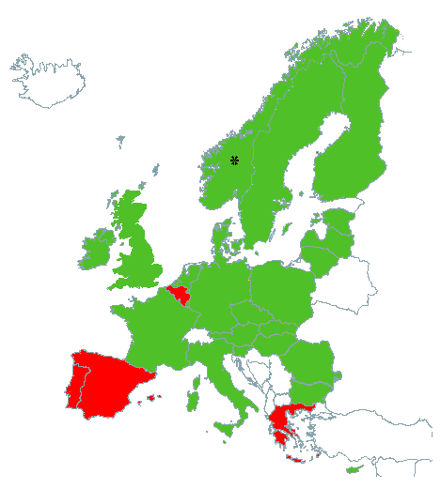
Status of adoption of WFD plans
GREEN - River Basin Management Plans adopted!
RED – consultations not started, ongoing or finalised but plans not adopted nor reported to EC
http://ec.europa.eu/environment/water/participation/map_mc/map.htm

Slide 10
Assessment of River Basin Management Plans: Some general findings
A lot of effort put into preparation of the plans and impressive knowledge improvement
High uptake of the common framework and common language on water management provided by the WFD
Integration of ecological perspective into water management
Enhancement of international cooperation
Public participation, stakeholder involvement
4 Member States yet to submit plans
Low ambition in many of the plans.
Uncompleted setting of measures
Lack of comparability in some areas (e.g. chemical status!)
Little understanding of aligning water management practices and environment protection (e.g. definition of exemptions)
Insufficient consideration of water pricing and definition of costs
10

Slide 11
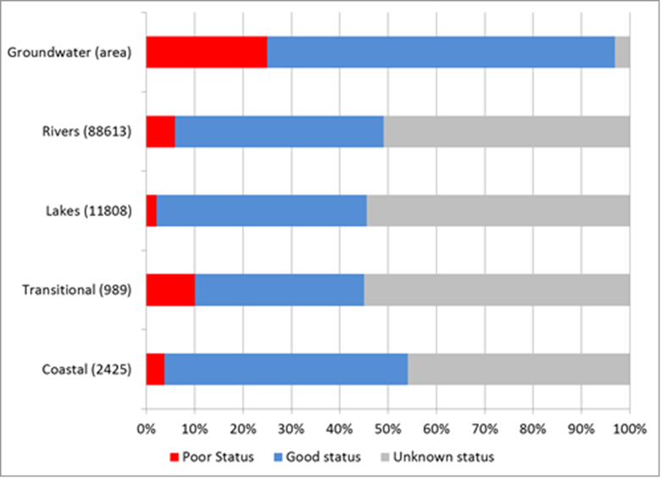
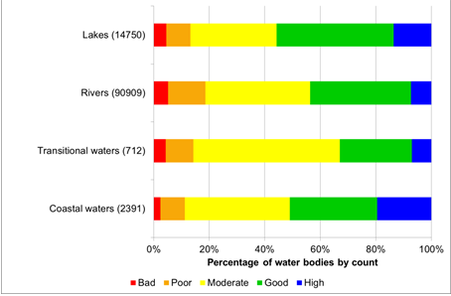
Status of surface waters
Notes:
Figure on the left: Distribution of ecological status or potential of classified rivers, lakes, coastal and transitional waters, calculated as percentage of the total number of classified water bodies. It shows the distribution of ecological status or potential for the different types of water bodies (rivers, lakes, transitional and coastal). Overall, more than half (55 %) of the total number of classified surface water bodies in Europe are reported to have less than good ecological status/potential. Only around 44% of rivers and 33% of transitional waters are reported to be in high or good status. 56% of the lakes are reported to be in good or high status, and 51% for coastal waters.
Figure on the right: Overview of chemical status of surface and groundwater bodies Percentage of rivers, lakes, groundwater, transitional and coastal waters in good, poor and unknown chemical status
There is a high percentage of water bodies for which the reported chemical status has been 'unknown' .
In many cases, the main reason for this gap is that the status assessment methods have not been fully developed yet or there were not enough monitoring data in this first cycle. In that case, it is advisable to adopt and implement no-regret measures, along with further development of the assessment methods and monitoring networks. However, in most RBMPs, there is no information on what actions will be taken to improve the monitoring and assessment methods for the next cycles.
Note: Number of Member States contributing to the dataset: Groundwater (26); Rivers (25); Lakes (22); Transitional (15) and Coastal (20). Percentages shown for rivers, lakes, transitional and coastal are by water body count. Groundwater percentages, however, are expressed by area. The total number of water bodies is shown in parenthesis.
Data from Sweden are excluded from surface water data illustrated in the figure. This is because Sweden contributed a disproportionately large amount of data and, classified all its surface waters as poor status since levels of mercury found within biota in both fresh and coastal waters exceed quality standards.

Slide 12
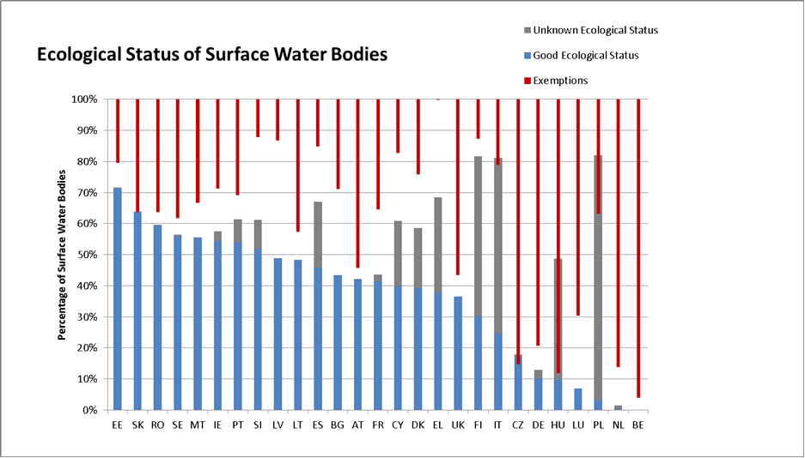

Slide 13
Water bodies in good status in 2009 and 2015: What progress expected?
 | Nb of MS | Nb of water bodies | % Water bodies in good status or potential 2009 | % Water bodies in good status or potential 2015 | Progress 2009-2015 in %
Ecological status of surface waters | 21 | 82 684 | 42 | 52 | 10
Chemical status of surface waters | Information unclear to establish the 2009 baseline
Quantitative status of groundwater | 24 | 12 022 (5 197) | 89 (85) | 96 (92) | 7 (7)
Chemical status of groundwater¹³ | 24⁷⁷ | 12 022 (5 197) | 83 (68) | 89 (77) | 6 (9)
Notes:
The number of surface water bodies in the calculation is 82684, this is because certain MS are excluded:
EL and ES: Lack of RBMPs
FI, PL and IT: a high number of WBs in unknown status (threshold 50%)
DK: Did not report on exemptions and therefore it is not possible to estimate expected status.
For Belgium only Flanders and the Coastal waters are included, for Portugal the information is coming from the draft RBMPs
Total of WBs from WISE and RBMPs (for IE and SI)(127407) – ES (5012)- EL (1324) – DK (17983) – IT (8614) – PL(5643) – FI (6153) = 82678 which is about the number in the table (82684)
For Groundwater: Numbers in brackets are calculated excluding FI and SE that reported a large proportion of groundwater bodies (around half of the EU total) which are largely in good status.
EL and ES excluded from the calculations due to lack of plans. DK excluded as it did not report exemptions and therefore it is not possible to estimate the expected status in 2015. Information included from PT refers to draft plans. Information from Belgium refers to Flanders and coastal waters only.

Slide 14
Follow up
Ensuring correct implementation of WFD in first and second RBMP period (Follow up RBMP assessment)
Follow up bilaterally
Possible enforcement action
Common Implementation Strategy (delivery of Blueprint policy options)
Possible new legislative initiatives
Assessment of PoM and integration of EU Water Directives
2019 review WFD
Notes:
14

Slide 15
Opportunities for Danube Strategy
In close coordination with ICPDR, ensuring correct implementation of EU water acquis, in particular WFD, UWWTD and ND in DRBD
Main challenges/issues identified in the EC assessment of relevant and available RBMPs
EC Report on the implementation of the UWWTD
Facilitating the prioritisation of the required investments
Notes:
15

Slide 16
Thank you for your attention ! http://ec.europa.eu/environment/water/blueprint/index_en.htm
Notes:
Blueprint Communication COM(2012)673+ Impact Assessment SWD(2012) 381 & 382
Report on River Basin Management Plans COM(2012)670
Commission Staff Working Document, European Overview on River Basin Management
Plans, Volumes 1 and 2 SWD(2012) 379
Commission Staff Working Document, River Basin Management Plans, Volumes 3 to 30
(All Member States + Norway) SWD(2012) 379
Communication on the Review of the European Water Scarcity and Drought Policy
COM(2012)672 + accompanying Commission Staff Working Document SWD(2012)380
Fitness Check SWD (2012)393

