Slide 1

Seed Money Facility
EUSDR PA4 – 14th SG meeting
Budapest, 17 October 2017

Slide 2

Seed Money Facility (SMF) Call – main elements

Slide 3



Aim and format of the
SMF within DTP
To support the development of complex strategic transnational projects contributing to the EU Strategy for the Danube Region, projects that will apply for funding from any other EU, national or other funding sources
Open call for seed money projects
Targeted only to a limited number of topics for each EUSDR Priority Area

Slide 4

Governance
Main bodies
DTP MA/ JS:
Drafts the framework and launches the call
Assesses the SMF projects
Monitors the implementation
Verifies the mandatory outputs
EUSDR PACs:
Define the thematic focus of the call
Providing the Declaration of alignment
Other involved actors: CA, AA, NCPs, LPs, FLC
Monitoring Committee:
Approves the call framework
Selects the projects based on JS assessment
Notes:
Other involved actors: CA, AA, NCPs, LPs, FLC

Slide 5

Project structure
Output 1: Report on the state of play in the addressed field
Description of the situation in the field and countries
Description of the target groups addressed by the future project and their needs
Output 2: Main project work plan
A work plan, describing activities, outputs and expected results of the main project
The composition of the potential project partnership;
Output 3: Report on funding possibilities
The analysis of funding sources for the main project
A road map defining steps to be taken after the seed money project is finalised
An indicative budget plan for the main project
The partnership will have to plan the budget for costs related to control (in case of decentralised systems) and a maximum of 100 EUR as costs for printing the mandatory poster per each partner. The AF contains a special section for these costs

Slide 6



Partnership and partners
Two and maximum five financing partners from at least two different DTP countries of the programme area: the Lead Partner and at least one project partner.
LP – located on the territory of an EU MS
Local, regional, national public bodies/ bodies governed by public law (including EGTCs in the meaning of Article 2(16) of Regulation (EU) No 1303/2013)
International organisations
Private non-profit bodies
Private enterprises are not eligible

Slide 7
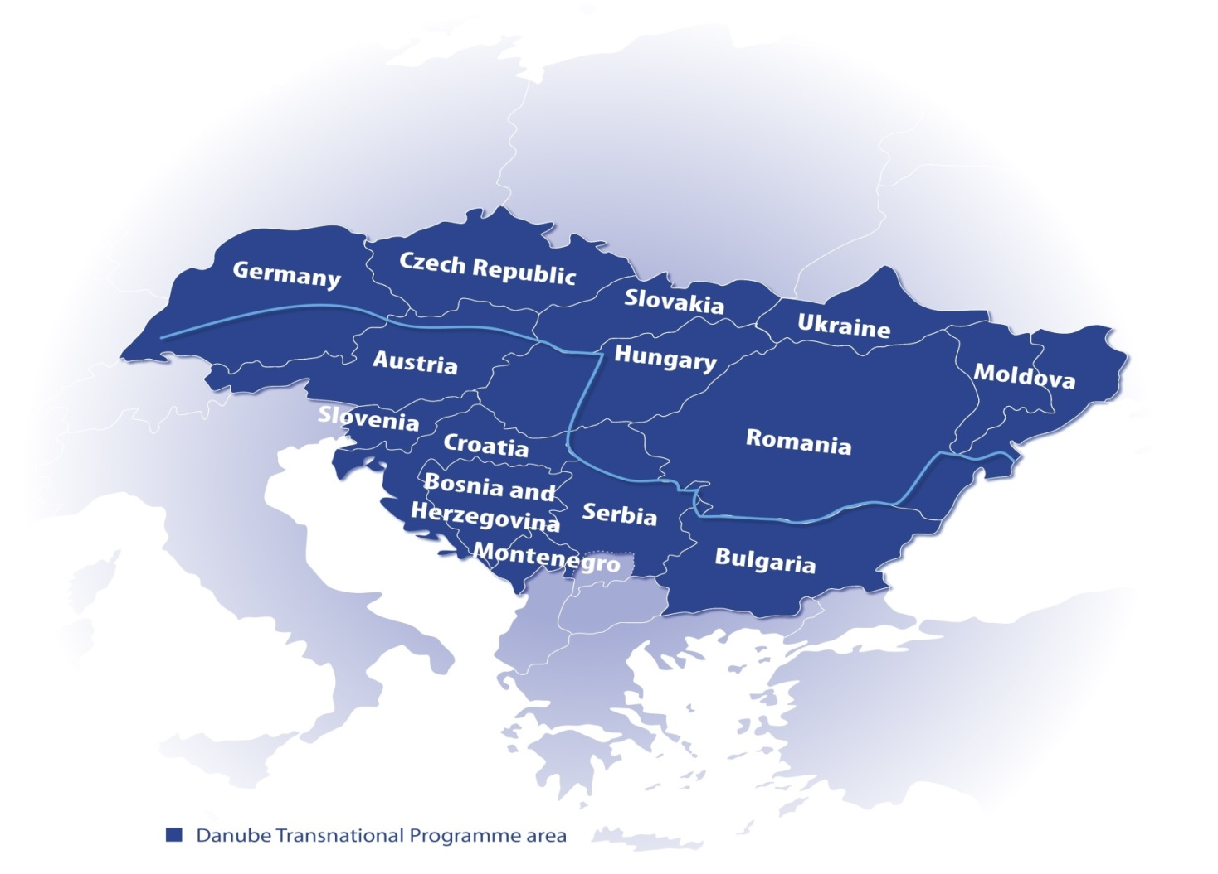
Partnership and partners

Slide 8

Partnership and partners
Associated Strategic Partners (ASPs)?
EU countries
Non EU countries of DTP
No budget
Added value to the partnership
Recommendation: maximum two ASPs

Slide 9
Budget and project duration
Maximum total budget 50,000.00 EURO
Maximum EU contribution 42,500.00 EURO
Fixed for 12 months

Slide 10
Eligibility of expenditure
Staff costs calculated only based on real costs
Travel and accommodation
Eligible budget lines
Office and administration costs: 15% flat rate of the eligible staff costs
External expertise and services

Slide 11







SMF Application - Timeline
Selection
by DTP MC
Signature of the
Subsidy Contract
Submission
07.12.2017
Opening
02.10.2017
Application
Assessment
Conditions
08.11.02017
(recommended)
DTP JS
Declaration of Alignment
by PACs
Max. 3 proposals per Priority Area to be selected
Implementation

Slide 12

SMF Application - Framework
Elaboration and submission of the application through the electronic Monitoring System (eMS) http://www.interreg-danube.eu/about-dtp/dtp-ems
Main Documents:
Programme documents and Guidelines
Cooperation Programme
SMF Programme Manual
Call Announcement
SMF eMS Guidlines
http://www.interreg-danube.eu/calls/calls-for-proposals/seed-money-facility-call

Slide 13
SMF Project - Implementation
No pre-financing through the DTP
Simplified Reporting Procedure
Slim mid-term “Summary of project implementation”
One (!) final report after project end

Slide 14

Gusztáv Csomor
Project Officer
Tel: +36 1 795 38 36
gusztav.csomor@interreg-danube.eu
www.interreg-danube.eu

