Slide 1
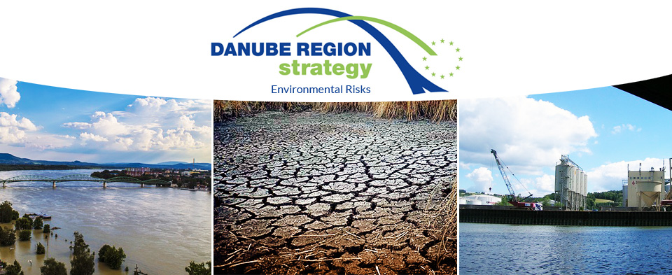
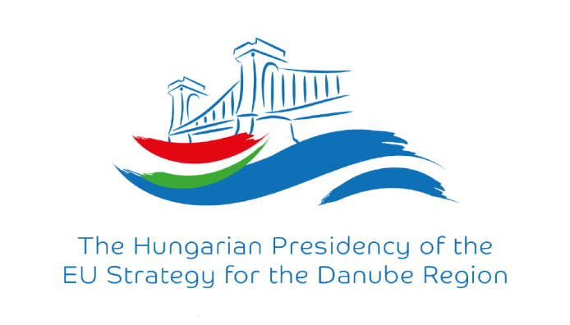
Danube Region Strategy and PA5 - Environmental Risks
Status report; Károly Gombás
16.10.2017, Budapest

Slide 2

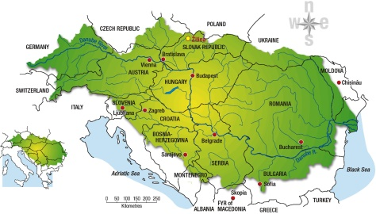

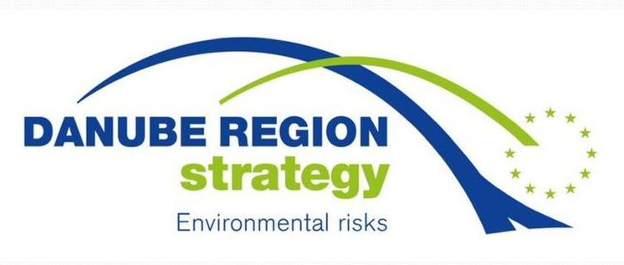
European Union level: Working Group on Floods (WG-F)
Danube basin, „level A”
Flood Protection Expert Group (FP-EG)
Environmental Risks Priority Area (PA5)

Slide 3



Environmental Risks Priority Area (PA5)
HU Coordination
Ministry of Foreign Affairs and Trade
Mr. Károly GOMBÁS
Priority Area Coordinator
RO Coordination
Ministry of Environment, Water and Forests
Mr. Gheorghe CONSTANTIN
Priority Area Coordinator
Website: http://www.danubeenvironmentalrisks.eu/
Colleagues in MFA-HU: Beatrix Kosztyi, Viktor Oroszi (Danube.Envirisks@mfa.gov.hu)
Colleague in MAP-RO: Manuela Miron (manuela.miron@map.gov.ro)
The first period between 2014-2016 was closed. New work programme for 2017-2019 period have been elaborated. The coordination is financed by a DTP project.

Slide 4
Period 2017-2019
PA5 project elements
Output 2.1: Development of CCA Strategy-Update2018
A2.1: Cooperation with GWP CEE's IDMP: historic droughts event database , review of 5 EU policies from drought management point of view
A2.2: Support of a special international issue of a scientific journal on climate change through research (PA5 Action7)
A2.3: Contribution with expertise to the ICPDR Climate Change Adaptation Strategy 2018 Update (participation on meetings, proofreading/comments)
Output 2.2: Pilot study on coordination of OFMPs (operative flood management and civil protection plans ) in the DB
A2.4: Pilot study on coordination of OFMPs in the Danube Basin, workshop and study tours (MD, UA)
Output 3.1: Strategic network
Cooperation with other EUSDR Pas and with other international organizations and EU institutes (ICPDR, JRC, CC, GWP, ISRBC, EC DGs, 3 macro-regional strategies)

Slide 5
Period 2017-2019
PA5 project elements
Output 3.2: Flood protection training scheme
A3.3: Facilitating the organization of a flood protection training and enlargement of an education network (DR Oper&Cooper measure Nr.6)
  International conference session on flood protection experiences, techniques and technologies
  Special issue on flood protection experiences of a scientific journal
  Workshop for higher education institutes for networking, curricula development, identifying funds/scholars
  E-learning material related to flood protection (InterFloodCourse, DAREFFORT)
  International flood protection postgraduate training
Output 4.1: Supported and/or generated projects
A4.1: Identification of strategic issues:
  Number of SMF projects identified
  Laflet about PA4/5/6 support for projects with LoRs (October)
  Letter of recommendations issued by PA5 to new project ideas (8 so far)

Slide 6
Activities in 2017
  Participation in national conferences on flood protection & river management (April), potential project financing (May) and forecasting&monitoring (September)
  29th of June, workshop in Budapest, ’International Workshop on Flood Protection Education Network in the Danube River Basin’
  5th of July, Annual meeting of the Hungarian Hydrological Society - special international side event on flood protection practices
  17th of October SDR 6th Annual Forum, back-to-back workshop on Pillar-2 financing possibilities
  Annual Forum in 18-19th October – capitalisation, funding sessions
  Annual Forum EXPO PA5 stand, possibilitiy to promote projects
    Special SDR edition of the Hydrological Journal, based on the side event outcomes in July, additionally research and scientific articles

Slide 7
Activities in 2017 - highlights
  29th of June, workshop in Budapest, ’International Workshop on Flood Protection Education Network in the Danube River Basin’
    11 institutes from 8 countries, 30+ participants
    The audience received horizontal information about the opportiunities that Danube Strategy provides by PA5 – environmental risks, PA7 – knowledge society and PA9 - People&Skills areas
    Financing possibilities introduced: ERASMUS+, CEEPUS, DAAD, Horizon 2020
    Networking strated with a tour de table, where the different institutes introduced themselves and shared their vision on the issues of education
    Common findings document - please check PA5 website
  17th of October SDR 6th Annual Forum, back-to-back workshop on Pillar-2 financing possibilities (link)
    BUDAPEST, 17th October 2017 14:00-18:00 PM, 7 minutes/20 slides
    Venue: Ministry of Agriculture 1055 Budapest Kossuth Lajos ter 11.

Slide 8


EUSDR PA5 supported projects in 2017
Ongoing supported projects
  DriDANUBE, Danube Sediment, JOINTTISZA (e.g. peer review group), CAMARO-D
Project development:
  InterFloodCourse (submitted DSPF project)
    LP: National University of Public Services
    Aims to develop e-learning material in flood protection
  DAREFFORT (submitted to DTP 2nd call)
    Focuses on better data share among countries, HU-LP
    ICPDR DanubeHIS system elaboration support
  Support for projects submitted to DTP 2nd call:
  Danube Floodplain, DAMWARM

Slide 9
InterFloodCourse project
Subsidy programme: DSPF - Danube Strategic Project Fund
Duration: 12 months
Start of the project: 2017.10.01.
Full budget: 97.156 EUR
Partners: 4 institutes (LP-HU NKE-BAJA, Deggendorf, Bratislava, Belgrade)
The main objective of the project is to develop a harmonized, international postgraduate course on flood and flood risk management which integrates the knowledge of all participating partners and involves expertise of Danube region professionals during this process. The result will be a comprehensive flood management curriculum and teaching material that offers a professional development possibility for Civil engineers

Slide 10
DAREFFORT project
Danube River Basin Enhanced Flood Forecasting Cooperation
Subsidy programme: DTP 2nd call SO2.1
Duration: 36 months
Start of the project: 2018.03.01.
Estimated full budget: 1,351,898.63 EUR (ERDF + ENI UA)
Potential partners: 24 institutes (12 PP, 12 ASP)
Aerial coverage: 12 countries, 2 DRB org, 1 EU org, 1 WW org
The main focus is to enhance the access to the recorded data and to provide coherent distribution for all the countries in the Danube catchment. The aim is to support the realisation of the DanubeHIS (ICPDR) and provide long-term development perspective for the sufficient conditions of proper basin-wide hydrological forecasting.

Slide 11
PA5 topics for Seed Money (Fall, 2017)
Coordinate the operative flood management and civil protection plans considering the benefits of the civil protection mechanisms for the shared flood basins or stretches of common interest to better use the available resources.
Safety of the critical water infrastructure on shared river basins, contingency planning for failure (havaria management)
Basin/Sub-basin wide (technical/professional) resource management masterplans to facilitate adaptation of the Danube countries to climate change and to support anticipating local and regional impacts of climate extremities
Improve the capacities to tackle accidental pollution risk at the transboundary, regional and basin level, including development and/or modernization of plans, equipment (including monitoring capacities), information and warning systems and joint trainings, taken also into account the effects of climate change

Slide 12
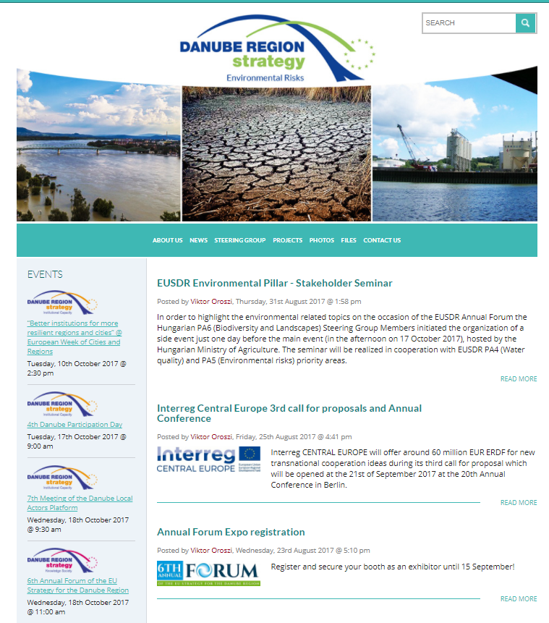
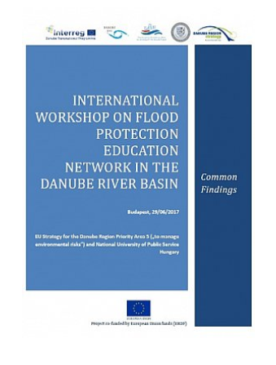
http://www.danubeenvironmentalrisks.eu

Slide 13

Thank you for your attention!
http://dunaregiostrategia.kormany.hu/
https://www.danube-region.eu/
http://www.danubeenvironmentalrisks.eu/

