Slide 1



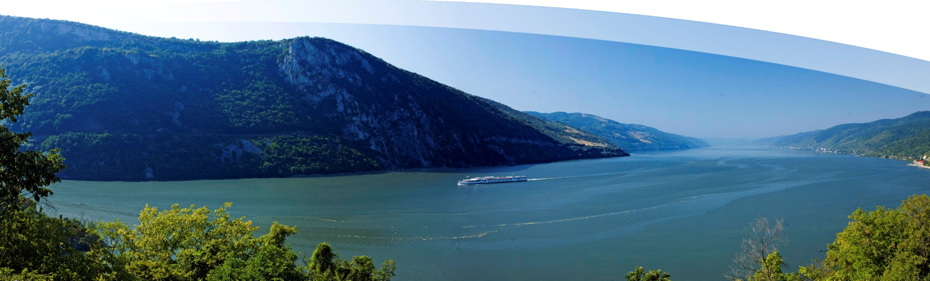
Financing of the EUSDR activities and projects for 2014+
5 June 2013 | Bratislava, SK
László Perger Coordinator of PA4 HU

Slide 2



OUTLINE
Justification
Connections to
  EU Strategy 2020
  DG Environment
  ICPDR
  JRC
  Pillar B and other Priority Areas (horizontal issues in EUSDR)
Financing for MFF (Multiannual Finacial Framework)
EU STRATEGY FOR THE DANUBE REGION (EUSDR) | www.danube-region.eu

Slide 3
JUSTIFICATION (Why need it fundings?)
Many actions per priority areas
For implementing of actions needs for projects
The relevant projects are transnational and mainly horizontal (bigger budgeting)
Less remained money for financing (calls are closed)
Born new policies (e.g. Blueprint)
Emerged new challanges (climate change with growing needs in different sectors)
Extension of coordination and governance (enhancing institutional capacities)
EU STRATEGY FOR THE DANUBE REGION (EUSDR) | www.danube-region.eu

Slide 4
Connections to EU Strategy 2020
3 key priorities
  The economy (smart growth) – Pillar A
  The environment (sustainable growth) - Pillar B such as preventing of
    Environmental degradation – PA 4
    Biodiversity loss – PA 6
    Unsustainable use of resources – PA 4 and PA 5
  The social policy (inclusive growth) – Pillar C and D
Connections to DG Environment policies
Mainly the PA 4 and all Pillar B Actions cover by Directives
EU STRATEGY FOR THE DANUBE REGION (EUSDR) | www.danube-region.eu

Slide 5
EU WFD
Priority substances
UWWT
Drinking Water
NATURA 2000
Nitrate
Bathing Water
Flood
Groundwater
EU STRATEGY FOR THE DANUBE REGION (EUSDR) | www.danube-region.eu

Slide 6
Connections to DG Environment policies
Most of PA 4 Actions refer to Water Blueprint (HOW?)
  The biggest pressures for ecological status
    HYMO alterations (refers Action 10)
    Water over abstraction (refers Action 11)
    For ecological water flow (refers Action 11)
  Consequencies of week chemical status assessment
    Shortage of data (refers Action 2 and 3)
    Few steps away to solve eutrophications (refers Action 4 and 5)
    Fulfill the directives (for UWWT refers Action 7)
  For the effectivness of water using
    Improvement of irrigation (refers Action 11)
    Measures against leakage of distribution network (refers Action 13)
  Vulnerability of european waters
    Improvement of ecosystem resilience (refers Action 11)
  Improvement of water information system
    WISE, INSPIRE, GMES, etc. (refers Action 3)
    Promoting SPI (refers Action 6)
  More stronger cooperation at sub-basin level (refers Action 2 and 14)
  Communication for transparency (refers Action 12)
EU STRATEGY FOR THE DANUBE REGION (EUSDR) | www.danube-region.eu

Slide 7
Connections to ICPDR activities
The ICPDR is taking lead in the following eight actions of PA4
Action 1: To implement fully the Danube River Basin Management Plan
• Action 2: To greatly strengthen cooperation at sub-basin level
• Action 3: To continue to invest in and support the information collection systems already developed by ICPDR
• Action 4: To continue boosting major investments in building and upgrading urban
wastewater treatment facilities across the Danube Basin, including measures to build capacity at the regional and local level for the design of such infrastructure
• Action 7: To legislate at the appropriate level to limit the presence of phosphates in detergents
• Action 9: To assure the proper control and progressive substitution of substances that are considered problematic for Danube Region
• Action 10: To reduce existing water continuity interruption for fish migration in the Danube river basin
• Action 12: “To strengthen general awareness and facilities exchange of good practice in integrated water management issues in the Danube Basin among decision-makers at all levels and among the population of the Region
EU STRATEGY FOR THE DANUBE REGION (EUSDR) | www.danube-region.eu

Slide 8
Connections to JRC activities
(‚Scientific support to the Danube Strategy’)
Main objectives: to gather scientific expertise and data for comprehensive modeling
Priorities:
  Environment protection (PA 04 - Water Quality, PA 05 - Environmental Risks, PA 06 - Biodiversity, landscapes, quality of air and soils, PA 07 - Knowledge society and ICT
  Navigability (PA 1A - Mobility – Waterways, PA 07 - Knowledge society and ICT )
  Irrigation and agricultural development (PA 04 - Water Quality, PA 07 - Knowledge society and ICT)
  Energy production (PA 02 – Energy, PA 07 - Knowledge society and ICT )
Objective of DWN: surveilling of water-agriculture-energy-ecosystem nexus by
  horizontal management in fields of water quality, nature protection and biodiversity
  scenario analysis
  modeling
EU STRATEGY FOR THE DANUBE REGION (EUSDR) | www.danube-region.eu

Slide 9
Financing issues (overview)
Proposal for 2014-2020 Programmes (expected completion by October 2013)
  ETC –will be more definite in the next period
    INTERREG (remained but with less sources)
    Transnational Programmes (CE remained but SEE is changed (will be separated) with more promotion)
    CBC (with the highest attention)
  South East Gateway
    Covers the Adriatic, Ionian and related areas. This programme would replace the remaining parts of the current South East Europe and the IPA CBC Adriatic programmes. It would include Italy, Slovenia, Croatia, Cyprus, Malta, two Austrian Länder (Kärnten and Steiermark) as MS and Albania, Bosnia and Herzegovina, Montenegro, Serbia and Fyrom as third countries
  Danube Transnational Programme
EU STRATEGY FOR THE DANUBE REGION (EUSDR) | www.danube-region.eu

Slide 10
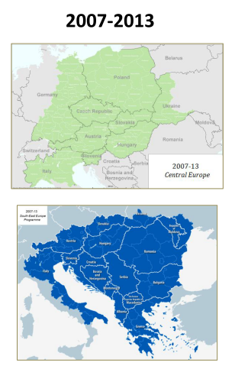
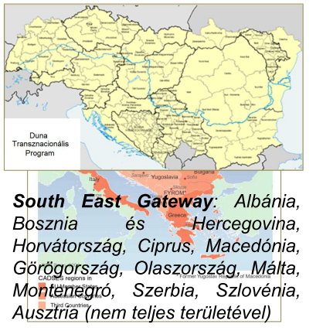
EU STRATEGY FOR THE DANUBE REGION (EUSDR) | www.danube-region.eu

Slide 11
The Danube Transnational Programme (direct linking to the EU Strategy for the Danube Region)
    A new Danube programme would cover the same geographic areas as the EUSDR. It would thus include some parts of the current Central Europe and considerable parts of the South East Europe programme. There is a clear acceptance for a new Danube transnational programme to include the German Länder of Baden Württemberg and Bayern, as well as the Czech Republic and Ukraine to facilitate its EUSDR participation
    The proposed Programme strategy is aligned with the objectives of the Europe 2020 strategy
    The proposed Programme is framed by the 11 “Thematic Objectives” (TO) with “Investment Priorities” (IP) proposed by the European Commission for the 2014-2020 programming period
EU STRATEGY FOR THE DANUBE REGION (EUSDR) | www.danube-region.eu

Slide 12
THEMATIC PRIORITIES in the DTP (link to PA 4)
Strengthening research, technological development and innovation
Enhancing access to, and use and quality of, information and communication technologies
Enhancing the competitiveness of SMS enterprises, the agricultural sector (for the EAFRD) and the fisheries and aquaculture sector (for the EMFF)
Supporting to shift towards a low-carbon economy in all sectors
Promoting climate-change adaptation, risk prevention and management
Protecting the environment and promoting resource efficiency
Promoting sustainable transport and removing bottlenecks in key network infrastructures
Promoting employment and supporting labour mobility
Promoting social inclusion and combating poverty
Investing in education, skills and lifelong learning
Enhancing institutional capacity and an efficient public administration
EU STRATEGY FOR THE DANUBE REGION (EUSDR) | www.danube-region.eu

Slide 13

Thank you for attention
www.danube-region.eu
and please consider the following event:
21 June | Stuttgart (DE) | 2nd Joint Meeting between the EUSDR and programming actors
Visit www.danube-region.eu

Slide 14
EU STRATEGY FOR THE DANUBE REGION (EUSDR) | www.danube-region.eu

