Slide 1

15 years
supporting
cooperation
www.interact-eu.net

Slide 2

14th PA4 Steering Group Meeting
16 October 2017 I Budapest
Jörg Mirtl, Interact programme

Slide 3
Three aspects
Results and recommendations from the studies conducted by Interact
Macro-regional strategies as learning platforms and tools for project and policy development
The role of Interact

Slide 4

Studies conducted by Interact
Results and recommendations

Slide 5

Study ”Embedding Macro-regions”
Study on cooperation methods and tools in the Danube and Adriatic & Ionian Region Study conducted 2016-2017
Assessment of 23 programmes of different types in the Danube Region

Slide 6
Recommendations
Include MRS in the future legislation of ESIF and beyond
Better communication of MRS, involvement of stakeholders by the programmes
Develop guidance for project applicants with MRS actors and programmes, collect practice
Exchange of experience among programmes
Development of programme-level monitoring of MRS (indicators)
MC meetings should increasingly consider MRS, involve key implementers of MRS (Even as members? New regulations ESIF/ECCP)
More fund-related networks in the 4 MRS!
Exchange of experience on embedding among programmes

Slide 7

Study on added value of macro-regional strategies
Conducted in 2016 and 2017

Slide 8
Study on Added value of macro-regional strategies
Macro-regional strategies can be driving forces for change if the right momentum is achieved
Macro-regional cooperation can occur independently of the macro-regional strategies
Projects and programmes are usually not aware of the macro-regional strategies
Better capitalisation of project results is the most tangible benefit macro-regional strategies bring to projects and programmes
Macro-regional strategies offer a strategic framework for projects and programmes to define priorities
Macro-regional strategies need to be positioned stronger in the territorial cooperation arena and beyond
The future of the macro-regional strategies is a shared responsibility of all its key implementers

Slide 9
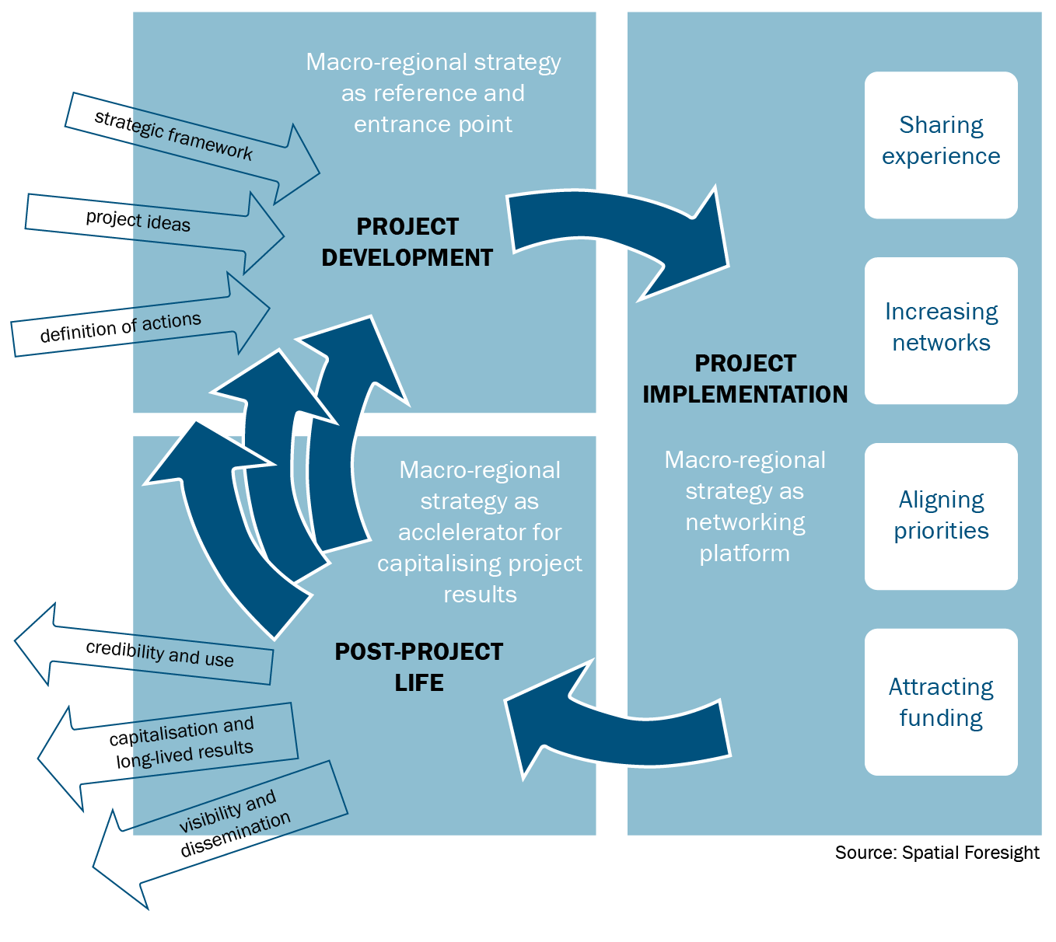
MRS project cycle
Figure 1. Added values of macro-regional strategies throughout the project cycle

Slide 10
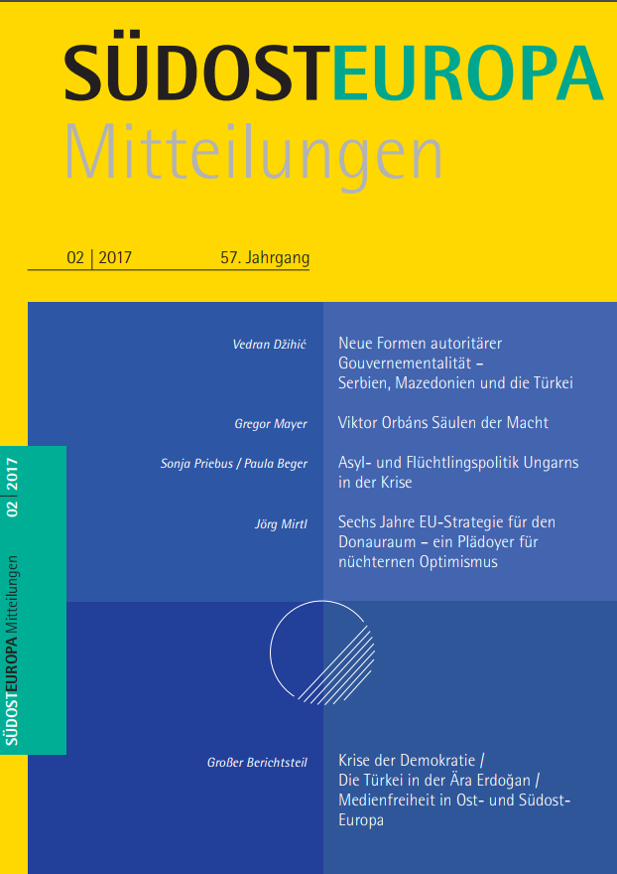
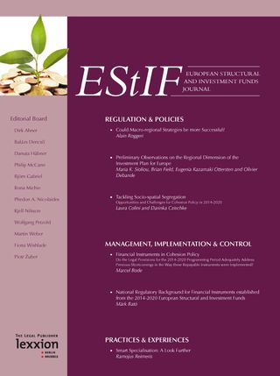
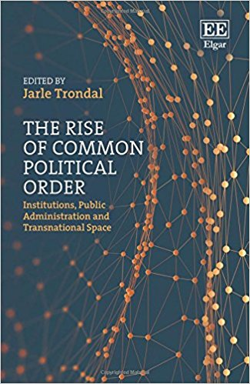

Slide 11
EU macro-regional Strategies and experimentalist governance (EG)
EG element | RECURSIVE PROCESS → | EUSBSR | EUSDR | EUSAIR | EUSALP | RECURSIVE PROCESS →
Framework goals |  | Strategy & (rev.) Action Plan SEC(2009) 712, | Strategy & Action Plan SEC(2010)1489 | Strategy & Action Plan SWD(2014) 190 final | Strategy & Action Plan with result/policy indicators & examples for indicators/units SWD(2015) 147 final
Delegating to local units |  | Nomination of PACs/HACs/NCs/SG Members | Nomination of PACs/NCs/SG Members | NCs, Pillar Coordinators, Governing Board, involvement of EP and EESC | Thematic Action Groups and their Leaders, NCs; Executive Board & General Assembly
Local units regularly reporting on their performance with agreed indicators/framework goals |  | Report to the Commission | Report to Danube Strategy Point/ Monitoring | Reporting to Governing Board | Reporting to Executive Board
Revision of framework goals |  | New Action Plan updated in 2013 and 2015, defining targets and indicators SEC(2009) 712/2 SWD(2015) 177 SWD(2017) 118 final | New Action Plan under discussion | N/A | N/A
 |  | ← RECURSIVE PROCESS → (Commission Communications, Council Conclusions)

Slide 12

The services of Interact

Slide 13
Interact’s contribution to the advancement of MRS
Cross-strategy thematic meetings (transport, climate, etc.)
Exchange of the four transnational programmes supporting MRS
Alignment of funding concept/Embedding Platform
Communication of MRS
Studies and collection of practices
Cooperation with academia/civil society (research on MRS)
Participation and suport to NC meetings, Annual Fora

Slide 14
Interact networks combining funds and programmes
Networks of Interreg & beyond
Capitalisation Networks
  Activities related to the interaction between Interreg, mainstream funds and funding outside the ESIF (Horizon, Life, Erasmus+, COSME, etc.)
  Inter-programme cooperation and coordination
  Future support for MA networks?
  Dealing i.a. with migration, social inclusion, climate, institutional capacity, transport, security
  Involving macro-regional strategies, mainstream funds are invited to participate

Slide 15
Cooperation works
All materials about MRS are available on:
http://www.interact-eu.net/library?field_fields_of_expertise_tid=33

