Slide 1





European Strategy for the Danube Region
Activities and plans of the Priority Area 4
„To restore and maintain the quality of waters“
since 13th SG Meeting (25-26/04/2017 Bratislava)
Andrea Vranovská
PA4 14th Steering Group Meeting, 16-17 October 2017, Budapest
www.danubewaterquality.eu

Slide 2
PA4 activities
Hungarian Presidency in the EUSDR from 11/2016 to 10/2017
Bulgarian Presidency in EUSDR from 11/2017 to 10/2018
Coordination & Administration (1)
Implementation of the new contract with DTP for coordination of PA4 for the period 2017-2019 (HU – lead partner, SK – partner, ICPDR - associated partner); project implementation since 01/01/2017; EMS for reporting available since October 2017, expected first Interim Report by the end of October 2017 according to the DTP rules – Progress Report for the period - 01/01/2017 to 31/12/2017 (January 2018)
Coordination meetings – NCP, PA4 and PA7 SK in Bratislava
29 June 2017 - SK EUSDR Consultation Group – NCP+PAs – information on financing possibilities, DSP Future, AF, events
6 July 2017 - interview with Consulting Associates – preparation of the study about macro-regional strategies in Slovakia
13 July 2017 – SK joint statement on DSP future role
21 September 2017 – NCP, PA4, PA7 – role and future of DSP, financing possibilities - Central Europe and SMF DTP information
Coordination meetings – NCP, PA2, PA4 and PA5 HU in Budapest
June 2017 – HU joint statement on DSP future role
www.danubewaterquality.eu

Slide 3
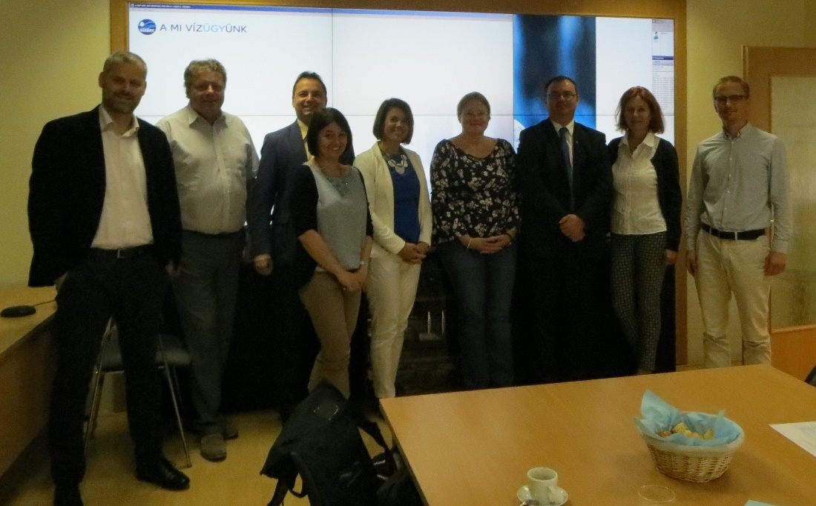
PA4 activities
Coordination & Administration (2)
Organization of Trilateral Meeting – PA4 HU, PA4 SK, ICPDR and Sava Commission – 7 September 2017, Budapest
only PA4 participants - side session with Danube Transnational Programme regarding DTP PAC project reporting – deadlines, obligations; all participants - planning PA4 workshops at Annual Forum – capitalization and financing possibilities, HU EUSDR Presidency information, information on ICPDR and ISRBC actions, synergy with their events, preparation of special issue of Hydrological Bulletin for AF
www.danubewaterquality.eu

Slide 4
PA4 activities
2. Projects (1)
Seed Money Facility call launched on 2/10/2017
Deadline to submit project proposals to PACs for Declaration of Alignment – 8/11/2017
Deadline for projects submission 7/12/2017
Project duration – fixed 12 months
Min 2, max 5 partners from EU MS and non-EU (LP - EU MS), max 2 ASP
Max budget 50 000 EUR out of it 42 500 EUR EU contribution (i.e. 85 %)
No pre -financing
Max 3 proposals per PA will be accepted
PA4 priorities:
1. Implementation and promotion of eco-friendly waste water treatment for small settlements;
2. Support effective management of water resources from the water quality viewpoint in the conditions of climate change (e.g. drought, water scarcity);
3. Solving the problem of Hazardous and Problematic substances (problematic infrastructures) endangering water ecosystems in the DRB
4. Development of knowledge building and policy recommendations on the level of pharmaceutics and other emerging substances (e.g. cyano bacteria toxins) in the water.
http://www.interreg-danube.eu/calls/calls-for-proposals/seed-money-facility-call
www.danubewaterquality.eu

Slide 5
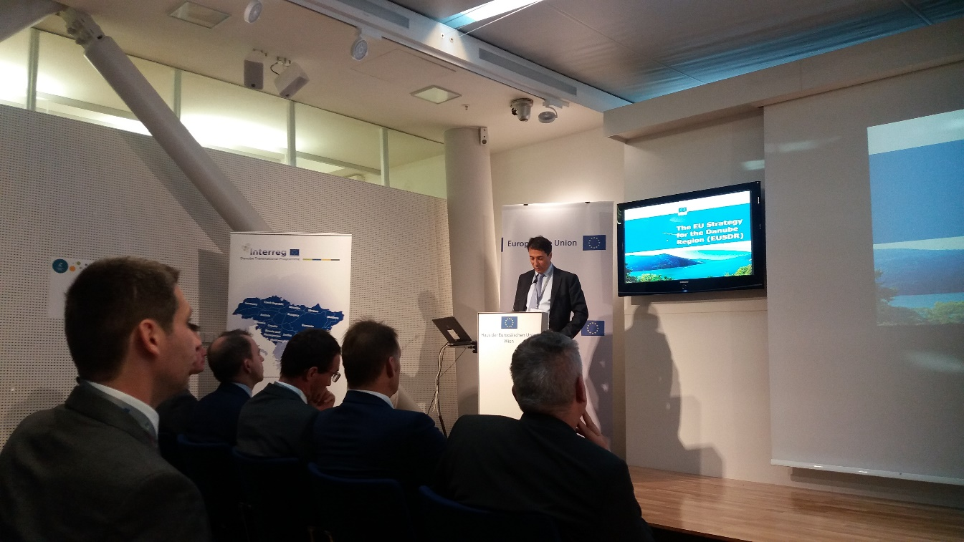
PA4 activities
2. Projects (2)
Seed Money Facility
Information day organized by DTP on 27 September 2017, Vienna
Basic information on SMF DTP call and other financial mechanisms:
Horizon 2020
LIFE
ERASMUS+
Interactive separate sessions
of PAs representatives with
potential applicants for SMF,
discussion on new project
ideas
www.danubewaterquality.eu

Slide 6
PA4 activities
2. Projects (3)
JOINTISZA (meeting in Szolnok, Hungary – 26-27 June 2017)
Danube Sediments (meeting at WRI, Bratislava – 6-7 June 2017)
CAMARO
DriDanube (meeting at SHMI, Bratislava – 7 June 2017)
projects launched, organized SG and technical meetings, submitted half years reports for project implementation to DTP
Cooperation and synergy among projects´ activities and outputs – Capitalization strategy – workshop organized within 6th Annual Forum in Budapest
DSPF - Danube Strategic Project Fund; under PA10 EUSDR, deadline 15/02/2017
Within PA4 submitted 4 projects:
Danube Hazard – hazardous substances
Water Agent of the Danube Region – drinking water and wastewater treatment
COOPLANDS – water management
Woptions – wastewater collection and treatment
https://www.danube-capacitycooperation.eu/danube-strategic-project-fund
Decision from PA10 is exepcet in mid/end October 2017
www.danubewaterquality.eu

Slide 7
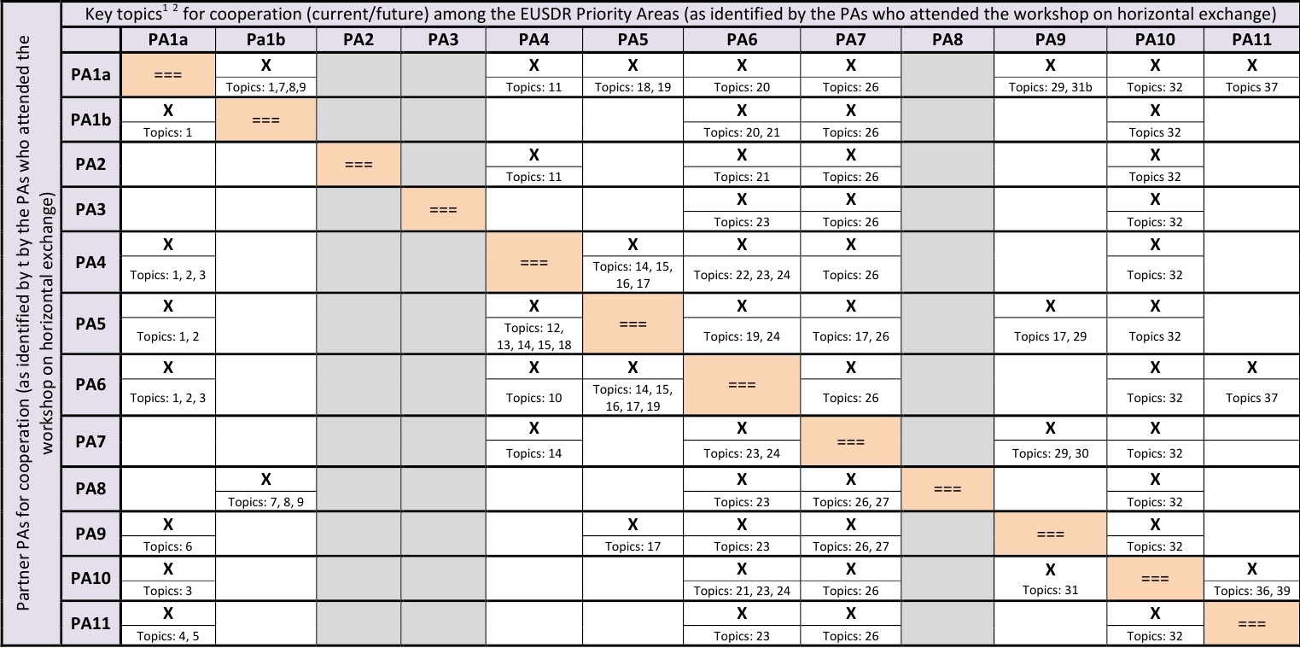
PA4 activities
3. Events (1)
Horizontal cooperation among PAs – meeting on 3-4 May 2017, Vienna
Meeting organized by PA1A and PA6 on possible synergies among particular priority areas
www.danubewaterquality.eu

Slide 8
PA4 activities
3. Events (2)
Danube Transnational Programme and Interreg Central Europe Information Day
3 May 2017, Bratislava
Interreg Central Europe Information Day
26 September 2017, Bratislava
Cooperation with Carpathian Convention
meeting on 10-12 October 2017, Lillafured, Hungary
Discussed draft of "Outlook on Climate Change Adaptation in the Carpathians„ prepared by Carpathian Convention Working Group on Adaptation to Climate Change and the Carpathian Convention Implementation Committee
www.danubewaterquality.eu

Slide 9
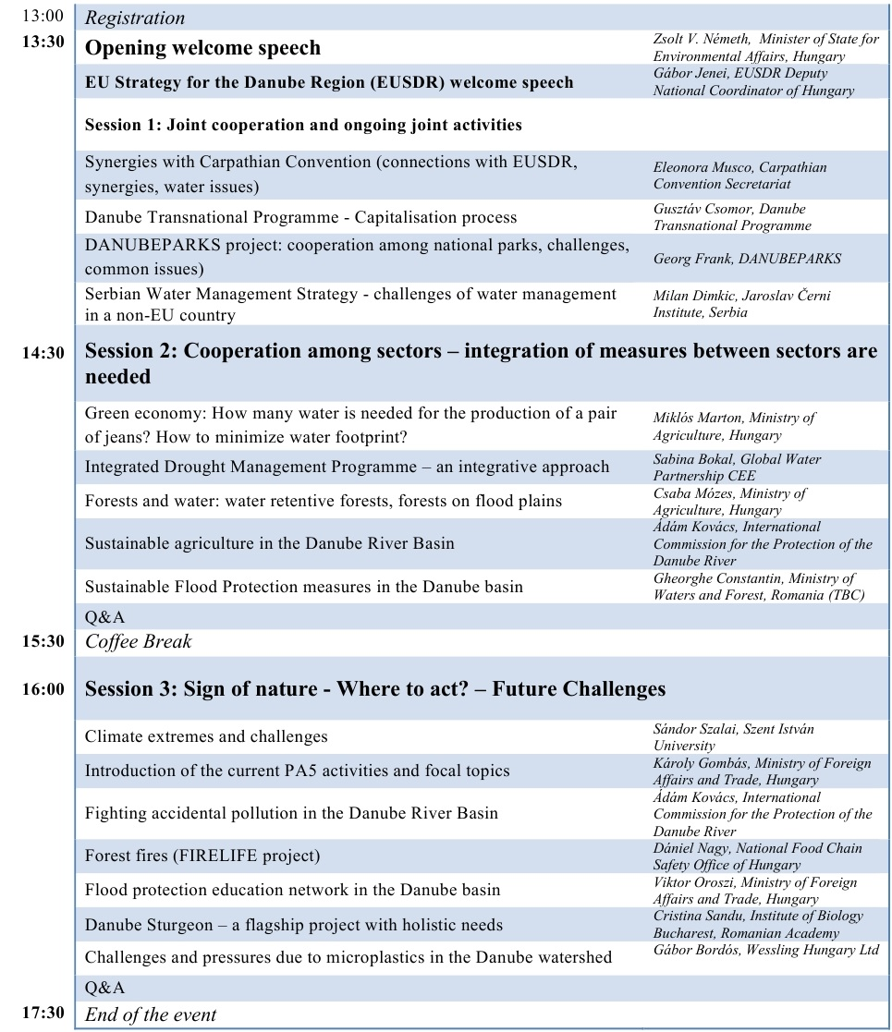
PA4 activities
3. Events (3)
EUSDR Environmental Pillar
- Stakeholder Seminar
17 October 2017, Budapest
Organised by PA4, PA5 and PA6
the future perspectives in the field of water and environmental issues
snap shot of the diversity of environmental issues in the Danube Region in accordance with economic development
to offer basis for balanced and long term development
www.danubewaterquality.eu

Slide 10
PA4 activities
3. Events (4)
6 Annual Forum of EUSDR „A secure, connected and prospering Danube Region“ 18-19 October 2017, Budapest
the Forum will emphasize the different challenges related to perspectives of energy security, transportation development, clean connectivity issues and financing opportunities. The key question to answer - how to transform political commitments into operational policies and measures in the best way.
PA4 organizes 2 interactive workshops on 19 October 2017 within Annual Forum Programme:
Moderator – Mr Balázs Horváth
Moderator – Ms Zsuzsanna Kocsis-Kupper
10:30 – 11:30 | Workshop: Danube Transnational Programme Capitalisation – Group 2 (Bartók Room)
12:00 – 13:30 | Workshop: Funding opportunities for Pillar II of the EUSDR (Liszt Room)
www.danubewaterquality.eu

Slide 11
Thank you for your kind attention ☺
www.danubewaterquality.eu
andrea.vranovska@vuvh.sk

