Slide 1
BLUE Danube
Improving framework conditions for fast track
eco-innovation in waste waster treatment
&
Reflections on funding opportunities for EUSDR

Slide 2
Overview
I. Life+ Proposal „BLUE DANUBE“
II. Reflections on funding opportunities for EUSDR activities

Slide 3
Life+ Proposal „BLUE Danube“
Objectives
Technological Innovation: Promote eco-innovation for Waste Water Treatment Plants (WWTP)
  ➔ Case study: nano-filtering of clinical waste
Policy & Governance innovation: Improve cooperation on municipal level between public sector, innovation actors and private executors with the aim to promote integrated water management
➔ Transfer of the Ulm (DE) model of regional administration unions (Zweckverband) for waste water management to Vidin (BG)

Slide 4
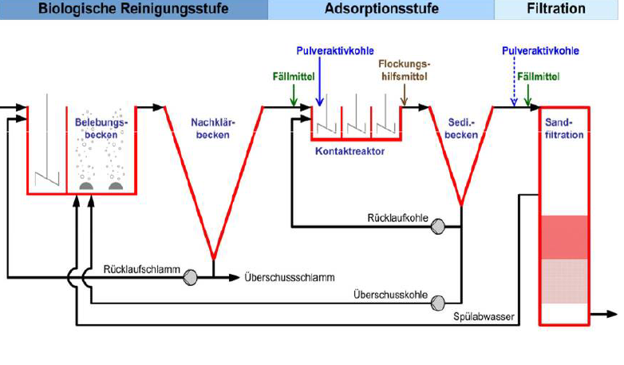
Technology focus: Nanotechnology for Wastewaster treatment
Activated charcoal adsorption for removal of pharmaceutical substances as 4th stage of wastewater treatment

Slide 5
Policy and Governance focus:
Regional administrative unions for waste water management
Inclusion of stakeholders from regional political stakeholders, waste water treatment operators and innovation actors
Improve openness for and speed of eco-innovation
Better coordination between different stakeholder groups
More efficient working routines, improvement of staff skills

Slide 6




Leverage between funding programmes:
Approach „BLUE Danube“
( )
ERDF
Life+
FP7/ H2020
R&D

Slide 7
Reflections on funding opportunities for EUSDR activities
Cohesion Policy – ERDF Target 1 and 2: Provision of Infrastructure – regional focus
INTERREG A/B/C: Interregional cooperation on innovative ways to regional development
Life+ Policy and governance – demonstration of tools, structures, methods – EU focus
FP7/Horizon 2020: R&D on tools, methods, technology: EU focus
Lifelong Learning: Training and education

Slide 8
RIS
RIS
ERDF OP – Region E
ERDF OP – Region A
INTERREG
FP7/8
RIS
ERDF OP – Region D
EUSDR
ERDF OP – Region B
RIS
ERDF OP – Region C
Etc.
IEE/ Life+
IEE
RIS

Slide 9
RIS
RIS
ERDF OP – Region E
ERDF OP – Region A
? Coordination ?
INTERREG
FP7/8
RIS
ERDF OP – Region D
EUSDR
ERDF OP – Region B
RIS
ERDF OP – Region C
Etc.
IEE/ Life+
RIS

Slide 10
EUSDR funding – Open Questions
How to coordinate the integration of EUSDR into different EU funding programmes
How to create leverage effects by combining funding schemes
  of different EU-programmes and DGs
  of national and EU programmes
  of private and public institutions
Private support: How to promote EUSDR activities on private level?

Slide 11

Thank you very much for your attention.
Anna Lenka Schlosser
blue! advancing european projects
a.schlosser@the-blue.net

