Slide 1
CC-WaterS
Climate Change and Impacts on Water Supply

Slide 2
Programme
Project
Goals, methods and results

Slide 3
PROGRAMME
Countries participating in the project CC-WaterS
Austria
Croatia
Bulgaria
Macedonia
Greece
Albania
Hungary
Bosnia Herz.
Italy
Montenegro
Romania
Serbia
Slovakia
Maldova
Slovenia
Ukraine

Slide 4
PROJECT
Main Facts
CC-WaterS: Climate Change and Impacts on Water Supply
Duration: 36 months 05.2009-04.2012
18 partners from 9 countries
Total budget: € 4,22 Mio. (85% funding)

Slide 5
PROJECT
May 2009
April 2012
WP0:
Preparation
WP1:
Transnational project management and coordination
WP2:
Communication and dissemmination
WP3:
Climate Change
WP4:
Water Resources Availability
WP5: Land Use and Water Quality
WP6: Socio-Economy (Risk Assessment)
WP7: Adaptation Measures
01
02
03
04
05
06
07
08
09
10
11
12
13
14
15
16
17
18
19
20
21
22
23
24
25
26
27
28
19
30
31
32
33
34
35
36
Periode 1
Periode 2
Periode 3
Periode 4
Periode 5
Periode 6

Slide 6
PROJECT
Projectpartners
The participating partners represent the geographical and meteorological diversity of SEE and show complementary expertise. Three types of partners from 9 countries, representing a multi-sectoral consortium, complement their functions and implement the activities to achieve the project objectives
water suppliers
governmental bodies
research institutions
representing national, regional and local levels with transnational orientation.

Slide 7
Porjectgoals
Water resources availability
Safeguarding of a sustainable water supply for citiziens in different European regions till 2100 considering climate change
Land Use
Those will change according to climate change. Therefore methods will be developed to assess the impacts of those land use changes on water
Water Supply
Implemantation of measures in order to adapt watermanagemnt to climate and land use changes.

Slide 8
Goals and Results
WP3: Climate Change
WP4: Water Resources Availability
WP5: Land Use and Water Quality
WP6: socio-economic evaluation (risk assessment)
WP7: Adaptation Measures

Slide 9
Goals and Results
Selection of climate scenarios and models
Downscaling techniques for regional impactstudies
WP3
Data
base
Bias correction for simulation data
Assessment of uncertainties for precipitation and temperature
WP4: Water resources availability
WP5: land use and water quality
WP6: socio-economic evaluation (risk assessment)
WP7: adaptation measures

Slide 10
Goals WP3
- Meteorological data base
- Daily and monthly series for precipitation and temperature for 2000-2100 for europe
- Comparison and evaluation of different regional climate models.
- Assessment of the uncertainties

Slide 11
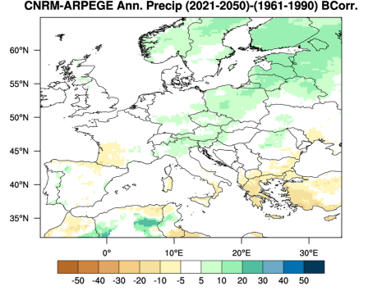
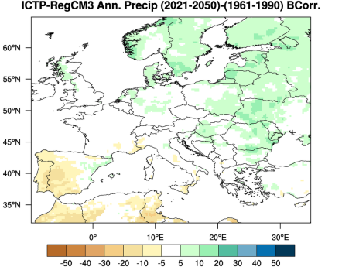
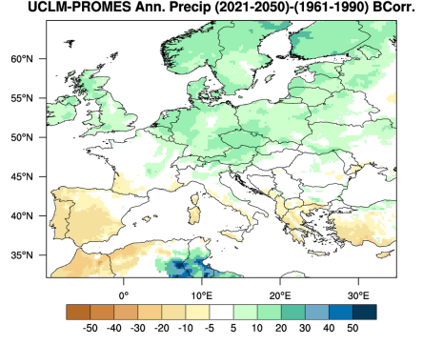
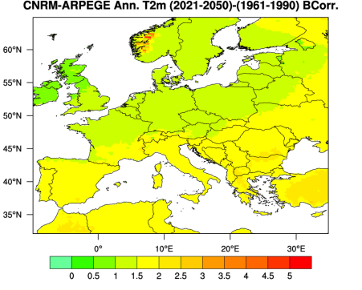
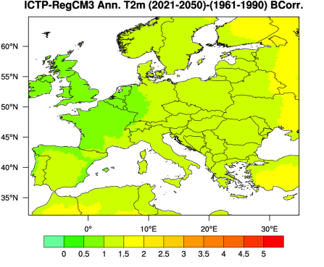
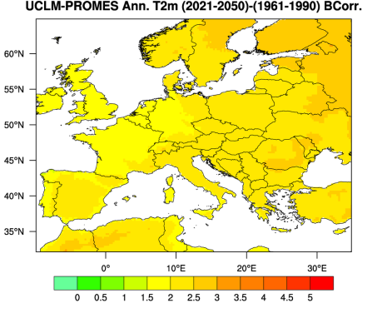
    Expected changes in precipitation until 2050
RESULTS WP3
Changes of precipitation til 2050
Bias corrected climate change signal - mean annual precipitation for the period 2021-2050.
changes of temperature till 2050
Figure 14: Bias corrected climate change signal - mean annual temperature for the
period 2021-2050.

Slide 12
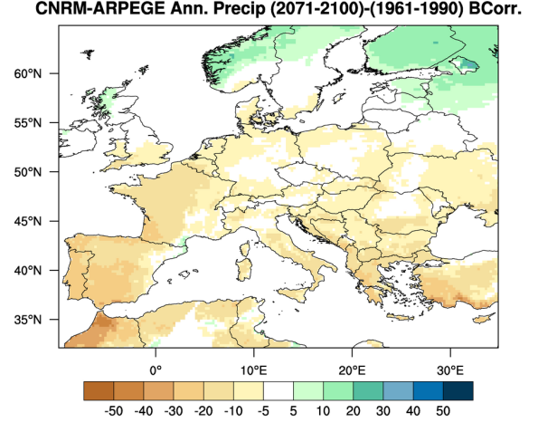
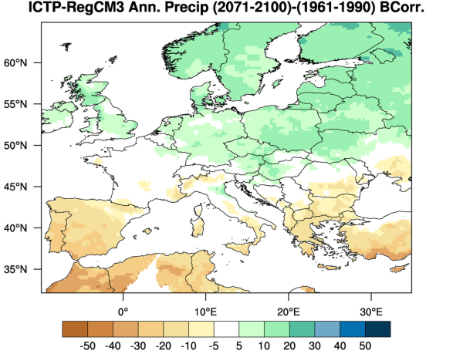
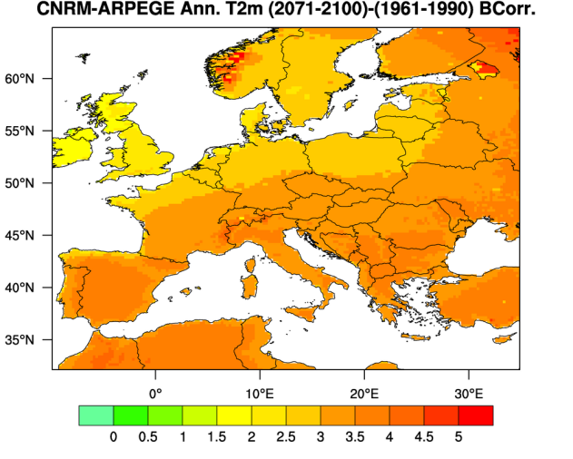
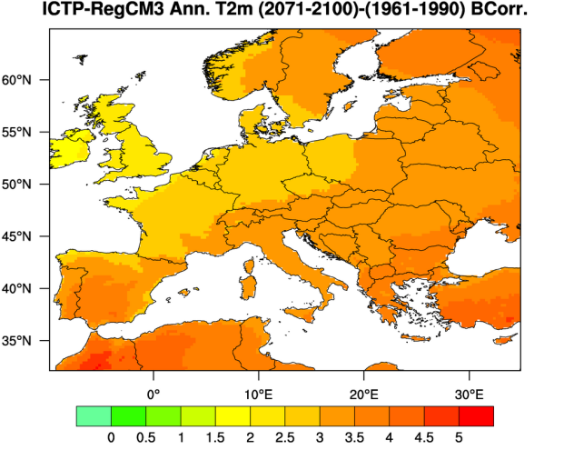
RESULTS WP3
changes of precipitation till 2100
Figure 17: Bias corrected climate change signal - mean annual precipitation for the
period 2071-2100.
Changes of temperature till 2100
Figure 19: Climate Change signal [°C] of the annual temperature of the CNRM-ARPEGE model
(left side) and RegCM3 (right side) for the period 2071-2100 versus 1961-1990.

Slide 13
WP4 Water Resources Availability
Climate Change (WP3)
Ecological and environmental criteria
Meteorological and hydrological characteristics
Quantity and quality of water resources
Water demand
WP4
Economic assessment (WP6)
Land use & water quality (WP5)
Water Supply Management (WP7)
Proposals and tools

Slide 14
Goals WP4
CC-WaterS
- Setup of a transnational hydrological database
- Assessment of actual and future water resources considering climate change and climate change induced land use changes.
- Assessment of the sensitivity regarding climate change in different regions and different types of aquifers.
- Actual water demand vs. actual water resources
- Conclusions for socio-economic impacts and water management.

Slide 15
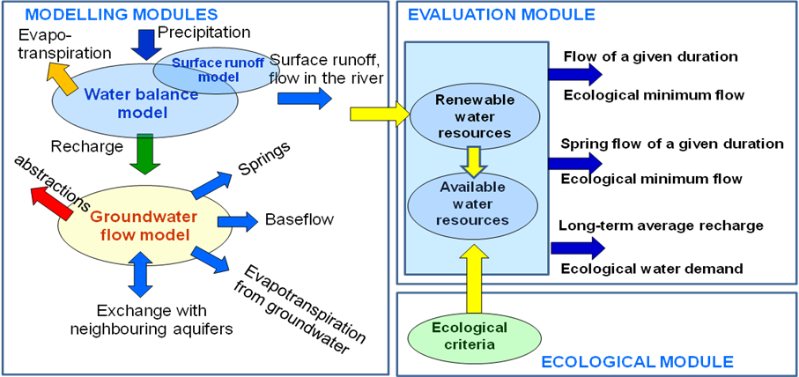
METHODS WP4
Figure 3: Modular system of the methodology.

Slide 16
Figure 15: Changes in the water resources due to the climate change as percentage of the
baseline values (1961 – 1990).
RESULTS WP4
Changes in surface runoff, recharge and renewable water resources
○ 2021-2050
○ 2071-2100
100%: 1961-90
Remark: in the case of Patras test area only one climate scenario has been analysed (double CO₂).
Remark: In the case of Belgrade, Patras and Matese test areas, the characteristic renewable water resources were not determined.
Figure 15: Changes in the water resources due to the climate change as percentage of the
baseline values (1961 – 1990).

Slide 17
RESULTS WP4
Ranking of the test areas according to problems
in the field of water supply
Figure 20: Classification of the test areas according to water availability problems, in particular related to drinking water supply.

Slide 18
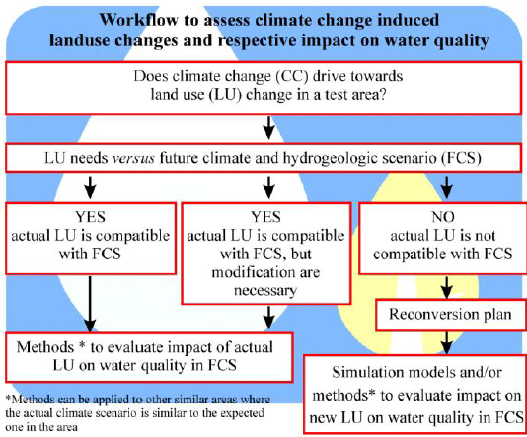
WP5 Land Usa and Water Quality
WP3: Climate Change
WP4: Water Ressources Availability
WP6: socio-economic evaluation (risk assessment)
WP7: adaptation measures

Slide 19
Goals WP5
- Hydrological characterisation of test areas
- Analyses of actual land use activities and designing of land use maps.
- Compilation of water quality data and analyses of selected parameters.
- Impact of climate change signals (WP3) on actual land use activities and generation of land use scenarios.
- Assessment of probable impacts of future land use activities on water quality.
- Analyses and syntheses using the DPSIR method.

Slide 20
GOALS WP5
Surveyed Land Use Activities
- Mountain pature
- Agriculture
- Forestry
- Urban Developement

Slide 21
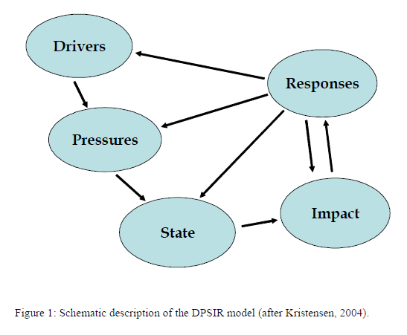
METHODS WP5
DPSIR
- Driver: sealed areas
- Pressure: reduced groundwater recharge
State: actual groundwater quality
and quantity
- Impact: microbial contamination
Response: rehabilitation of sealed areas

Slide 22
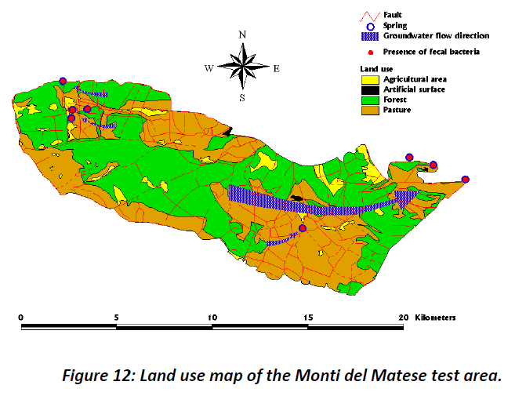
RESULTS WP5
Mountain pasture (Molise)
Climate change causes increased load of facal micro organisms.
Possible measures:
Change of protection areas
Reduction of cattle or other domestic animals

Slide 23
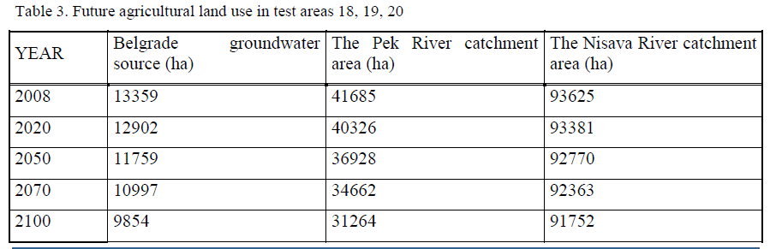
RESULTS WP5
Agriculture (Serbia)
Climate change causes
- need for intensified irrigation
- increased erosion
- need for increase application of pesticides

Slide 24
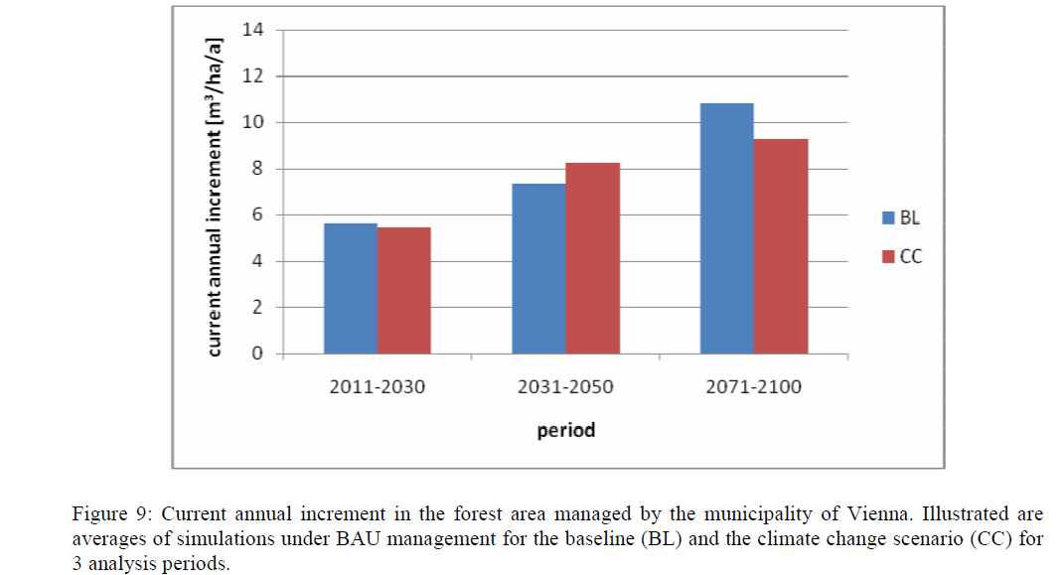
RESULTS WP5
Forestry (Vienna)
- xxx

Slide 25
RESULTS WP5
Urban developement (Ljubljana)
Future land use activities in water management typical for urban areas are governed by planning policies and are (almost) not dependent from climate change.

Slide 26
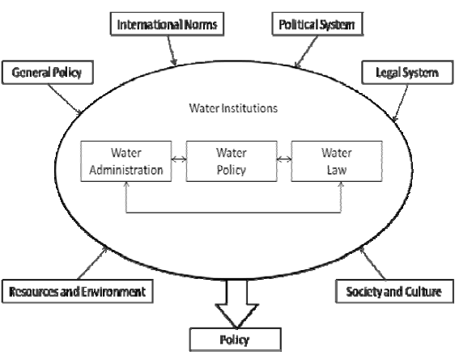
WP6 Socio-economic evaluation (risk assessment)
WP3: Climate Change
WP4: Water Resources Availability
WP5: Land Use and Water Quality
WP7: Adaptation Measures

Slide 27
Goals WP6
Story line for the socio-economic assessment of the status quo and ot the future development trends.
Assessment of the water demand of different economic sectors
Assessment of economic impacts on water management caused by climate and land use changes.
Assessment of impacts on environment.

Slide 28
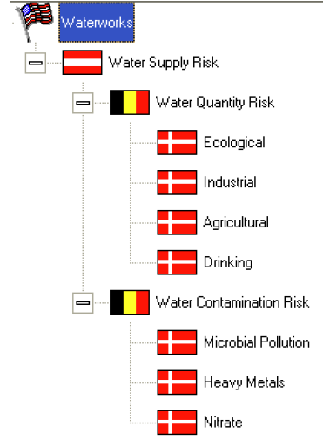
METHODS WP6
The methodology consists of the following main parts:
1. Construction of the structure of criteria (relevant risk assessment factors) with two main
branches: water quantity risk and water quality risk.
2. Assessment of water quantity adverse events (water shortages)
3. Estimation of unit (specific) consequences of shortages
4. Calculation of water supply quantity risks by multiplying shortages and unit consequences.
5. Assessment of water supply quality adverse events
6. Estimation of water supply quality risks
7. Verbal evaluation of water supply quantity and quality risk

Slide 29
RESULTS WP6
Socio-Economic Evaluation (Riswk Assessment)
No Problems: Austria, Slovenia
Minor Problems: Leu-Rotunda Plain, RO; Bükk, HU; Aravissos, GR; Struma River BG; Kucevo, RS; Veliko Gradiste, RS; Croatia
Significant Problems: Nyirseg, HU; Timis Plain, RO

Slide 30
WP7 Adaptation Measures
WP3: Climate Change
WP4: Water Resources Availability
WP5: Land Use and Water Quality
WP6: Socio-Economic Evaluation (Risk Assessment)
WP7: Adaptation Measures
Best practices
Adaptation Water Supply Management
Analyses of alternative Management Options

Slide 31
GOALS WP7
Presentation and mutual exchange of “best practices”
designing of different management options based on results of WP6.
Assessment and ranking of those management options

Slide 32
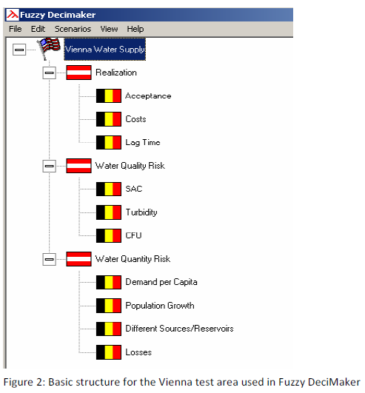
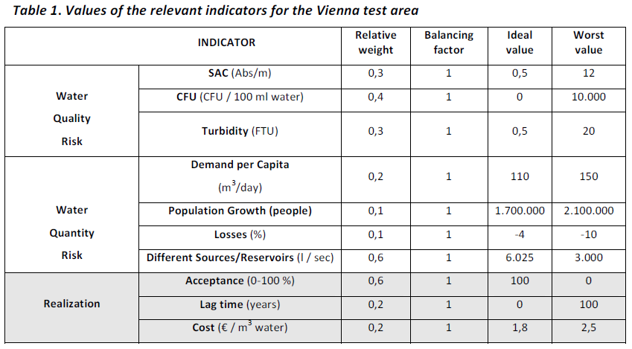
Methods WP7
xx

Slide 33
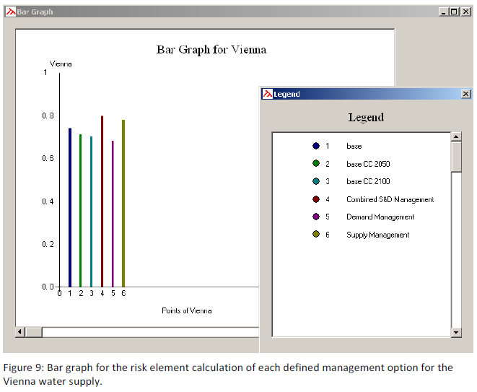
RESULTS WP7
Am Beispiel Wiener Wasserversorgung
xx

Slide 34
Thank You
(www.ccwater.eu)

