Slide 1
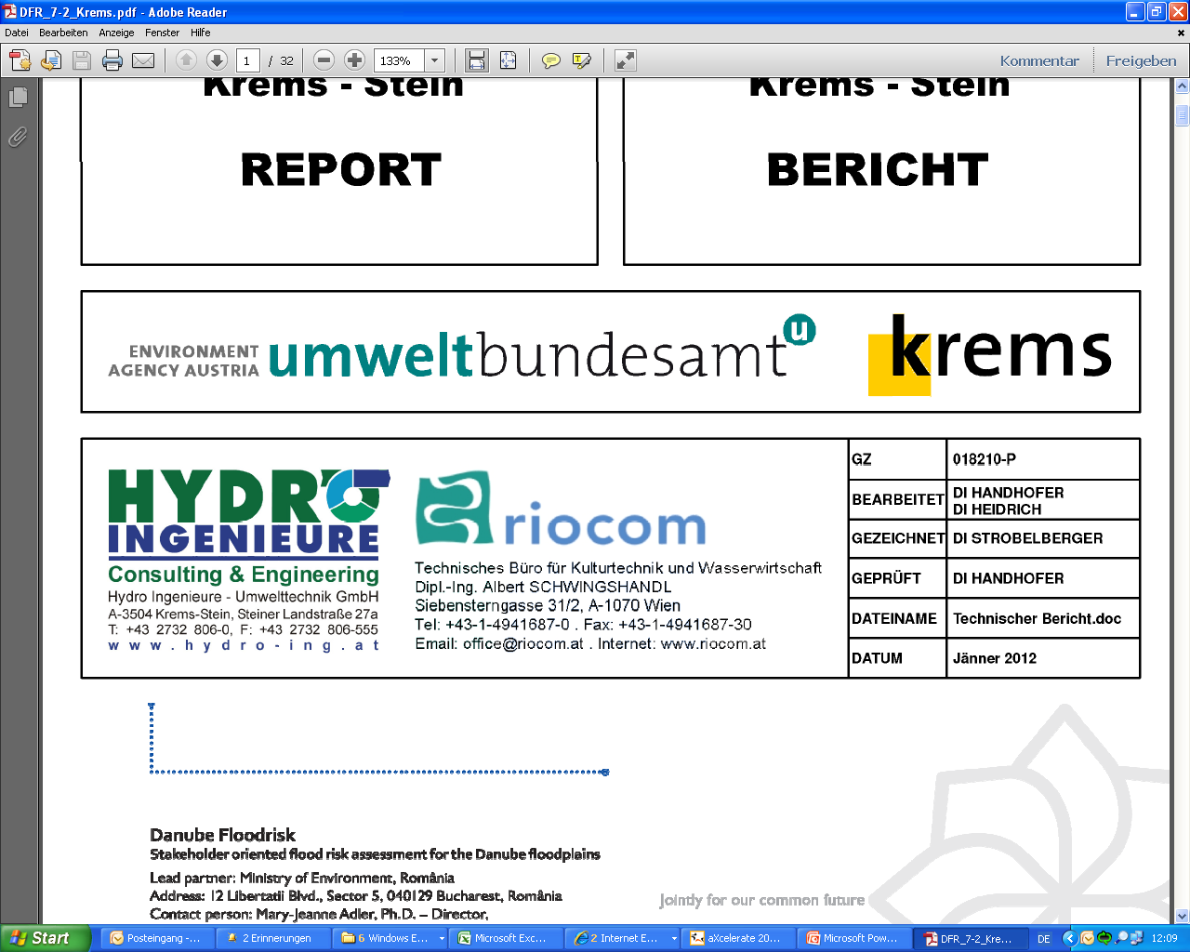



Communicating Residual Risk in Krems, Austria
Budapest, 06. November 2012
Dr. Yvonne Spira yvonne.spira@umweltbundesamt.at
Dr. Therese Stickler therese.stickler@umweltbundesamt.at
Dr. Robert Konecny robert.konecny@umweltbundesamt.at

Slide 2
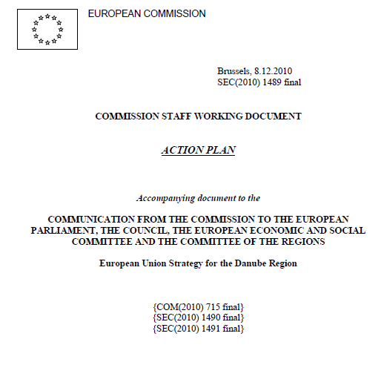
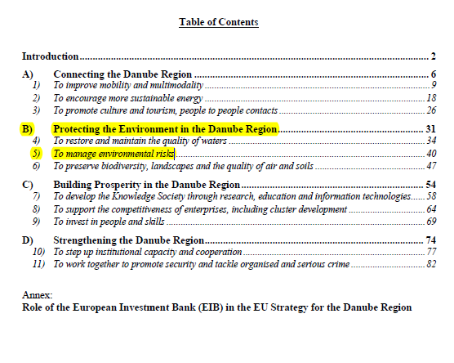
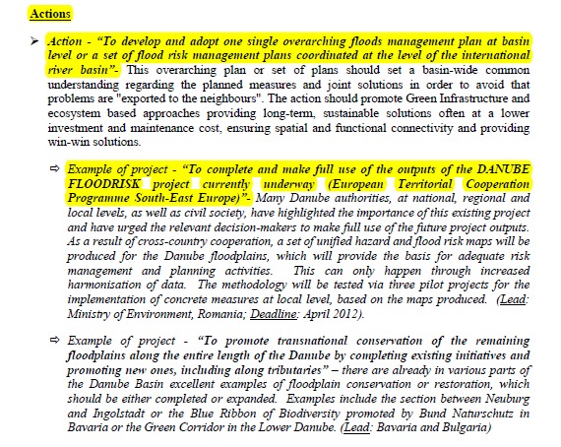

Slide 3
DANUBE FLOODRISK - Objectives
Overall:
Improvement of the socio-economic conditions of the population in the Danube floodplain by flood risk mapping
Long-term:
Reducing the flood damage in the Danube floodplain
Improving the long-term strategic planning framework for flood risk management

Slide 4
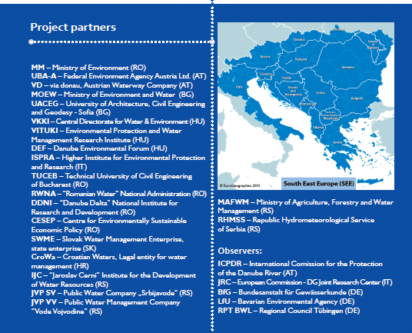
DANUBE FLOODRISK - Facts
03/09-10/12
Budget 5,3 M€
14 ERDF Partners
from 6 MS (AT, BG,
HU, IT, RO, SK)
6 IPA Partners from
2 countries (HR, RS)
5 observers from
3 MS (AT, IT, DE)
LP: Mary-Jeanne Adler
Ministry of Environment, RO

Slide 5
DANUBE FLOODRISK – Main Results
Common methodology for hazard and risk assessment
Common database with hazard and risk maps
Danube Atlas with Hazard and Risk maps
8 Pilot Projects in AT, BG, IT, RO

Slide 6
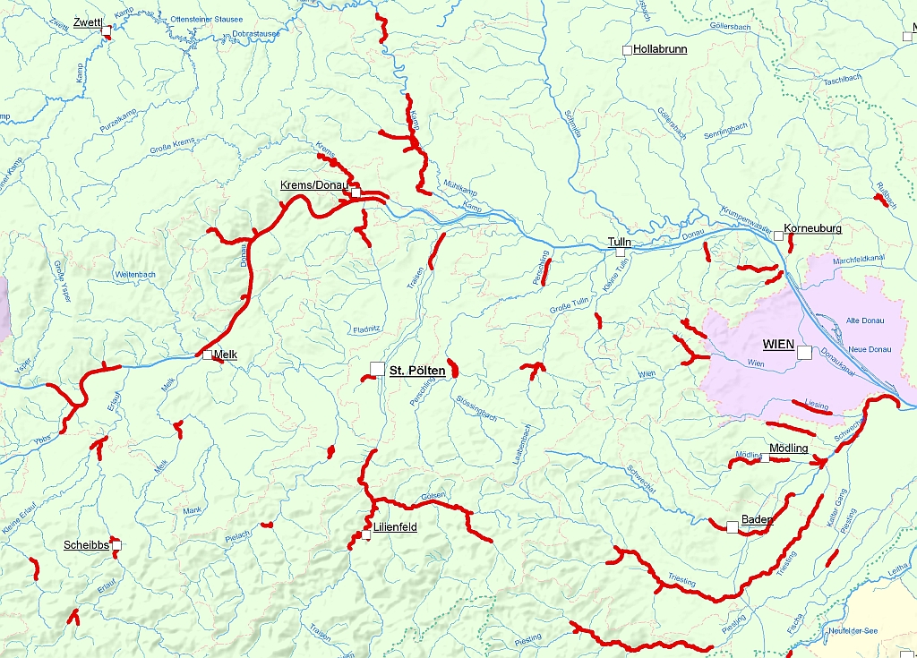
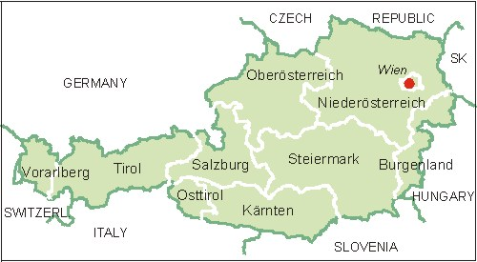
Location of Austrian Pilot Area
Krems:
Long-standing flood experience
Inside APSFR
Receptors:
  25,000 inhabitants
  Economy
  IPPC installations
  Cultural world heritage

Slide 7
The Story of Making Krems a Pilot Area
11/09-02/10 environment ministry and province Lower Austria: discussion about suitable and potentially willing pilot municipalities → Krems?
04/2010 1st meeting with Krems municipality for getting their OK to pilot
- no cooperation between UBA-A and Krems so far
+ known and trusted province representative
+ support of administration
- political reservations, strong skepticism
→ trust building: experiences from other stakeholder involvement projects, rules for cooperation
→ agreement on flood scenarios & support of municipality

Slide 8
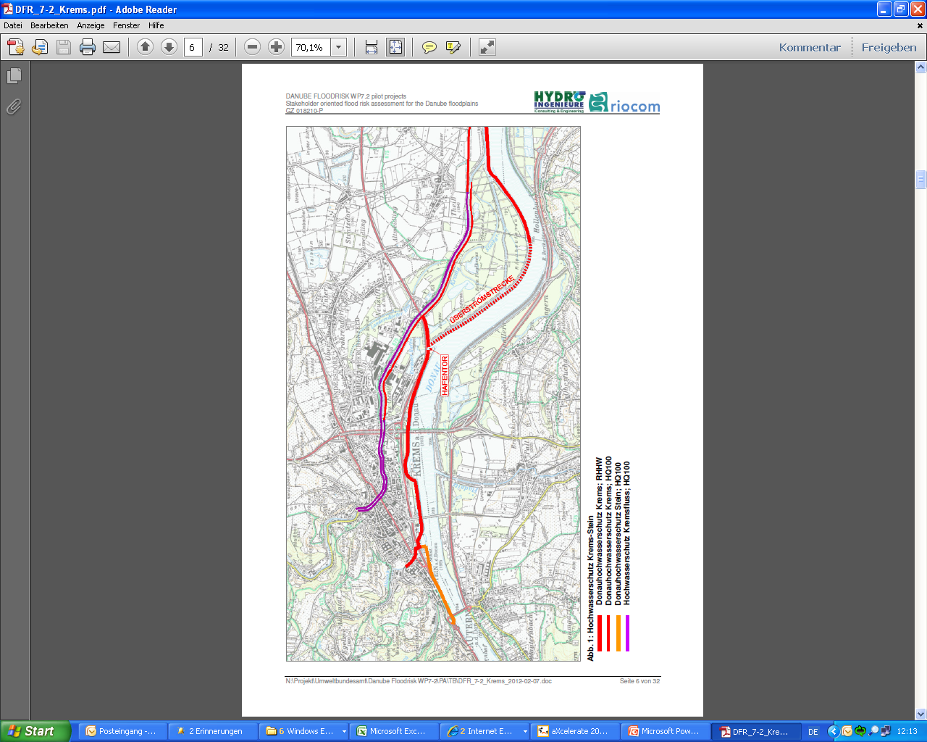
Investigated Scenarios
Failure of mobile defense wall in settlement area,
adverse consequences
to population, economy, culture
Failure of harbor gate,
adverse consequences
to economy, environment (3 IPPC companies)
HQ1000
HQ100
HQ100 mobile
HQ100 tributary
Existing flood protection

Slide 9
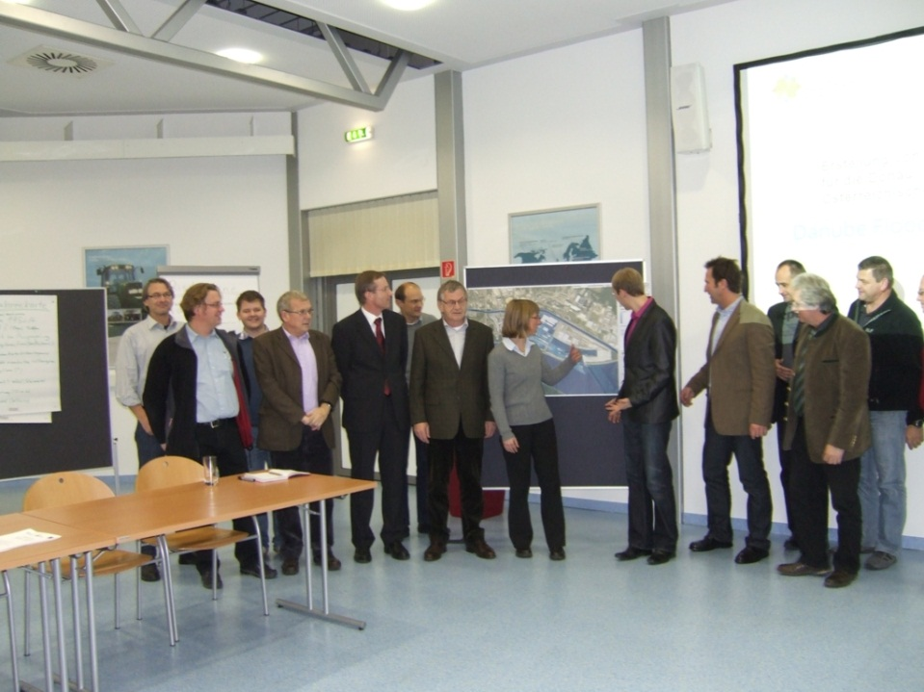
Start of Stakeholder Workshops
10/2011 Presentation of hazard results to municipality → Agreement on harbor stakeholder involvement → Agreement on risk mapping for settlement area and on stakeholder and broad public involvement ☺ positive atmosphere
11/2011 1st Stakeholder Workshop at VOEST
+ municipality as
door opener
+ one strong
company supporter
(“Local champion”)
→ companies decided to meet internally
to define suggestions for risk assessment

Slide 10
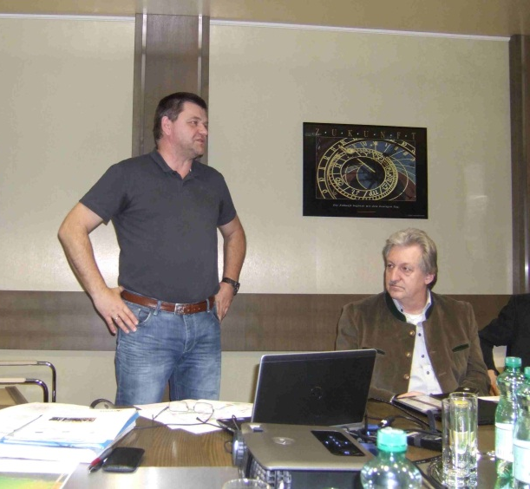
Further Harbor Stakeholder Workshops
01/2012 2nd Stakeholder Workshop at DYNEA
→ Presentation of results of company meeting → Presentations of risk assessment trial (€/m²) → Agreement on other risk assessment method
02/2012 Follow up meeting
with Local Champion
and risk scientists
→ decision on detailed
risk assessment method
and data delivery

Slide 11
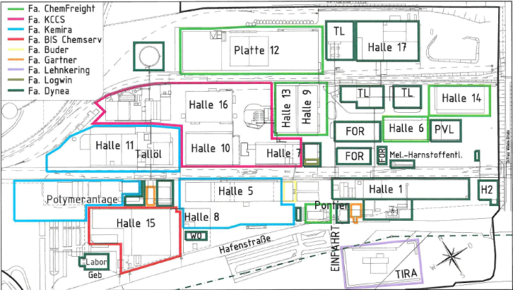
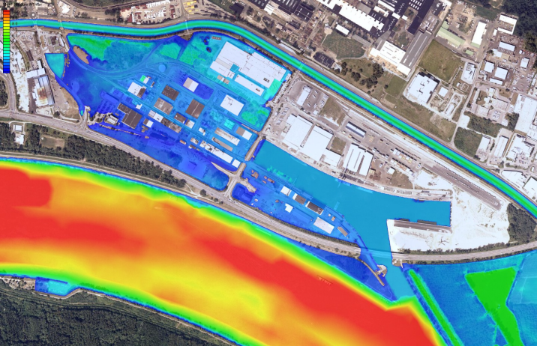
Risk Assessment Method for Harbor
Method is similar to ALP-S model and Lower Austria model for municipalities exposed to different kinds of risk

Slide 12
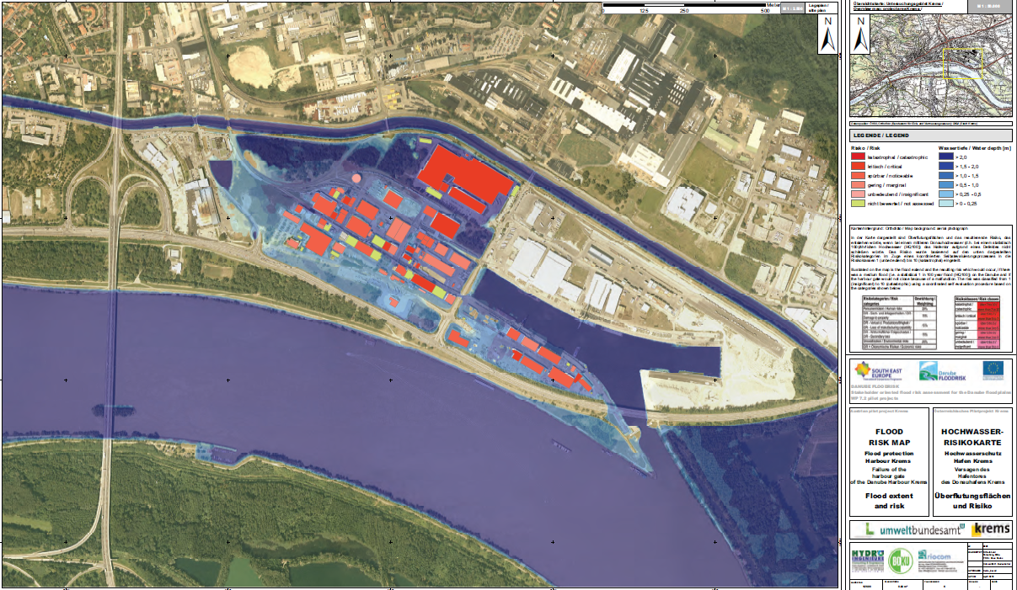
Harbor Hazard and Risk Map

Slide 13
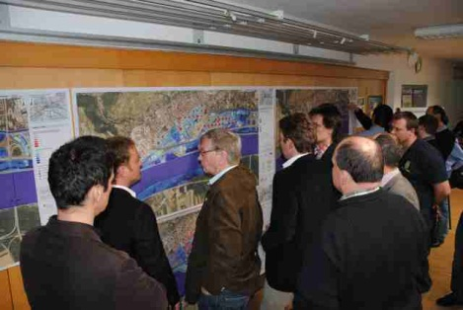
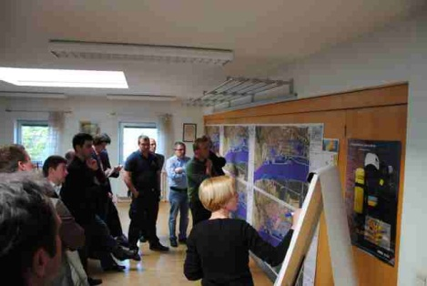
Settlement Area Stakeholder Workshop
03/2012 civil protection staff workshop:
→ presentation of settlement hazard and risk map proposals and asking feedback
☺ open and constructive discussion and feedback

Slide 14
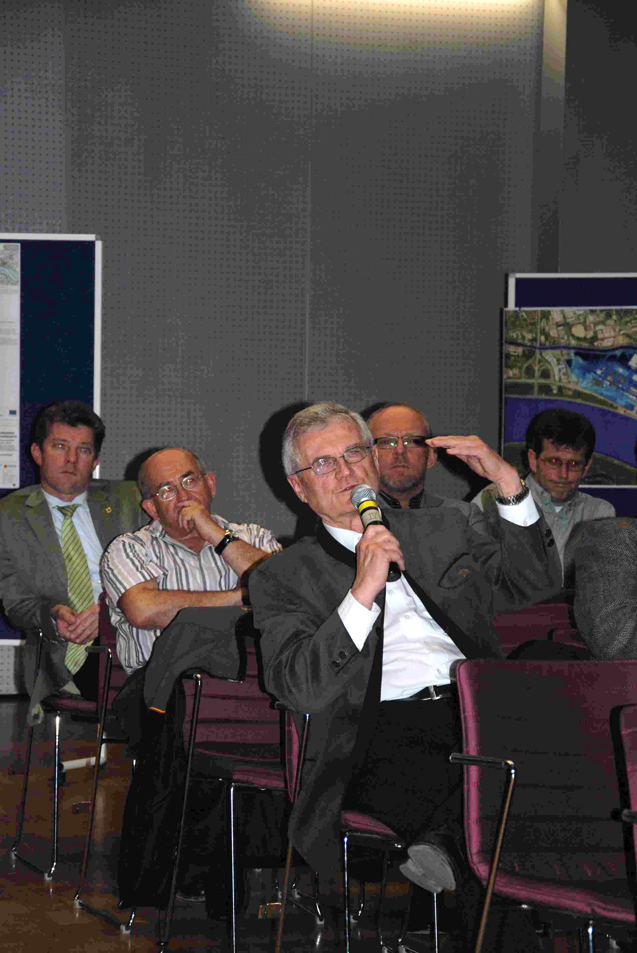
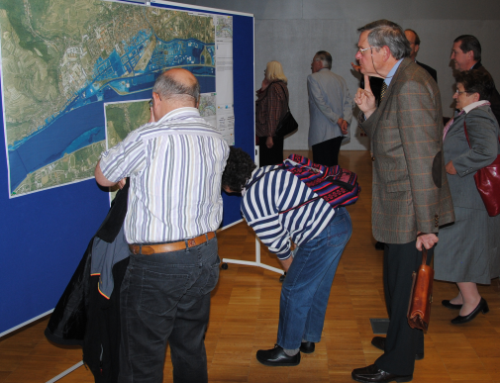
Public Participation Event and Final Meeting
04/2012 Presentation of final FHM & FRM to broad public
(incl. press release) in cooperation with municipality
☺ open dialogue
06/2012 final meeting with municipality and harbor stakeholders regarding further use of pilot results
☺ positive closure of pilot project

Slide 15
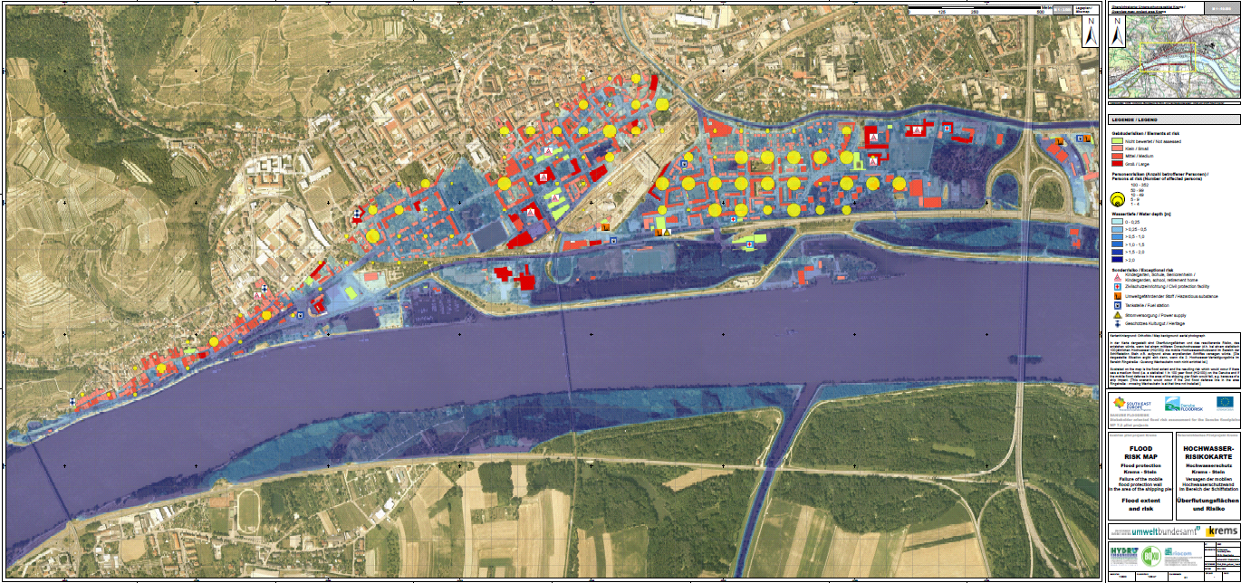

Settlement Hazard and Risk Map 1 (wo 2nd D-L)

Slide 16
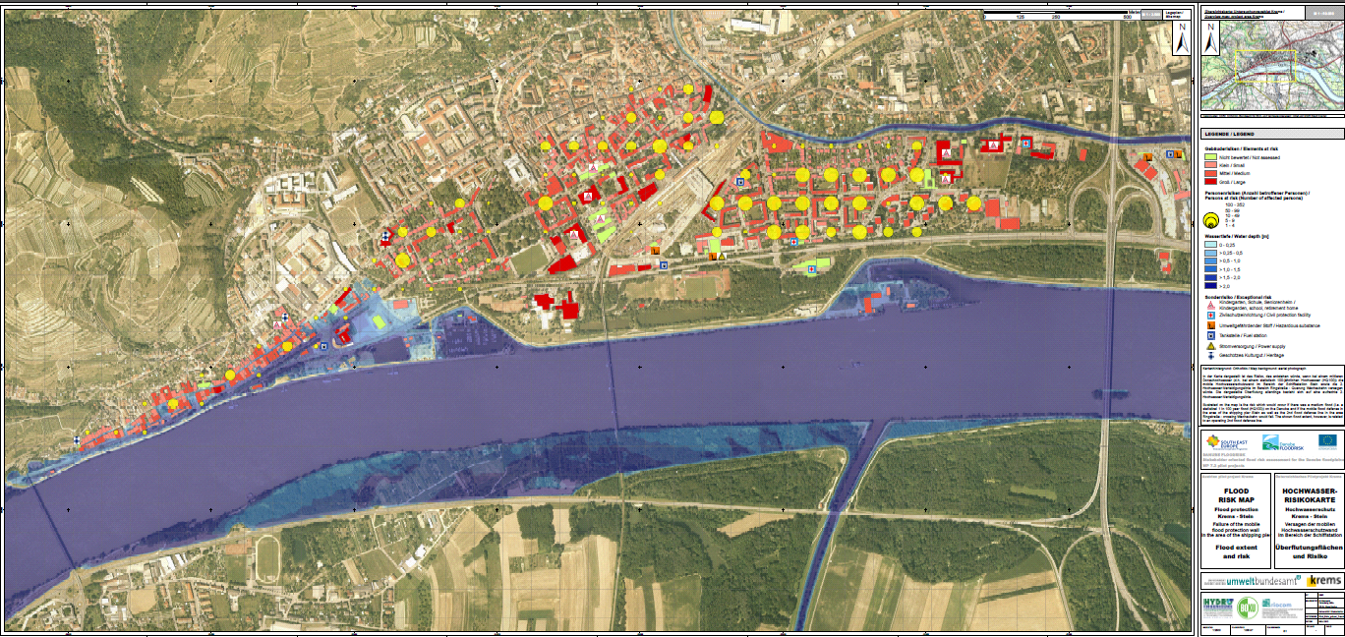
Settlement Hazard and Risk Map 2 (w 2nd D-L)

Slide 17
Conclusions from Pilot
Effort for Stakeholder involvement was severely underestimated (e.g. more than 2.5 years and more than 10 meetings in Krems, lots of „social“ telephone calls to stay in contact)
Trust-building with stakeholders is essential to overcome fear of negative spin by political opponents/media
Locally known door-opener and own communication person help a lot
Be open for creating win-win situations
No pressure
Learning was not one-way, but mutual - a real dialogue
→ Communication of residual risk is possible and in this case positive

Slide 18
Conclusions from DANUBE FLOODRISK for Danube Region Strategy
Good example of successful international cooperation
Harmonisation of data and methods was possible
Joint atlas helps setting flood risk management priorities for Danube river basin

Slide 19




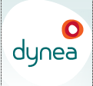
Thanks for the excellent support to our pilot project
Companies in harbor area: Mierka, Eybl, VOEST, Biodiesel, Dynea
Civil Protection Units:
Police and Fire Brigade Krems

Slide 20
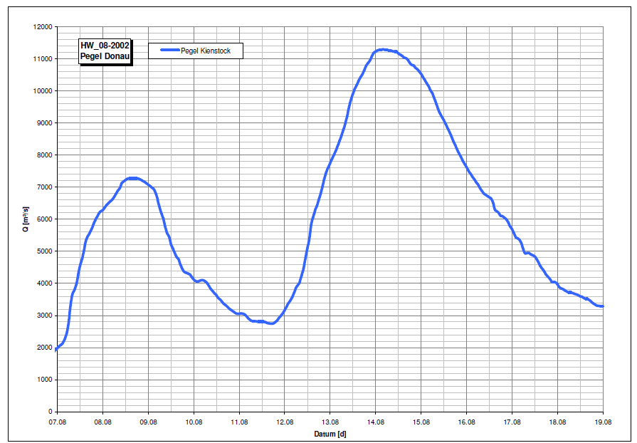
Hydrodynamic Modelling
2D-model based on LIDAR (floodplain) and multibeam echosounding (river bed) survey data
modelling software: HYDRO_AS-2D
unsteady flow simulation of
Q100 flood wave
Failure of mobile defense wall in Stein
  Before the peak discharge
  At peak discharge
  With/without upright second defense wall
Failure of harbor gate closure
  Before peak discharge

Slide 21
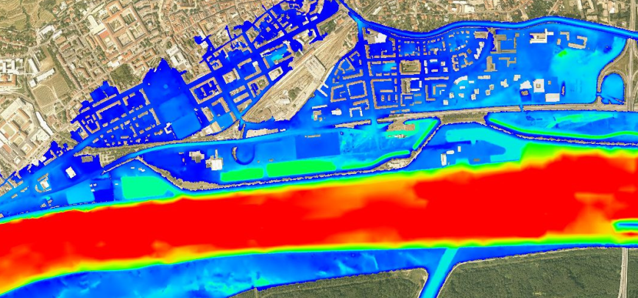
Risk Assessment Method for Settlement Area
Municipal register data
Statistical data
re property values

