Slide 1


SEERisk:
„Joint Disaster Management risk assessment and preparedness in the Danube macro-region”
Ágnes Rajacic, project manager
National Directorate General for Disaster Management
Stakeholder Seminar of Environmental Pillar of EU
Strategy for the Danube Region, 6/11/2012

Slide 2
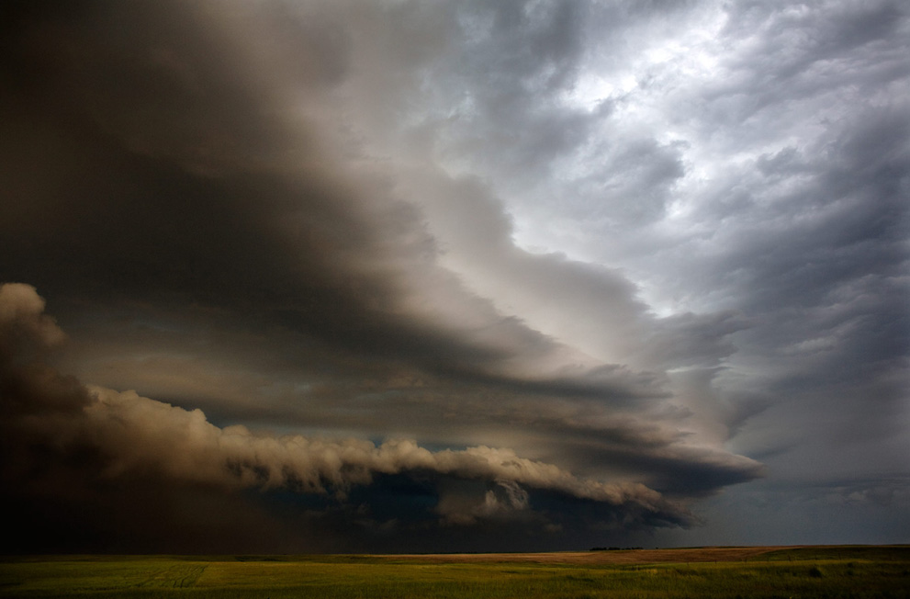
Table of content
Background & Rationale
2. Objective of SEERisk
3. Steps of SEErisk

Slide 3
1.Basic facts
Project preparation: April 2011- April 2012
Project started: July 2012
Funding: South-East Europe programme
Project partners:18 (municipalities, disaster management bodies, universities in the region)
Countries involved: Austria, Bosnia and Herzegovina, Bulgaria, Hungary, Serbia, Romania, Slovakia, Slovenia, Croatia
Lead partner: National Directorate General for Disaster Management, Hungary
Project pilot areas: 6 (Srbac, Siófok, Temerin, Trnava, Velingrad)
Received DRS label

Slide 4
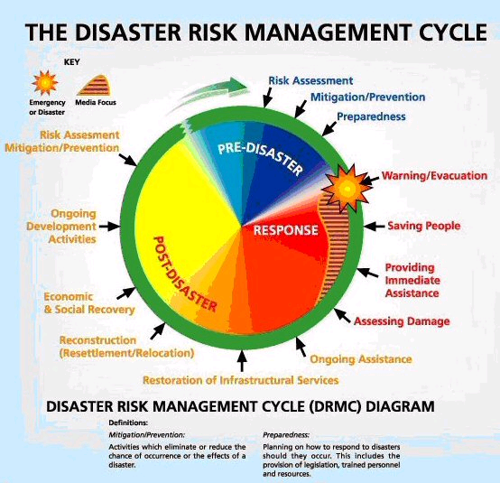
Notes:
A katasztrófa kockázat kezelés ábrája
Katasztrófát megelőző időszak egyben a megelőzés és a felkészülés időszaka is. Itt kell megtenni azokat az elsődleges lépéseket, amelyek segítségével megelőzhető egy súlyos esemény. A megelőzés eszközei lehetnek a jogszabályok, a jogkövető magatartás kieszközölése, a tervek (kitelepítési és befogadási terv), lakossági tájékoztató kiadványok, míg a felkészülés eszköze pl. a gyakorlatok szervezése és lebonyolítása.
Válasz – Ha már bekövetkezett a nem várt esemény, válaszolni kell rá, megfelelő mértékben és a megfelelő időben. Ez egy lecsengő folyamat, a bekövetkezett esemény kezdetekor hirtelen megemelkedik a beavatkozások száma, az életmentéssel és az azonnali segítségnyújtással kapcsolatos tevékenységek – kimenekítés vagy kitelepítés. Ezt követően – az életveszély megszűntetése után egy lassabb, elemző szakasz következik, a további segítségnyújtás és a további teendők átgondolása.
Katasztrófa utáni időszak – először is a helyreállítás, majd az újjáépítés. Az újjáépítés a polgári védelmi mechanizmusban például nem haladhatja meg a katasztrófát megelőző helyzet szintjét. Nálunk ez nem így van, lásd vörösiszap katasztrófa.

Slide 5
1. Disaster Risk Assessment in the EU
March 2009 – Annoncement of the EU Commission
„Conception on the prevention of natural and man made disasters”
November 2009 – EU Council Conclusion No. 15394/09
„Conclusion on a Community framework on disaster prevention
within the EU”
April 2011 - EU Council Conclusion No. 8068/11
„on Further Developing Risk Assessment for Disaster
Management within the European Union”
Notes:
On 4 March 2009, the Commission submitted to the Council, the European Parliament, the European Economic and Social Committee and the Committee of the Regions, a communication on a Community approach on the prevention of natural and man-made disasters.
Based on this paper draft Council conclusions were examined. One of them was accepted by the Working Party on Civil Protection.
According to the council conclusion was published in November 2009 the council invites the Member States that before the end of 2011, make available to the Commission information on risks of relevance for the development of an overview of the major risks the Community may face in the future.
Member States are invited to further develop national approaches to, and procedures for, risk management, including risk analyses, covering the potential major natural and man-made disasters, taking into account the future impact of climate change, and recalling that before the end of 2012 the Commission, using the available national risk analysis and taking into account the future impact of climate change and the need for climate adaptation, is to prepare a cross-sectoral overview of the major natural and man-made risks that the EU may face in the future and on this basis identify risks or types of risks that would be shared by Member States or regions in different Member States.

Slide 6
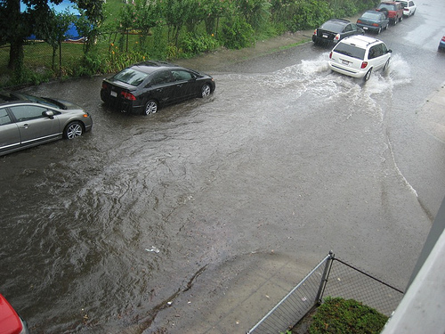
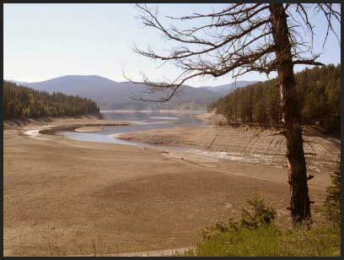

Extreme weather
South Eastern European (SEE) region: Common challenges and territorial coherence
Climate change→Extreme climate events→wide range of risk types (flashflood, thunderstorm, draughts etc.)
Challanges: low level of awareness, weaker preparedness and territorial planning, institutional gaps

Slide 7
1. Rationale
National requirements/preparadness vs local authorities’ ability to response
Local communities: regionally uneven awareness
Local authorities: varying degree of resilience/preparadness → same event may result in different magnitude of damage in SEE region
Goal: incorporate climate change into harmonized regional plans for SEE region

Slide 8
2. Objective of the Project
Develop a consistent risk assessment and emergency preparedness tool in SEE countries at national and local level, especially in case of disasters intensified/created by climate change.
by
formulating a common risk assessment methodology for natural hazards intensified/created by climate change
enhancing the quality of decision-making in disaster management by know-how transfer and to review the local plans and regulations upon which the disaster communication plans are built

Slide 9
3. STEPS
National level
Preparedness assessment
I. Risk assessment
Risk map
Information
Local level
Risk map
Information

Slide 10
3. RESULT
From the merge of the outcome of I. and II.
Examine the effectiveness of DM III.
Carry out a strategy action plan at local level.

Slide 11
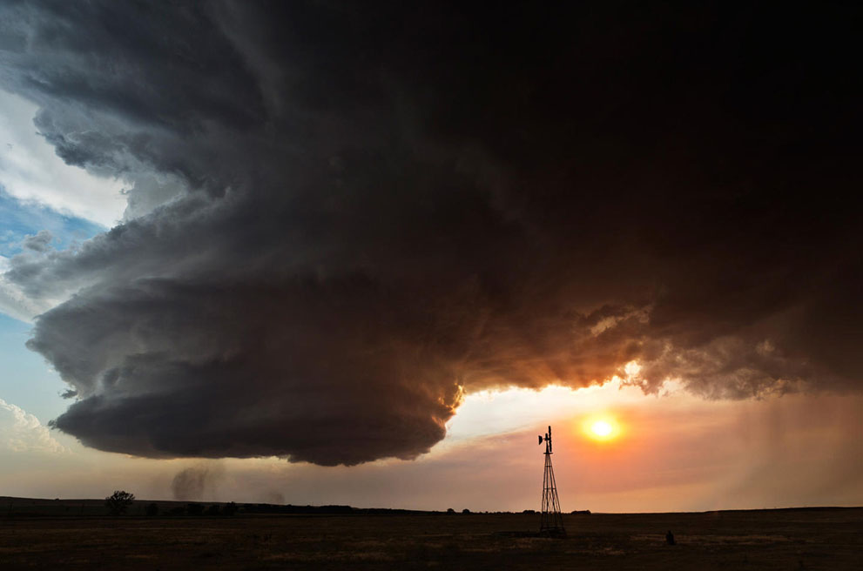
Work Package 3 – Risk Assessment
Aim: to produce a commonly elaborated methodology on the assessment of climate change triggered risks for the SEE area.

Slide 12
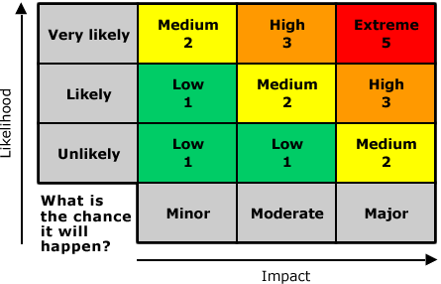
WP3
3.1 Elaboration of a common risk assessment methodology
3.2 Mapping and risk assessment of the pilot areas
WP3 Risk mapping and assessment
3.3 Analysis of social awareness and authority regulation of the pilot areas
3.4 Guideline on climate
change adaptation & risk assessment

Slide 13
WP3 Risk assessment
3.1 Common definition of harmonised methodology for risk mapping and
assessment.
3.2 Execution of risk mapping and assessment in the pilot areas (PA)
3.3 The social awareness on emergency situations shall be surveyed analysed and discussed within a PA. Comparison of social awareness and risk assessment results. Analysis on the coherence of local authority regulation and relevant territorial and sectoral planning documents with the disaster management exposure and plans.
3.4 Comparison of different PA risk assessment and social awareness
results. Prevention and mitigation advices.

Slide 14
Work Package 4 – Joint preparedness for climate change caused risk
Aim: to enhance the quality of decision-making in disaster management by know-how transfer and to review the local plans and regulations upon which the disaster communication plans are built

Slide 15
WP4
4.1 Workshops on emergency management issues
4.2 Collection of GIS best practices in emergency mgt.
WP4 Joint regional preparedness
4.3 Joint simulation field-exercises (at 5 pilot areas)
4.4 Common emergency communication strategy

Slide 16
WP4 Joint regional preparedness
4.1 Thematic technical internal workshops (4), public forums will be
organized on emergency prevention and mitigation issues in order to
enhance joint preparedness by know-how transfer.
4.2 Collection and know-how exchange of best practice applications,
workflow or projects based on GIS software.
4.3 Planning, organising and execution of joint disaster management
transnational field-exercises.
4.4 Analysis of present emergency communication and public information procedures (SWOT) of the countries and elaboration of a common guideline to improve the coordination of emergency cases with transnational character.

Slide 17
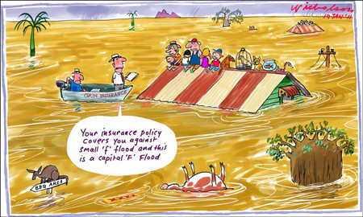
Thank you for your attention!
Agnes.rajacic@katved.gov.hu
Phone: +36 1 469 41 18
Mobile: +36 20 929 24 47

