Slide 1

Transboundary Biosphere Reserve Mura-Drava-Danube
Perspectives of Future Cooperation
Mirna Bojić
Ministry of Environmental and Nature Protection, Croatia
Budapest, November 2012

Slide 2
1. Previous actions and experience in preparation of TBR
2. Present tasks in management
3. Future perspectives

Slide 3
Improvement in the management of natural values in MDD river ecosystem
Particular PA’s + National Ecological Network, Mura- Drava preventive protection
2007
Regional Park
2011
TBR MDD
2012

Slide 4
Main goal – Natural solutions for MDD area!
Nature
Management
Natural solutions

Slide 5
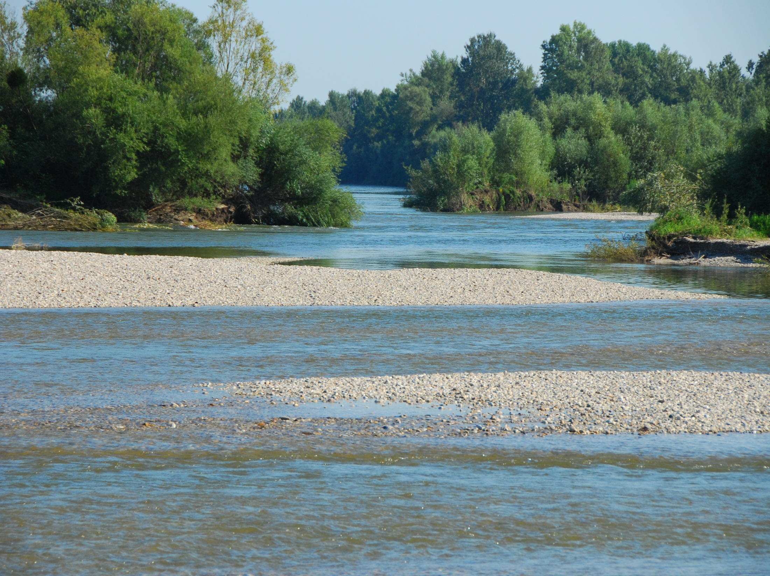
In this long complex process, we learned the importance of
patience
persistance
consistence
confidence in our goal
many discouraging notes:
on too large area, long duration, useless of protection, obstacles to the land use etc.
Importance of process of public hearing
- to clear all open questions
- to remove all prejudices
- to communicate with different stakeholders
Public hearing for Regional park Mura-Drava - good lesson
50 letters, presentation in each county, wide number of stakeholders, detailed explanation of each raised question, approval of the proposal -> raised public awareness

Slide 6
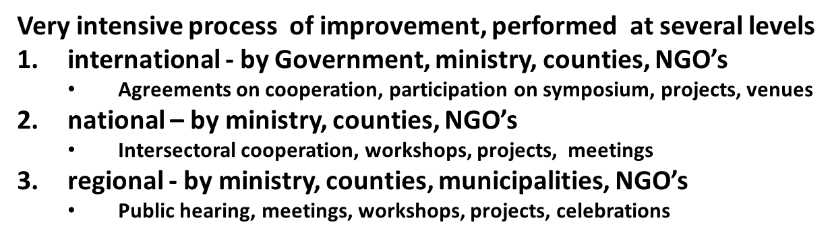
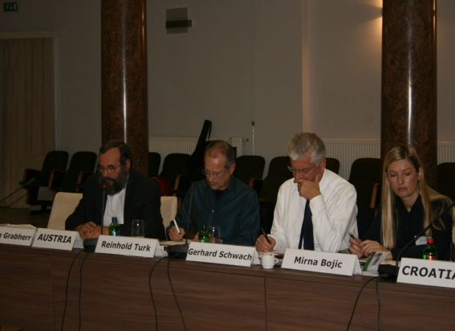
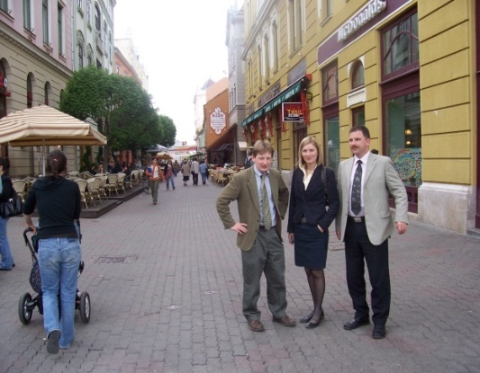
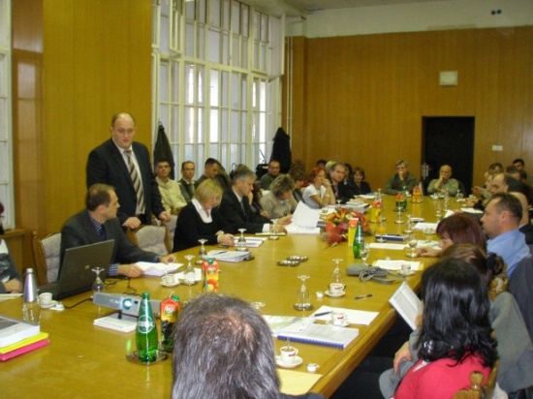
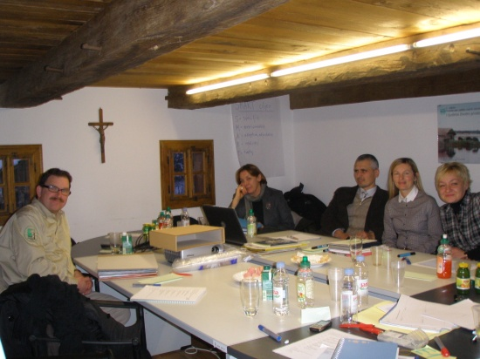

Slide 7
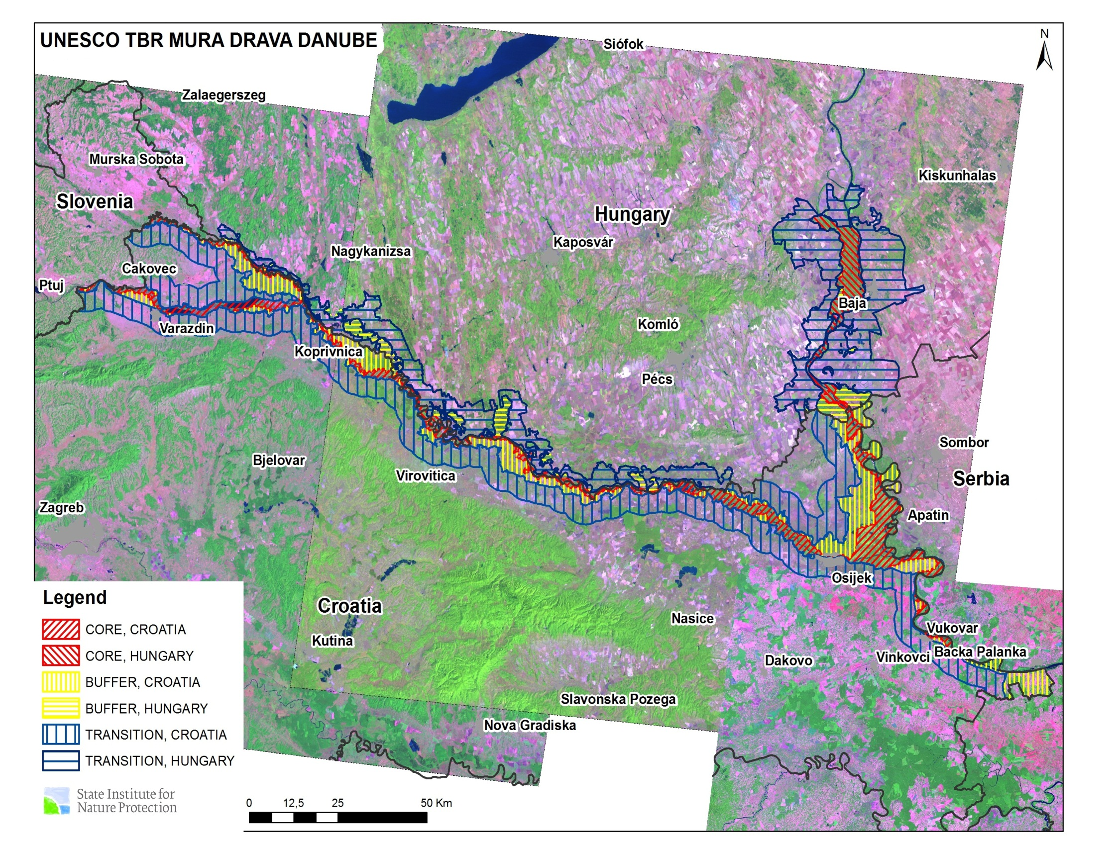

Slide 8
2. Present tasks in management –
three functions of biosphere reserve
Conservation Function – contribution to the landscape and ecosystem biodiversity
Development Function – to foster economic and human sustainable development, to promote ‘eco’ concept
Logistical Support Function – for research and monitoring

Slide 9
TRANSITION ZONE
Cities and developed area in surrounding
Implementation of BR concept
BUFFER ZONE
Helps protection
Variety of uses which promote BR
CORE ZONE
Strictly protected area- NEN
Use in line with conserv. objectives

Slide 10
Management of Transboundary biosphere reserve requiers:
Coordination structure
focal point in each country
Coordination Board -HR-HU Sub-committee for nature protection
Coordination Committee - county institutions, water management companies, forest management companies, other interested stakeholders
Scientific board
Web site
Co-operation plan
management plan
yearly cooperation programme
Identification of potential funding and (joint) application
each party shall, to the fullest possible extent support projects and activities
IPA projects and other programmes
Danube Strategy for EU

Slide 11
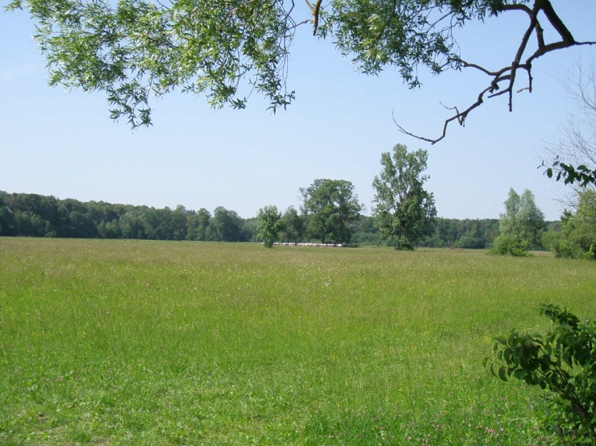
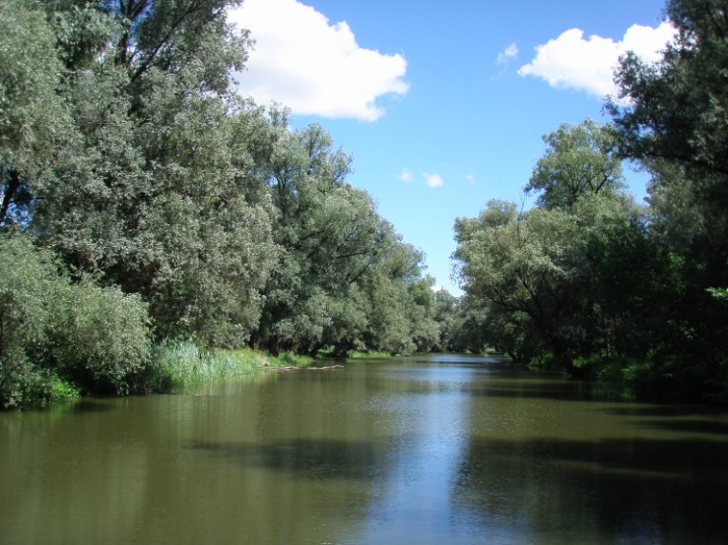
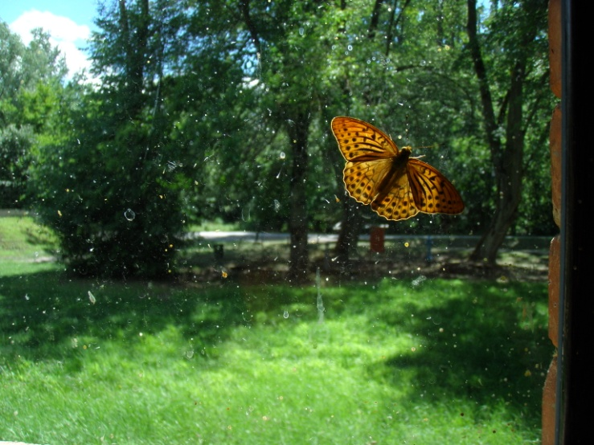
3. Future perspectives - Planned activities according to the three functions of BR’s:
...to conserve natural and cultural diversity
co-ordination of regulatory measures
common actions for threatened and protected species and ecosystems, migratory species and control of alien species
activities on rehabilitation and restoration of degraded areas
Improvement of the renger service of the area

Slide 12
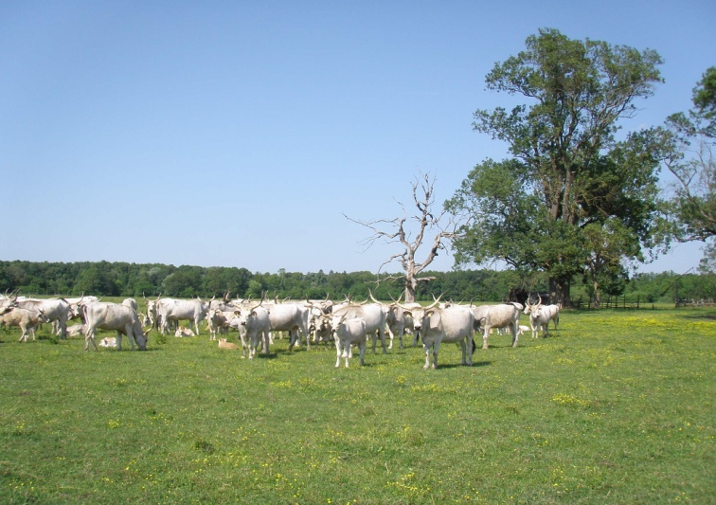
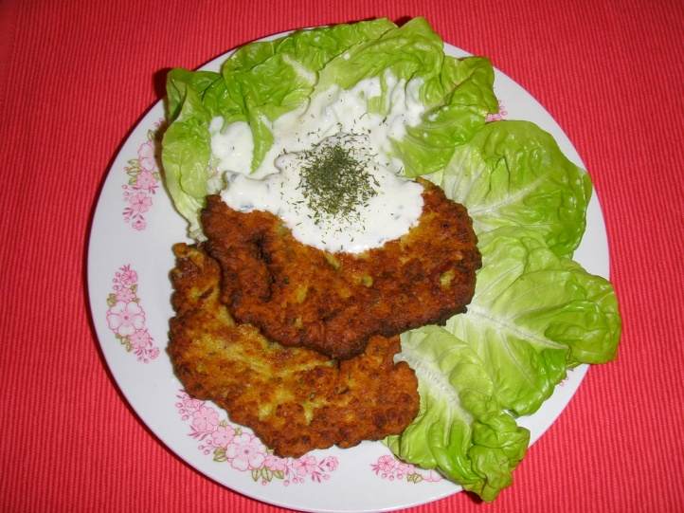
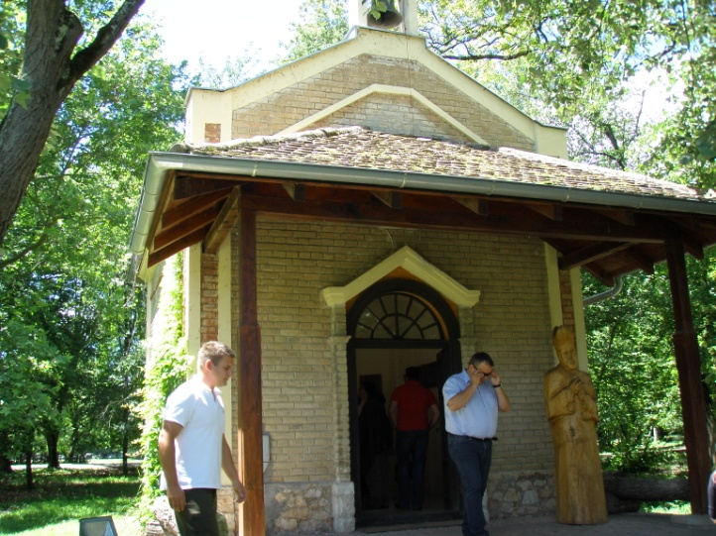
...to promote sustainable development
co-ordination of management practices in forestry, forest regenaration, pollution control...
elaboration of joint tourism policy
various partnerships with local communities, NGO’s, societies, stakeholder councils
promotion of joint cultural events, conservation of cultural heritage

Slide 13
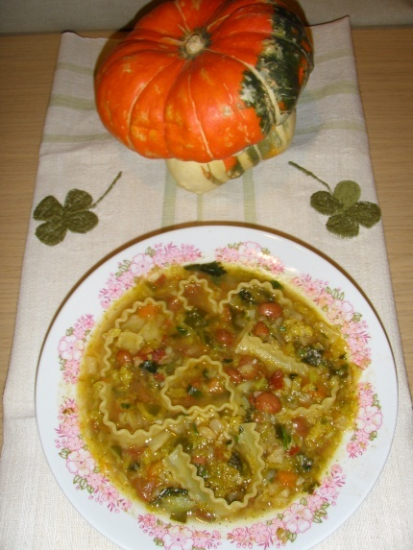
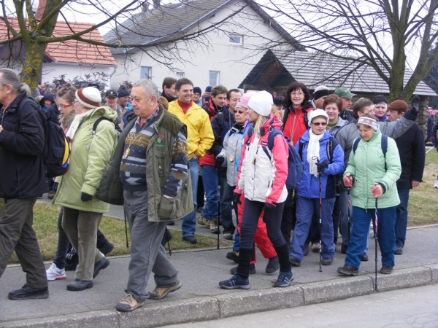
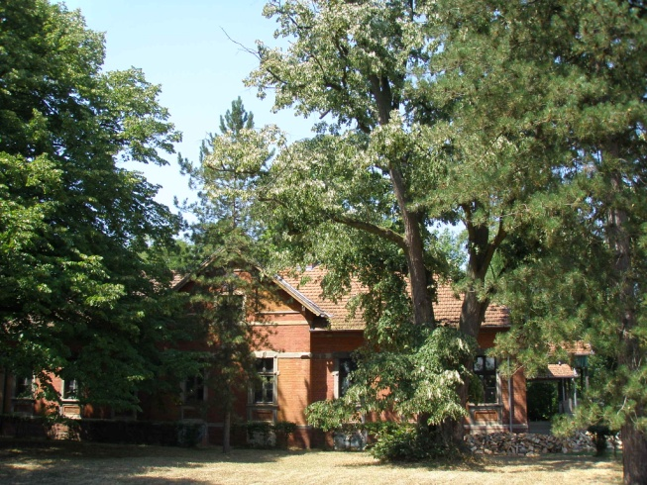
...to support research, monitoring, education and training
to prepare joint reserch programmes
to develop common data formats, indicators and methods for monitoring
to share scientific information, maps
to organise workshops, training courses, conferences, expert meetings
to publish results of common research
to develop joint mapping
to promote understanding of neighbours culture
to support school exchange
to develop common public relations’
strategy to raise awareness on TBR
to produce information material
to organise exhibitions and events in TBR

Slide 14

Thank you for your attention!

