Slide 1




Protecting the Environment in the Danube Region PA6: Preserving biodiversity, landscapes and the quality of air and soils
Annual Stakeholder Seminar of the Pillar II
- Protecting the Environment -
of the EU Strategy for the Danube Region
Florian Ballnus
Bavarian State Ministry of the Environment
and Public Health
Priority Area Coordinator
Budapest, 06. November 2012

Slide 2
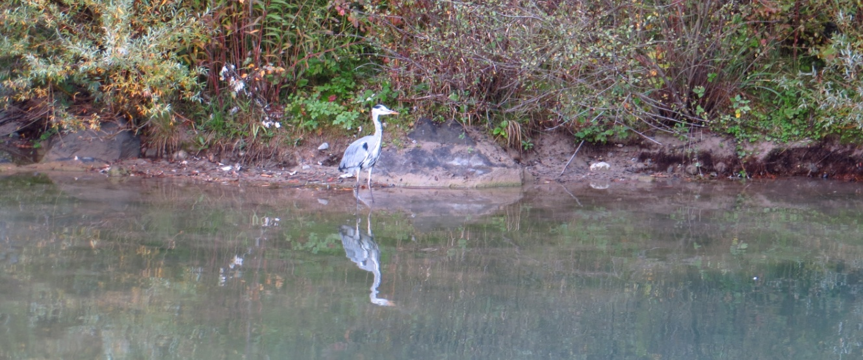
Implementing PA6
Expectations and Experiences

Slide 3
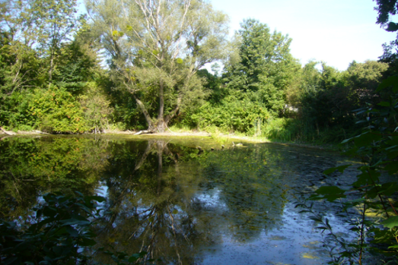
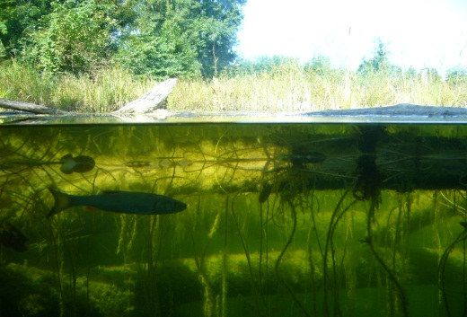
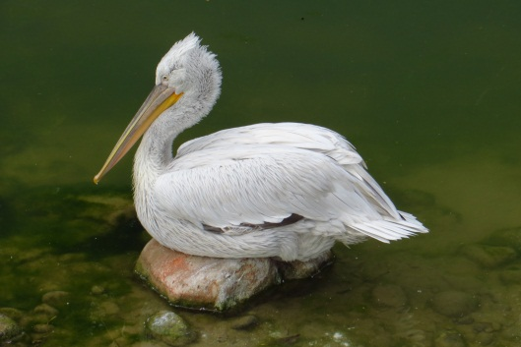

The Danube – Important habitat for Europe
As the only European river, the Danube flows from west to east.
It connects Western Europe with the Black Sea and crosses a variety of different habitats.
The Danube valley touches many natural areas and is therefore a connecting corridor between the different landscapes.
Danube has great significance for animal migrations, particularly for migratory fish.
Migratory birds use the Danube River as a major axis on the way south or north. A variety of areas along the Danube are suitable for resting, culmination in Danube Delta.
The corridor function results in a large diversity of species and habitats along the Danube River.
How can the EUSDR – PA 6 - contribute significantly to maintain and enhance
the status of the Danube, its tributaries and the entire region as an area with
rich biodiversity assets?

Slide 4
Implementing the EUSDR – the PA6 approach
The start (February 2011 – June 2011):
Political start, high-level conferences, beginning of Pillar II cooperation
Capacity building, organisational setting, organigram, internal networking
Establishing first contacts to actors on various levels
First Steering Group meeting in June 2011
The progress (July 2011 – June 2012):
Official start of the EUSDR
Balancing between high expectations and actual possibilities (“Three no´s”)
Strenghtening the network and gathering project ideas (in preperation and ongoing)
Development of further working documents, establishing the labelling system within Pillar II
Participation at project events, bilateral meetings with stakeholder, information activities
2nd and 3rd Steering Group meeting, 1st report to EU COM
Enhancing integrative approach within EUSDR

Slide 5
Implementing the EUSDR – the PA6 approach
The current situation July 2012 - now
Lessons learned in dialogue with stakeholders: level of international/transnational cooperation and the setting of existing networks in the field of biodiversity and nature protection is quite weak.
Stakeholder involvement and their networking is seen as precondition for PA6 and EUSDR-related activities.
PA6´s mission: Make the voices of biodiversity and nature protection heard by using EUSDR momentum!
Make the voices of biodiversity and nature protection heard by developing and implementing realistic and convincing activities!
Challenge: bridge the time gap until 2014 without project funding
Preparing “ready-to-go” projects for next EU funding period 2014-2020
Capacity building, Networking and Content oriented implementation as main pillars to proceed.
Information about opportunities and possibilities of PA6 and EUSDR to stakeholder and public.

Slide 6
Implementing the EUSDR – the PA6 approach
Integrative approach within EUSDR
Cooperation in the Environmental Pillar II is developing very well.
Biodiversity is strongly connected to other Priority Areas (e.g. Transport, Energy), cooperation must be enhanced here as well.
PA6 starts cooperation with PA1 (Steering Group attendance, Joint Panel in Regensburg).
EUSDR provides opportunity to create and develop horizontal thematic links among different “branches”!
Further Reflections
Tendency of „hot spots“ with high degree of activities and areas without EUSDR knowledge or interest.
“Danube Strategy“ tends to become a well known term.
Media coverage generally positive.
Complexity of Danube Strategy is not easy to communicate.

Slide 7
Implementing the EUSDR – the PA6 approach
Summary of the PA6 approach – key characteristics
Horizontal integration: cross-sectoral perspective
Vertical integration: bottom-up (involving stakeholder and actors), connection to policy level, using EUSDR-momentum
Demand-driven: facilitate, strengthen and foster emerging and existing activities
Open and flexible processes, there is no “one-fits-it-all” approach.
Networking of stakeholder, projects, other networks, …, in entire Danube Region to join forces.
Development of PA6 Stakeholder Network in Danube Region.
Philosophy:
Realistic and feasible activities
Positive and self-confident activities
Respect principles of sustainability and equal opportunities
Enhancing visibility

Slide 8
Organisation Chart of PA6 – Reflection (October 2012)
Concepts
top-down
European Commission
DG Regio
High Level Group
National Contact Points
Coordination
Advice & support
Technical Ass.
Report
PA6 Steering Group
Decision making body
Danube Countries repres.
Observers
Interact
techn. support &
guidance
inform & involve
EUSDR
Priority Areas 1-11
inform & decide
Projects
Implementation
of Action Plan
Exchange
Cooperation
Priority Area Coordinator
Bavaria & Croatia
Funding Opportunities
EU programmes e.g. ETC,
LIFE, FPR, …,Obj. 1 & 2,
Foundations, others..
Pillar II
Priority Area 4-6
Working Groups
Project Development
Information & Service offered
Feedback, Project ideas, demands
bottom-up
Impact
PA6 Stakeholder Network
NGO´s, local authorities, networks
(-> potential project holder)
Thematic Working Groups
Workshops, ad hoc meetings
Public Participation

Slide 9
Tasks of the Priority Area Coordinators
What can the PAC do for you?
Policy level
Establish policy discussions and policy development on PA6-related issues
Make policy level aware of specific projects and potential or open conflicts
Monitor and report to the Commission on the progress
Project Level
Identify Project Leaders and assist them in order to facilitate the implementation of projects
Seek for available funding opportunities and make full use of already existing sources of information
Identify new project ideas and track on-going projects
Coordination with other Priority Areas
Ensure communication and visibility of results, promote public awareness
Monitor and report to the Commission on the progress

Slide 10
Example on Project level
Danubeparks 2.0
Georg Frank
Donau-Auen National Park

Slide 11
Example on Project level
Mura-Drava-Danube TBR

Slide 12
Thank you for your attention!
Contacts
Dr. Florian Ballnus
Bavarian State Ministry of the Environment
and Public Health
Rosenkavalierplatz 2
81925 München
Germany
Phone: +49 (0)89 9214-3144
florian.ballnus@stmug.bayern.de

