Slide 1



Annual Stakeholder Seminar of the Pillar II
- Protecting the Environment -
of the EU Strategy for the Danube Region
PA6: Preserving biodiversity, landscapes and the quality of air and soils
Priority Area Coordinator 6 - PAC
Budapest, 06. November 2012
Ana Kobašlić
Ivna Vukšić
Ministry of Environment and Nature Protection
Nature Protection Directorate
CROATIA
Dr. Florian Ballnus
Bayerisches Staatsministerium für
Umwelt und Gesundheit Referat E3
"Donaustrategie, Alpenraum„
GERMANY

Slide 2
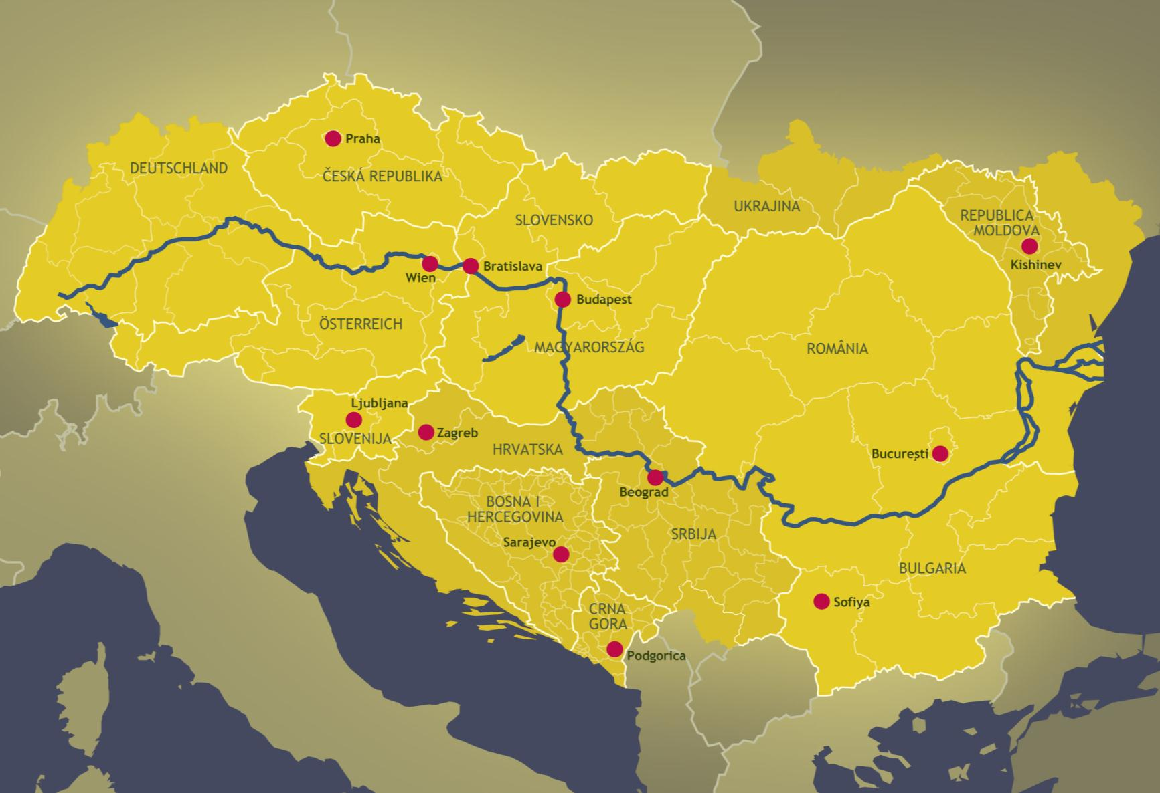

Slide 3

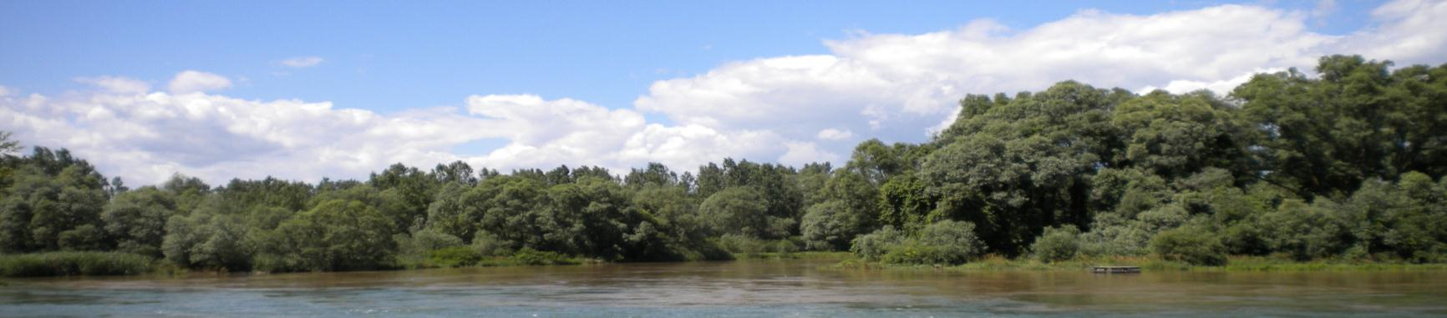
4 PILLARS
3. Building prosperity in the Danube Region
2. Protecting the environment in the Danube Region
1. Connecting the Danube Region
4. Strengthening the Danube Region
4. Strengthening the Danube Region
Annual Stakeholder Seminar of the Pillar II, Budapest, 06. November 2012

Slide 4

PILLAR II:Protecting the environment in the Danube Region
Biodiversity, landscapes, air and soil quality
Water quality
Environmental risks
Annual Stakeholder Seminar of the Pillar II, Budapest, 06. November 2012

Slide 5

Organisation Chart of PA6
Pillar 2: Protecting the Environment in the Danube Region
PA 4 Water Quality
PA 5 Environmental Risks
PA 6 Biodiversity
Close cooperation concerning projects, actors, events, PR
Cooperative approach concerning project labeling, finding appropriate funding programmes
Meetings of PACs according to needs
PA6 Steering Group
Actor
Actor
Actor
Members from all participating countries
Actor
Actor
Actor
Actor
Actor
Actor
PAC Bavaria
PAC Croatia
Project Level
Actor
Actor
Actor
PA6 operative implementation.
Actor
Actor
DG ENV
Carpathian Conv.
Actor
Actor
Actor
DG REGIO
ICPDR
Actor
Actor
Actor
Actor
Actor
Actor
Actor
Actor

Slide 6
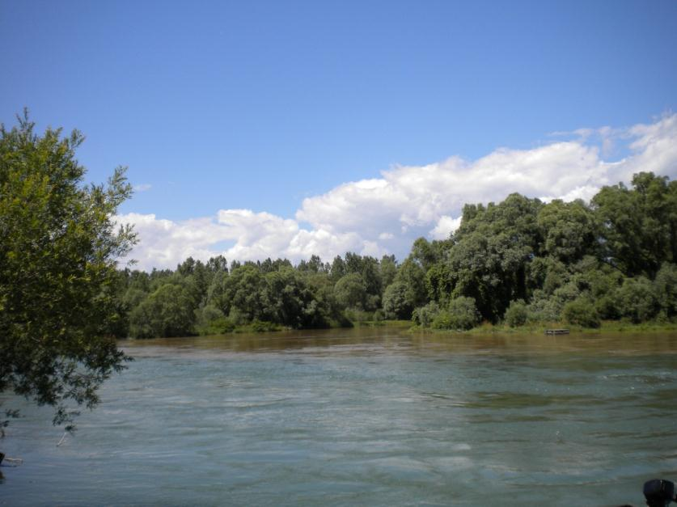
Targets of PA6 Preserving biodiversity, landscapes and the quality of air and soils
To halt the deterioration in the status of all species and habitats covered by EU nature legislation and achieve a significant and measurable improvement, adapted to the special needs of the Danube Region by 2020.
By 2020, ecosystems and their services are maintained and enhanced by establishing green infrastructure and restoring at least 15% of degraded ecosystems, including degraded soils.
By 2020, Invasive Alien Species and their pathways are identified and prioritised, priority species are controlled or eradicated, and pathways are managed to prevent the introduction and establishment of new IAS.
Secure viable populations of Danube sturgeon species and other indigenous fish species by 2020.

Slide 7

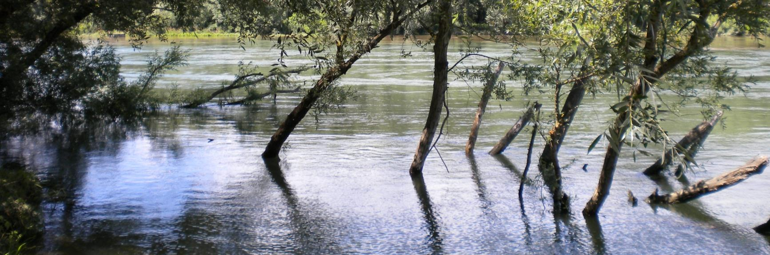
Action Plan for PA6
Preservation of biodiversity and landscapes:
To contribute to the 2050 EU vision and 2020 EU target for biodiversity
To manage Natura 2000 sites and other protected areas effectively
To protect and restore most valuable ecosystems and endangered animal species
To explore together the appropriateness of reviewing the Convention Concerning Fishing in the Waters of the Danube
To develop green infrastructure in order to connect different bio-geographic regions and habitats
To reduce the spread of invasive alien species (IAS)
To decrease the input of pesticides into the environment of the Danube Region
To remove safely obsolete pesticides and other obsolete chemicals in the area of Danube Region
To prepare and implement transnational spatial planning and development policies for functional geographical areas (river basins, mountain ranges etc.)

Slide 8


Action Plan for PA6 (cont.)
Preservation and improvement of the quality of soils:
To ensure appropriate treatment of solid waste
To create standardised and compatible information on land cover on transnational basis
To raise awareness about soil protection
Improvement of air quality:
To decrease air pollutants
Education of people on the value of natural assets, ecosystems and the services they provide:
To raise awareness of the general public, by acknowledging and promoting the potentials of natural assets as drivers of sustainable regional development
To educate children and young people
To build capacities of local authorities in the environment-related matters

Slide 9
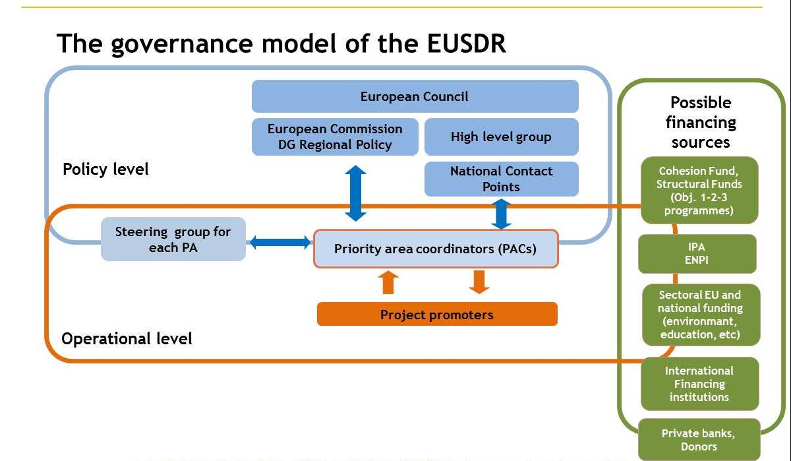
Annual Stakeholder Seminar of the Pillar II, Budapest, 06. November 2012

Slide 10

Labeling procedure
issuing EUSDR Letter of Recommendation for project proposals
or
EUSDR Label for projects that are already financed
Annual Stakeholder Seminar of the Pillar II, Budapest, 06. November 2012

Slide 11
Labeling procedure - Submission
Submission of the description of the project on the joint Project Data Sheet of Pillar II via e-mail to PACs
The Labelling of a project is done through a unanimous decision of the Steering Group; decisions can be taken at meetings or through written procedures
Annual Stakeholder Seminar of the Pillar II, Budapest, 06. November 2012
Notes:
The sheet shall be completed in English and shall be submitted via e-mail to at least one of the two co-coordinators of the concerned Priority Area. Submission of project (idea) descriptions is continuous.

Slide 12
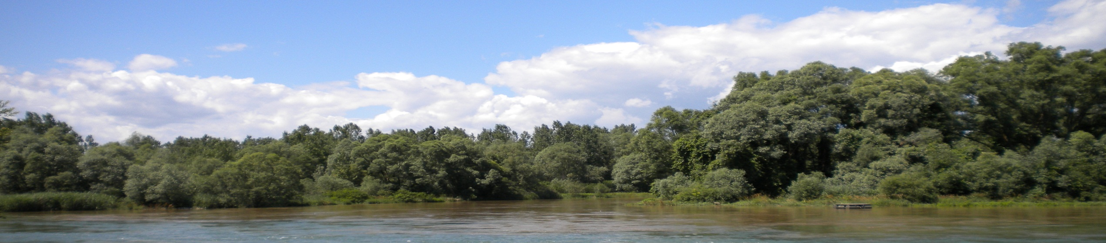
Labeling Criteria
In order to get EUSDR Label, project has to fulfil the following criteria:
The project has a transnational impact on the macro‐region or a significant part of it
The most part of the project, its activities and its related impacts are located in the Danube Region
The project demonstrates measurable benefits for the implementation of the EUSDR
The project is in line with the relevant PA and does not contradict any target of the Pillar II of the EUSDR
The project provides concrete results for the Priority Area concerned
The project application is deemed to be realistic and thus the project proposal could be submitted to relevant funding sources
Notes:
The sheet shall be completed in English and shall be submitted via e-mail to at least one of the two co-coordinators of the concerned Priority Area. Submission of project (idea) descriptions is continuous.

Slide 13
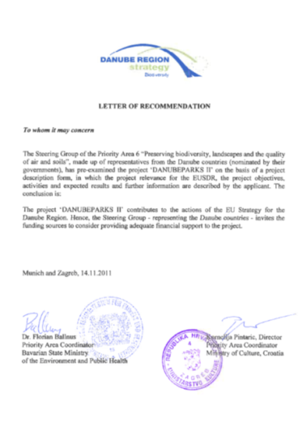
Labeling procedure - Issuing Letter of recommendation
Letters of Recommendation are issued only for new project proposals and in case there is a favourable decision for the project
They will be sent by the Priority Area Coordinators to the contact person of the Lead Applicant indicated in the Project Data Sheet in order to be submitted with the application for financing to the chosen funding source
Annual Stakeholder Seminar of the Pillar II, Budapest, 06. November 2012
Notes:
The sheet shall be completed in English and shall be submitted via e-mail to at least one of the two co-coordinators of the concerned Priority Area. Submission of project (idea) descriptions is continuous.

Slide 14
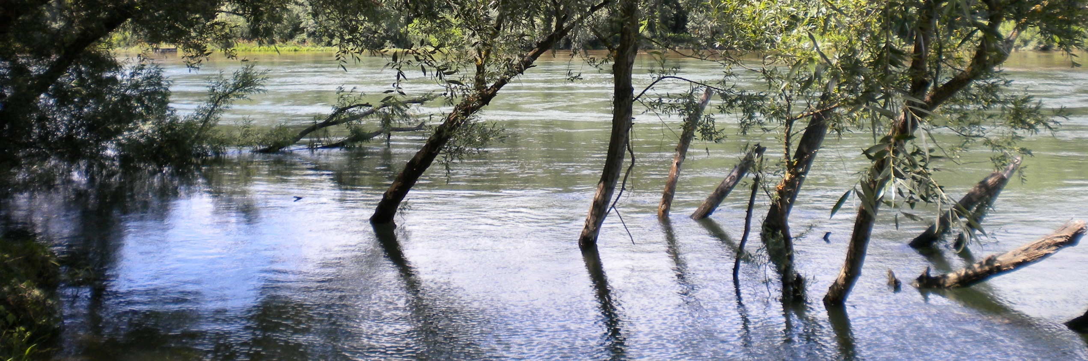
Labeling procedure - Issuing Letter of recommendation
The Letter of Recommendation does not automatically imply that financing is granted to the project… ☹
In order to get financing projects must comply with the governing rules of the financing source and must successfully pass the specific evaluation phases.
Projects which have been already financed and/or labelled shall not receive a Letter of Recommendation. In case it is needed Lead Partners can ask for a “Letter of Acknowledge­ment”.
Notes:
The sheet shall be completed in English and shall be submitted via e-mail to at least one of the two co-coordinators of the concerned Priority Area. Submission of project (idea) descriptions is continuous.

Slide 15




Looking forward to the new project proposals
Contacts
EUSDRbiodiversity@mzoip.hr
florian.ballnus@stmug.bayern.de
www.mzoip.hr
www.zastita-prirode.hr
www.stmug.bayern.de
www.danube-region.eu
Activity is supported by by European Union
2011CE160AT093

Slide 16
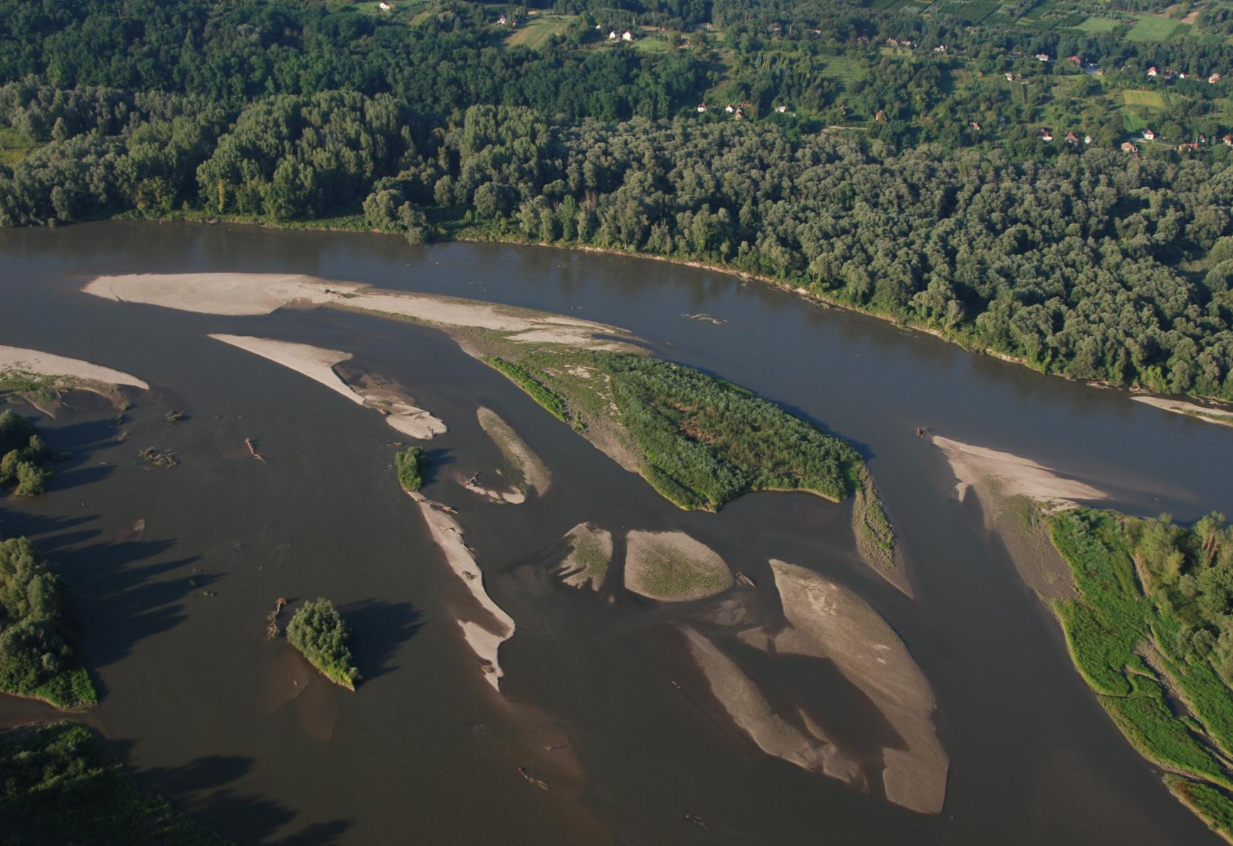
THANK YOU FOR YOUR ATTENTION

