Slide 1
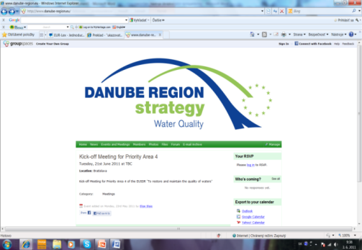
Hungarian Water Management and the EU Danube Regional Strategy
Mr. Péter Kovács
State Secretary for Water
Annual Stakeholder Seminar of Pillar II. – Protecting the Environment - of the EU Strategy for the Danube Region
06 November 1012. Budapest

Slide 2
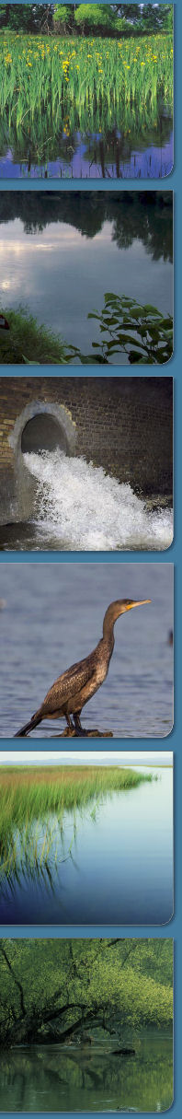
Water is a natural resource of strategic importance from social, environmental and economic aspects
fundamental ingredient of our biological life (healthy and safe drinking water and food supply),
secures water related ecology (nature conservation, ecological services)
basic for agriculture and forestry
environmental precondition for several industrial and service activities
in some countries it is an environment safety factor and a renewable source of energy
Protection and utilization of water resources and adaptation of sustainable water management response strategies, reduction of pollution have become a crucial factor in sustainable development at local, regional, national and global level

Slide 3
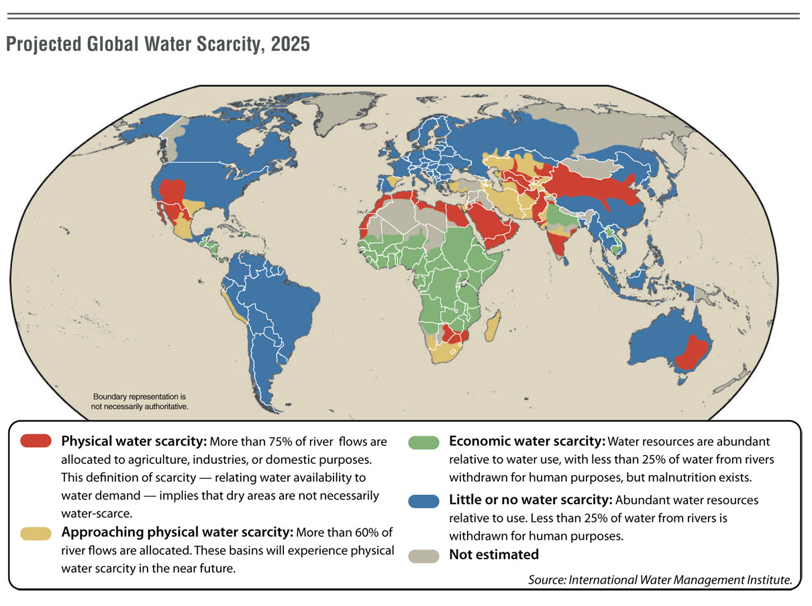
WATER SCARCITY PROBLEMS IN THE WORLD

Slide 4
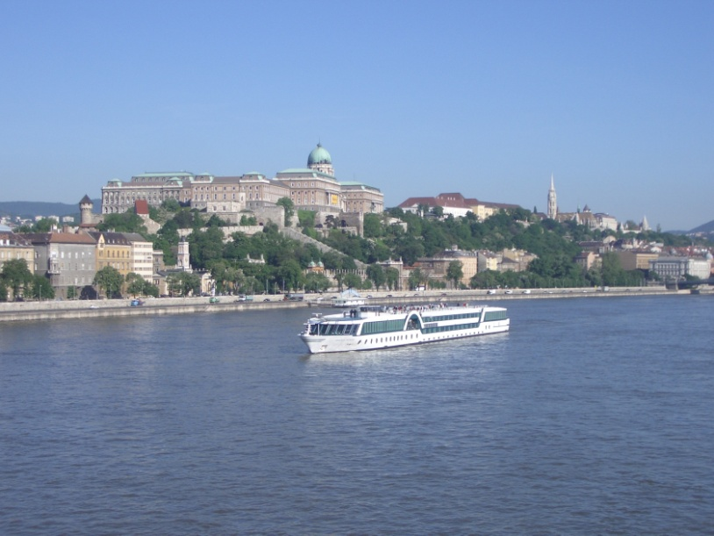
Structure of the Danube Region Strategy
Connecting the Danube Region
(1) improving mobility -
1a (inland navigation) – AT, RO;
1b (rail, road air) – SI, SRB
(2) encouraging sustainable energy – CZ, HU
(3) promoting culture and tourism – BG, RO
Protecting the environment in the Danube Region
(4) restoring water quality – HU, SK
(5) managing environmental risks – HU, RO
(6) preserving biodiversity – GE, CRO
Building prosperity in the Danube Region
(7) developing research capacity – SK, SRB
(8) education and information technologies, supporting
the competitiveness of enterprises - DE, CRO
(9) investing in people’s skills – AT, MD
Strengthening the Danube Region
(10) stepping up institutional capacity, and cooperation of institutions – AT, SI
(11) improving cooperation to tackle organised crime, security – DE, BG
Adaptation of the DRS at Council meeting 23 June 2011.

Slide 5
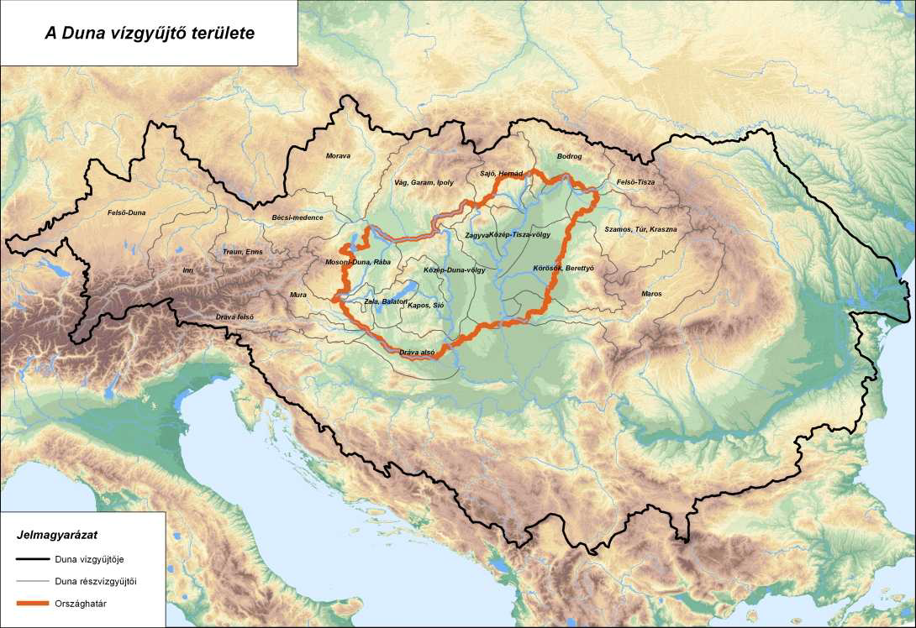
Hungary 100 % - in the Danube River Basin

Slide 6
International co-operation in the water sector
Bilateral co-operation
Transboundary (neighbouring countries)
With other countries
Multilateral co-operation
International Conventions
(Helsinki, Danube,etc.)
EU Danube Region Strategy
European (Union) level co-operation
Common working platform (27 Member States)
Common basic legislation
Help in implementation process:
Investment funds, projects
Twinning Projects, etc.
EU Danube Region Strategy
Global level water co-operation

Slide 7
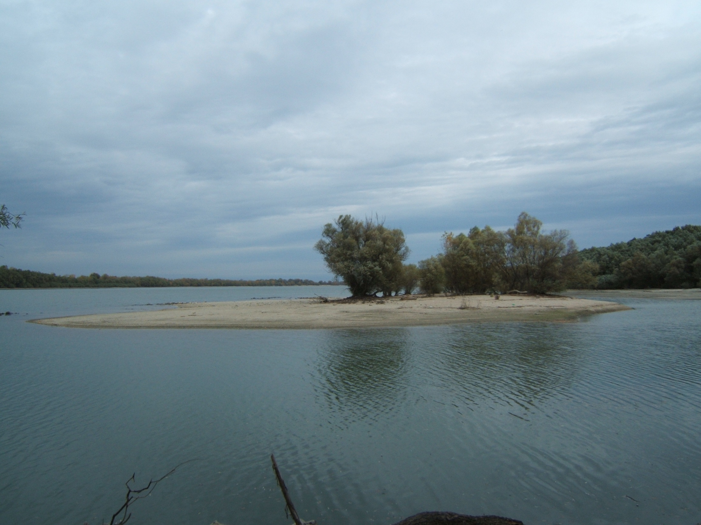
Main functions of the Danube river:
Ecology, green corridor
Flood plain area
Recreation
Water resource
Wastewater recipiens
Energy resource
Transport way

Slide 8
Main drivers, pressures and impacts on waterbased ecosystems
Drivers: energy production, flood control, navigation, developments in industry and agriculture, urbanization and other infrastructural developments
Pressures: construction of dams, weirs, ports, river
diversion and regulation, irrigation, water abstraction, wastewater discharge, canalisation, shoreline protection
Impacts: changes in hydro-morphological conditions, horizontal and longitudinal ecosystem discontinuity of water courses, disappearing floodplains, degraded shoreline ecosystems, increased chemical loads

Slide 9
Danube River Protection Convention
Legal frame for cooperation to assure protection
of water and ecological resources and
their sustainable use in the Danube River Basin.
Signed: 29 June 1994, Sofia
The main objectives of the Convention:
- sustainable and equitable water management
- conservation and rational use of surface and groundwater
- contol of hazardous substances originating from accidents
- control of floods and ice-hazards
- reduction of pollution loads of Black sea
Notes:
Despite the differences the countries signed the DRPC in 1994.

Slide 10















ICPDR Delegations of Contracting Parties
ICPDR Secretariat
IMGIS EG
ad hoc S EG
Information Management & Geographical Information System
ad hoc Strategic
PP EG
RBM EG
River Basin Management
Public Participation
Flood EG
PM EG
Flood Protection
Pressures & Measures
MA EG
APC EG
+ Task Groups
Monitoring & Assessment
Accident Prevention/Control
Notes:
The ICPDR consists of the delegations of its contracting parties and the EU. This panel meets twice a year, once in December, once in June. It is supported in operative issues by the permanent secretariat, which has about 12 members of staff. In addition, there are currently seven expert groups and several task groups for specific topics. The expert groups draw their members from the contracting parties, typically the relevant ministries of countries. Expert groups meet twice or three times a year.

Slide 11

















„Observers”
Black Sea Commission
Die Donau –
Tourism Commission
Navigation Commission
Friends of Nature
Europ. Angling Ass.
GWP CEE
UNESCO - IHP
REC
VGB Power Tech
Notes:
Wide range of observers
17 spanning from NGOs, business associations, scientific institutions
We spent a lot of effort in the last years to enhance the cooperation and to establish good working relation with stakeholder groups – actually based on a stakeholder analysis

Slide 12
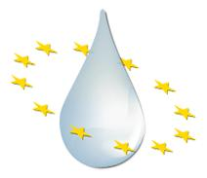
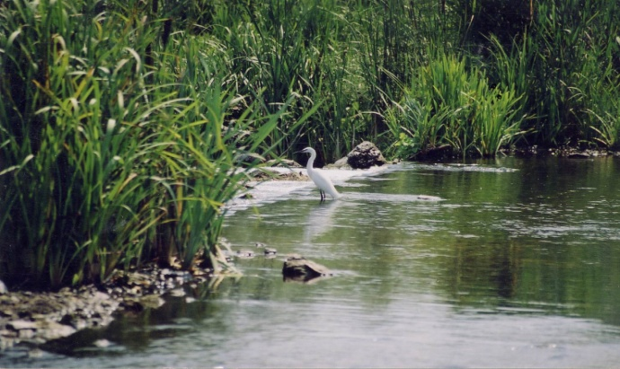
ICPDR and the
EU Danube Region Strategy
Connecting the Danube Region
(1) improving mobility -
1a (inland navigation) – AT, RO;
1b (rail, road air) – SI, SRB
(2) encouraging sustainable energy – CZ, HU
(3) promoting culture and tourism – BG, RO
Protecting the environment in the Danube Region
(4) restoring water quality – HU, SK
(5) managing environmental risks – HU, RO
(6) preserving biodiversity – GE, CRO
Building prosperity in the Danube Region
(7) developing research capacity – SK, SRB
(8) education and information technologies, supporting
the competitiveness of enterprises - DE, CRO
(9) investing in people’s skills – AT, MD
Strengthening the Danube Region
(10) stepping up institutional capacity, and cooperation of institutions – AT, SI
(11) improving cooperation to tackle organised crime, security – DE, BG

Slide 13
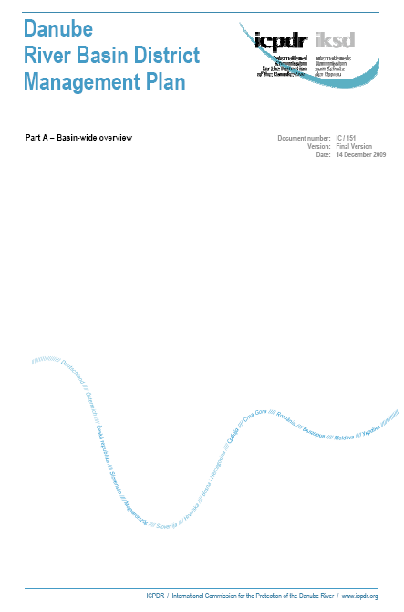
ICPDR and the
EU Water Framework Directive
Implementation legal requirement for 8 EU Member States
Political commitment of 6 Non-EU Member States to work towards a coordinated Danube River Basin Management Plan
Milestone: Adoption of 1. Danube River Basin District Management Plan according to WFD requirements in December 2009

Slide 14
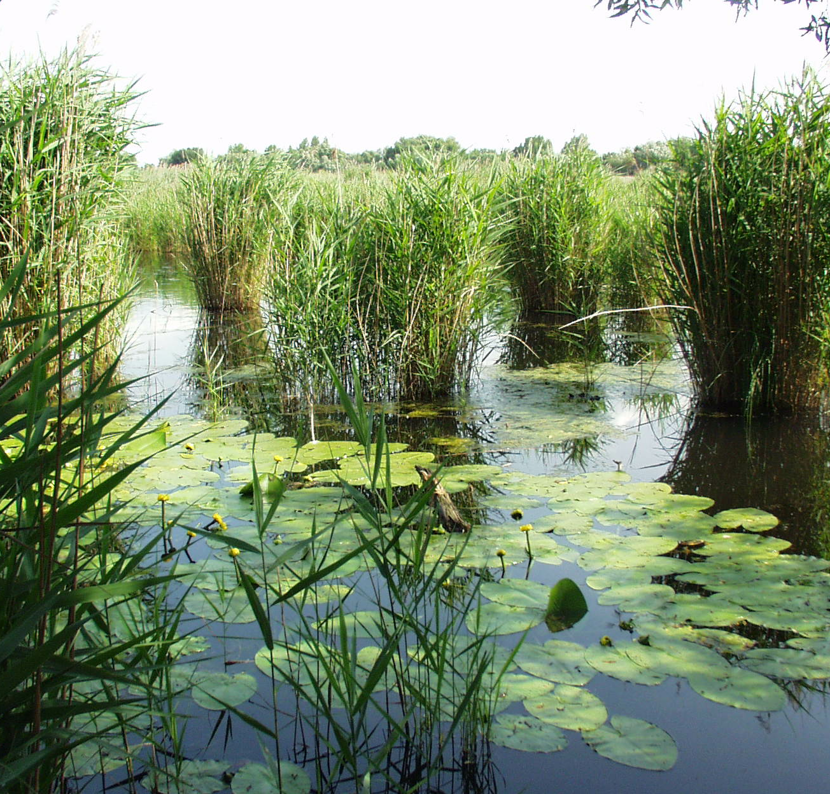
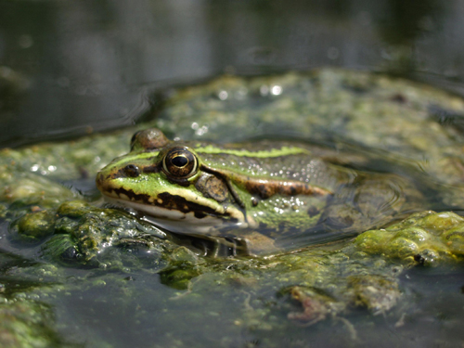
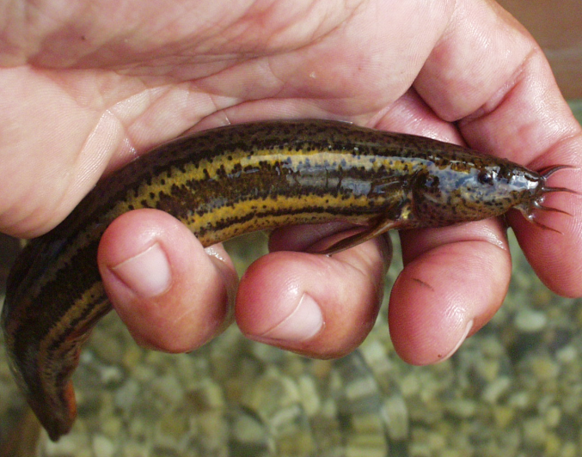
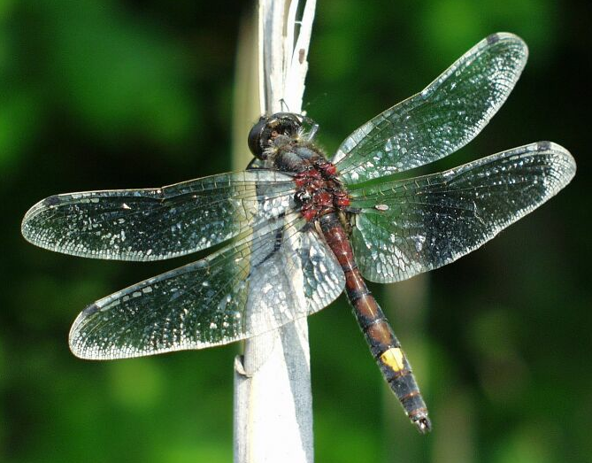
Water Framework Directive
„Directive 2000/60/EC of the European Parliament and of the Council of 23 October 2000 establishing a framework for Community action in the field of water policy”

Slide 15
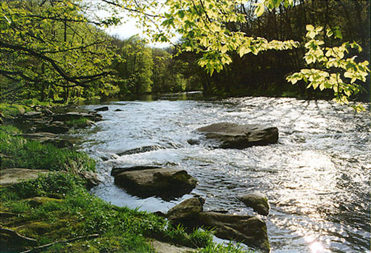
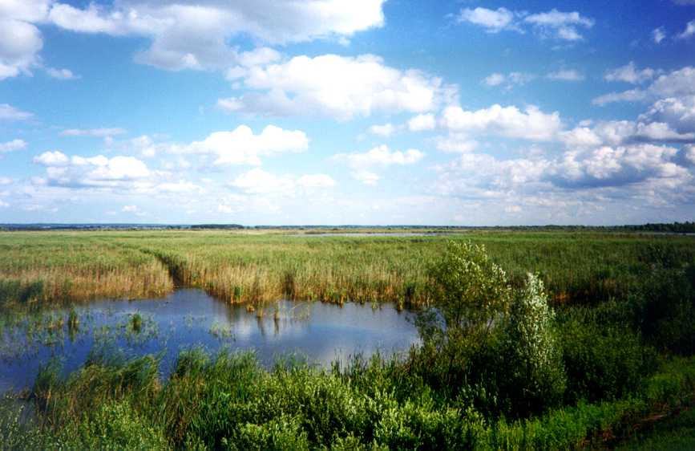
General objective: good status of water bodies by 2015
surface waters:
good ecological status
good chemical status
sub-surface waters:
good quantitative status
good chemical status
Main tools - RBMP’s , Programmes of Measures

Slide 16
Main steps of implementation of WFD
Report from implementation (Art.15)
Revise
SWI
Revise RBMP
Previous status assessment
(Art. 5. and 6.)
Environm. objectives (Art.4)
Assessment, Preparation
2004
Monitoring programes
(Art. 8)
2013
2015
Implement. of program of measures
2006
2012
Public
Participation
(Article14)
2009
Gap-analysis
River Basin Management Plan (RBMP) (Art. 13, Annex VII)
Programe of measures (Art. 11)

Slide 17
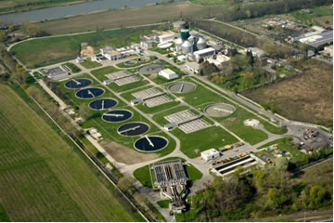
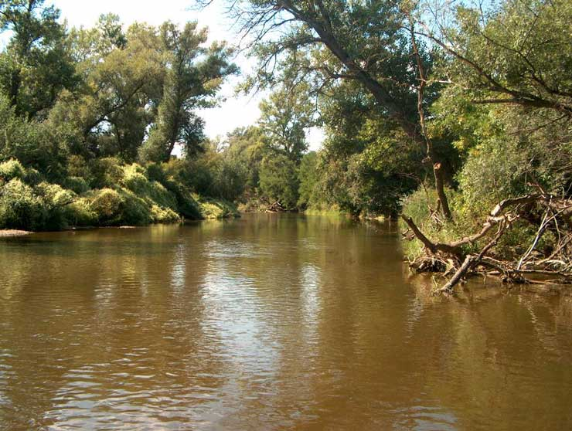
Program of Measures
Basic measures:
Waste water treatment program
Drinking water quality improvement
program
Pollution reduction programs
Nitrate action programs
Natura 2000
Additional measures:
Remediation projects
Protection of drinking water resources
River bed rehabilitation program
Excess surface water management
……..

Slide 18
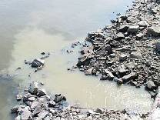
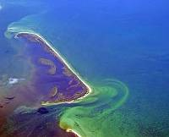
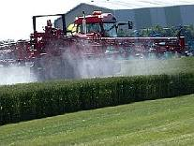
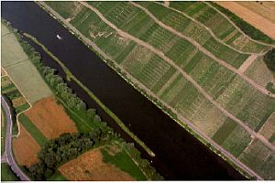
Significant water management issues on Danube level
Organic Pollution
Nutrient Pollution
Hazardous Substances Pollution
River and Habitat Continuity Interruptions
Disconnection of Adjacent Wetlands/Floodplains
Hydrological Alterations
Hydromorphological Alterations
Future Infrastructure Projects

Slide 19
Organic pressures (decreasing O₂ content)
• unsuitable urban wastewater treatment
• bad practice of animal & fish farming
Nutrient pressures (eutrophication)
unsuitable agriculture practices
uncontrolled fertilizer uses
contaminated internal water intake
agricultural activity close to the rivers
• inappropriate urban wastewater treatment
Hazardous substances
unsufficient pre-treatment
historical pollution
bad agricultural practice

Slide 20
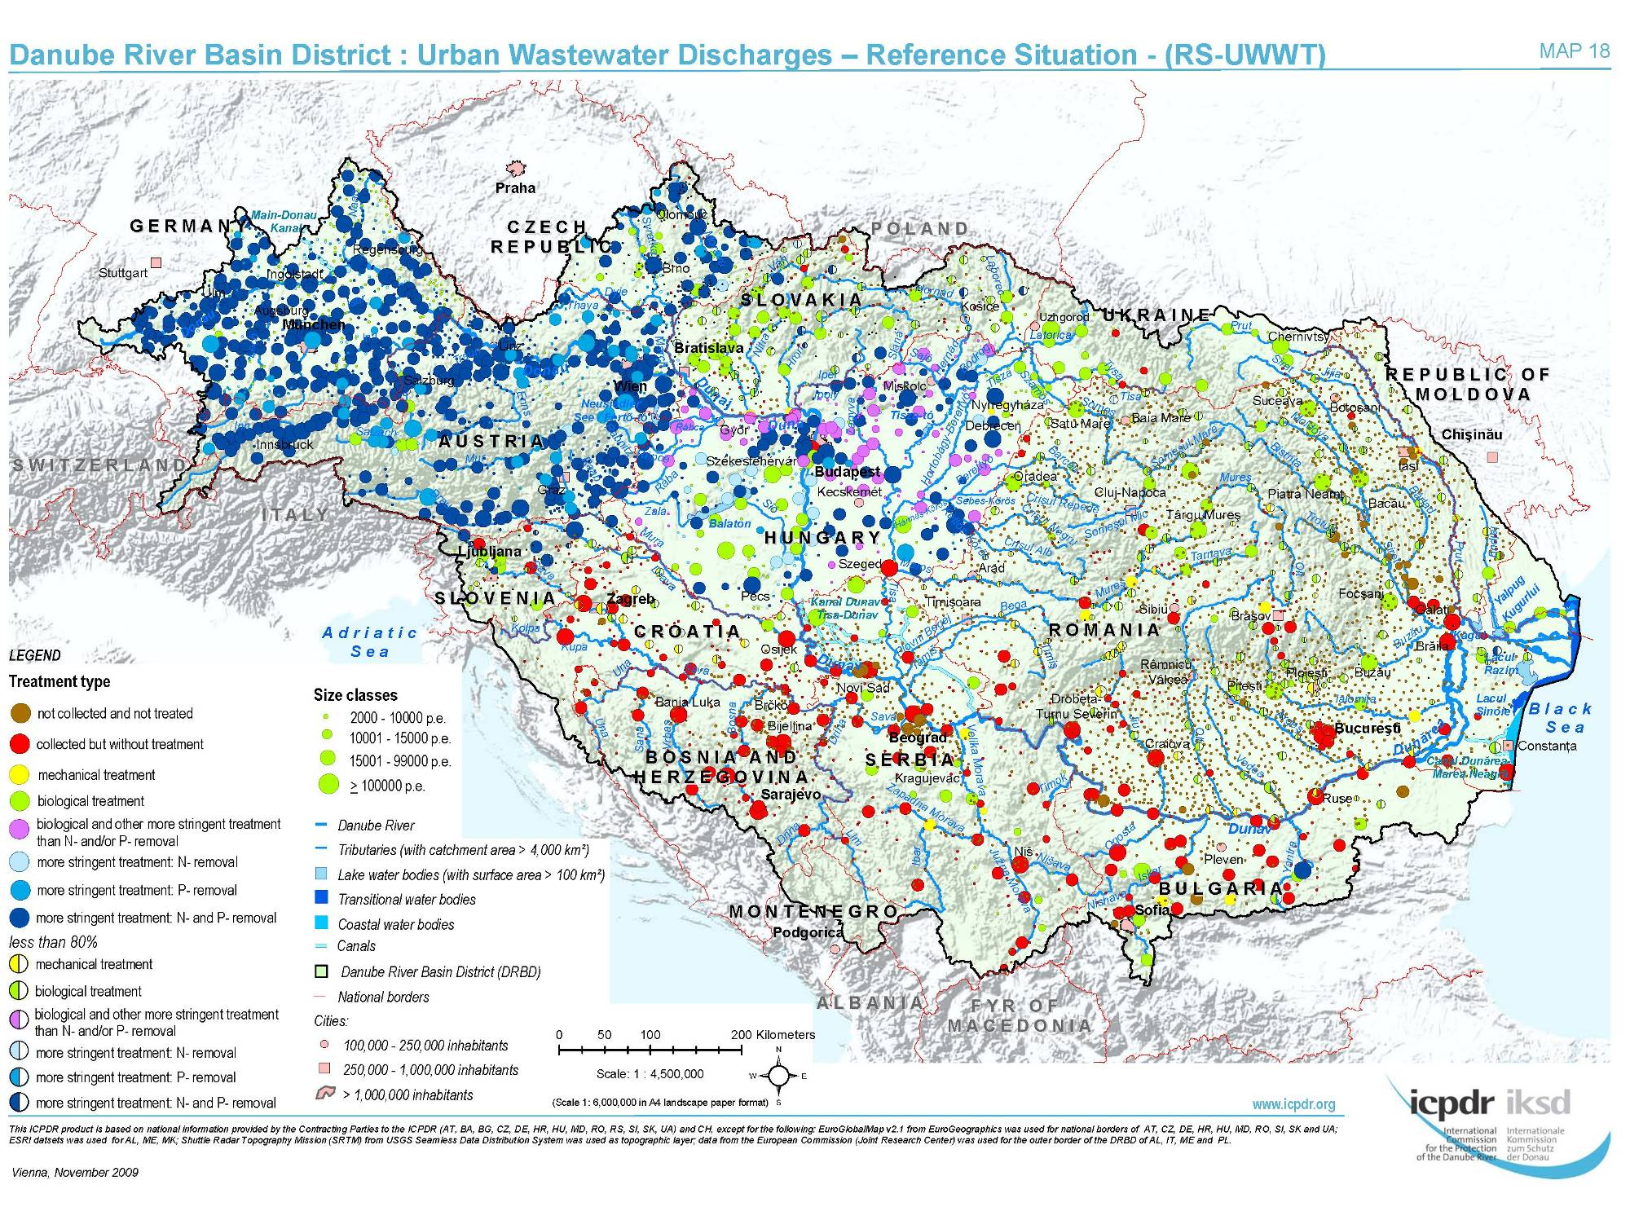
Notes:
Municipalities generate around 60% of the wastewater discharge in the Danube River Basin, and much of this wastewater is released into rivers not sufficiently treated. Inadequate treatment of municipal wastewater has been identified a severe problem in the Danube River Basin. Among other measures, the ICPDR encourages that more nutrients are removed from municipal wastewaters in wastewater treatment plants and water pollution from landfills must be prevented. Until 2015, many plants will be modernised or newly built according to the River Basin Management Plan.

Slide 21
Natural values along the Danube
The whole Hungarian Danube section is part of the Natura 2000 network
Many endemic species and valuable habitats are living in the river and the connected areas
Planning of projects, assessment and consultation have not always been carried out in an integrated way
Conflicts due to infrastructure development and riverbed modification, intensified traffic on rivers causing disturbance of waterfowl/fish and wave effects …

Slide 22
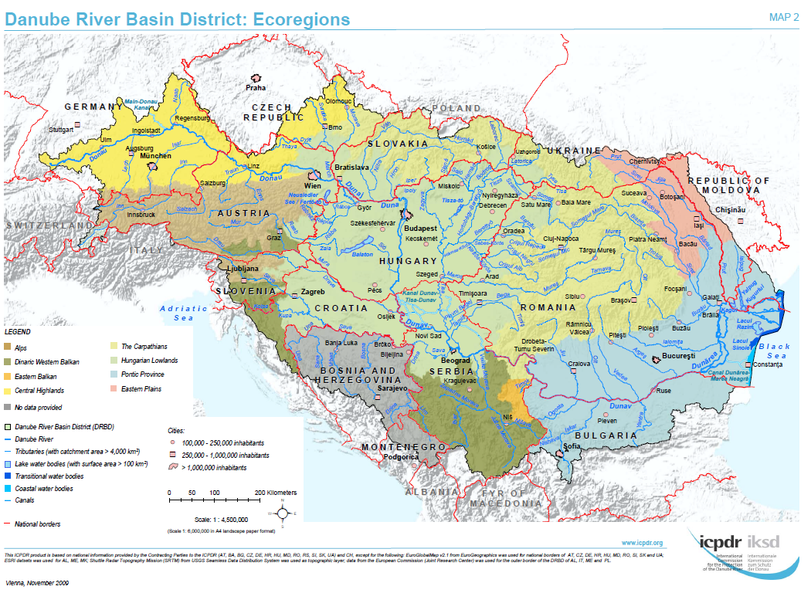

Slide 23
Implementation of EU legislation
Water Framework Directive
No deterioration for all water bodies, also relevant for water dependant protected areas (floodplains, wetlands, delta), tests for new modifications, polluter pays, public participation)
Birds and Habitat Directives
Habitats and species affected
SEA/EIA directives
Conventions
Danube River Protection Convention
Bern Convention
Ramsar Convention
Espoo Convention
World Heritage Convention

Slide 24
Ecological status & ecological potential in the Danube River Basin (catchment areas > 4,000 km²)
In relation to total length of river water bodies
22% ecological status/potential good or above
53% ecological status/potential moderate or worse
25% no data
Ecological status and ecological potential for river water bodies in the DRBD indicated as length (km) and relation to total length of river water bodies

Slide 25
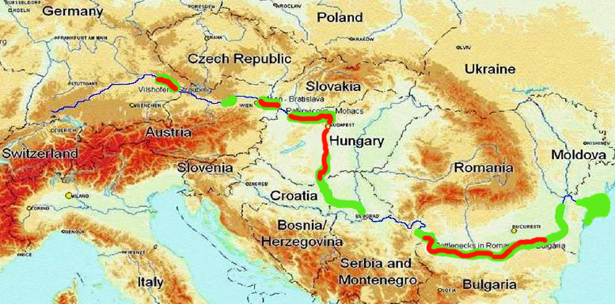
The Danube
areas of high ecological value
priority sections for inland navigation (EU TEN-T axis No 18)
other navigation projects (supported e.g. by EU EAR, ISPA, Ukrainian government)

Slide 26
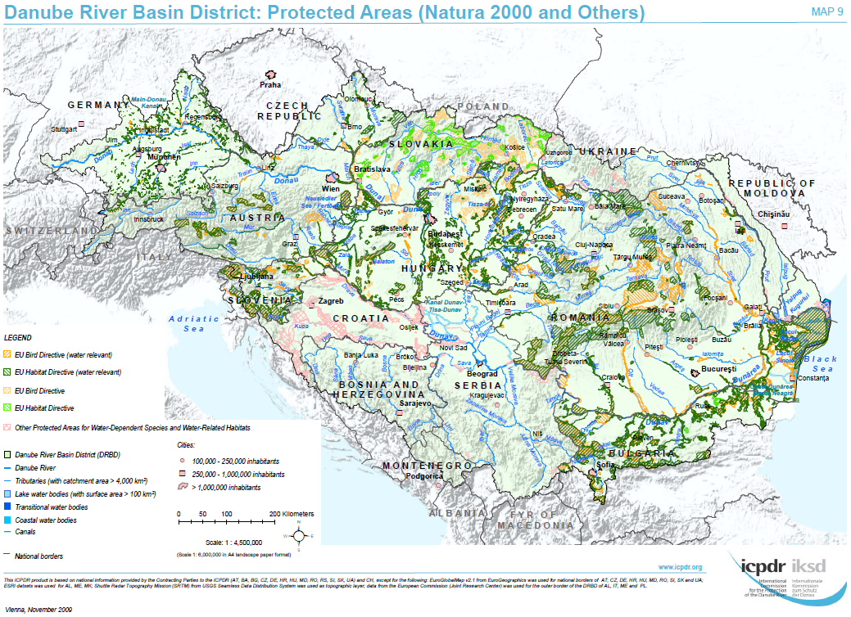

Slide 27
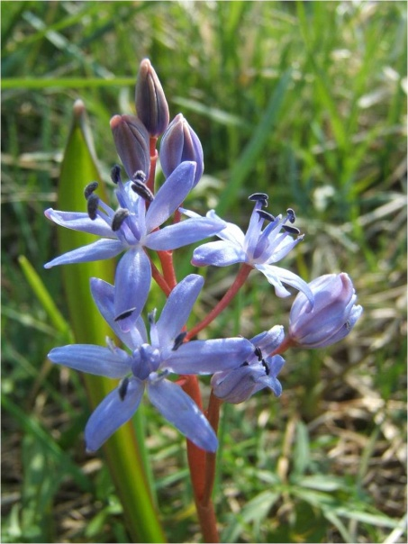
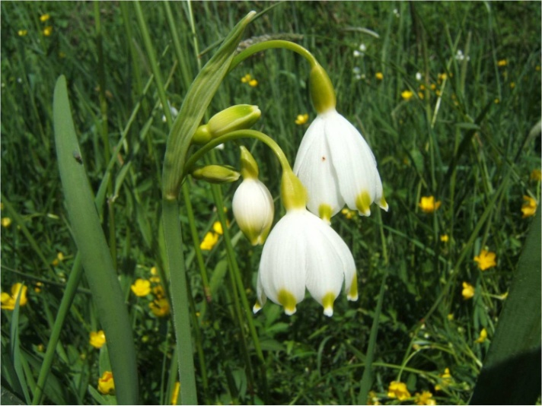
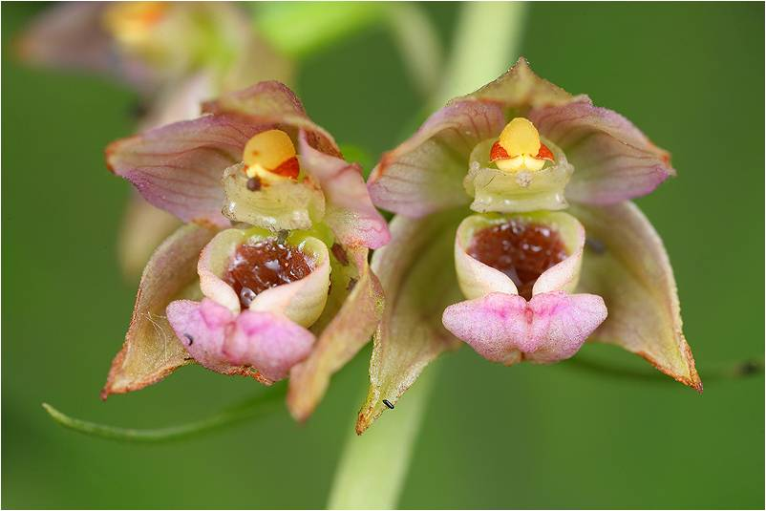
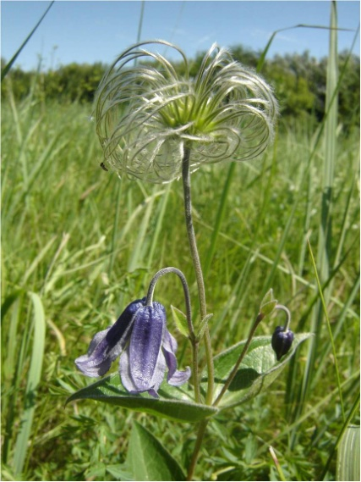
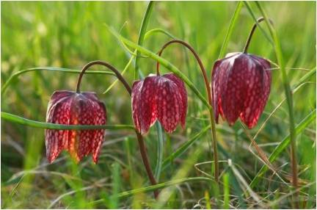
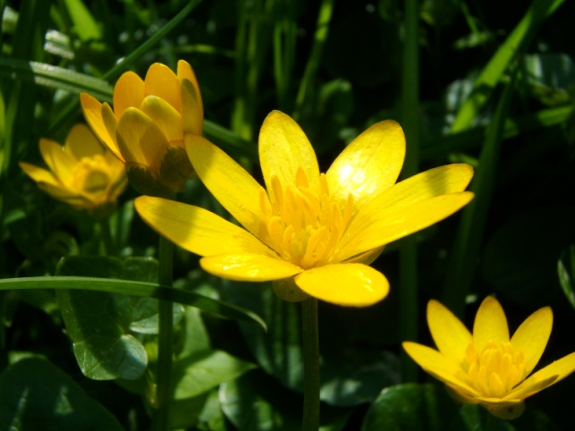

Slide 28
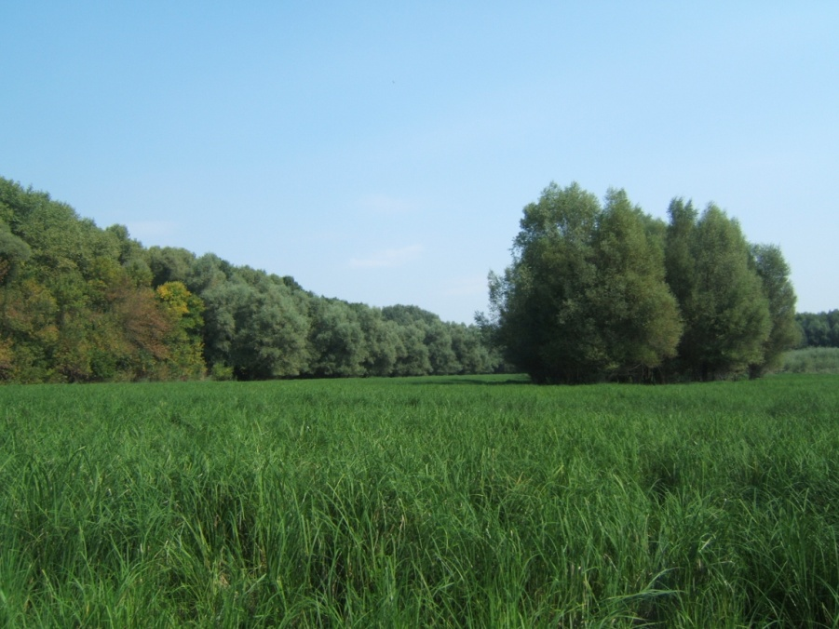
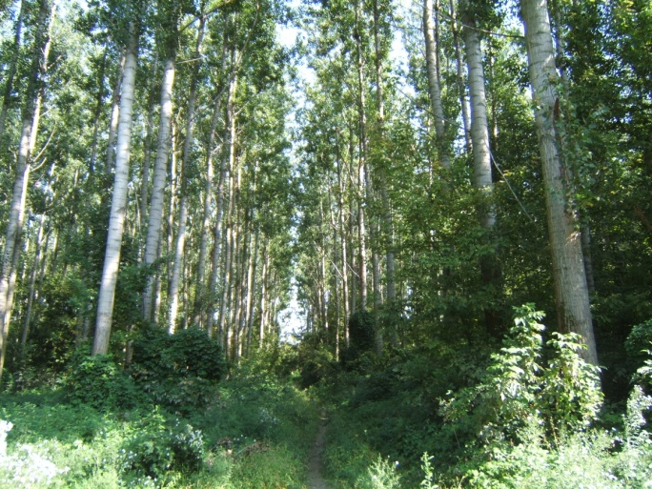
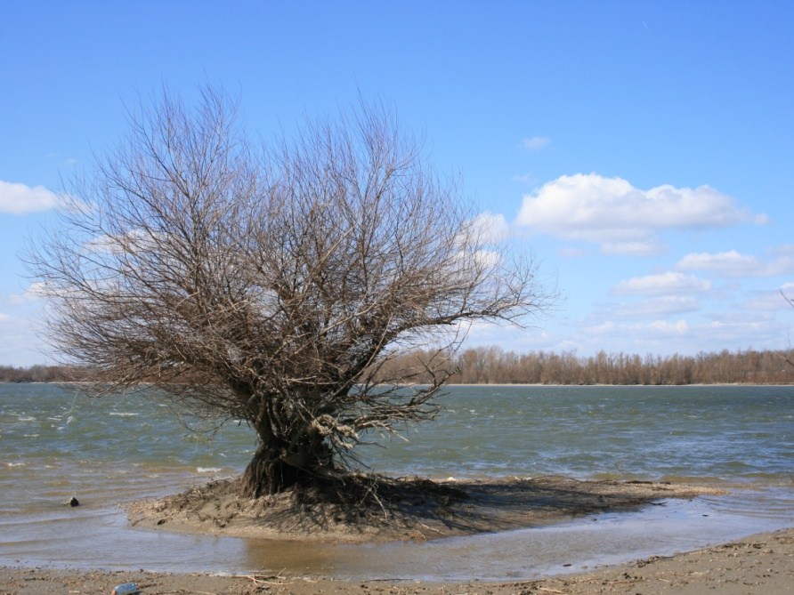
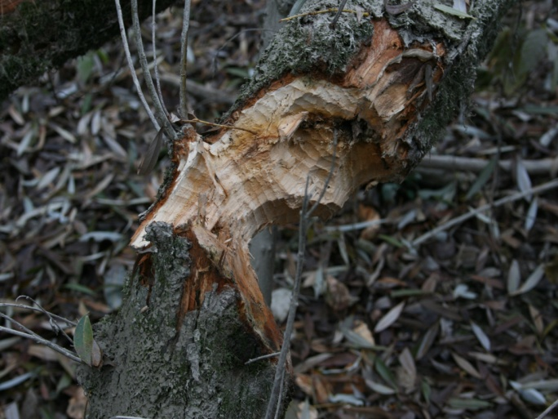

Slide 29
Disconnected Wetlands/Floodplains
612,745 ha of wetlands/floodplains with reconnection potential
62,300 ha reconnected and/or the hydrological regime improved by 2015

Slide 30
Current problems in river conservation
Regulation works on the Danube in the 19th century for navigation, flood protection
- concrete and stone embankments, groynes
- separated river-branches => silting and drying
- dredging in the main stream
- scouring riverbed => deepening water-level (main stream)
- deepening underground water-level
=> speeding up the habitat changes
=> drying habitats
=> spreading invasive alien species
Sediment deficit due to hydropower dams upstream
=> scouring riverbed => deepening water-level
Long flood protection dikes => shrinking riverine forests
Sand and river-gravel exploitation
Deforesting the native forests
Forestation with cultivar plants
Climate change (extreme participation or extreme dry seasons)

Slide 31
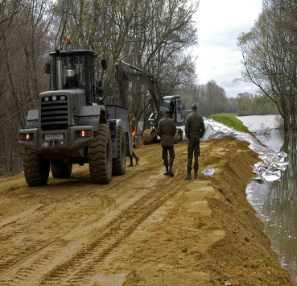
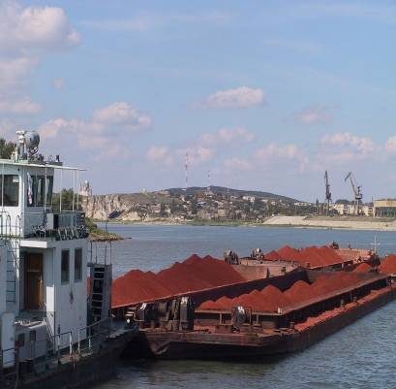
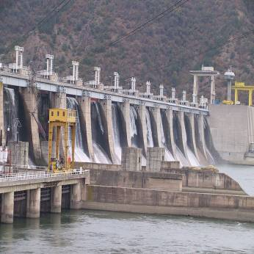
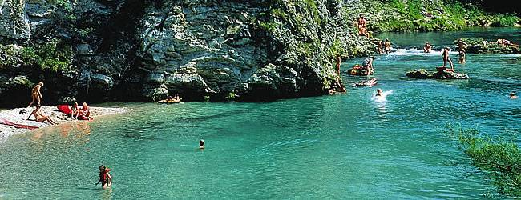
Hydromorphological Alterations
Key Drivers
Hydropower generation
Navigation
Flood defence
Water supply
Other Drivers
Recreation
Urban planning
Agriculture

Slide 32
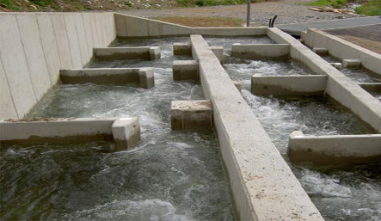
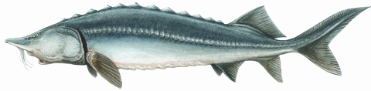
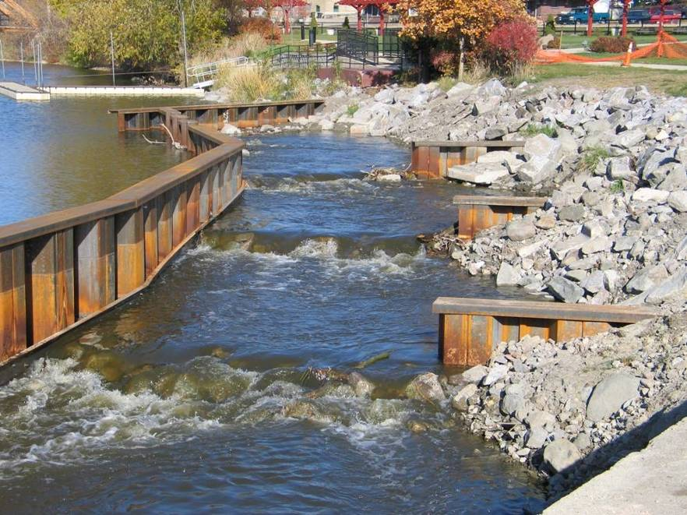



Connectivity & Fish Migration
Source: www.biotactic.com
Notes:
Migratory fish species, such as sturgeons or Danube Salmon, are good indicators of the ecological condition of the entire Danube River Basin. The Danube itself as well as its tributaries are key migration routes. Through test sites and best practice cases, the ICPDR fosters the development of fish passes, wetland reconnection and habitat protection. This has a positive effect not only on fish populations, but also on landscape diversity and biodiversity.

Slide 33
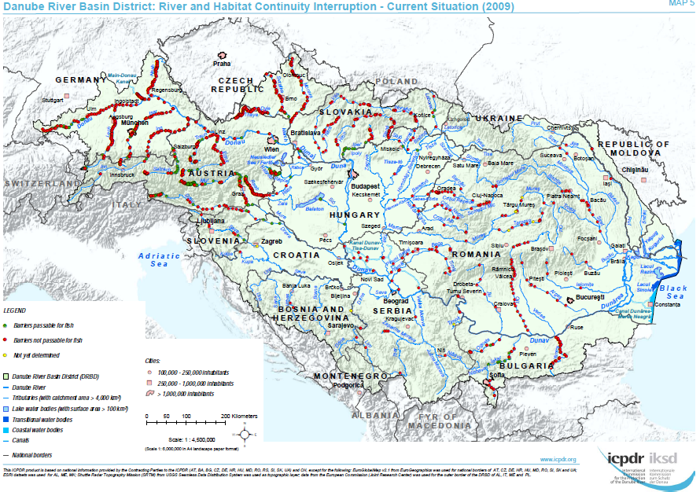

Slide 34
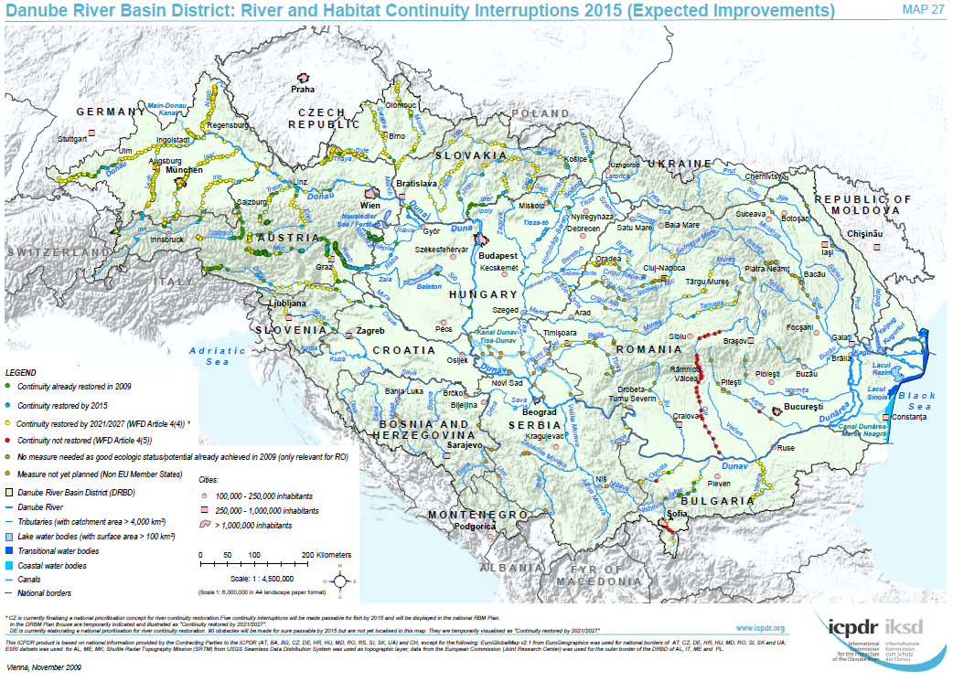

Slide 35

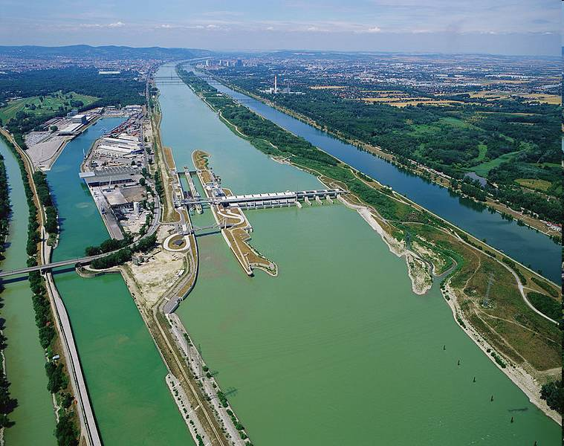
Future Infrastructure Projects
Future Infrastructure Projects (FIPs) can impact and deteriorate water status, including potential negative transboundary effects
FIPs reported for navigation, flood protection, hydropower generation, water supply and others,

Slide 36


NAVIGATION Joint Statement and Platina Manual
Guiding Principles for the Development of
Inland Navigation and Environmental Protection in the Danube River Basin
Manual on Good Practices in Sustainable Waterway Planning (Platina Manual)
http://www.naiades.info/platina/downloads

Slide 37
Need for inter-sectoral cooperation recognized by Danube countries in order to achieve coherent implementation of EU legislation
Work on cooperation regarding navigation already ongoing; process on hydropower launched
Exchange and cooperation between sectors pre-requisite for successful implementation of different policies (energy, climate, nature conservation, environment) and achievement of defined objectives
Creation of win-win situations and benefits for all actors involved

Slide 38
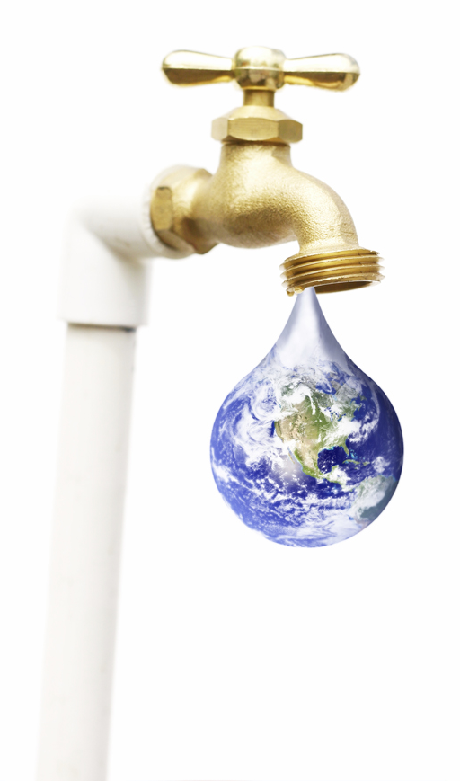
Way forward - Future of water policies
The world, Europe, Danube basin and Hungary facing with new water challenges:
We are looking for steps further…
World Water Forum
(Marseille, March 2012)
Rio+20 Conference
(Rio de Janeiro, 20-22 June 2012 )
Blueprint to Safeguard Europe's Water Resources - Future of EU water policy
(2012)

Slide 39
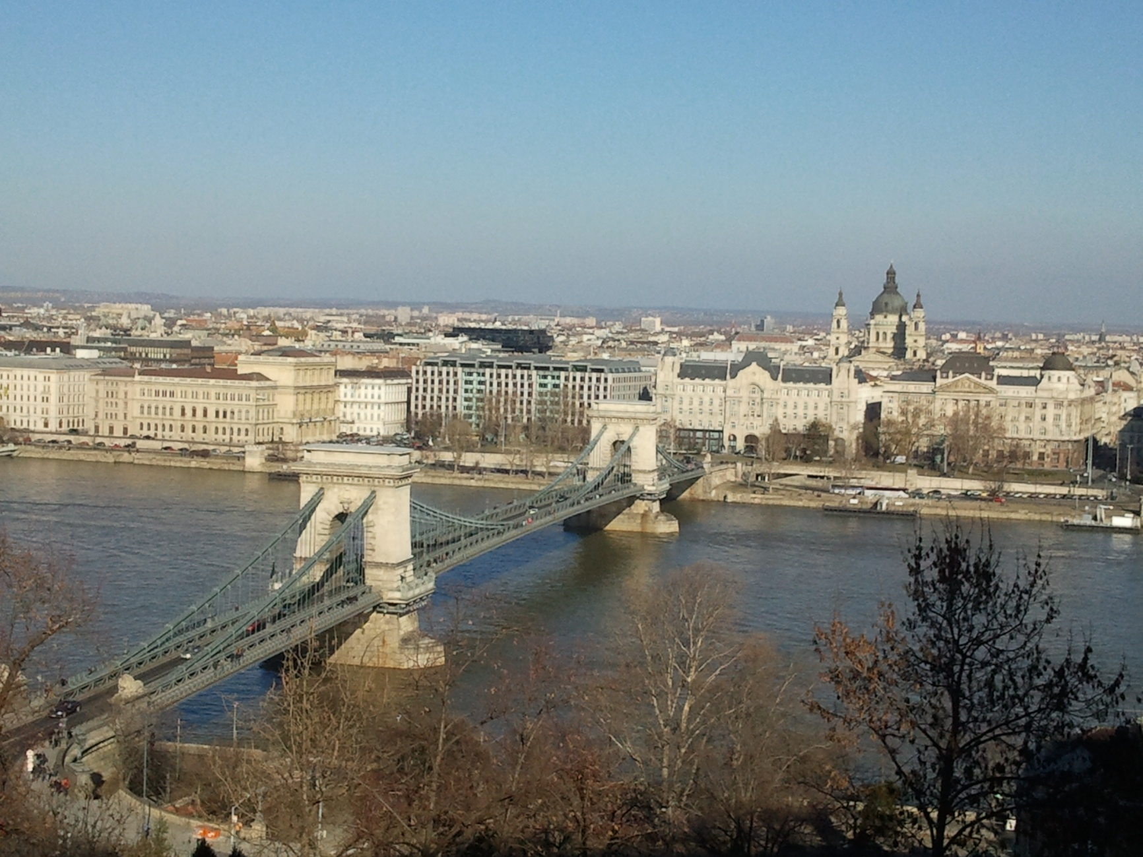
Thank you for your kind attention !

