Slide 1

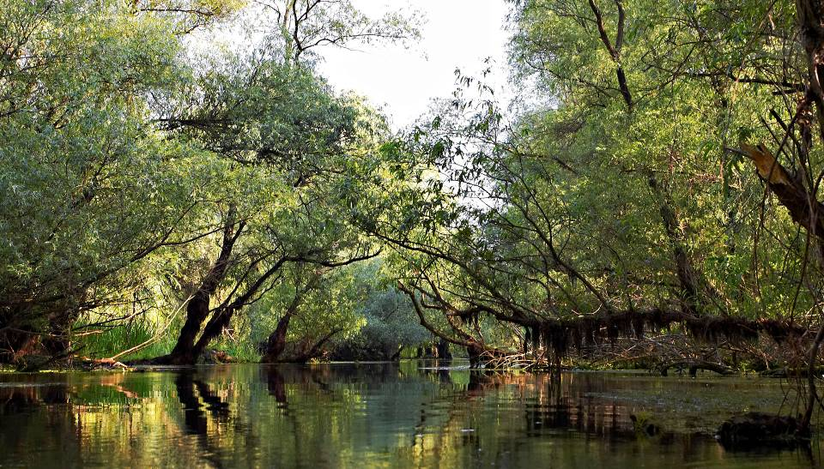
Biodiversity integration
under the EUSDR
Sturgeon conservation and other examples of integrating biodiversity issues into different EUSDR priority areas
Laurice Ereifej, WWF CEE
Annual Stakeholder Seminar of the Pillar II; EU Strategy for the Danube Region, 2012.11.06. Budapest

Slide 2
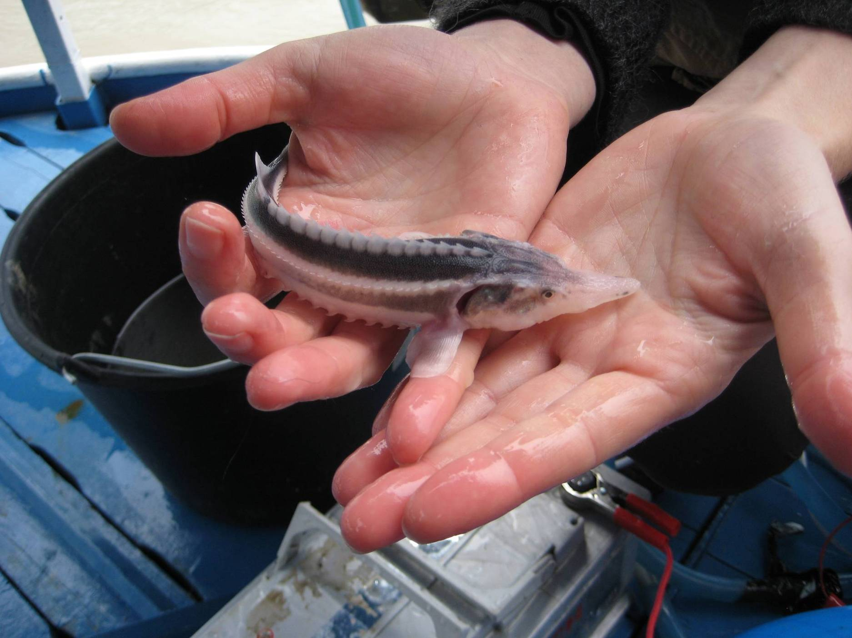
1
Sturgeon conservation
(PA6)
6. November 2012.

Slide 3
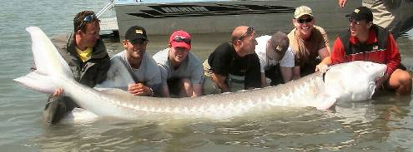
Why Sturgeon conservation?
Indicators of “healthy” river ecosystem
Unique value for EU biodiversity:
6 native species in Danube basin: 1 extinct, 1 near extinction, 3 critically endangered, 1 vulnerable (IUCN)
High scientific value:
“living fossils”, over 200 million years old;
can get over 100 years old;
weigh: 1.5 t and length: 5 m
High economic value
for fishing communities/
hatchery owners
6. November 2012.

Slide 4
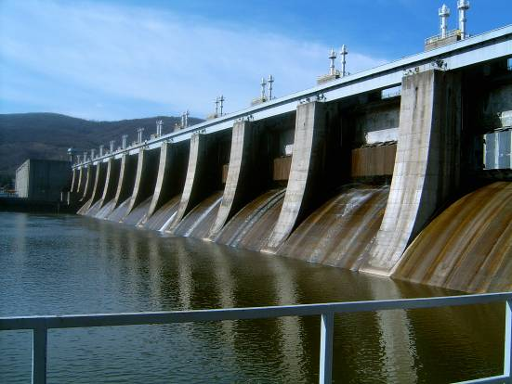
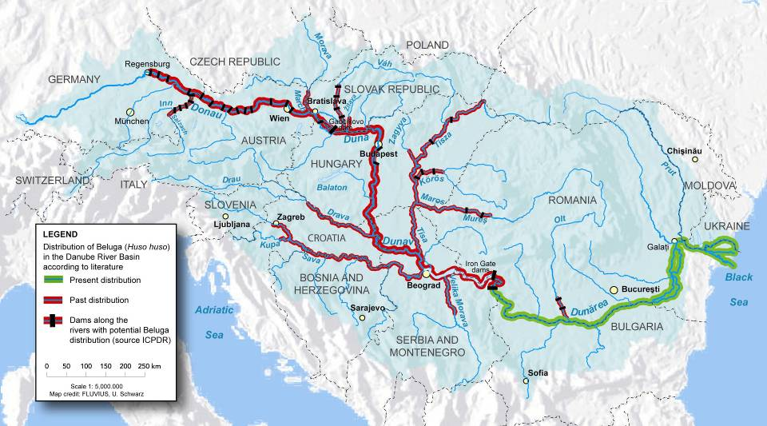

Which problems to tackle?
Habitat loss
dams (in particular Iron Gates) / cut off side-arms ➔ migration barriers ➔ reduced carrying capacity
6. November 2012.

Slide 5

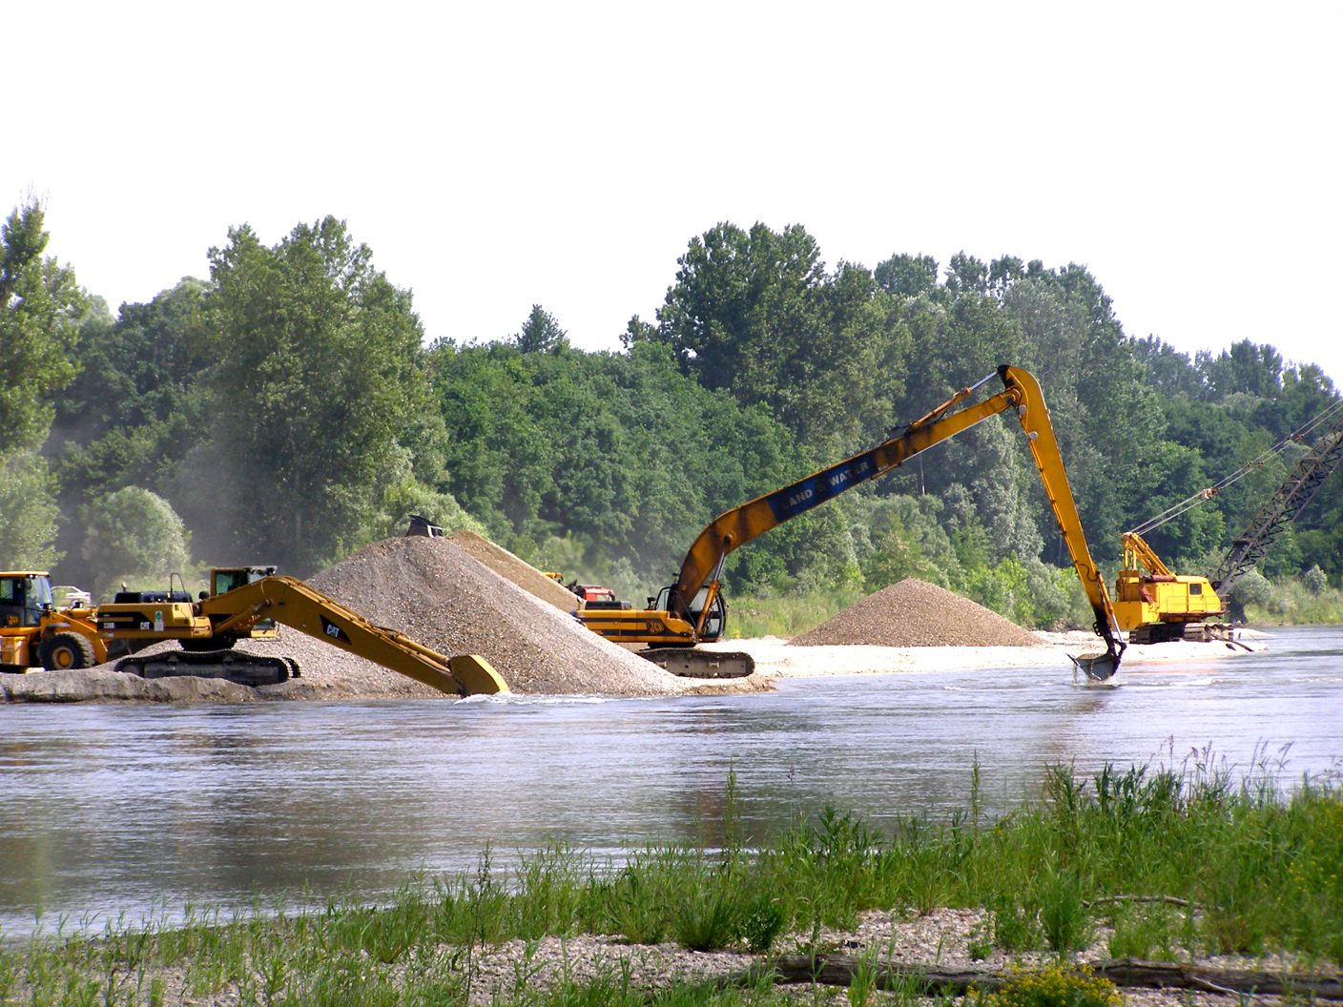
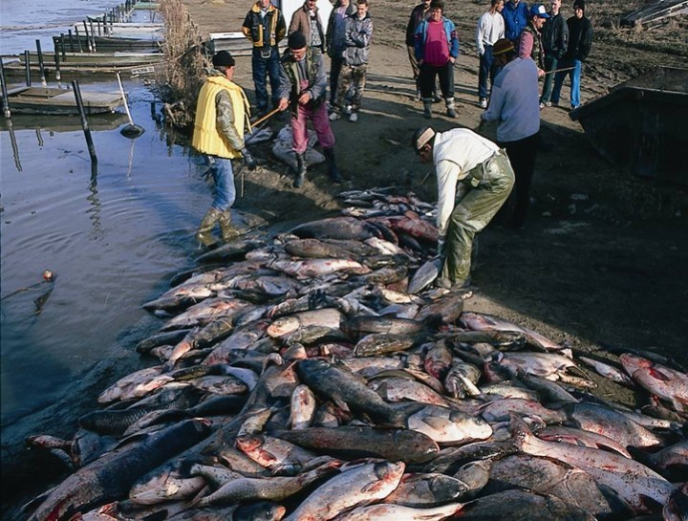
Which problems to tackle?
Habitat degradation
river engineering (e.g. navigation, flood
protection) ➔habitat modification
(e.g. siltation, homogenous bedload
transport) ➔ destruction of spawning /
feeding sites
pollution➔ high mortality in early life phase
or reduced reproductive performance
6. November 2012.

Slide 6
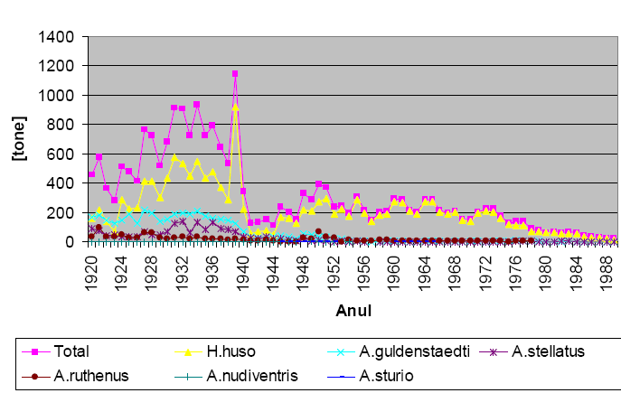
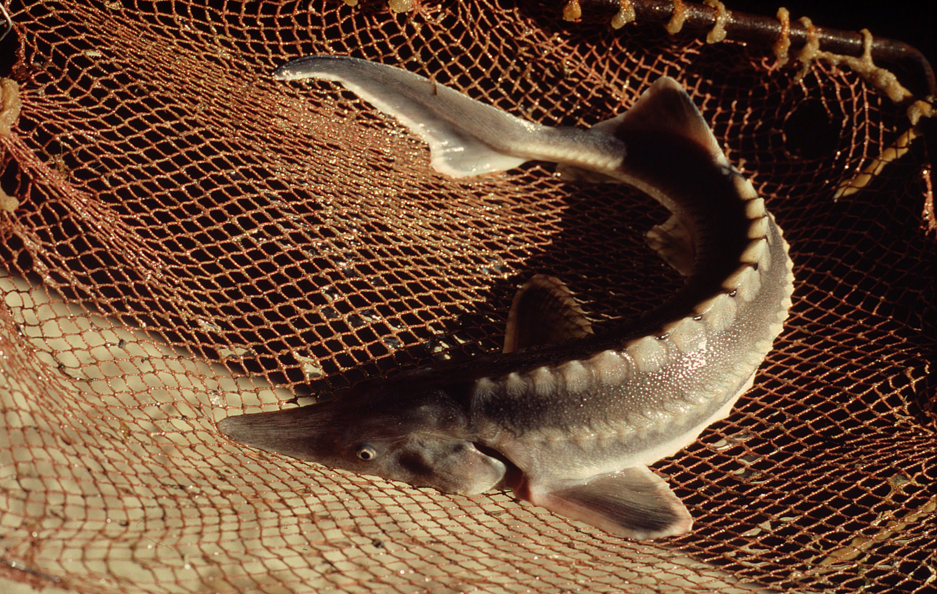
Which problems to tackle?
Overexploitation
more efficient fishing equipment inadequate management
specific life-cycle traits
➔ persistent population decline
Source: Stoica, G., PhD thesis, 2011 - compilation of data
provided by the Danube Delta National Institute, Tulcea

Slide 7
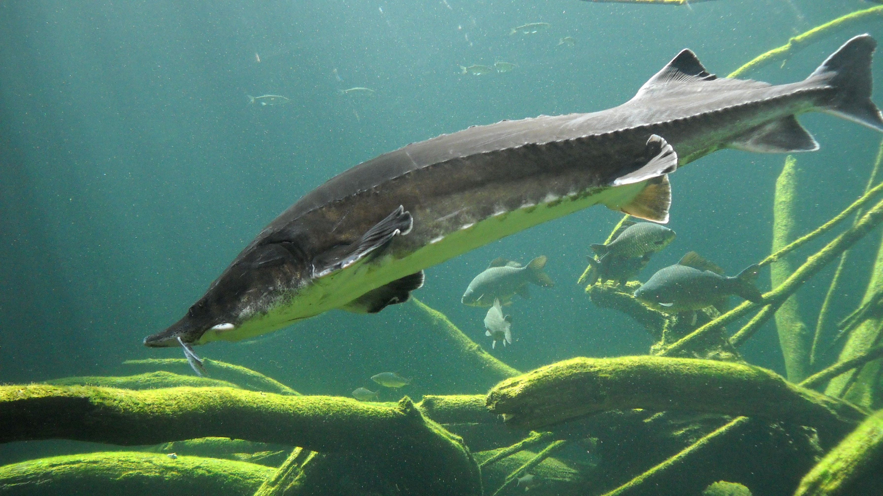
Solutions!
Sturgeon Action Plan:
for the Danube River Basin
issued in 2005
under Bern Convention
signed by all Danube countries
Results:
temporary bans on sturgeon fisheries in Romania and Bulgaria
EU Strategy for Danube Region focus on sturgeon
CITES, TRAFFIC, IAD, WWF, WSCS, ICPDR efforts
… but large parts of Sturgeon Action Plan not tackled, threats remain (e.g. navigation) and more coordination needed!
6. November 2012.

Slide 8
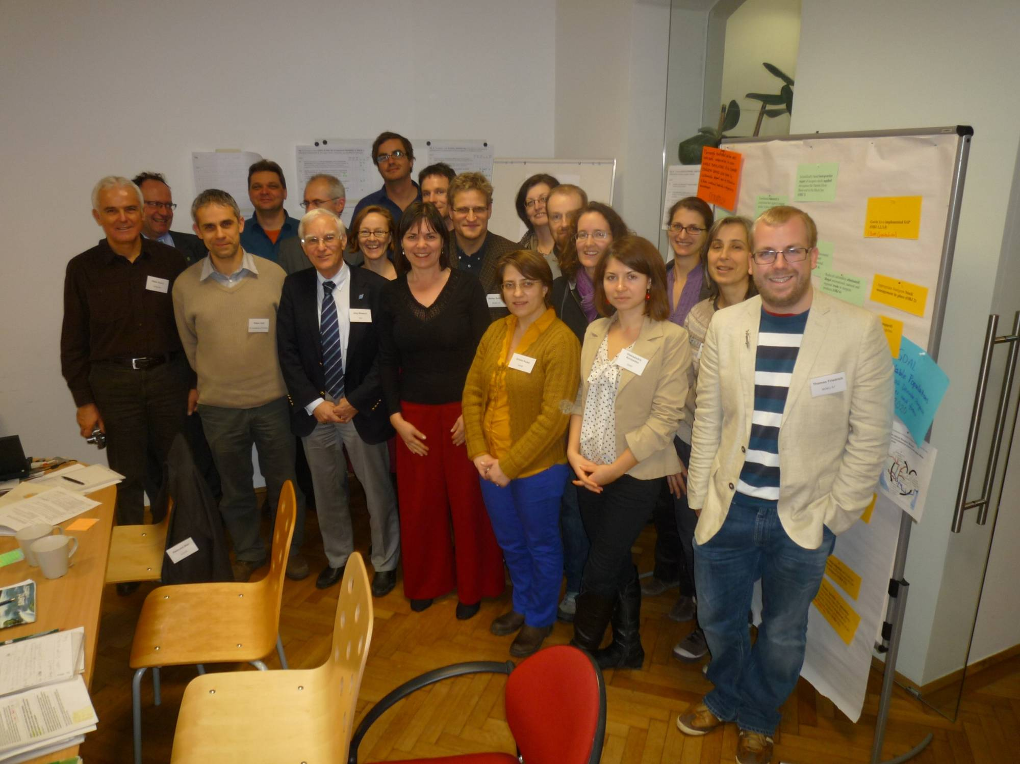
Solutions !
Danube Sturgeon Task Force

Slide 9
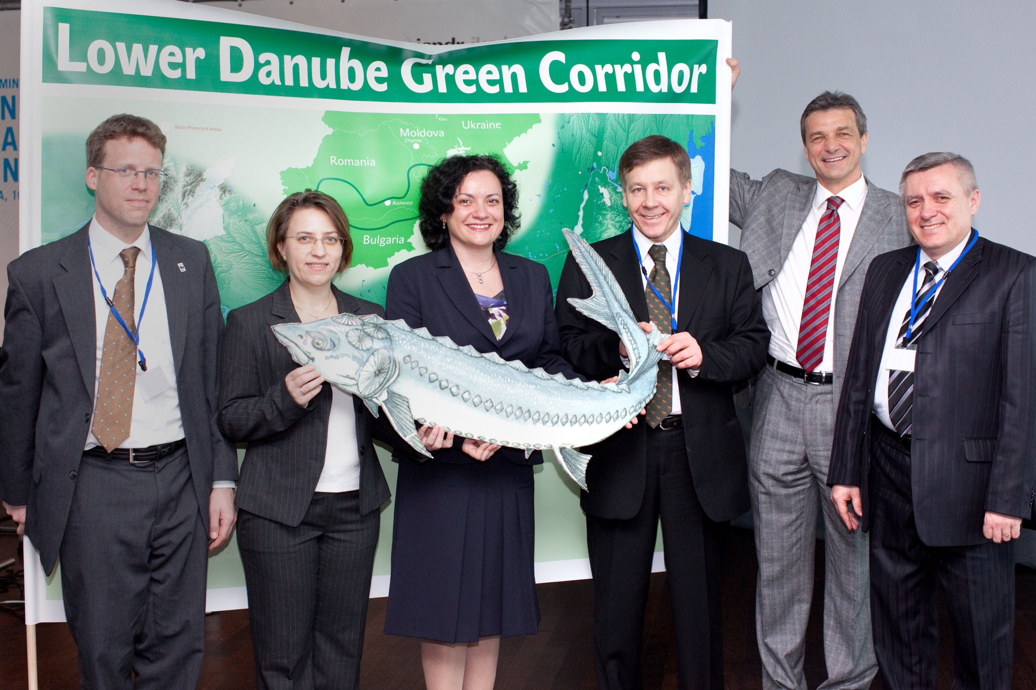
Solutions !
Programme “STURGEON 2020” with EUSDR support:
gain political support at DRB level,
reduce overexploitation,
protection/restoration of habitats,
ensuring migration,
rearing of sturgeons in hatcheries,
targeted communication activities
6. November 2012.

Slide 10
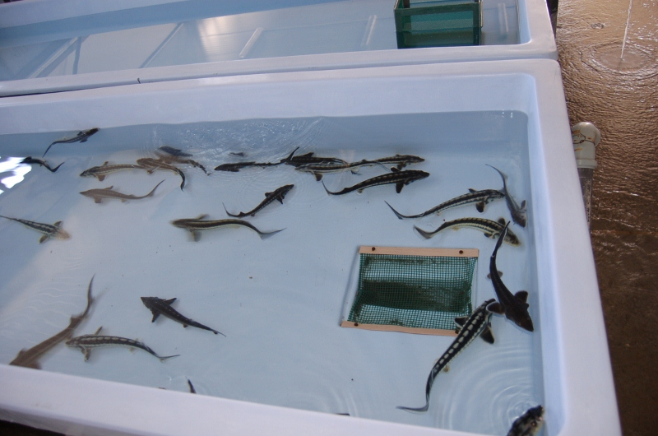
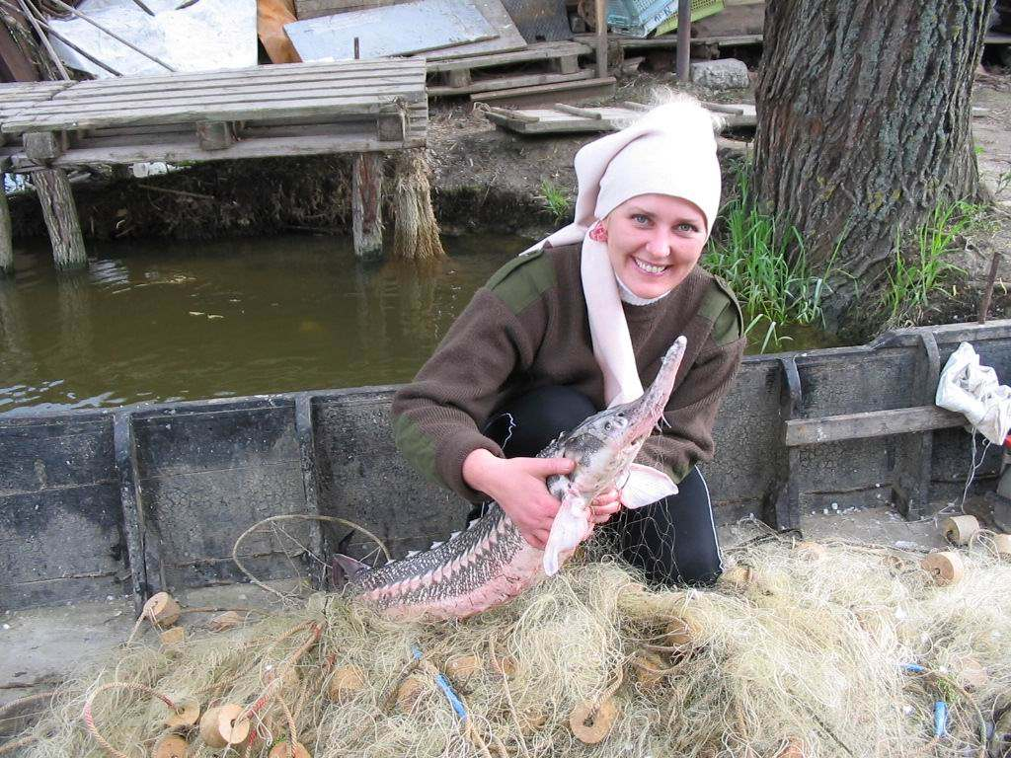
Solutions !
Some WWF projects:
ENVI OP Conserving Sturgeons in Bulgaria:
research on (spawning) habitats
restocking with 50.000 specimens
of 4 species
advocacy work with stakeholders
LIFE project Saving Danube Sturgeons:
to reduce overexploitation in Bulgaria
and Romania
awareness raising and targeted information work with fishermen, agencies, decision makers, sturgeon breeders/caviar traders
6. November 2012.

Slide 11
Solutions !
STURGEON
2020
Genetic pool
PA 6
Biodiversity
PA 1a
Navigation
Habitat alteration
Key habitats + species
PA 7
Research
Continuity disruption
PA 2
Energy
Small eco-business
PA 8
Competitiveness
Eco-tourism
PA 3
Tourism
Ecological education
PA 9
People and skills
PA 4
Water quality
Food web + habitat
Law enforcement
PA 10
Institutional capacity
PA 5
Environmental risk
Flood protection
Caviar black market
PA 11
Security
Copyright: Dr. Cristina Sandu, Institute of Biology Bucharest
6. November 2012.

Slide 12
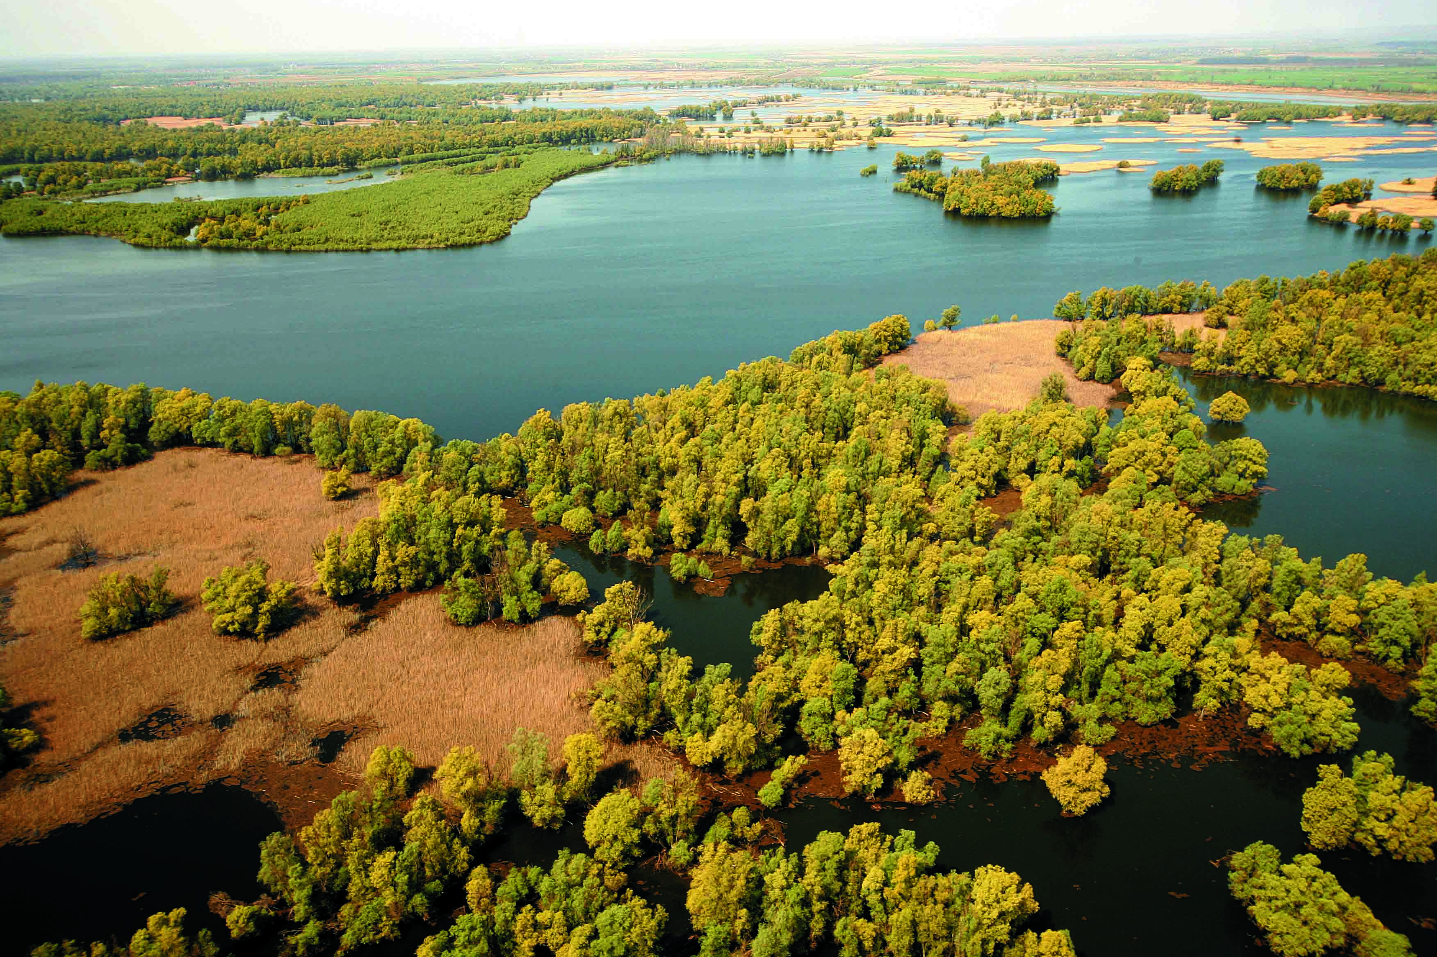
2
Green infrastructure
6. November 2012.

Slide 13
Alps-Carpathian Corridor Project (PA 6)
Values:
The Alps and the Carpathians are among the most diverse
ecoregions of the world.
Problems:
The former continous landscape is interrupted by motorways and threatened by intensive landuse.
The ecological network might be cut into pieces within view years without counter actions.
Goal:
To maintain, improve the Alps-Carpathian Corridor and foster sustainable spatial development.
6. November 2012.

Slide 14
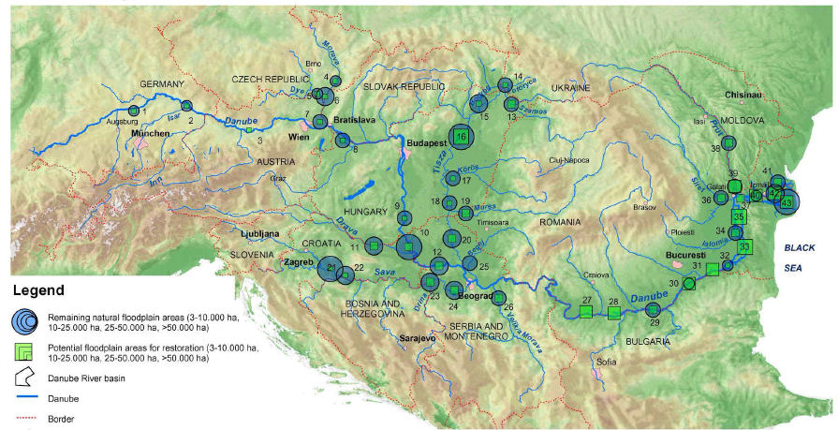
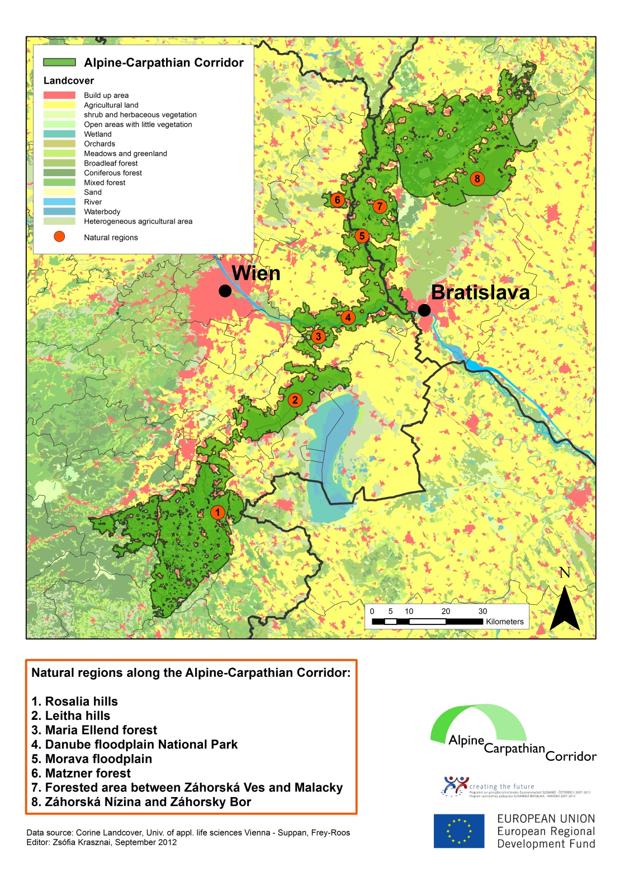
Alps-Carpathian Corridor Project (PA 6)
Solution:
A crossborder project (AT-SK) with 11 partners (motorway companies,
protected areas, universities, NGOs and regional development
institutions)

Slide 15
Alps-Carpathian Corridor Project (PA 6)
AC
C
CORR
I
DOR
Reestablishing connectivity
Protected species
PA 1b
Roads/rail
PA 6
Biodiversity
PA 3
Tourism
Eco-tourism
Key habitats + species
PA 7
Research
PA 4
Water quality
Maintain floodplain and greenzones
Spatial planning
PA 10
Institutional capacity
PA 5
Environmental risk
Maintain floodplain and greenzones
6. November 2012.

Slide 16

Morava-Dyje floodplains –
RAMSAR site management (PA5, PA6)
Values:
the Morava-Dyje floodplains (AT, CZ, SK) were declared wetlands of international importance in 2007
deliver valuable ecosystem services - especially flood mitigation
Problems:
alteration (dykes, straightened course) of Morava river and adjacent floodplains
Goal:
The main objective of the Ramsar SKAT project is to foster trilaterale cooperation and to preserve, improve outstanding biodiversity of the Morava-Dyje floodplains.
6. November 2012.

Slide 17
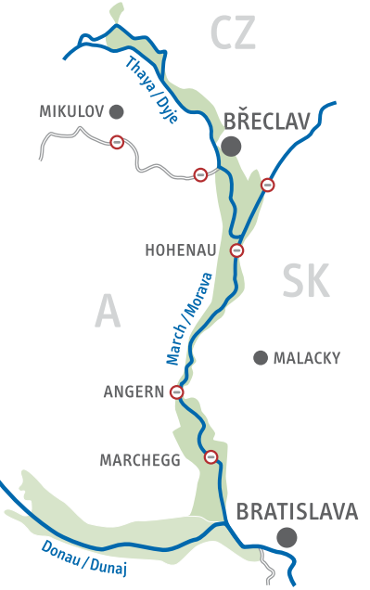
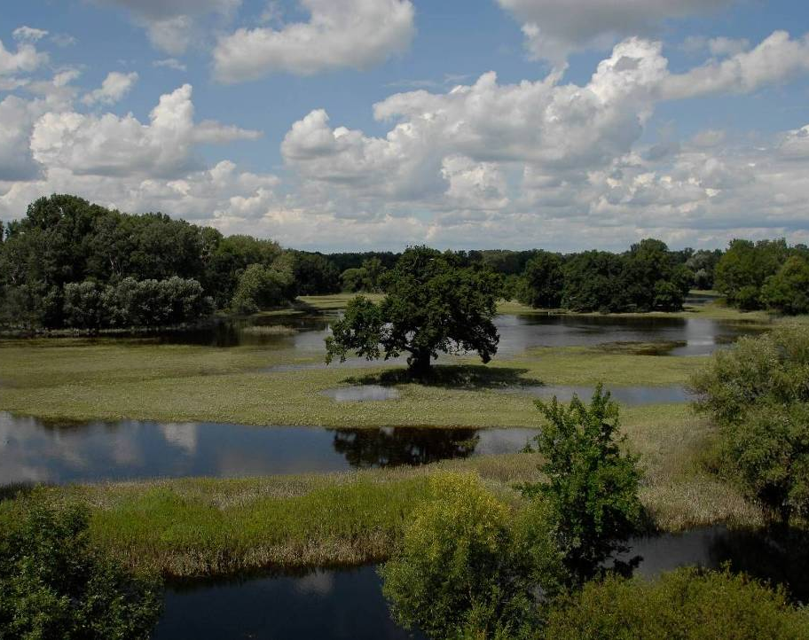
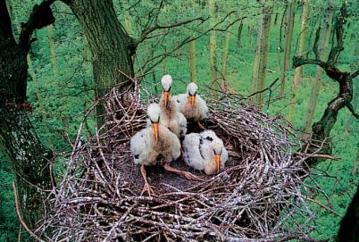
Morava-Dyje floodplains –
RAMSAR site management (PA5, PA6)
Solutions:
Within the project a crossborder management strategy is being developed to :
focus on common objectives,
activities,
manage the river wisely
LIFE+ project (floodplain restoration measures started in 2012)
6. November 2012.

Slide 18
Morava-Dyje floodplains –
RAMSAR site management (PA5, PA6)
MORAVA
-
DYJE
Genetic pool
PA 6
Biodiversity
PA 1a
Navigation
Habitat alteration
Crossborder traffic infrastructure
Key habitats + species
PA 7
Research
PA 1b
Roads
Small eco-business
PA 8
Competitiveness
Eco-tourism
PA 3
Tourism
Ecological education
PA 9
People and skills
PA 4
Water quality
Food web + habitat
Law enforcement
PA 10
Institutional capacity
PA 5
Environmental risk
Flood protection
6. November 2012.

Slide 19
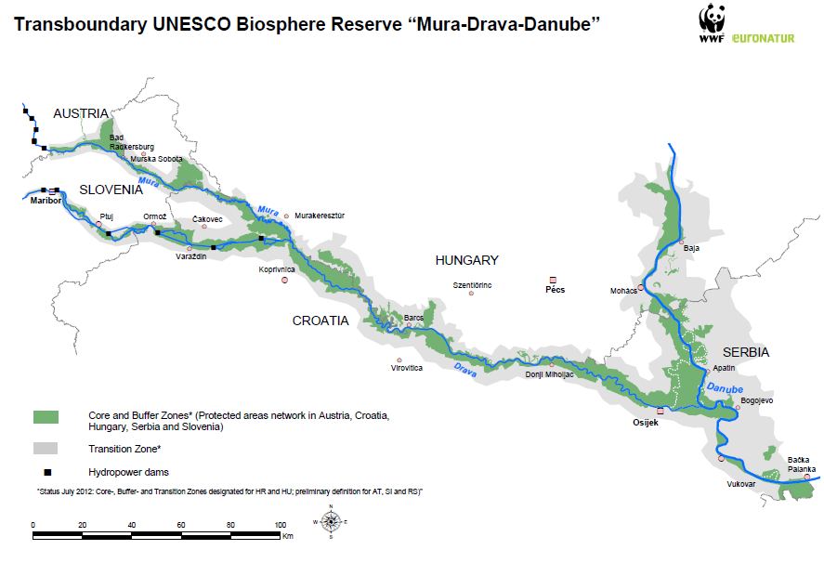
Mura-Drava-Danube Biosphere Reserve (PA6)
6. November 2012.

Slide 20
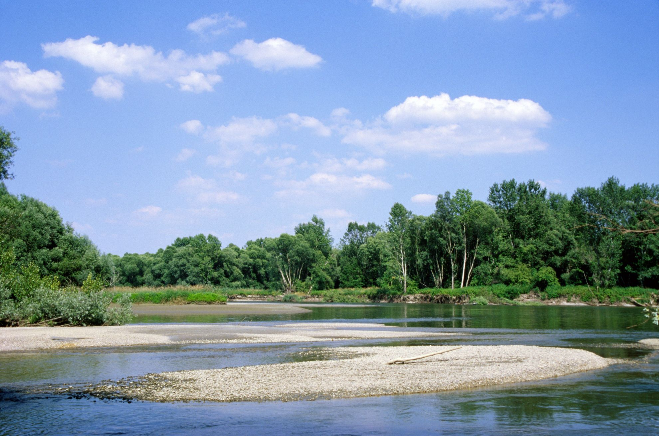
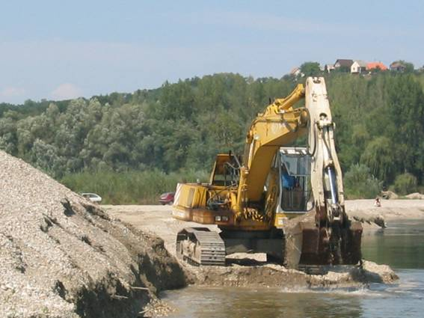
Mura-Drava-Danube Biosphere Reserve (PA6)
Values:
rich biological values and natural
resources
natural habitats rare in Europe (large
floodplain forests, river islands, gravel/
sand banks, side branches, oxbows)
700 km of free flowing rivers
soon to be Europe´s largest protected
river area (800.000 ha)
Problems:
the impact of dams,
past river regulation work,
sediment imbalance
6. November 2012.

Slide 21
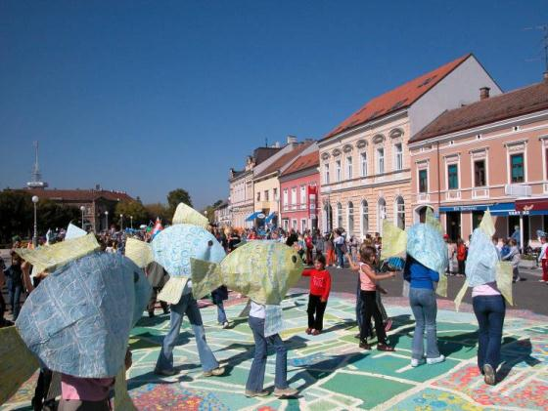
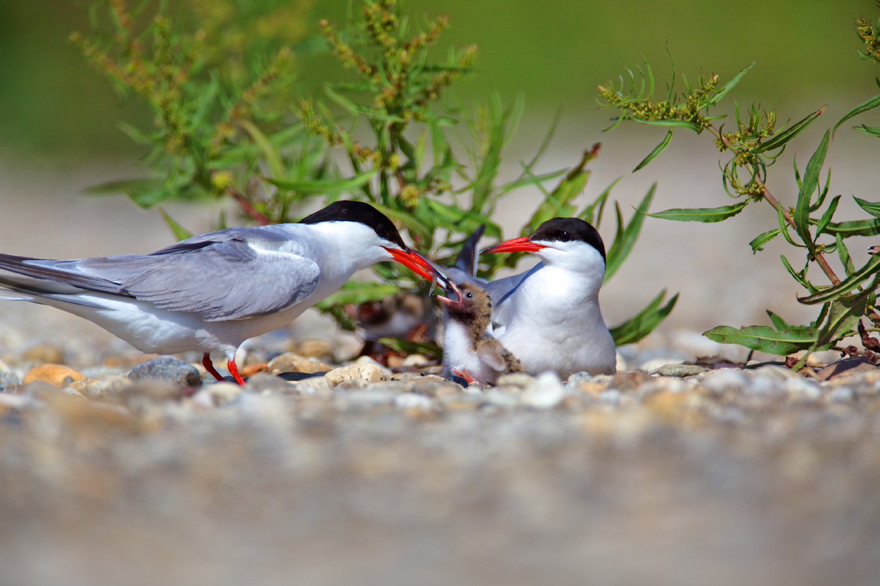
Mura-Drava-Danube Biosphere Reserve (PA6)
Solution:
restoration
prevention of further damage
proper management
5-country biosphere reserve:
maintaining ecosystems,
cluster of more than 10 single PAs
jointly (by 5 countries!) managed river
ecosystem in a sustainable manner,
encouraging education, research
and environmental monitoring
encouraging socio- and economic
development
6. November 2012.

Slide 22
Mura-Drava Danube Biosphere Reserve (PA6)
MDD
B IOSPHE
RESERVE
PA 1a
Navigation
Habitat alteration
Genetic pool
PA 6
Biodiversity
Continuity disruption
Key habitats + species
PA 7
Research
PA 2
Energy
Eco-tourism
Small eco-business
PA 8
Competitiveness
PA 3
Tourism
PA 4
Water quality
Floodplain restoration
Ecological education
PA 9
People and skills
PA 5
Environmental risk
Flood protection
Law enforcement
PA 10
Institutional capacity
6. November 2012.

Slide 23
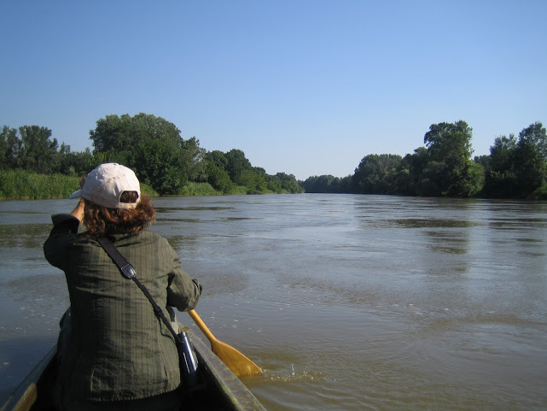
3
Conclusion
Presentation to Company Name
6. November 2012.

Slide 24
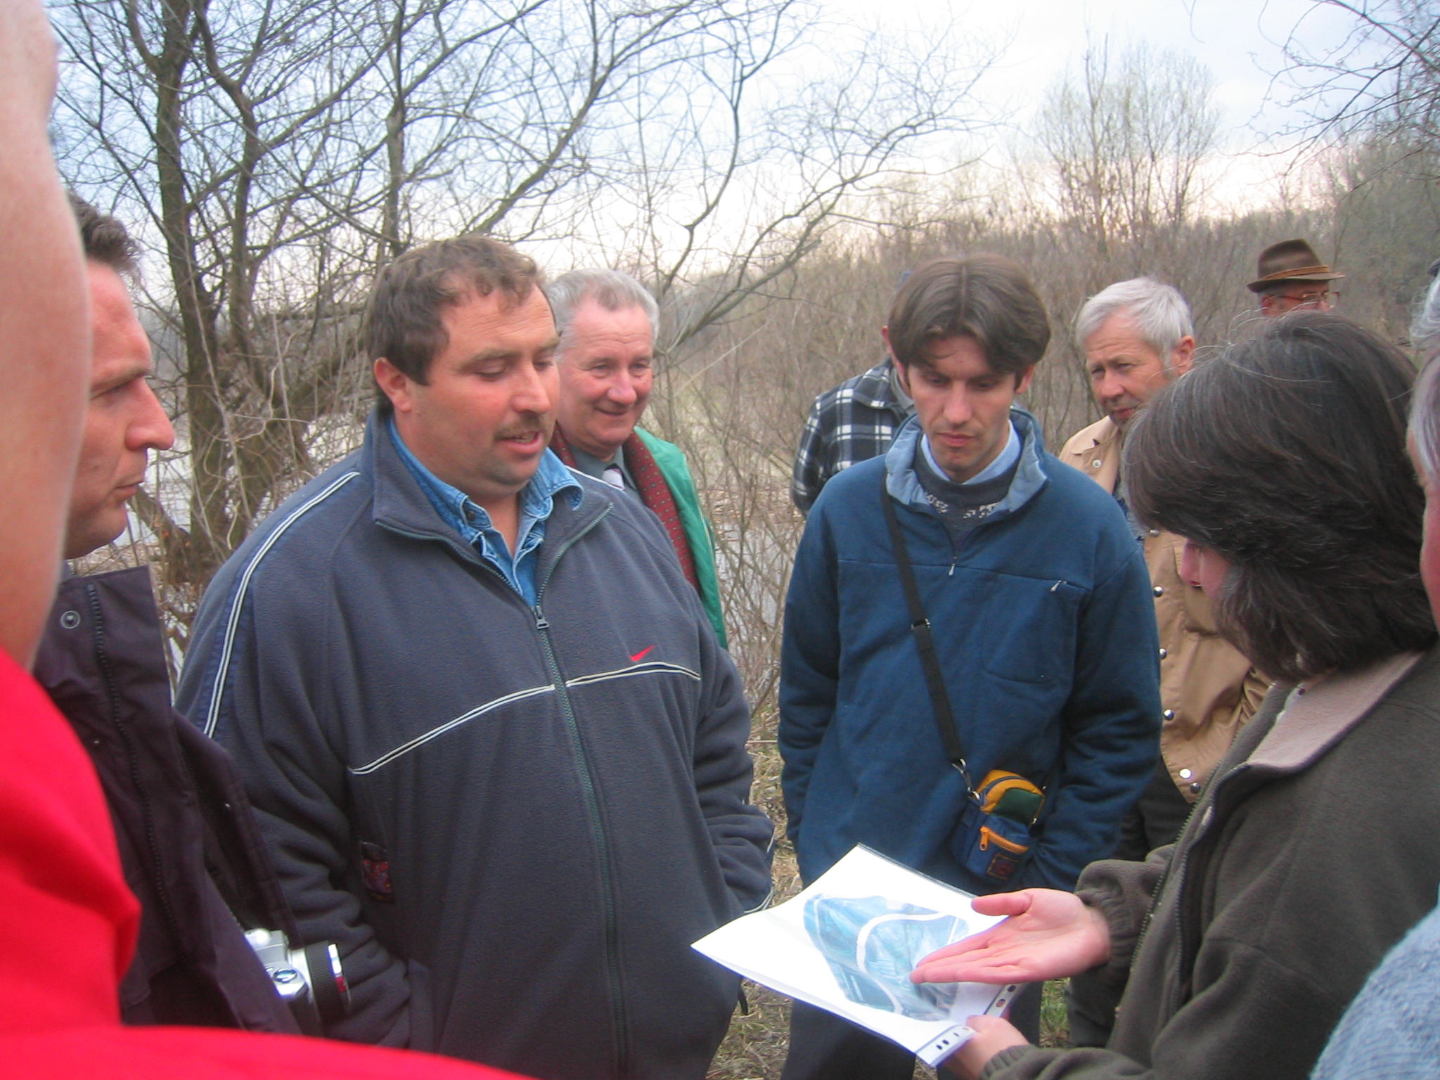
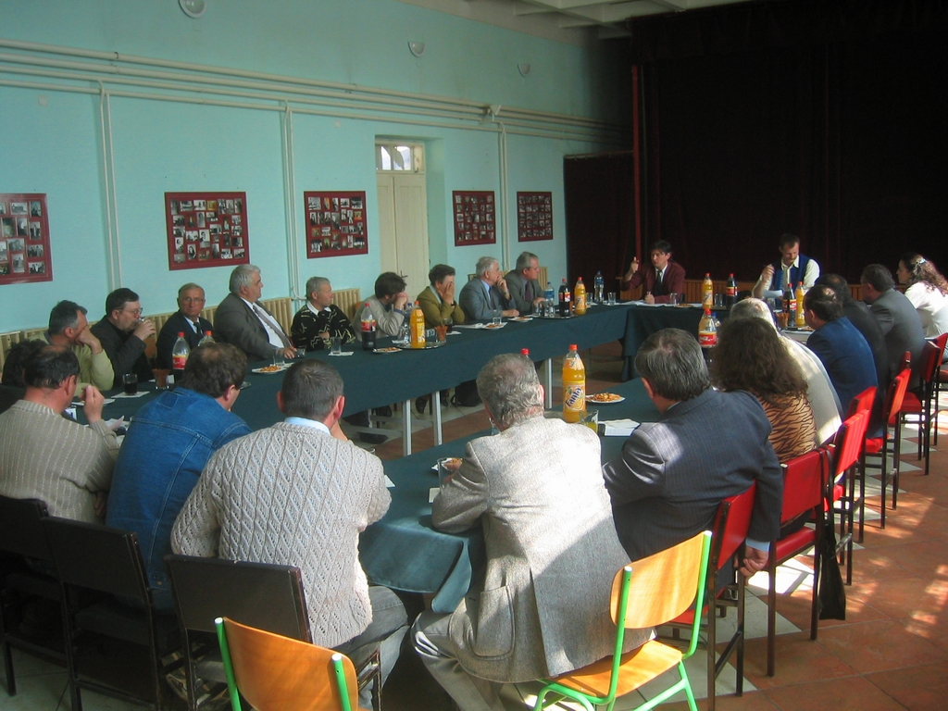
Conclusion
Biodiversity conservation needs cooperation of multiple sectors in order to be effective.
The EUSDR is providing a promising structure for fostering such cooperation and integration.
6. November 2012.

Slide 25
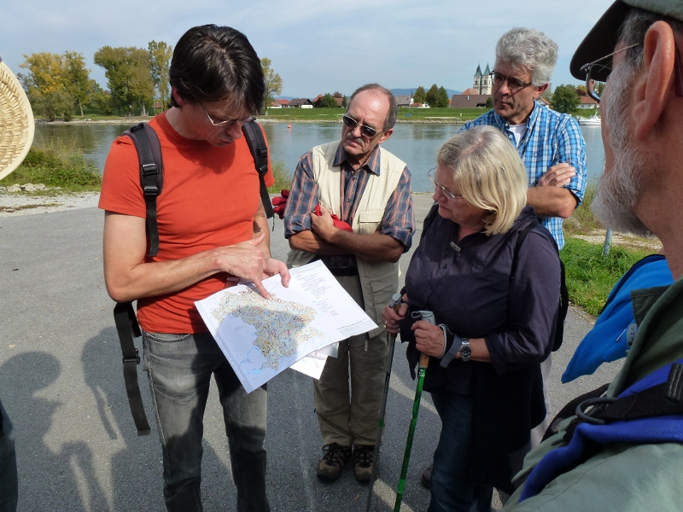
Biodiversity integration
under the EUSDR
Thank you!
www.panda.org
Further information:
Sturgeons: jutta.jahrl@wwf.at , smihov@wwfdcp.bg
ACC Corridor, RAMSAR SKAT: gerhard.egger@wwf.at
MDD Biosphere Reserve: arno.mohl@wwf.at

