Slide 1



Annual Stakeholder Seminar of the Pillar II. - Protecting the Environment
of the EU Strategy for the Danube Region
6 November 2012, Budapest
Priority Area 4
Restore and maintain the quality of waters
István Ijjas Prof. Emeritus
Budapest University of Technology and Economics
EU STRATEGY FOR THE DANUBE REGION (EUSDR) | www.danube-region.eu

Slide 2
Contents
1) History of basin-wide cooperation for water protection in the Danube Basin
2) Danube River Basin Management Plan
3) The need for basin-wide measures and Danube Strategy for water protection
4) The actions of the Danube Strategy for the implementation of the DRBMP
5) Actions for water protection in the Baltic Sea Region Strategy
6) Expected added values of the water protection actions of the Danube Strategy
EU STRATEGY FOR THE DANUBE REGION (EUSDR) | www.danube-region.eu

Slide 3
History of basin-wide cooperation
for water protection in the Danube Basin
EU STRATEGY FOR THE DANUBE REGION (EUSDR) | www.danube-region.eu

Slide 4
Main programmes for water protection in the Danube River Basin
The Danube...for whom and for what, Equipe Cousteau (1992)
Environmental Programme for the Danube River Basin
Danube Integrated Environmental Study (1993-1994)
Strategic Action Plan - SAP (1994)
SAP Implementation Plan (1995)
Danube Nutrient Reduction Programme (1997 –1999)
ICPDR Joint Action Plan 2000- 2005
DABLAS programme (specific reports in 2002 and 2004)
EU WFD Danube River Basin Analysis (2005)
UNDP/GEF Danube Regional Project (2001 – 2006)
UNDP-GEF-ICPDR Danube Basin Transboundary Diagnostic Analysis
Based on EU Water Framework Directive (2006)
Danube River Basin Management Plan (2009)
EU STRATEGY FOR THE DANUBE REGION (EUSDR) | www.danube-region.eu

Slide 5
Existing inter-governmental cooperation bodies and tools
for water protection in the Danube Basin
Long history of co-operation
Danube Navigation Convention (Belgrade, 1948)
Bucharest Declaration (1984)
UNECE Transboundary Water Convention (Helsinki Convention, 1992)
UN International Hydrological Programme (UN IHP)
Danube River Protection Convention (DRPC,1994)
EU Water Framework Directive (WFD, 2000)
Commission for the Protection of the Danube River (ICPDR)
Bilateral/multilateral agreements between individual countries
EU STRATEGY FOR THE DANUBE REGION (EUSDR) | www.danube-region.eu

Slide 6
2) Danube River Basin Management Plan
EU STRATEGY FOR THE DANUBE REGION (EUSDR) | www.danube-region.eu

Slide 7
The main basin-wide environmental problems
Four significant transboundary issues
Nutrient Pollution – from point sources and diffuse sources
Organic Pollution – from point sources and diffuse sources
Hazardous substances - industrial and accidental pollution
Hydromorphological alterations - engineering works for
navigation, hydropower generation, flood prevention
New issues: sediments, climatic changes
EU STRATEGY FOR THE DANUBE REGION (EUSDR) | www.danube-region.eu

Slide 8
Future visions for the status of waters in Danube Basin level:
Organic pollution: zero emmission of untreated wastewaters
into the waters
Nutrient pollution: the waters are not threatened or impacted by
eutrophication
Hazardous substances pollution: no risk or threat to human health
and the aquatic ecosystems
Hydro-morphological alterations:
Interruption of river and habitat continuity: hydro-morphological
changes of the river shall not hinder the migration of fish
Disconnection of floodplains and wetlands: floodplains and wetlands
will be re-connected and restored
Hydrological alterations: the aquatic ecosystem shall not be
influenced in its natural development and distribution
Future infrastructure projects: negative local and transboundary
effects will be fully prevented, mitigated or compensated.
EU STRATEGY FOR THE DANUBE REGION (EUSDR) | www.danube-region.eu

Slide 9
Short- and long-term targets for the recovery of the Black Sea:
Short-term:
to avoid exceeding loads of nutrients discharged into the Sea
beyond those that existed in 1997.
Long-term:
to reduce the loads of nutrients discharged to levels allowing
Black Sea ecosystems to recover to conditions similar to those of the 1960s
EU STRATEGY FOR THE DANUBE REGION (EUSDR) | www.danube-region.eu

Slide 10
The key conclusions of the DRBM Plan
The assessment of the ecological status will be further developed.
Measures identified will not ensure the achievement of the
environmental objectives on basin-wide scale,
significant further efforts will still be necessary regarding
organic pollution
N and P
hazardous substances
pressures from all hydomorphological components
and other relevant issues:
quality and quantity of sediments,
invasive species,
water quantity issues and
climate change
EU STRATEGY FOR THE DANUBE REGION (EUSDR) | www.danube-region.eu

Slide 11
3. The need for basin-wide measures
and Danube Strategy for water protection
EU STRATEGY FOR THE DANUBE REGION (EUSDR) | www.danube-region.eu

Slide 12
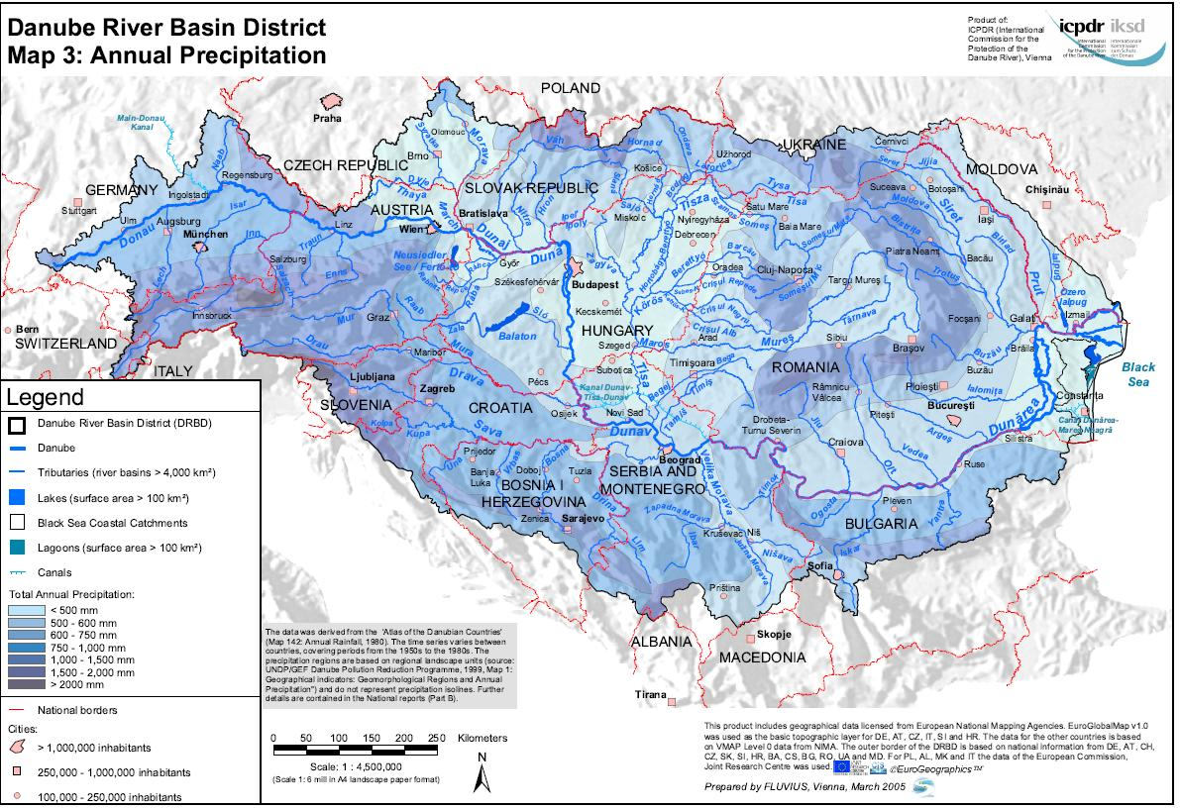
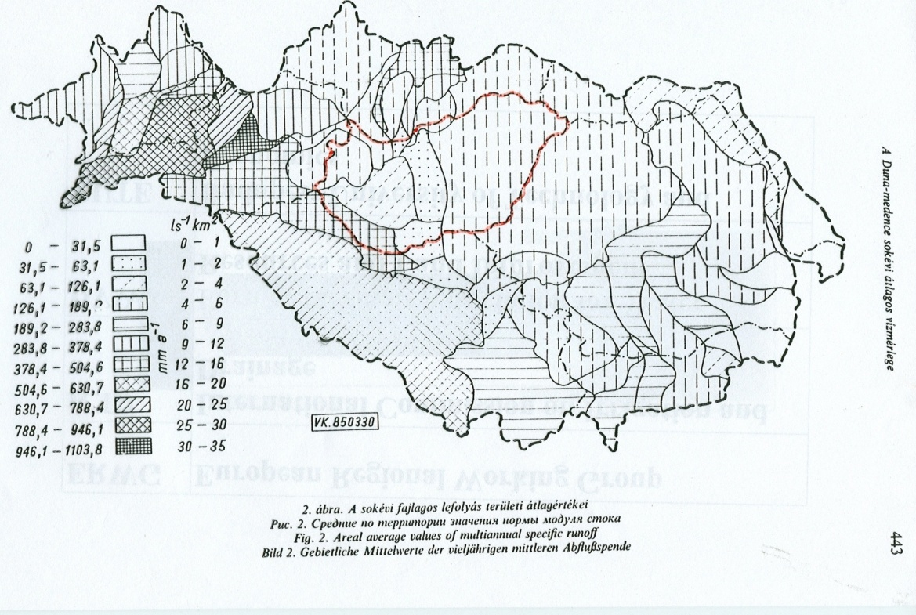
Annual precipitation in the Danube Basin
Areal average values of multiannual specific runoff
EU STRATEGY FOR THE DANUBE REGION (EUSDR) | www.danube-region.eu

Slide 13
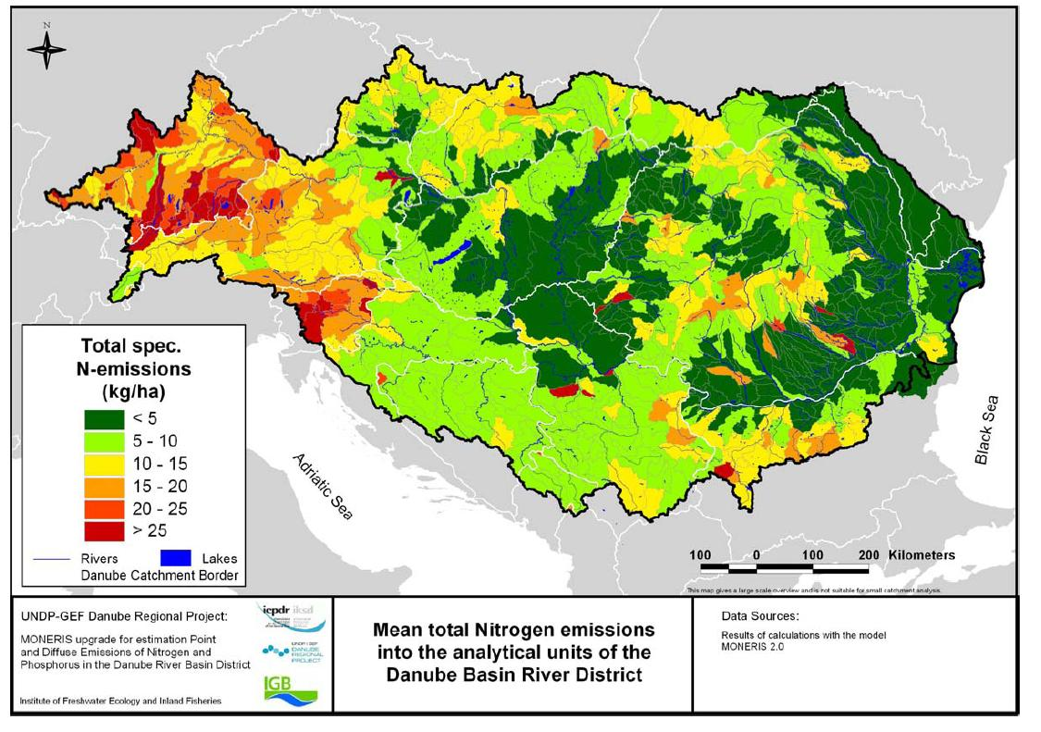
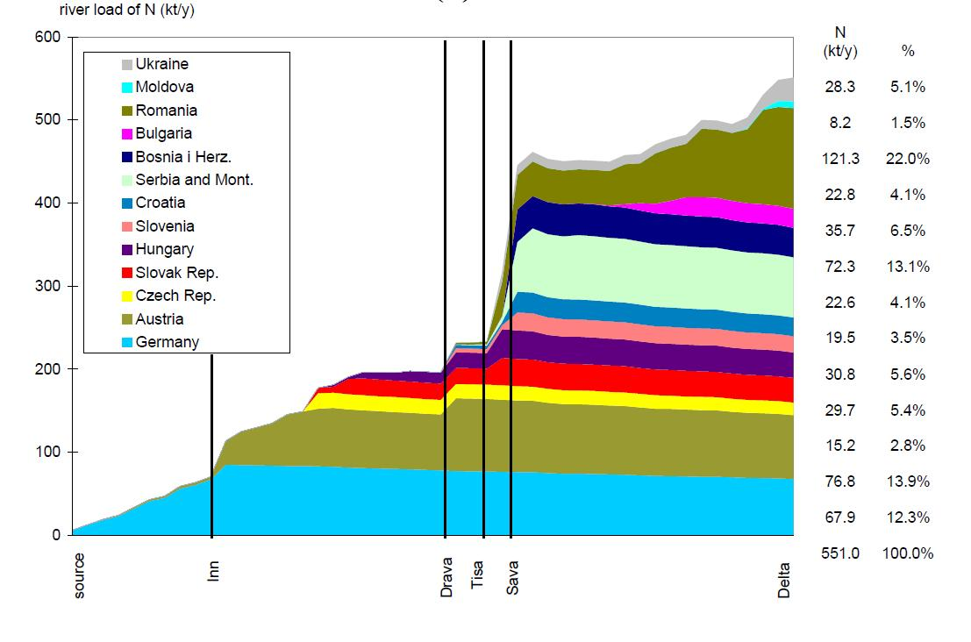
River load of N (kt/y)
Specific N-emissions
EU STRATEGY FOR THE DANUBE REGION (EUSDR) | www.danube-region.eu

Slide 14
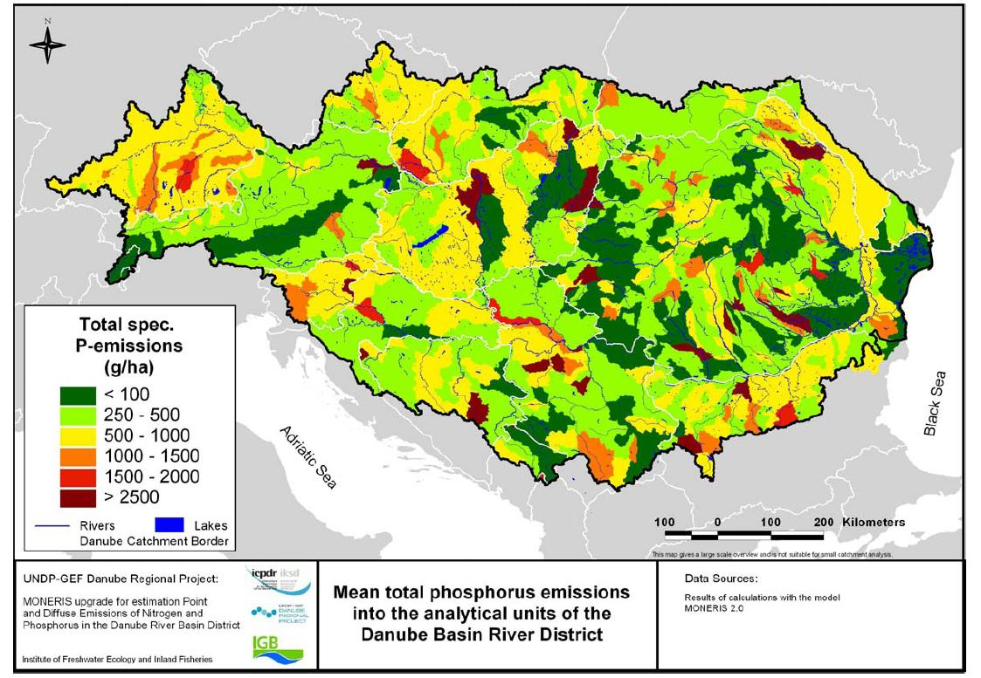
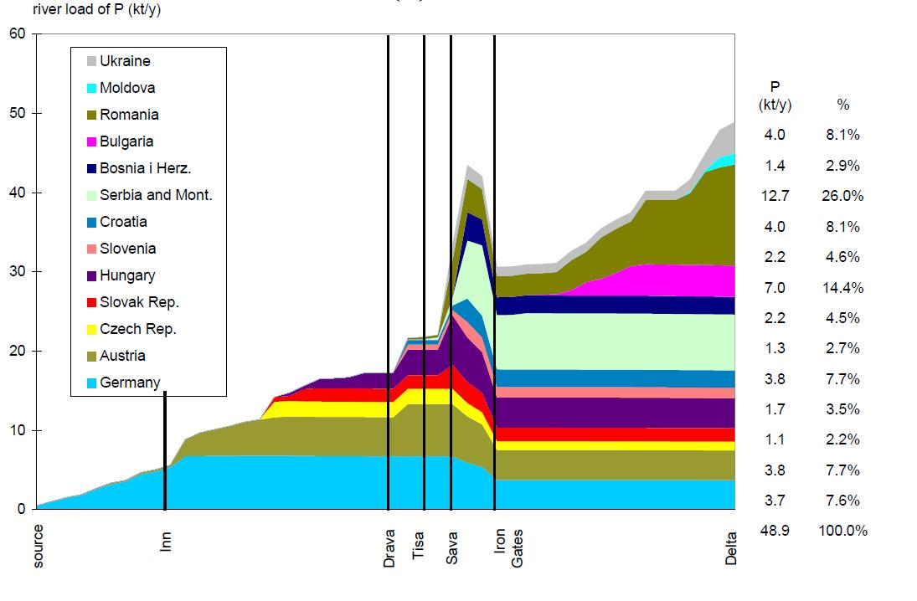
River load of P (kt/y)
Specific P emissions
EU STRATEGY FOR THE DANUBE REGION (EUSDR) | www.danube-region.eu

Slide 15
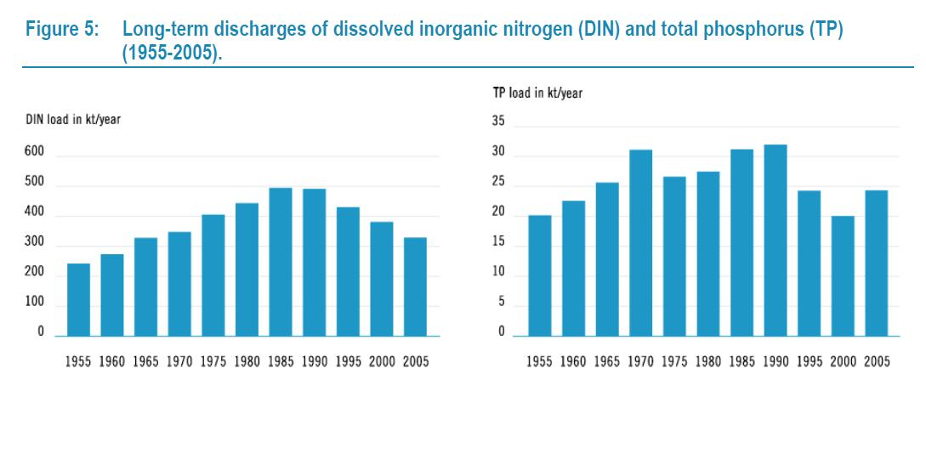
EU STRATEGY FOR THE DANUBE REGION (EUSDR) | www.danube-region.eu

Slide 16
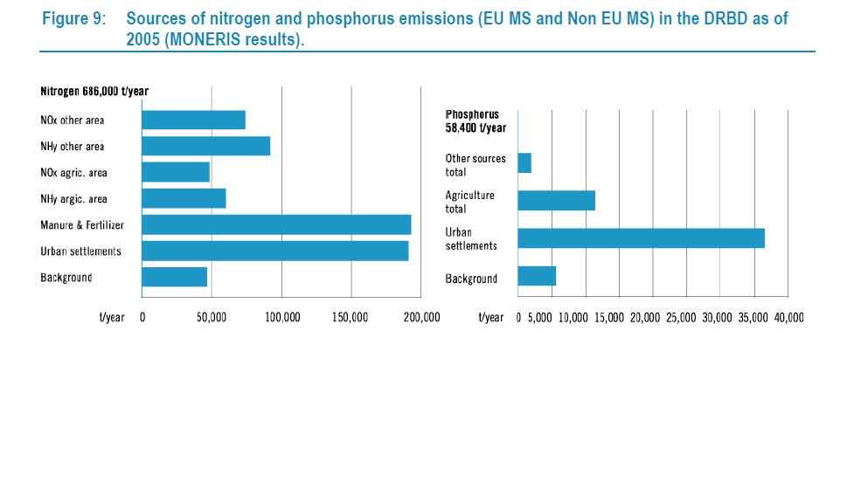
EU STRATEGY FOR THE DANUBE REGION (EUSDR) | www.danube-region.eu

Slide 17
Scientific help:
COST 869
Mitigation options for Nutrient Reduction
in Surface Water and Groundwaters
Final Meeting, Keszthely, 12-14 October 2011
and other joint projects
EU STRATEGY FOR THE DANUBE REGION (EUSDR) | www.danube-region.eu

Slide 18
Conclusions of the case study on nutrient emissions:
water does not recognise the political borders
water management and water protection requires
joint planning of actions, strong coordination and cooperation
across countries and across sectors
water management and water protection requires the
Danube Strategy
EU STRATEGY FOR THE DANUBE REGION (EUSDR) | www.danube-region.eu

Slide 19
4) The actions of the Danube Strategy for the
implementation of the Danube River Basin
Management Plan
EU STRATEGY FOR THE DANUBE REGION (EUSDR) | www.danube-region.eu

Slide 20
Main objectives of the Priority Area 4:
Implementation of the basin-wide,
joint programs of measures of the DRBMP
coordination of implementation of the basin-wide and national
measures identified in the river basin management plans
Planning and implementation of additional
joint programs of measures to achieve the Danube basin-wide
objevtives and visions where more work is needed in the future
(such as sediments and climate changes)
EU STRATEGY FOR THE DANUBE REGION (EUSDR) | www.danube-region.eu

Slide 21
Main criteria for selection of the water protection actions and projects
that should be implemented in the Danube Region
Issues of Danube basin-wide importance
Issues based on the Danube River Basin Management Plan adopted
by the Ministerial Meeting of the Danube River Basin countries
Issues that requires a basin-wide perspective and cooperation
between each of the countries sharing the whole basin
Issues that requires inter-ministerial/inter-sectoral coordinating
mechanisms and integration of different policies
EU STRATEGY FOR THE DANUBE REGION (EUSDR) | www.danube-region.eu

Slide 22
Priority Area 4 – Implementation of the DRBMP
Coordinators: Slovakia and Hungary
in close cooperation with ICPDR
Actions:
1) Implementation of the Danube River Basin Management Plan
2) Cooperation at subbasin level (Tisa, Sava, Prut rivers, Danube Delta)
3) Development of information systems (Danube Survey, Danube and Sava GIS
4) Building and upgrading wastewater treatment facilities
5) Establishment of buffer strips along the rivers to retain nutrients
6) Cooperation between authorities responsible for agriculture and environment
7) Limitations of phospates in detergents
8) Treatment of hazardous substances and contaminated sludge
9) Control of substances that are considered problematic
EU STRATEGY FOR THE DANUBE REGION (EUSDR) | www.danube-region.eu

Slide 23
10) Reducing water continuity interruptions
restoring continuity at the Iron Gates
restoration of the sediment balance in the Danube
biodiversity and sediments in the Sava River Basin
11) To promote measures to limit water abstraction
12) Exchange of good practice in integrated water management
13) Safeguarding of drinking water supply
14) Integrated Coastal Zone Management
EU STRATEGY FOR THE DANUBE REGION (EUSDR) | www.danube-region.eu

Slide 24
Example EUSDR flagship project:
Danube Sediment Management – Assessment for the
Restoration of Sediment Balance in the Danube River Basin
Cooperation of 8 countries – 14 partners
Lead Institution – Budapest University of Technology and Economics
Department of Hydraulic and Water Resources Eng.
EU STRATEGY FOR THE DANUBE REGION (EUSDR) | www.danube-region.eu

Slide 25
5. Actions for water protection in the EU Strategy
for the Baltic Sea Region
EU STRATEGY FOR THE DANUBE REGION (EUSDR) | www.danube-region.eu

Slide 26
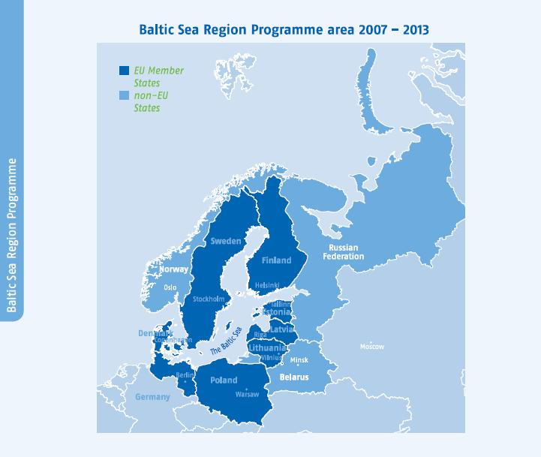
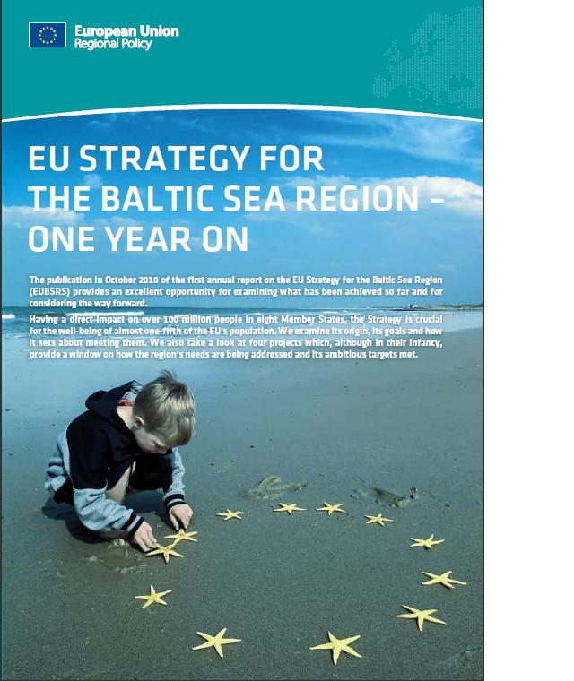
EU STRATEGY FOR THE DANUBE REGION (EUSDR) | www.danube-region.eu

Slide 27
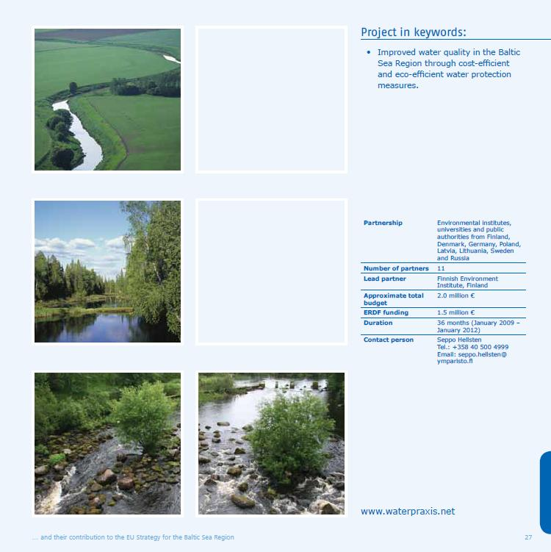
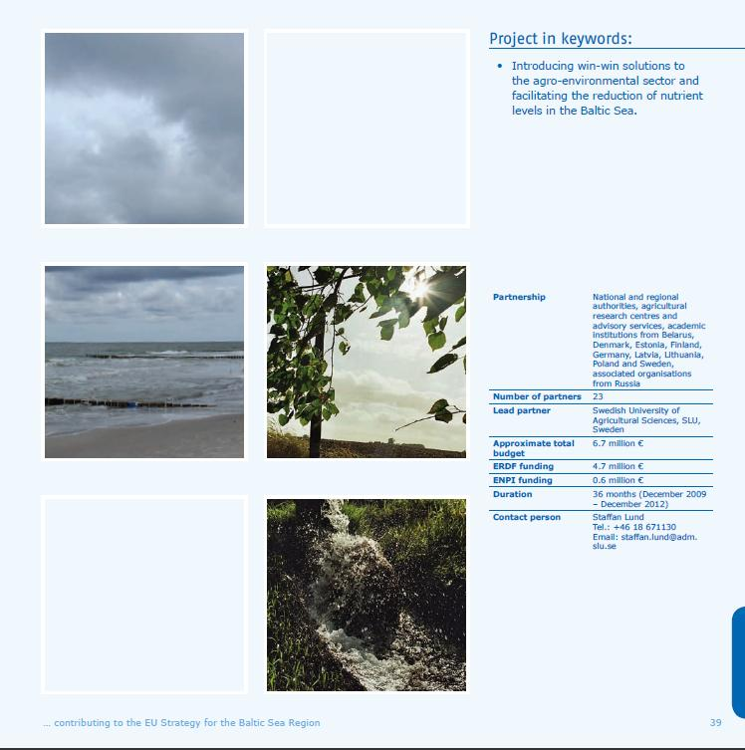
Reduction of
nutrient levels
in the Baltic Sea
Cost-efficient and
eco-efficient water
protection measures
23 partners
10 countries
6.7 million Euro
11 partners
8 countries
2.0 million Euro
EU STRATEGY FOR THE DANUBE REGION (EUSDR) | www.danube-region.eu

Slide 28
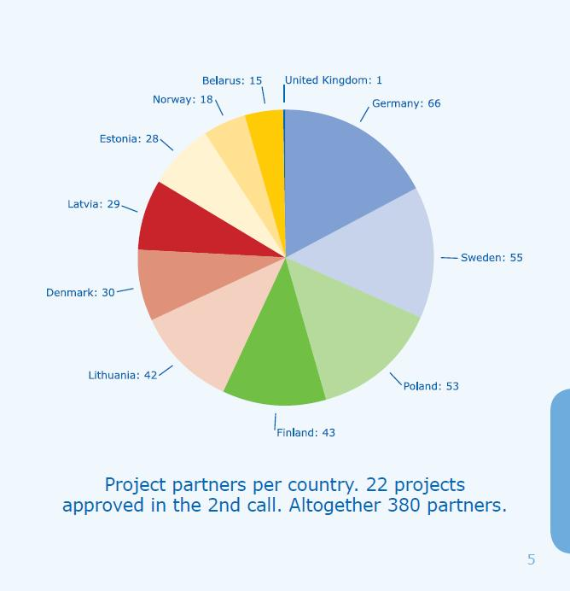
Projects approved
in the 2nd call
of the Baltic Strategy
22 projects
380 partners
from 11 countries
EU STRATEGY FOR THE DANUBE REGION (EUSDR) | www.danube-region.eu

Slide 29
6. Expected added values of water protection actions
of the Danube Strategy
EU STRATEGY FOR THE DANUBE REGION (EUSDR) | www.danube-region.eu

Slide 30
Expected added values of Priority Area 4.
The improvement of the status of waters
will conserve the water resources for the future water uses,
will significantly contribute to sustainable
regional development,
will ensure the preservation and the restoration
of the valuable ecosystems,
will reduce the impacts on the Black Sea.
EU STRATEGY FOR THE DANUBE REGION (EUSDR) | www.danube-region.eu

Slide 31
I wish you a succesfull seminar
and Danube Strategy!
Thank you for your attention!
EU STRATEGY FOR THE DANUBE REGION (EUSDR) | www.danube-region.eu

Slide 32
EU STRATEGY FOR THE DANUBE REGION (EUSDR) | www.danube-region.eu

Slide 33
EU STRATEGY FOR THE DANUBE REGION (EUSDR) | www.danube-region.eu

Slide 34
EU STRATEGY FOR THE DANUBE REGION (EUSDR) | www.danube-region.eu

