Slide 1

Information of the activities of the International Sava River Basin Commission
Samo Grošelj
Deputy Secretary, ISRBC

Slide 2
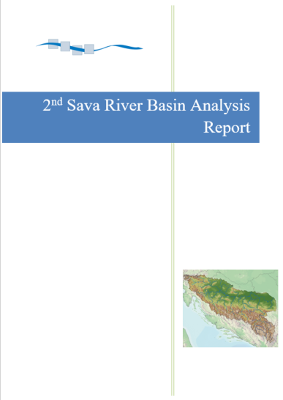
PA4: Sava RBM Plan
2nd Sava River Basin Analysis Report
ISRBC accepted at the 46th session
It is available at the ISRBC web site
Significant Water Management Issues
Open for public consultation from July 29 until October 20, 2016 (http://savacommission.org/announce_detail/63)
Final draft under finalization
It will be sent to ISRBC members for adoption
Joint Plan of Actions (JPA) developed and adopted by the ISRBC – next steps defined

Slide 3
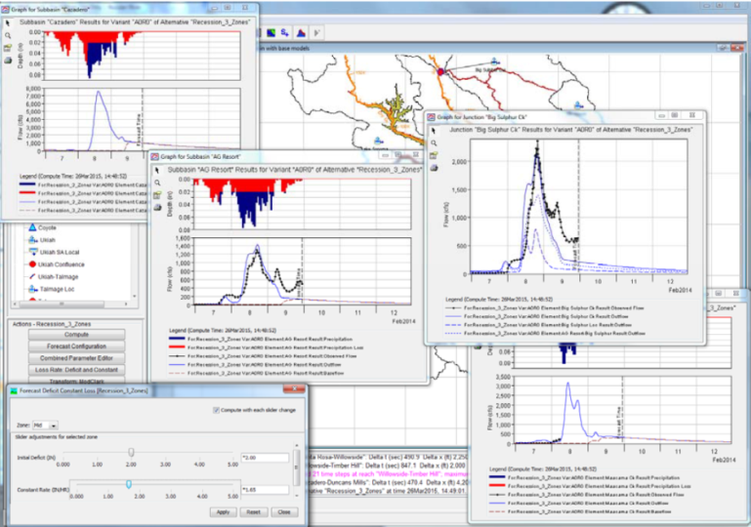
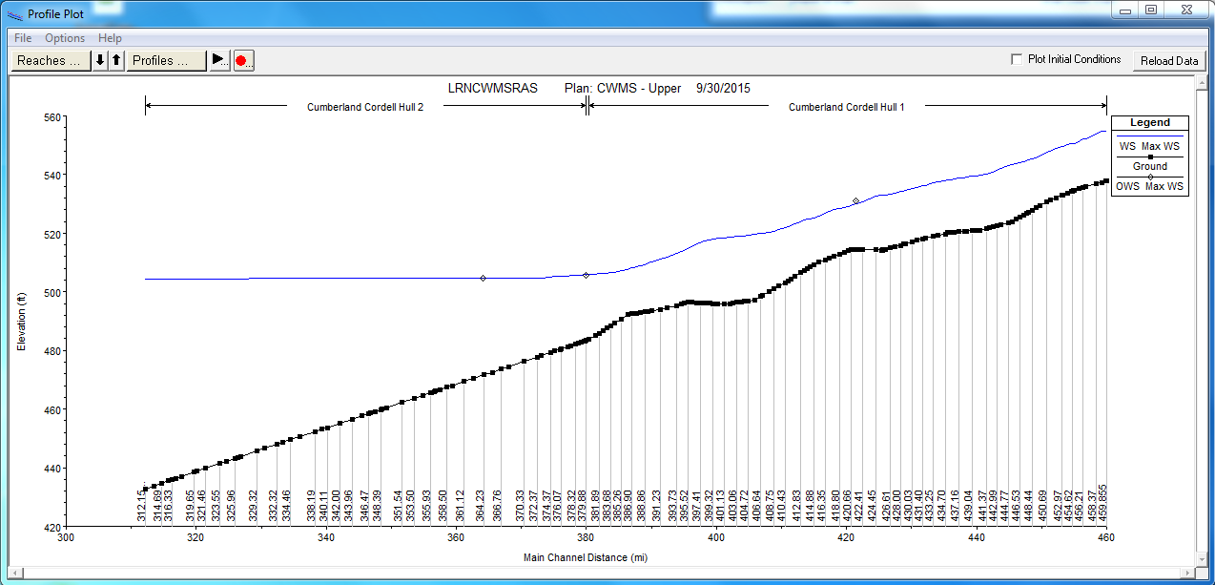
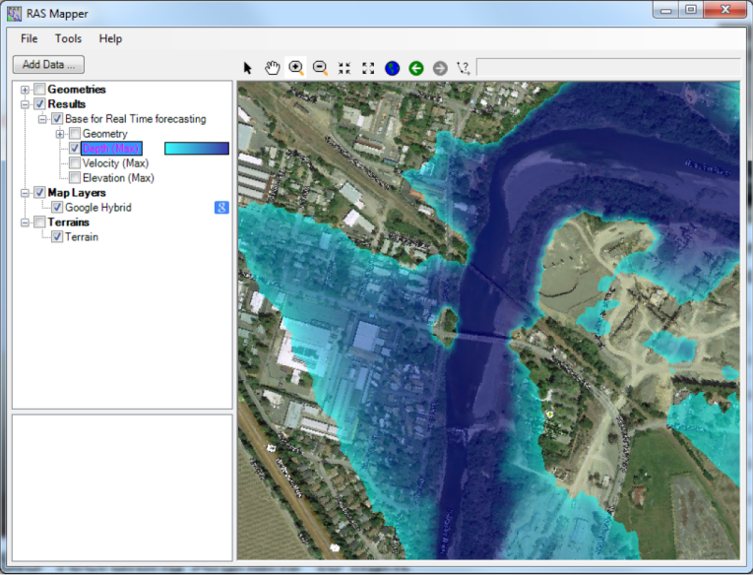
PA5: Flood management
‘WBIF project’
Sava FRM Plan (kick-off in April, Inception workshop in July 2017, draft Outline soon)
Sava FFWS (Pre-release version 0.2 + training held in June 13-14, 2017)
Hydrologic model
Hydraulic model
Consequence assessment
3
3

Slide 4
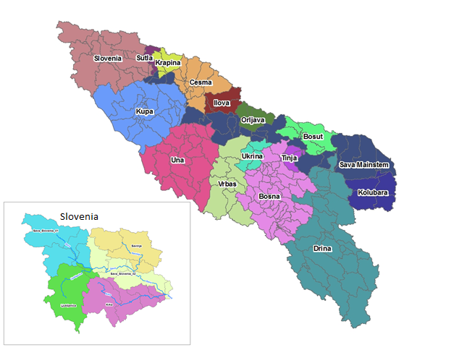
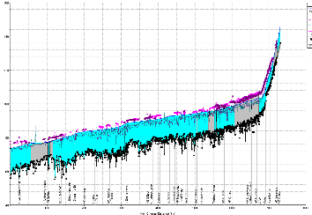
PA5: Flood management
Simulation models
Hydrological model of the Sava River Basin (2010, 2014, 2016) incorporated into Sava FFWS
Hydraulic model in preparation
4
4

Slide 5
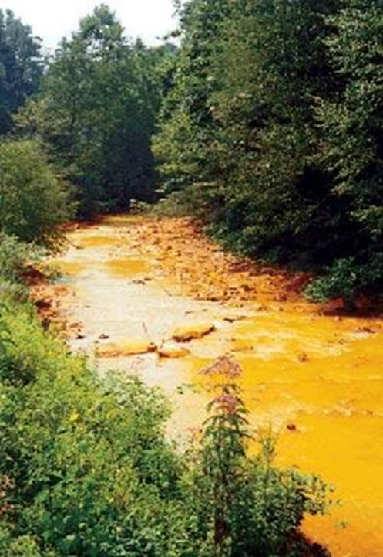
PA5: Accident pollution and control
Water Pollution Contingency Management System
Main objective
to address the specific environmental risk - accidental pollution
upgrading them with rapid response procedures, emergency management plans
web-based accidental pollution rapid response system toolbox
Partnership
11 Project partners, 10 Associated strategic partners
(LP:Univerity of Ljubljana (SI), SI, HR, RO,HU,RS, BA, UA, AT, SK)
Project proposal submitted to 2nd call of DTP.
5

Slide 6
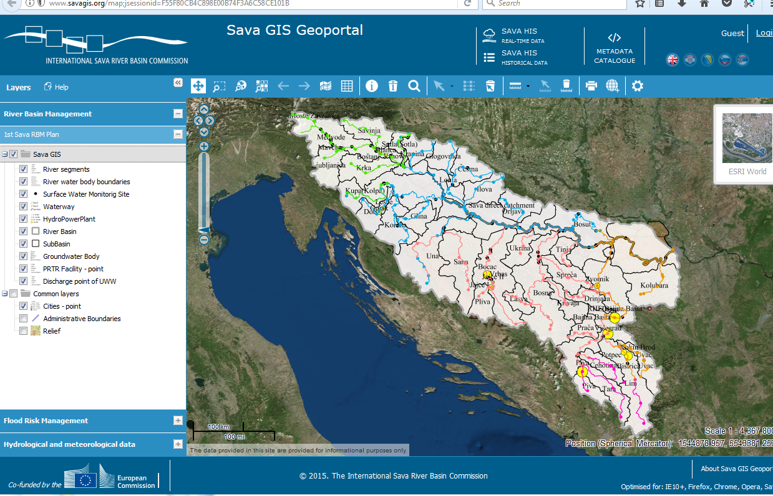
PA4, PA5: Data and information exchange
Sava GIS
FRM module to be upgraded through WBIF project
Sediment module in implementation
Navigation module in planning
www.savagis.org

Slide 7
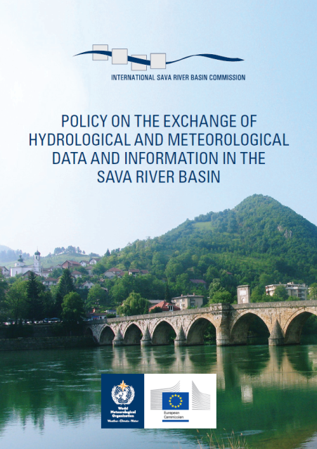
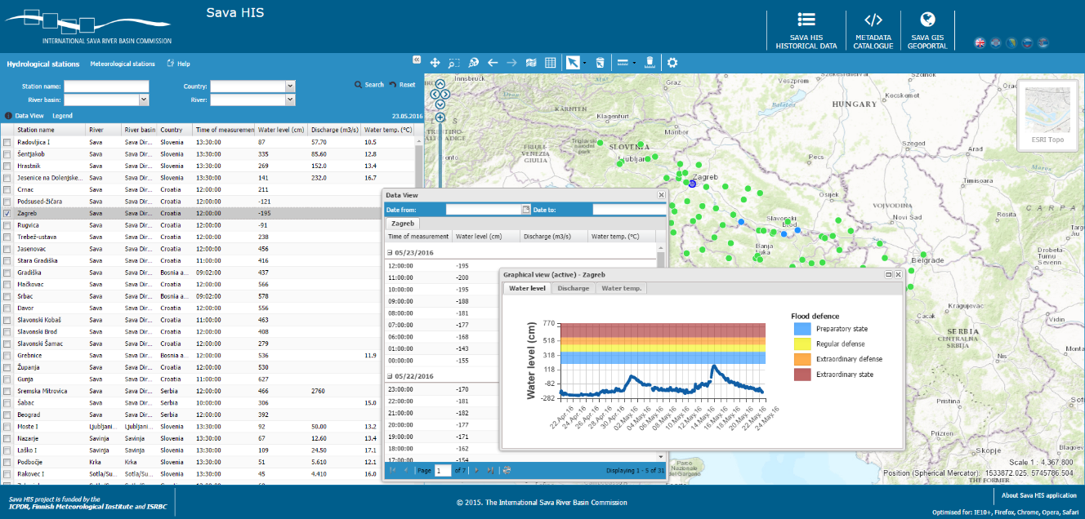
PA4, PA5: Data and information exchange
Sava HIS – on line data from selected HM stations
For the purpose of Sava FFWS:
the number of gauging stations increased
hourly meteo-data provided
increased
www.savahis.org

Slide 8


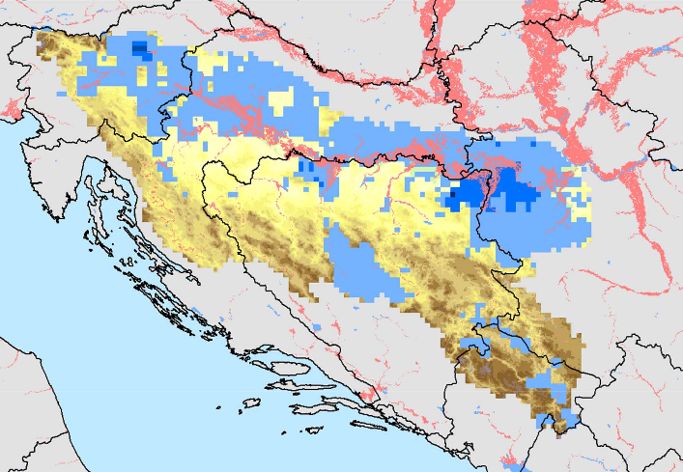
Other projects/activities
Consideration of intersectoral linkages
(water, food, energy, navigation, tourism, environment)
Sava Nexus – finnished (available at http://savacommission.org/news_detail/163/1)
Danube Water Nexus Project – Sava Case Study, implemented by the EC Joint Research Center (finalized in 2016)
Drina Nexus Assessment – finnished, June 2017 (avaiable at https://www.unece.org/index.php?id=46164)

Slide 9
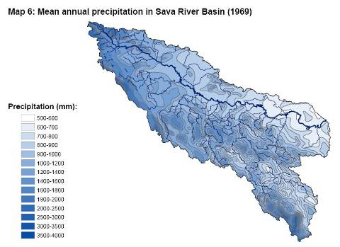
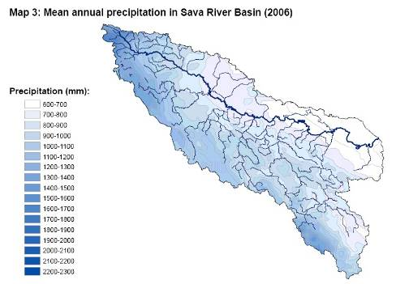
Other projects/activities
Adaptation on climate change
Outline of the Climate Adaptation Strategy and priority measures basin-wide for the Sava River Basin
to develop an Outline of the climate change adaptation strategy for Sava River Basin in consistence with the ICPDR’s regional adaptation strategy
to identify some priority basin-wide measures for CC adaptation;
to suggest modalities and cost estimates for the full development of the strategy and of its action plan.
The project is supported by IOWater and UNECE.

Slide 10
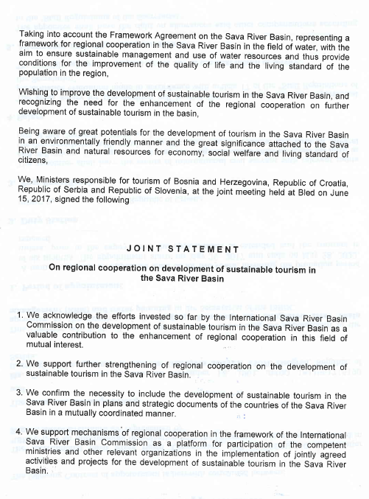
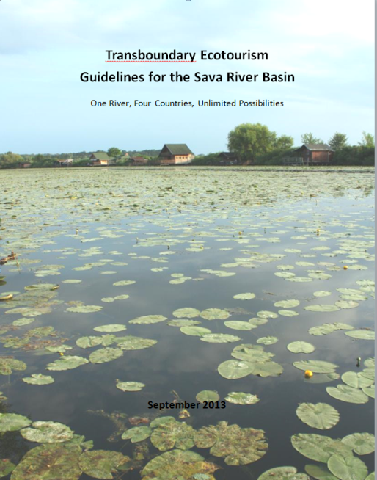
Other projects/activities
Tourism development
Roundtable (Zagreb, 7 Mar. 2017)
Joint statement On regional cooperation on development of sustainable tourism in the Sava River Basin signed (Bled, 15 June 2017)
Wetlands Ecotourism in the Danube River Basin (Danube Wets Ecotour)- project proposal submitted to 2nd call of DTP

Slide 11
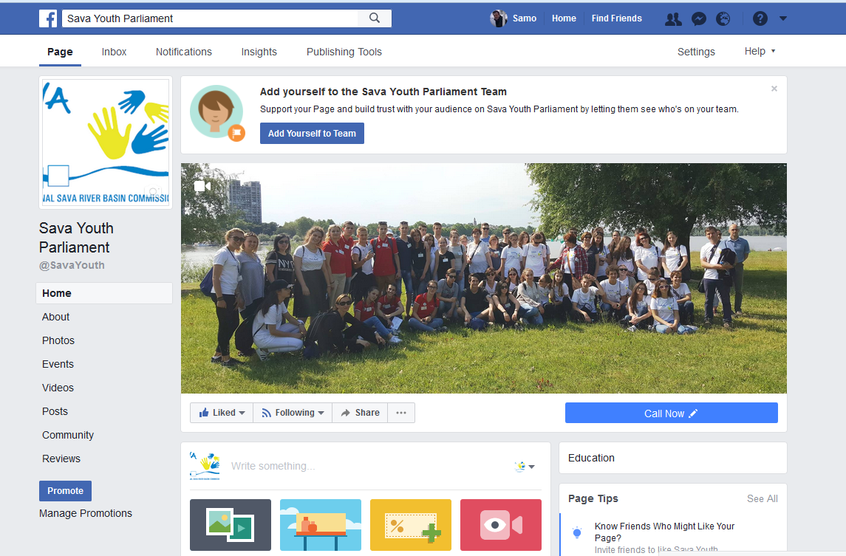
Public Participation
Strengthening public participation and stakeholder involvement in the SRB
Youth Parliament initiative
web page: http://sava-youthparliament.com/ - established
Facebook: https://www.facebook.com/SavaYouth/ - established
6th Youth parliament was held in Belgrade (RS) (June 2-3, 2017)

Slide 12
Protocols to FASRB
Protocol on | Signed | Ratified by | In force since
Navigation Regime | Kranjska Gora, 3 Dec. 2002 | All Parties | 29 December 2004
Prevention of Water Pollution caused by Navigation | Belgrade, 1 June 2009 | All Parties | 8 October 2017
Flood Protection | Gradiška, 1 June 2010 | All Parties | 27 November 2015
Sediment Management | Brčko, 6 July 2015 | All Parties | 8 October 2017
Emergency Situations | Final harmonization expected
Transboundary Impact | Draft under reconsideration

Slide 13
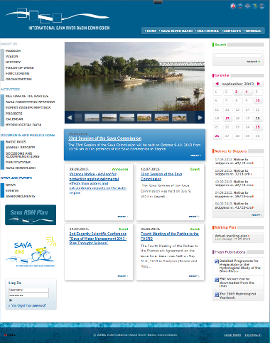
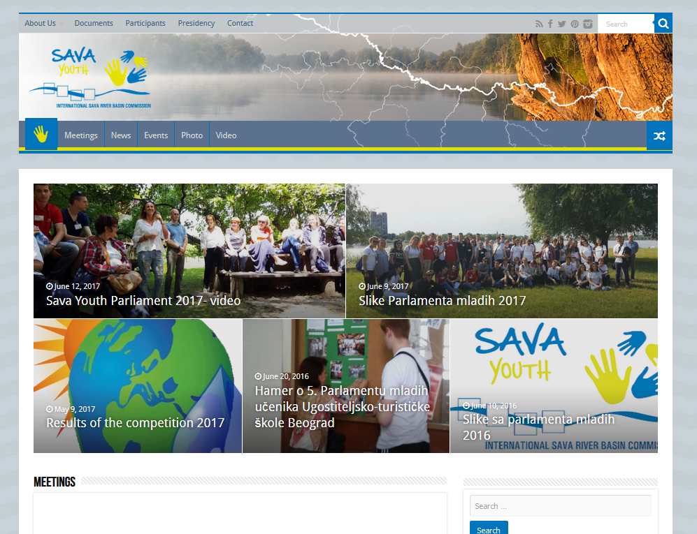
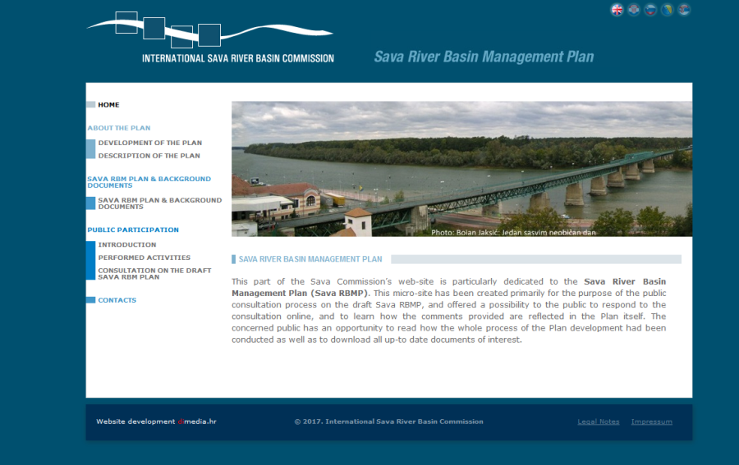
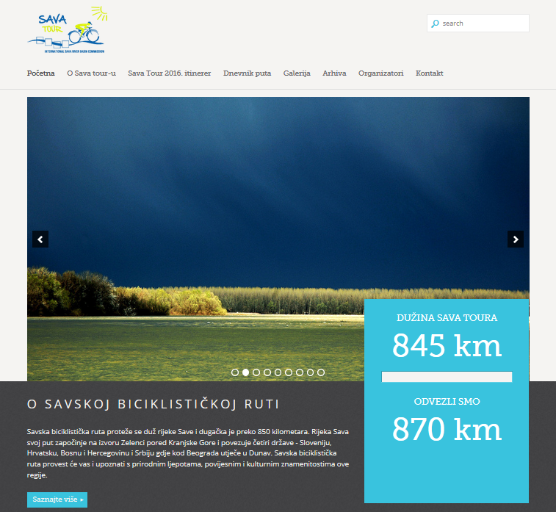
Contact information
International Sava River Basin Commission
Kneza Branimira 29
10000 Zagreb
Croatia
www.savacommission.org

