Slide 1


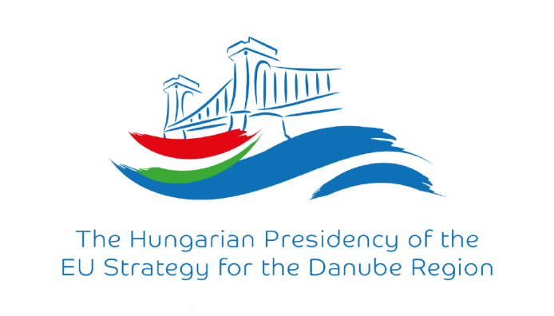
TRIMONITOR Danube TRIbutary MONITORing programme
Balázs Horváth
EUSDR PAC4

Slide 2
Project proposal
The main topic is to extend the coverage of JDS-4 to shared water courses (tributaries) beside the Danube which have common importance and effect on the Danube water quality issues
The aim is to define a monitoring programme to help the national and basin-wide WFD execution, international cooperation and raise attention on common responsibility. Execute the monitoring activity on pilot tributaries preferably in the same time as JDS-4 (2019) and accomplish joint analyses and evaluation
The monitoring helps to define the main pressures location and the effect of the tributaries on the Danube parameters. It could create reference stage which should be revised regularly. Long-term detection of alterations would be possible and sustainable common planning could be initiated.
Main outputs could be:
Joint monitoring program (location, measurements, agreed evaluation criterias)
Joint field measurements on selected rivers preferably in the same time as JDS-4
Common evaluation (IS database, longitudial profiles, weighting and conclusions)
Strategical action plan and long-term schedule with priorities
EU SDR PA4 is willing to facilitate the project preparation and OVF (HU) introduces the project as potential (Lead) Partner

Slide 3

Potential financing program: Central Europe 3rd call – some details
Countries: AT, CR, CZ, HU, PL, SK, SI, DE (South-East), IT (Northern part). Partner from outside of the target area is possible, but in very specific cases (not recommended)
Available ~60 M EUR; 20M€ to priority 3, 10M€ to priority 2
Projects magnitude 1-5 M EUR, average 2 M EUR
Min. 3 partners from 3 different countries, max. 12 partner, average 7-10
Usually 2-3 years duration, final deadline December 2021
1 step evaluation process
Evaluation priorities: relevance, partnership, implementation. If relevance criteria does not meet it is dismissed. Discuss with JS! (online chat, Linked-in Webinars, Q&A, national coordinators, JS Helpdesk - Lubor Jusko)
Submission deadline.: 18:00 on 25th of January in 2018
Transnational thematic workshop 7-8. november 2017, Prague, CZ

Slide 4

Thank you for your attention!
Contact:
EUSDR Water Quality Priority Area (PA4) Hungarian coordination:
Balázs HORVÁTH
HU Priority Area Coordinator
Mail: horvath.balazs@ovf.hu
Web: https://www.danubewaterquality.eu/

