Slide 1
JRC Scientific support to the EUSDR
An update
Alberto Pistocchi

Slide 2
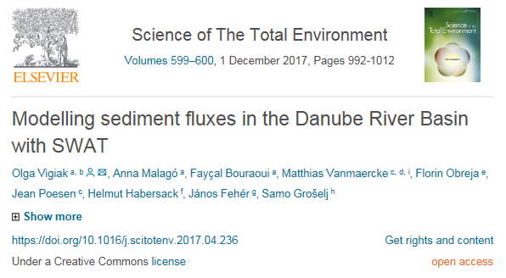
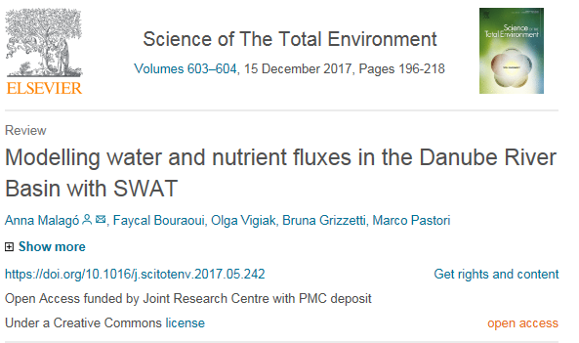
Sediments and nutrients
work finished, datasets and model (SWAT) ready
faycal.bouraoui@ec.Europa.eu

Slide 3
Water balance and climate scenarios
Work being finalized
Link with Danube climate adaptation work
ad.de-roo@ec.Europa.eu

Slide 4
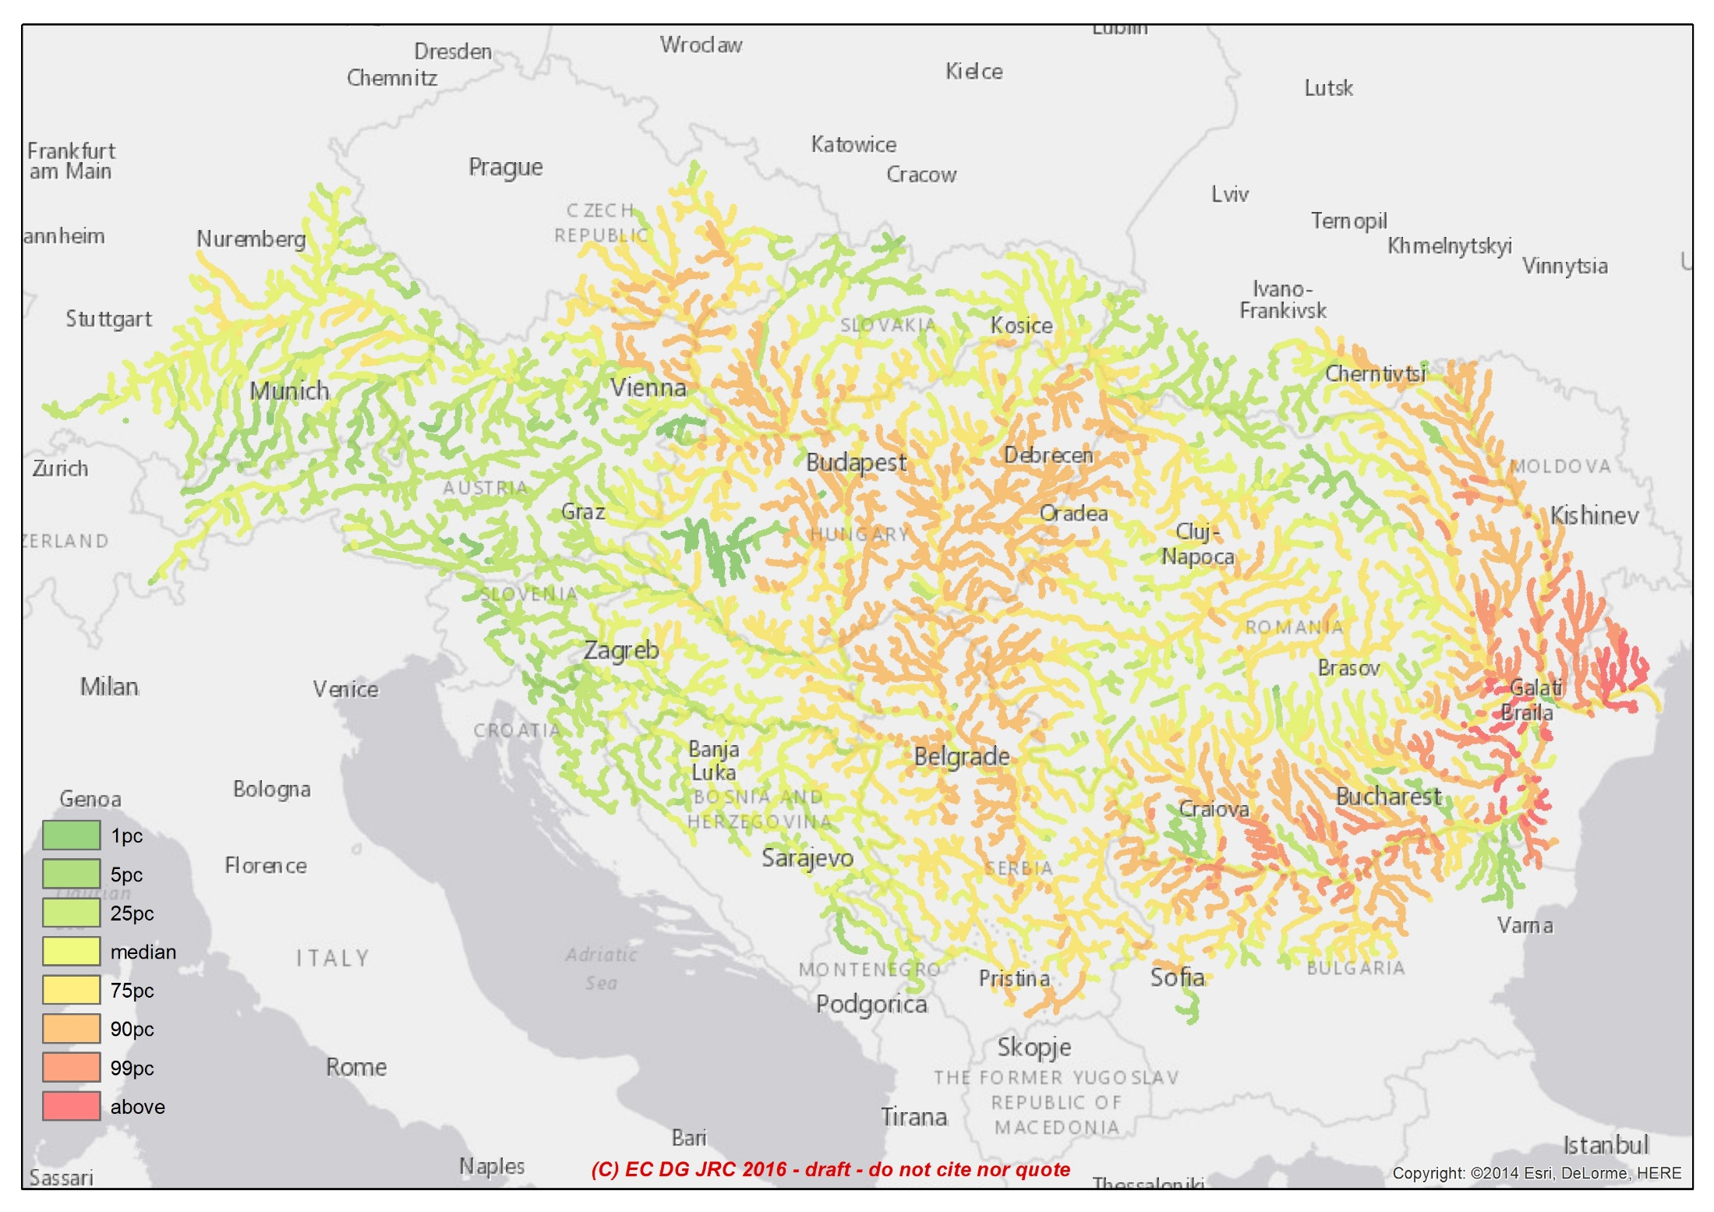
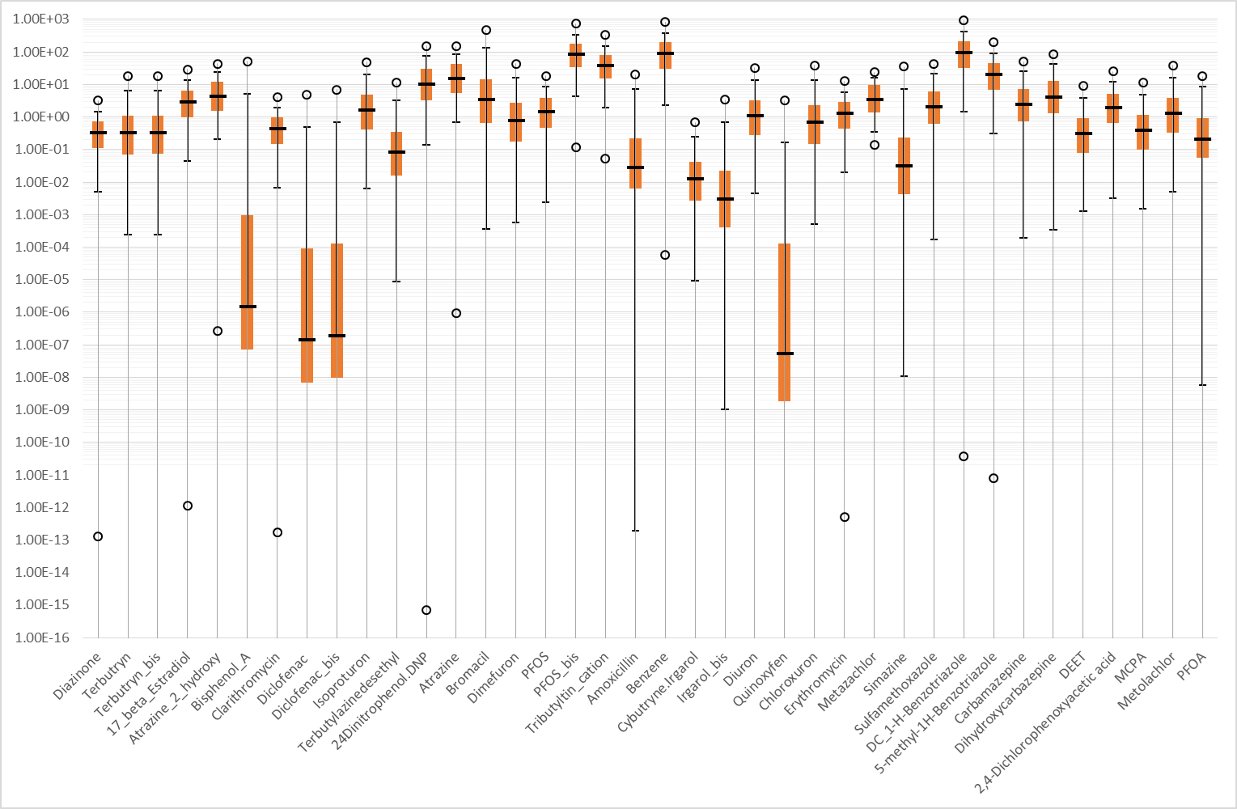
Chemicals
37 substances from JDS3 - Emission factors estimated; maps of concentrations/loads;
Validation underway/scientific paper to be submitted
Feedback welcome! Volunteers sought
Plans to extend the exercise to the next JDS?

Slide 5
Groundwater
Experts from DE, AT, SK, RS, HU, HR, SI, RO, BG
Data on abstractions, water levels, K, T collected
Database organized
Report with edited expert reports under finalization (June 2018)
Demonstration of opportunities and limitations for a bottom-up development of groundwater models
Is it possible to estimate GW residence time at regional scale?
PhD/MSc theses welcome – JRC supervision and GIS infrastructure offered

Slide 6
Wastewater treatment/synthesis centres
Feasibility studies in RS (“large plant”, focus on energy recovery) and SI (“small plants”, focus on constructed wetlands)
“reality check” underway in RO, BG, HR, BA, ME, UA, MD (deadline end May 2018)
Preparation of a report by June 2018
Continuing support to ICPDR/WB/IAWD Danube wastewater initiative

Slide 7
“Synthesis centres”
Discuss problem within community + identify technical options
Discuss solutions with stakeholders – let Smithian self-interest work for you
Examine opportunities beyond silos
Consider the opportunity side of problems: innovation/investments/growth/jobs…
Identify business models to make it happen

Slide 8
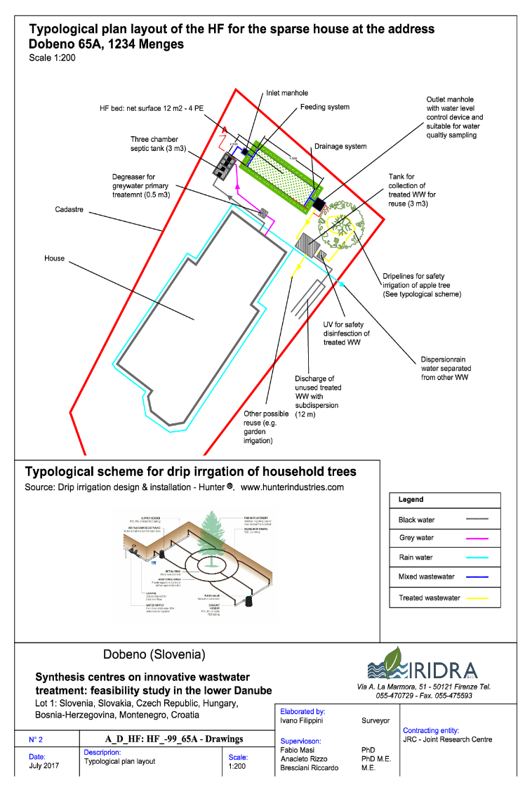
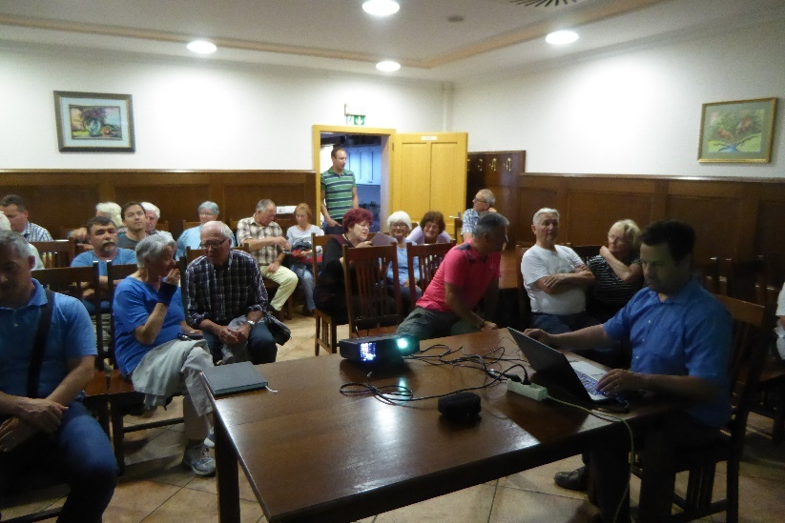
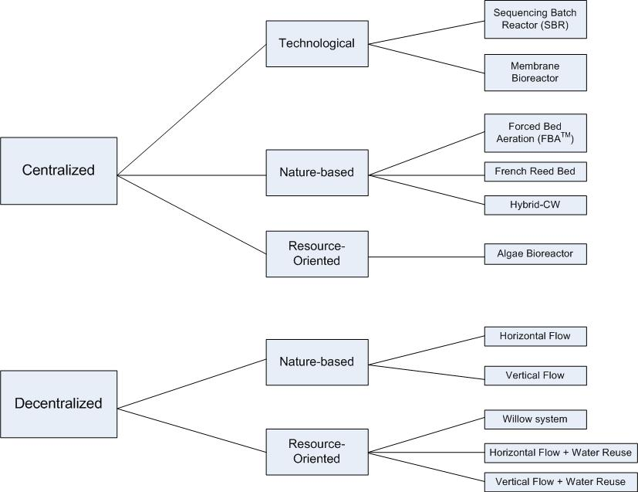
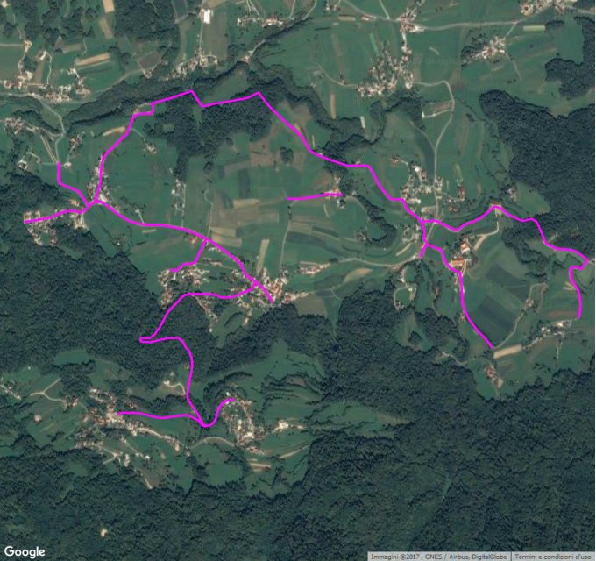
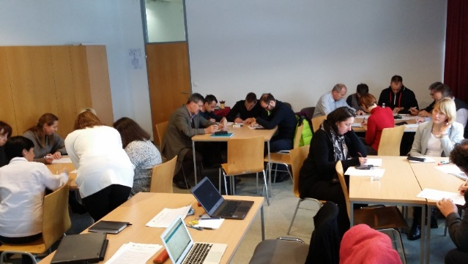

Slide 9
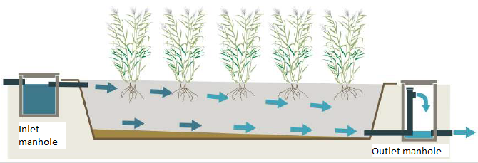
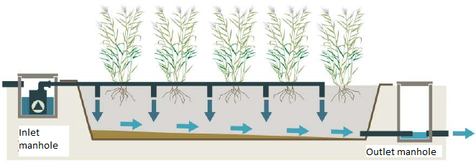
SC 1 - Slovenia
Small communities, decentralized (mostly nature-based) solutions
Preference for decentralized constructed wetlands allowing water reuse for fruit tree (fert)irrigation
Notes:
The feasibility study for nature-based solutions in Slovenia indicates that constructed wetlands are an attractive option for smaller settlements (still a significant source of pollution in the Danube) because of their low costs of operation and maintenance. They can be particularly effective if run also for treated water reuse, e.g. for family orchard irrigation, in which case attention for treatment efficiency is motivated not just by compliance with standards but also because the served community needs the reused water to be safe.

Slide 10
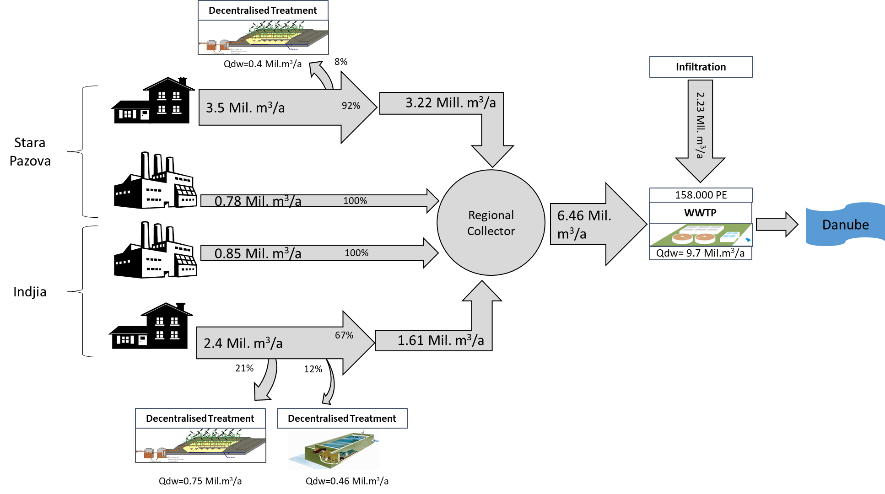
SC2 – Serbia

Slide 11
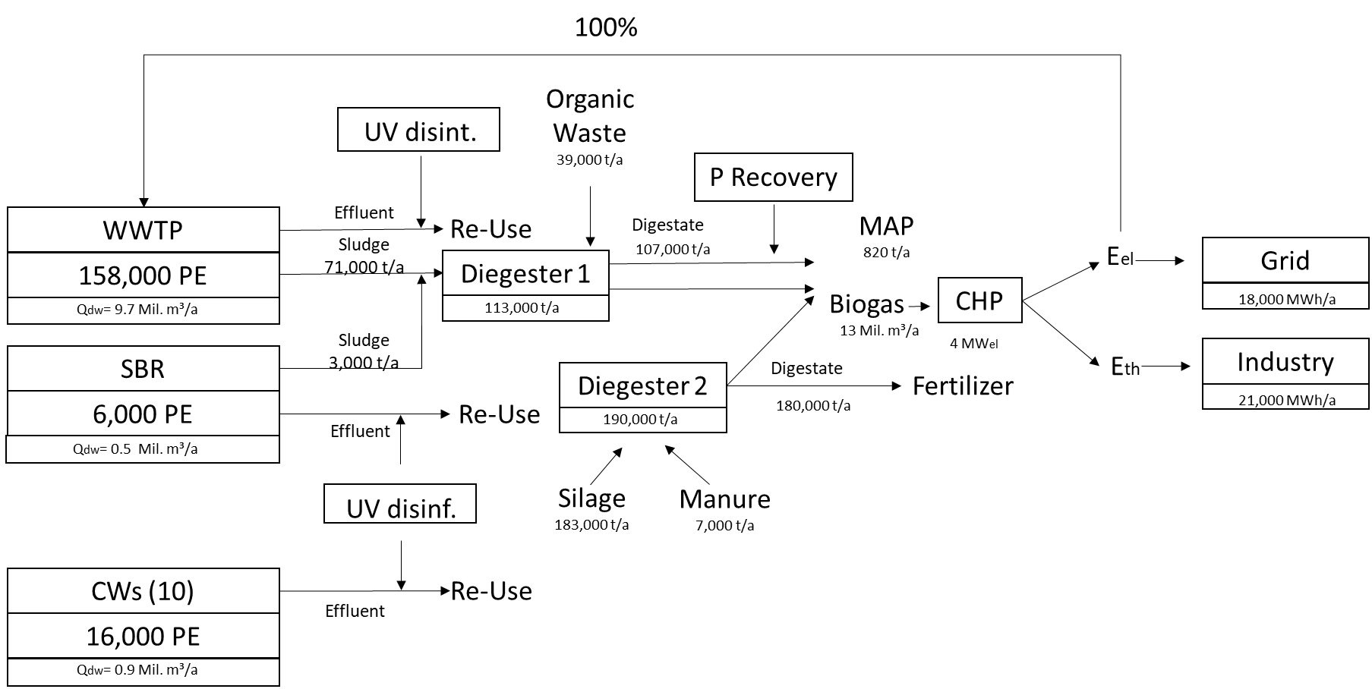
SC 2 - Serbia
Relatively Large centralized WWTP
Tariffs may be reduced by enlarging the « system boundaries »:
treat wastewater together with agricultural and municipal waste digestion ➔ recovery of energy + fertilizers
WWT is the pivot of a resource-efficient agro-industrial system
Notes:
The feasibility study for centralized wastewater treatment in Serbia explores the opportunity to couple the wastewater treatment plant with a digestion plant for sludge and agricultural, municipal and industrial waste. The coupling allows in principle to generate renewable energy sufficient to feed the wastewater treatment processes themselves, in addition to selling surplus thermal and electric energy. The corresponding incomes may help reducing the tariffs for wastewater treatment. At the same time, this solution poses significant challenges to be addressed in terms of efficiency and effectiveness of the processes, logistics related to the collection of waste, and risks related to the disposal of the digestate.

Slide 12
Challenges
Small treatment systems: issues with performance enforcement; monitoring
Large systems: extending system boundaries introduces complexity, logistic and technical challenges

Slide 13
Way forward
Test cases in MD, UA, HR, BA, RO, BG
Are the solutions applicable?
What are the specific challenges/opportunities?

Slide 14
“Pre-design” of the relevant solutions in the case study
total investment and operation cost
N, P, BOD loads/abatement
recovered flows of energy, water and nutrients from wastewater and their market value
tariffs necessary to cover the wastewater treatment service, net of revenues
areas where the proposed business models could be sustainably replicated, and areas with still insufficient capacity to pay for wastewater treatment.

Slide 15
Reality checks
Identify the relevant stakeholders/actors
WWTP operator,
local competent authorities
Municipality/local community
One-day discussion
present a set of wastewater solutions,
feedback
what is feasible (technically and economically),
possible bottlenecks and limiting factors, difficulties and opportunities.

Slide 16
Solutions
Large AS plant
SBR
CW
“improved” CW
Algae-based technologies
Evaporative willow system
Biogas from sludge
Fertilizer from digestate
Struvite
Water reuse
Biogas from sludge + organic waste
District heating
MBR

Slide 17
Way forward
WWT is a necessity; can it become an opportunity?
Properly designed small decentralized plants can be useful; issues with monitoring/responsibility can be partly addressed through aligning interests (e.g. water reuse)
Extending the boundaries of the WWT system(e.g. energy from organic waste, nutrient recovery) may stimulate the circular economy and add value
JRC supporting “solutions exploration”: synthesis centres approach

Slide 18
Scenarios for the Danube region
Foresight workshop in Budapest, October 2016
Draft report being finalized (june 2018)
Feedback from participants and publication by summer 2018

Slide 19





Stay in touch
JRC Science Hub: ec.europa.eu/jrc
Twitter:
@EU_ScienceHub
Facebook:
EU Science Hub – Joint Research Centre
LinkedIn: Joint Research Centre (JRC) - European Commission's Science Service
YouTube:
JRC Audiovisuals
Vimeo:
Science@EC

