Slide 1
no. 25 Steering Group Meeting of
EUSDR Priority Area 4
23 – 24 May 2023 | Bratislava

Slide 2

DSP support frame
Support for EUSDR core-stakeholders
Embedding / Funding
Capacity Building
Monitoring / Evaluation
Youth
Communication

Slide 3







DSP support for core stakeholders
What remains?
Support to PACs in organising SG meetings
technical/thematic support in organising SG meetings (web-based tools) & support of youth inclusion into PAs.
Technical and thematic support to PAC events
technical and thematic assistance to PAC events
(except Steering Group Meetings)
Cross-PA and cross-MRS events for PACs
support the EUSDR key stakeholders with inputs/knowledge/ exchange/adoption of ongoing initiatives and/or capitalisation trends
Revision of contact lists & common calendar
contact change in NCs/PACs/SG-members and events are updated
in EUSDR mailing & contact lists, website, intranet and smart app
“Unfolding EUSDR” sessions
tailored to specific needs of stakeholders to provide the newly appointed EUSDR governance actors an introduction sessions

Slide 4




DSP support for core stakeholders
Support to PACs in organising hybrid events
What’s new?
specific events to gain knowledge about hybrid events & guidelines
Targeted design for NCs, PACs, NCs-PACs and SGM
elaborating a USP / benefits / added value for and with interested
PAs to streghthen cooperation/ownership for horisontal coordination
Process-driven framework for PACs
support in narrowing/streamlining the topics within a PA
(e.g. WG/TF)
PACs team building seminars
support for horizontal EUSDR coordination/implementation by increasing mutual trust/cooperation/ownership at political level

Slide 5





Embedding process
Summary
01/2020
11/2020
ongoing
EUSDR TASK FORCE
MA LEAFLET & SK EUSDR Presidency Paper
Updates
formed for embedding the EUSDR into EU Programmes (EMB-DR); support for strategic planning and programming of the ESI/IPA III/ NDICI funds (5 meetings held)
Embedding a nutshell provided to MAs in the Danube Reingion incl. embedding formats.
FROM WORDS TO ACTION! Discussion Paper on further potential tools and processes for embedding initiated under the SK EUSDR Presidency
Update of the EUSDR Embedding Tool Annex 1a/1b (sources document)
Overview of the survey results of the EUSDR MA Networks (ERDF/CF & IPA/NDICI)
Paper on monitoring the outcomes of the embedding process
Guidance Paper for Embedding the EUSDR into EU Programmes - FROM ACTIONS TO FUNDING
Guidance Paper for Embedding from the Slovenian EUSDR Presidency
03/2020
EUSDR EMBEDDING TOOL with the SHORTLIST of STRATEGIC TOPICS
01/2021
elaborated as rolling document based on a screening of available funding instruments (EU and non-EU). In this matrix, for each action and strategic topic possible funding instruments are suggested. The shortlist of three strategic topics per PA was submitted by the PACs in 05/2020 and in endorsed in 10/2020.
MA NETWORKS
ESF MA Network since 2015
ERDF/CF MA Network est. 01/2021 (2 meetings held)
IPA/NDICI programming authorities network est. 04/2021 (3 meetings held)
Surveys conducted among the MA networks for better aligning priorities of the programmes to the actions/shortlisted strategic topics of the EUSDR

Slide 6

Embedding tools
The Guidance Paper for Embedding of the EUSDR : comprehensive instructions for the EUSDR Embedding process including a table filled in by Priority Areas to provide up to three strategic topics (per PA) and detailed description of each strategic topic (shortlist)
Guidance Paper for Embedding the EUSDR into EU Programmes - FROM ACTIONS TO FUNDING: further possible course of action, also putting emphasis on embedding the EUSDR in non-EU countries
UPDATED! The EUSDR Embedding Tool (Annex 1a): Actions of the EUSDR AP and of the shortlisted strategic topics, which have been in each case allocated to possible EU funds, IPA III and NDICI funds as well as to the Annexes D of the Country Reports 2019 and 2020
UPDATED! Sources for content of funding instruments (Annex 1b): a compilation of funding instrument sources to support PACs in their selection of strategic topics and NCs in approaching the MAs.
EUSDR EMBEDDING – FROM WORDS TO ACTION! Discussion Paper: discussion paper on further potential tools and processes for embedding initiated under the SK EUSDR PRESIDENCY
Updated! Overview of surveys of EUSDR MA Networks (ERDF/CF and IPA/NDICI): Based on the results of the surveys conducted in spring 2021, documents were designed to better align priorities of the programmes to the actions/shortlisted strategic topics of the EUSDR
MA Leaflet to embed the EUSDR into EU programmes 2021 – 2027: the how, the why, the what summary of EUSDR embedding for representatives of managing/programming authorities, NCs, PACs and other stakeholders working on embedding into EU programmes
Guidance Paper for Embedding the EUSDR into EU Programmes - FROM PROGRAMMING TO IMPLEMENTATION: concrete steps from the programming to the implementation phase with a focus on embedding in non-EU countries, cross-cooperation between MRS and cross-cooperation between the Priority Areas.
For EUSDR embedding process and the EUSDR tools elaborated, please visit:
https://danube-region.eu/projects-and-funding/embedding-2021-2027/
Notes:
Small recap of the tool available so far

Slide 7

Embedding / Funding
Embedding
2023/2024
Strategic Guidance Papers
EUSDR Embedding Weeks
EUSDR MA Network Meetings
Embedding/
funding support for PACs
May 2023
by SI
EUSDR
PCY
Embedding process expected to be completed by 12/2024 at the latest – focus on Implementation.
Subsequent, targeted further support on the topics of financing and funding programmes is envisaged.
Support by EuroAccess in providing tailor made overview of EU calls.
e.g. HE Mission support
12-16
June
2023
10
May
2023

Slide 8





Monitoring the outcomes of the embedding process
Programming Phase
Mapping of cooperation actions, including MRS embedding, by INTERACT
(based on EC screening of ERDF programmes)
Additional input from EUSDR Evaluations, NCs (e.g. Task Force EMB-DR) and managing/programming authorities (MA network meetings)
Potential steps and information sources
Implementation Phase
Scanning calls for EUSDR relevance via EuroAccess
Monitoring of projects via PAC Reporting Tool
Monitoring of projects via managing/programming authorities (e.g. labelling of projects, extra points for project proposals with MRS relevance, a standing point at programme MC meetings?)
Keeping track of programme evaluations
EUSDR
→ Interim and final report/analysis on outcomes of Embedding (2025 & 2028)

Slide 9
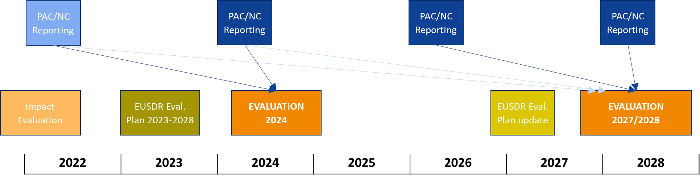
Monitoring & Evaluation
EUSDR Implementation Report 2020-2021
Published on the EUSDR Website
Summarising the progress and achievements of Priority Areas (PAC reporting) as well as on EUSDR level
Next reporting: 2024
(covering the period 2022-2023)
2023-2028: 2 Evaluations planned
Details currently being elaborated in the Evaluation Plan
In coordination with SG DANUVAL (meeting held on 10 May 2023)
Thematic focus (based on online survey and discussion with SG DANUVAL): strategic dimension, governance, technical implementation, policy impact, financial issues

Slide 10

Danube Strategy Flagships
Promotion of Danube Strategy Flagships 2022 ongoing
Identification of Danube Strategy Flagships 2023 according to the Guidance Paper started in March 2023
Selection of Flagships by the PA based on SG decision
(min. 1 and max. 3 new or updated Flagships per PA)
Submission of Flagships by the PACs via online form (https://danube-region.eu/danube-strategy-flagships-submission-2023) until 10 July 2023
Distribution & promotion of Flagships 2023 from autumn 2023 onwards

Slide 11

Communication
Annual Action Plan
Social media platforms constantly updated & 2 campaigns/ year
Flagships 2022 promoted in spring 2023
Website & smart app functional and updated
Embedding Week (e-booklet)
Online media campaigns (2024, 2027)
Information & brand-awareness materials (annually)

Slide 12

Align communication activities more with the EUSDR PCYs for more visibility
Flagships 2022 (15 flagships) will be promoted in spring 2023 → in relation to SI PCY events, in order to better approach the PACs & their activities
Flagship 2023 → campaign on social media in autumn 2023, also in connection to relevant events
INSTAGRAM platform → more content for youth, with the help of DYC comm group (5 DYC members)
Information & brand-awareness materials → to be elaborated & disseminated

Slide 13

What is NEW …
Website
new service provider, more exciting & user-friendly, related to the smart app, for improved content
Stages: questionnaire for website-users (Apr-July 2023), ToRs elaboration: summer 2023, contract signing: autumn 2023, contract implementation: early 2024 (website developments), new website launch: end of 2024
Smart app → back-end functions corelated to the website for better coordination of the content & different content
Videos & animated banners → a new contract signed & implemented
Embedding Week → online promotion, e-booklet disseminated
April - July
2023

Slide 14
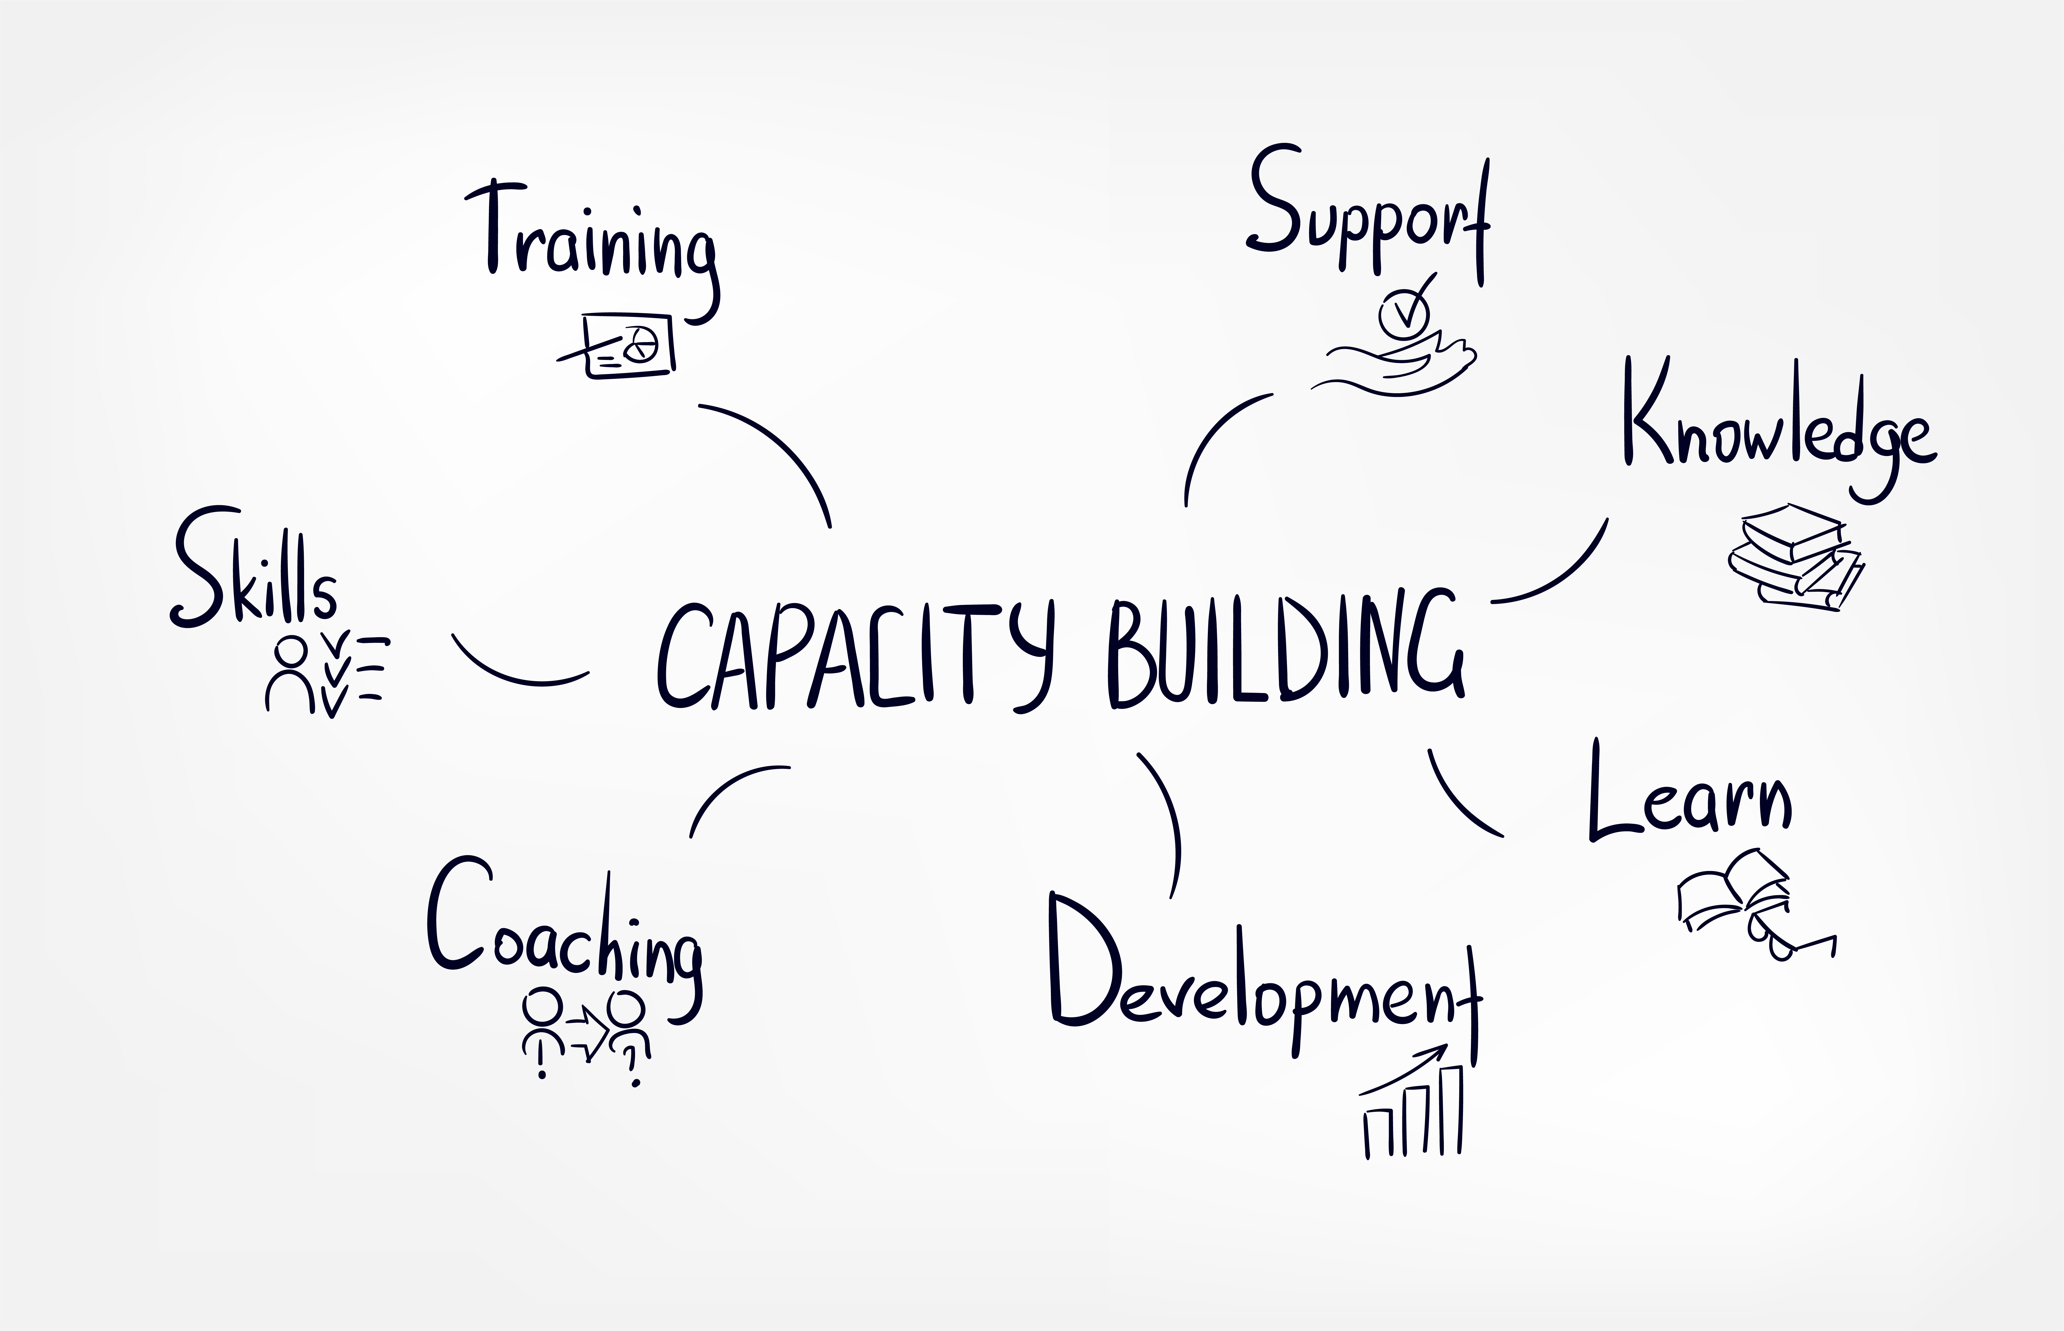
Capacity Building
Development of a capacity building (CB) framework :
  a Training Needs Analysis will be conducted in order to develop a CB framework for the EUSDR core stakeholders in respect to their roles & responsibilities:
  collect & analyse data for a training needs analysis
  develop a framework for improving capacity building through tailored training
based on TNA, 6 training sessions will be provided (1/year) - first training session will be organised in 2023.

Slide 15



Danube Youth Council
03/2023
2021 – 2022
12/2022
ESTABLISHMENT TF DYC
Danube Youth Camp
MATCHMAKING
10/2022
2023
PRESENTATION AT 11th EUSDR ANNUAL FORUM
TF DYC MEETINGS

Slide 16
Involvement of DYC members in PAs
The DYC members have begun their involvement on thematic (PA) level, based on their expressions of interest.
End of the Pilot Action in Oct. 2023: concrete steps shall be taken in the next months
Mutually beneficial exchange
PAs shall profit from gaining new, fresh perspectives / inputs
DYC members shall profit from gaining an insight into the daily work of the Strategy, making their voices heard and bringing in the perspective(s) of the young people

Slide 17
Involvement of DYC members in PAs
Possible ways of meaningful involvement:
  Letting the DYC members give their input on documents, projects, processes…
  Involving the DYC members in drafting reports, studies, agendas…
  Inviting the DYC members to meetings, conferences, events and (if possible) giving them an active role
  → Discussion and best-practices sharing with the DYC members & PACs

Slide 18
DYC members / PA-SG meetings participation
To support and intensify contacts with the PAs:
  DYC members should have the opportunity to participate in SG meetings
  Get in touch with SG members
  PAs shall use the benefits of onsite and online environments
  DYC members shall gain an insight into the work of PAs and actively contribute to the implementation of EUSDR
  Enabling this: via EC‘s Pilot Action budget within the DSP: 1 DYC member – to attend 1 SG meeting of each PA onsite, until 10/2023. A maximum of 1 onsite DYC-attendee per PA, covering travel and accommodation costs. Technicalities timely via DSP (3 weeks in advance): office@eusdr-dsp.eu.
  Above that:
    Online participation of DYC-members in SG meetings
    Coverage of travel and accommodation via PAC budgets

Slide 19
What’s next?
Priority Area & cross-PA/MRS relevant events
Scope | Date | Location
8th EUSAIR Annual Forum | 23-25 May 2023 | Sarajevo, BA
Horizon Europe Opportunities for Danube Countries | 24 May 2023 | online
EUSDR Chat with the Presidency | 31 May 2023 | online
EUSDR Embedding Week | 12-16 June 2023 | online
The Danube Region at turn of times | 10 July 2023 | Stuttgart, DE/BW
Young Bled Strategic Forum | 25-27 August 2023 | Bled, SI
Mediterranean Coast & MRS Week | 18-22 September 2023 | Izola, SI
Danube Region Transport Days | 3-4 October 2023 | Ljubljana, SI
14th EUSBSR Annual Forum | 4-5 October 2023 | Riga, LV
21st European Week of Regions & Cities | 9-12 October 2023 | Brussels, BE
8th Danube Parliamentary Conference | 12-13 October 2023 | Ljubljana, SI
7th Meeting of CC COP7 | 11-14 October 2023 | Belgrade, RS
10th Danube Participation Day | 23 October 2023 | Ljubljana, SI
EUSDR Management & Governance
Scope | Date 2023 | Location
SG DANUVAL Meeting | 10 May 2023 | online
EUSDR MA/programming authorities Network meeting | 10 May 2023 | online
NC Meeting | 16 May 2023 | Brdo pri Kranju, Slovenia
NC-PAC Meeting | 18-19 September 2023 | Izola, Slovenia
2nd Danube Youth Camp & POPRI Startup Challenge | 20-23 October 2023 | Primorski tehnološki park, Slovenia
12th EUSDR Annual Forum 2023 | 24-25 October 2023 | Brdo pri Kranju, Slovenia
Priority Area |  | Date 2023 | Location
SG meeting | PA 4 | 23-24 May 2023 | Bratislava, Slovakia
SG meeting | PA 2 | 31 May 2023 | Prague, Czech Reublic & online
SG meeting | PA 1b | 31 May 2023 | Ljubljana, Slovenia
SG meeting | PA 7 | 2 June 2023 | Bratislava, Slovakia
SG meeting | PA 10 | 6-7 June 2023 | Belgrade, Serbia
SG meeting | PA 9 | 14 June 2023 | Online
SG meeting | PA 8 | 10 July 2023 | Stuttgart, Germany
SG meeting | PA 11 | 11 July 2023 | online

