Slide 1













EUSDR Priority Area 4, 25th Steering Group Meeting, 23-24.5.2023, Bratislava
Project
Implementation of the river basin management plan in selected river-sub-basins in Slovakia
Project scheme | LIFE Strategic Nature and Integrated Projects (SNaP/SIP) | Partneri projektu
Acronym | LIFE21-IPE-SK-LIFE Living Rivers
Project code | 101 069 837
Duration | 1.1.2023 - 31. 12. 2023
Budget | 27 799 420,33 €
EU contribution | 16 677 073,39 €

Slide 2
Duration
1.1.2023-31.12.2032
Call | LIFE Strategic Nature and Integrated Projects (SNaP/SIP) | Partneri projektu
Acronym | LIFE21-IPE-SK-LIFE Living Rivers
Project code | 101 069 837
Duration | 1.1.2023 - 31. 12. 2023
Budget | 27 799 420,33 €
EU contribution | 16 677 073,39 €

Slide 3

Water politics
in Slovakia

Slide 4
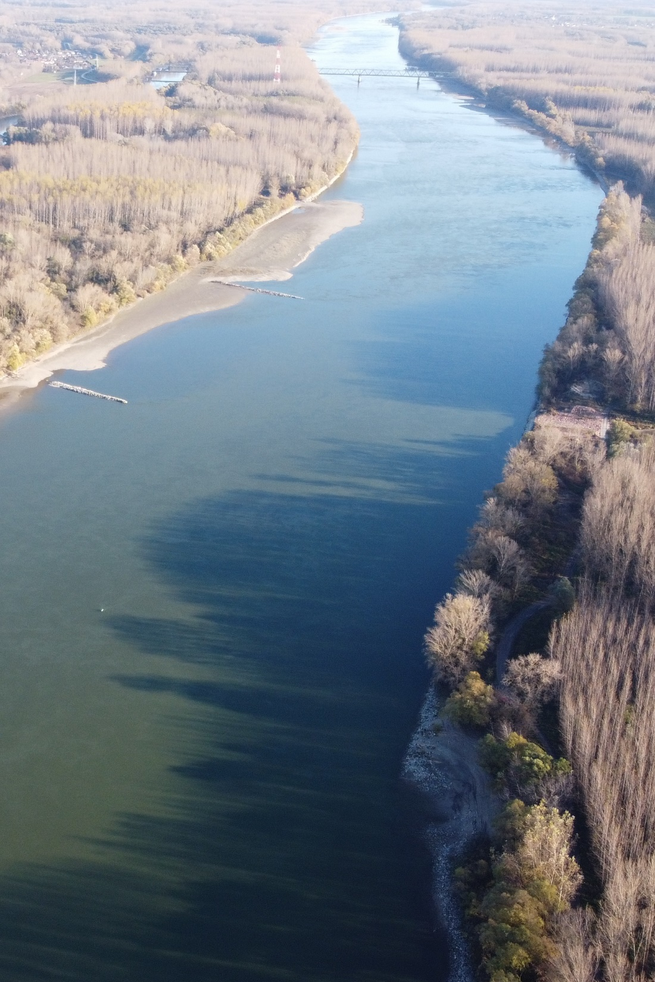
Key EU documents and directives
Water Framework directive 2000/60/EC
EU Floods directive 2007/60/EC
European Union Strategy for the Danube Region (EUSDR)
The Convention on Co-operation for the Protection and Sustainable Use of the River Danube (Danube River Protection Convention - DRPC)
EU Habitats Directive 92/43/EEC,
EU Birds directive 2009/147/EC
Convention on the Conservation of European Wildlife and Natural Habitats (Bern convention),
Convention on the Conservation of Migratory Species of Wild Animals (Bonn convention),
Pan-European Action Plan for Sturgeons
Biodiversity Strategy 2030
EU Strategy on Adaptation to Climate Change
European Green Deal
Nature Restoration Law – in preparation
...

Slide 5
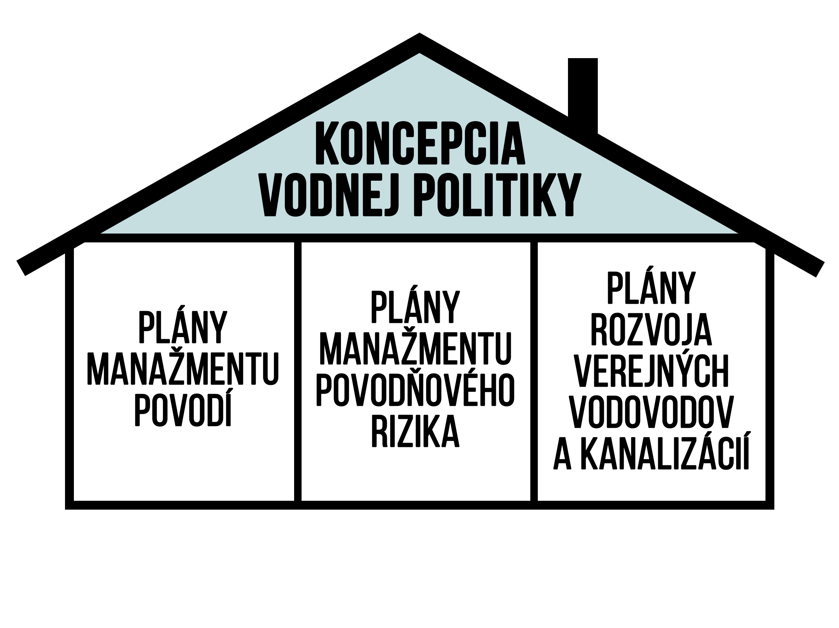
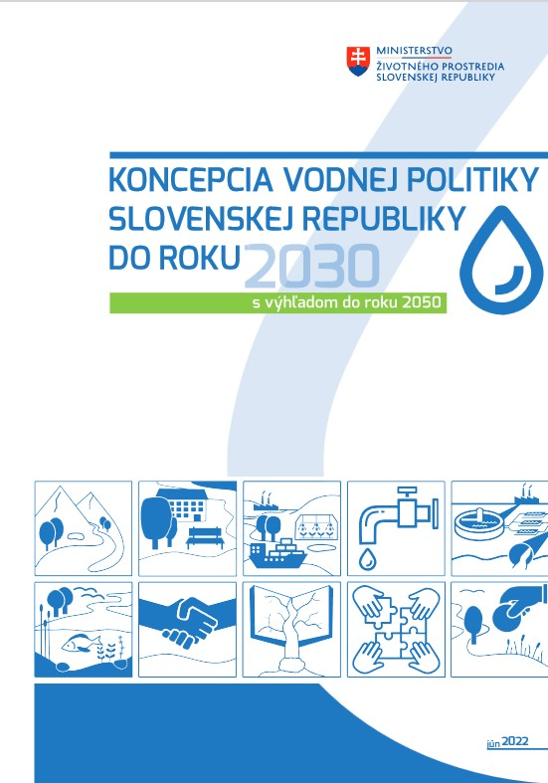
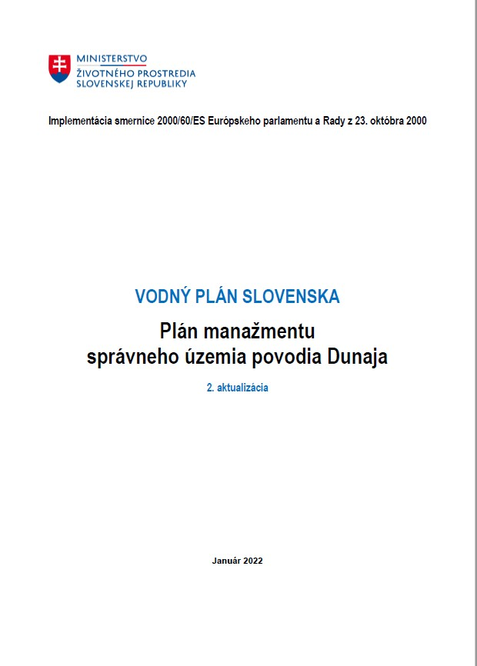
Water policy conception
River
basin management plan
Flood
risk management plan
Plan of Public Sewage and Fresh Water System
Water Policy Conception (2021-2030 with prospects till 2050) – adopted by the government 1.6.2022 https://www.minzp.sk/voda/koncepcne-dokumenty/koncepcia-vodnej-politiky-roky-2021-2030-vyhladom-do-roku-2050.html
The 3rd River Basin Management Plan (2021-2027) adopted by government 11.5.2022 https://www.minzp.sk/voda/vodny-plan-slovenska/

Slide 6
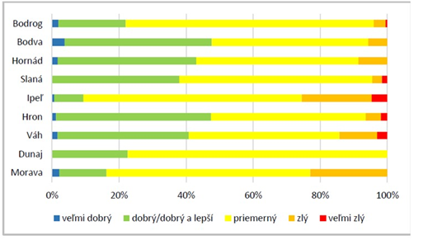
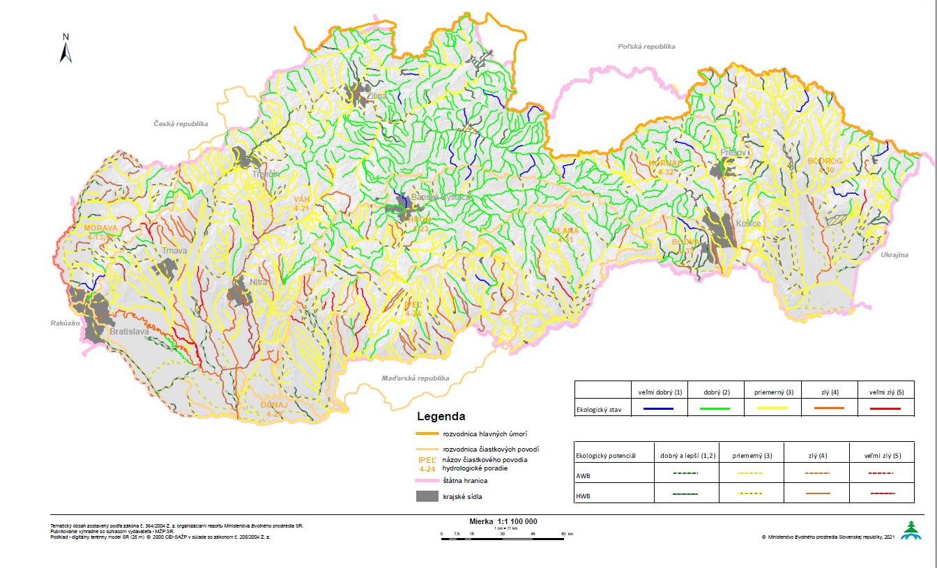
Ecological status of water bodies
2013-2018
59 %
Water bodies failed to reach good ecological status/ potential

Slide 7
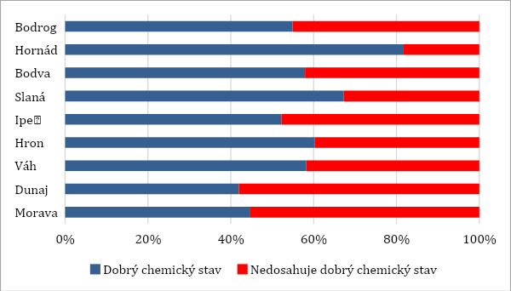
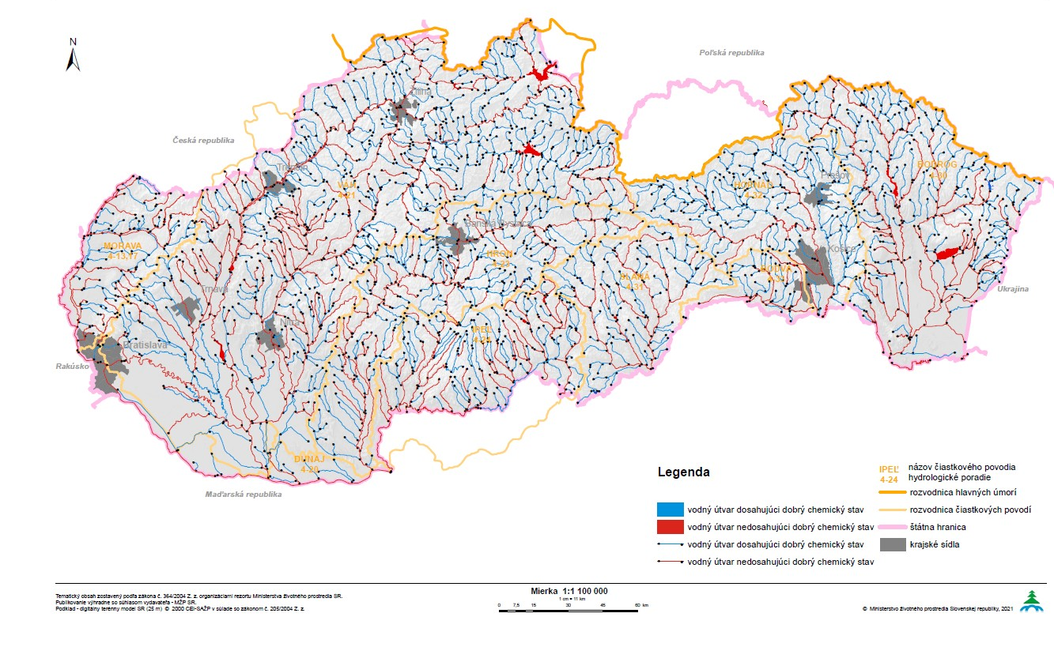
Chemical status of water bodies
2013-2018
29 %
Water bodies failed to reach good chemical status

Slide 8

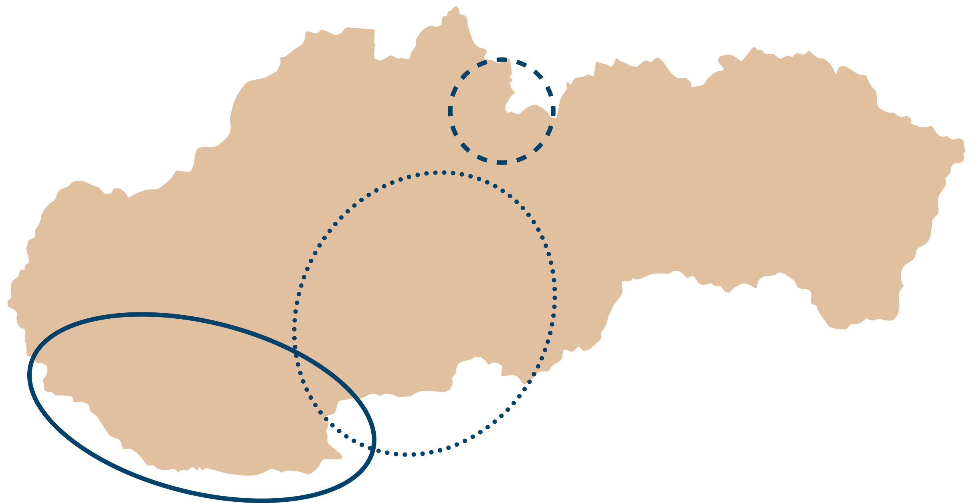
Project sub-basins
Dunaj
Hron
Ipeľ
Belá

Slide 9

Project objectives

Slide 10
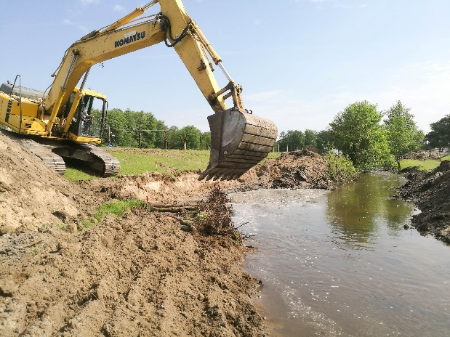
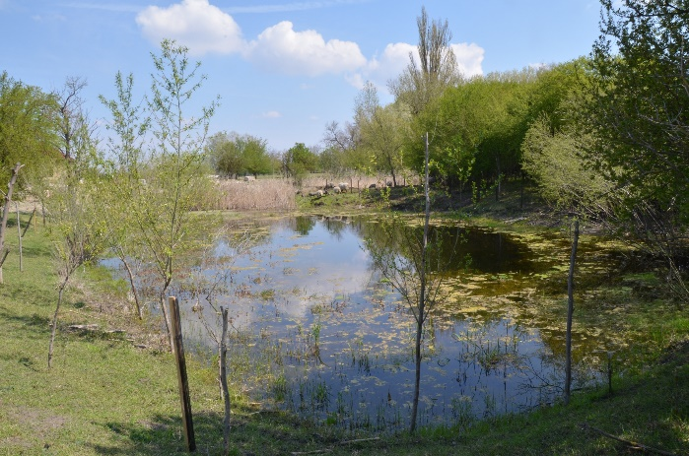
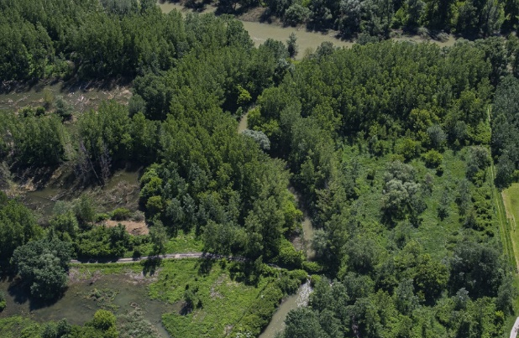
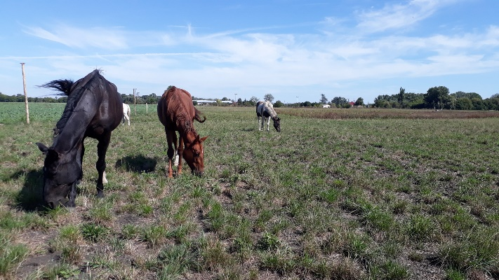
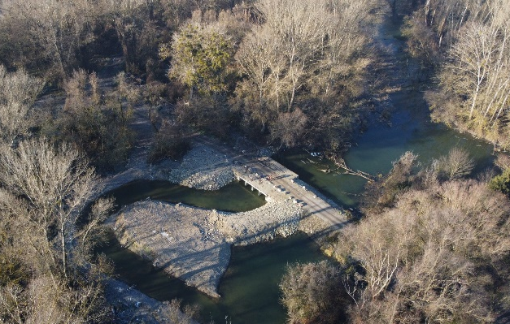
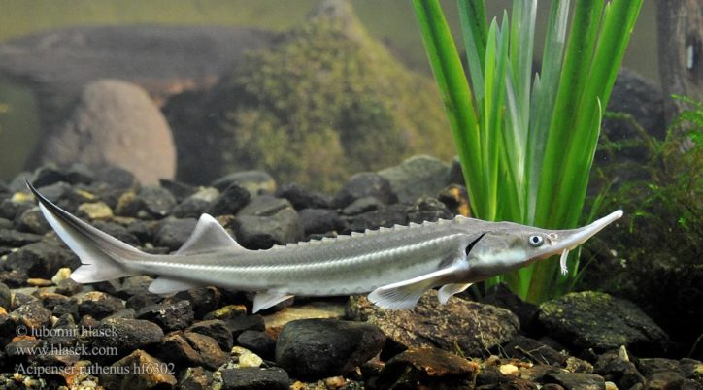
Main project goal
Implementation of the 3rd RBMP of the Danube (2021-2027) - ecological targets of the Water Framework Directive 2000/60/EC to achieve good ecological status/potential (GES/GEP) of surface water bodies
Active measures (in the field) on 10 water bodies (344 km)
10
344
Water bodies
km
adriaticnature.com

Slide 11

Key topics
HYMO
measures
Sustainable land managament
management of protected areas
reproduction of native fish species
sustainable forest management
water quality measures on local scale
AI generated

Slide 12
Project objectives
improvement of the RBM planning (Harmonised Plan of measures, Action Plan, inputs for the 4th RBMP, GIS services, databases, prioritisation etc., bottom-up approach, priorities)
Good practice examples, replication
mobilisation of complementary funds and actions
cooperation of stakeholders and institutions, capacity building, education, dissemination of results, public awareness etc.
Detailed monitoring – effectiveness of measures
Innovative approaches – eDNA, drones, automatic stations
Capacity building - workshops, methodologies, studies...

Slide 13
Key parts of the RBMP plan
Measures to eliminate hydromorphological pressures: longitudinal continuity, lateral connectivity, in-stream river morphology, improved hydrological conditions – nature based solutions
Sediment management
Fishery management and sturgeon migration issue
Measures to reduce pollution (organic, nutrient pollution, priority and relevant substances)

Slide 14
WP2: Integrated management planning – from basin scale to river reach
WP4: Nature and biodiversity friendly fishing management and active measures to support prospects of target umbrella fish species
WP3: Restoration measures on selected surface water bodies at pilot basins
WP5: Nature and river friendly forest and land management and restoration
Key project actions
STUDIES, PREP.ACTIVITIES
IMPLEMENTATION IN THE FIELD
IMPLEMENTATION IN THE FIELD
Detailed monitoring, stakeholder cooperation, capacity building, networking
Replication and exploitation of project results

Slide 15
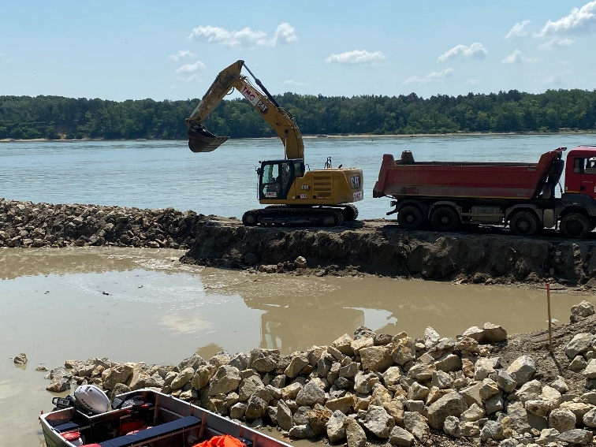
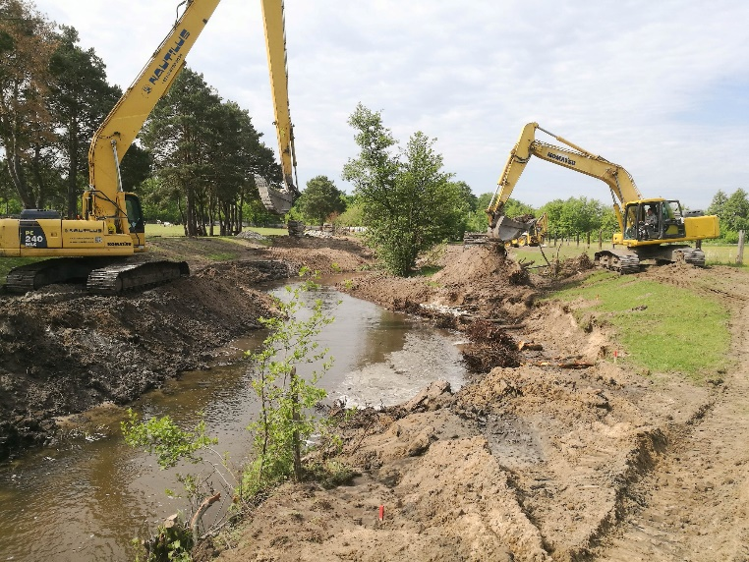
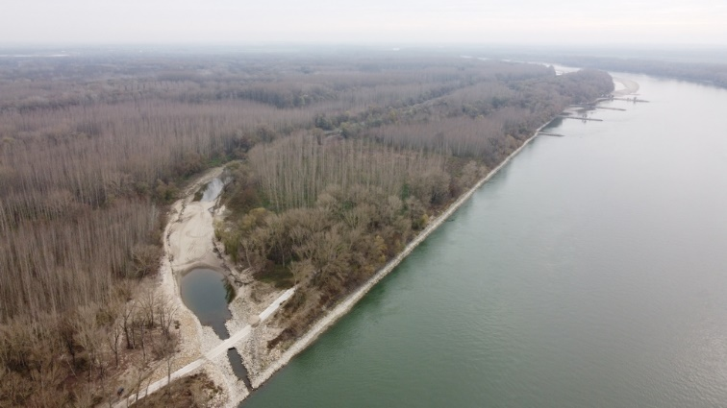
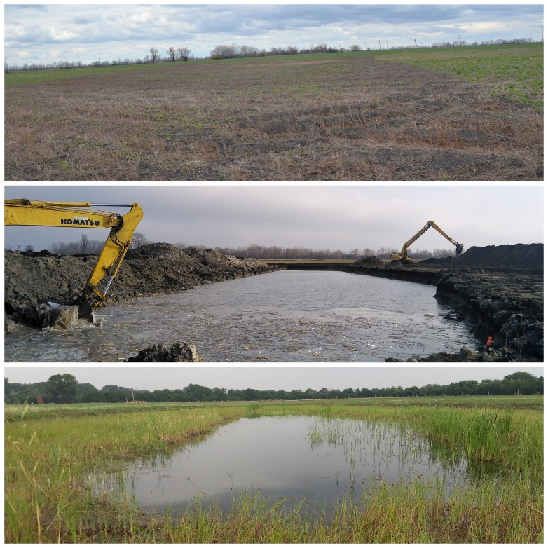
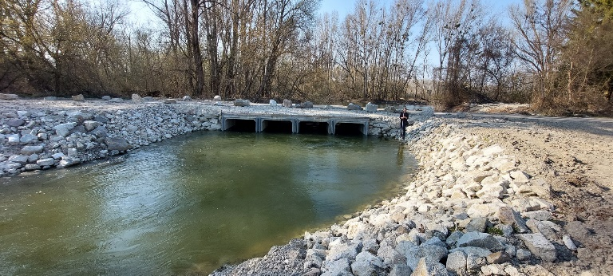
Upscaling results of other EU projects
REFORM, AMBER - recommendations relevant and applicable also in Slovakia - hydromorphological classification of river reaches, monitoring, ecological prioritisation approach, barriers classification and tracking, possible measures etc.
Danube Sediment DTP - sediment monitoring (practices, network), sediment management measures, sediment balance calculation etc. which will be applied on the SK Danube and tributaries
DanubeFloodplain DTP - floodplain evaluation, approaches to restore floodplain areas with combination with flood peak reduction, measures and approaches to deal with nature based solutions, development of feasibility studies for NBS, methods for assessment of ESS and CBA
DREAM SK-AT – hydrodynamic modelling and sediment transport modelling on Danube river, sediment management issues, sediment monitoring stations construction, calibration and start of operation in SK
DuReFlood SK-HU Interreg project - developed concept of measures at SK-HU section of the Danube to improve ecological status in combination with flood protection, with special focus on Medveďov-Kľúčovec side arm and recommended type of measures in the Danube channel
LIFE PROJECTS: LIFE12 NAT/SK/001137 Restoration of nesting and feeding habitats of Sand Martin, Kingfisher and European Bee-eater in Danube-Morava region, LIFE12 NAT/SK/001155 Conservation of birds in SPA Ostrovné lúky, LIFE14 NAT/SK/001306 - Restoration and management of Danube floodplain habitats, LIFE18 NAT/AT/000733 Dynamic LIFE Lines Danube follow-up implementation of measures at additional localities, LIFE19 IPE/SK/000003 Role of the Natura 2000 network and management of some prioritized habitats in the integrated landscape protection of the Slovak Republic - habitats and species monitoring methodology in areas targeted by SIP
DANUBE4all - Horizon project - this SIP can also be part of the puzzle for Restoration Plan of the Danube River Basin to be developed in the DANUBE4all project, knowledge transfer
Danube
Rudava
Ostrovné lúky
wetlands restoration
Danube
Danube sidearm system

Slide 16
Complementary actions

Slide 17
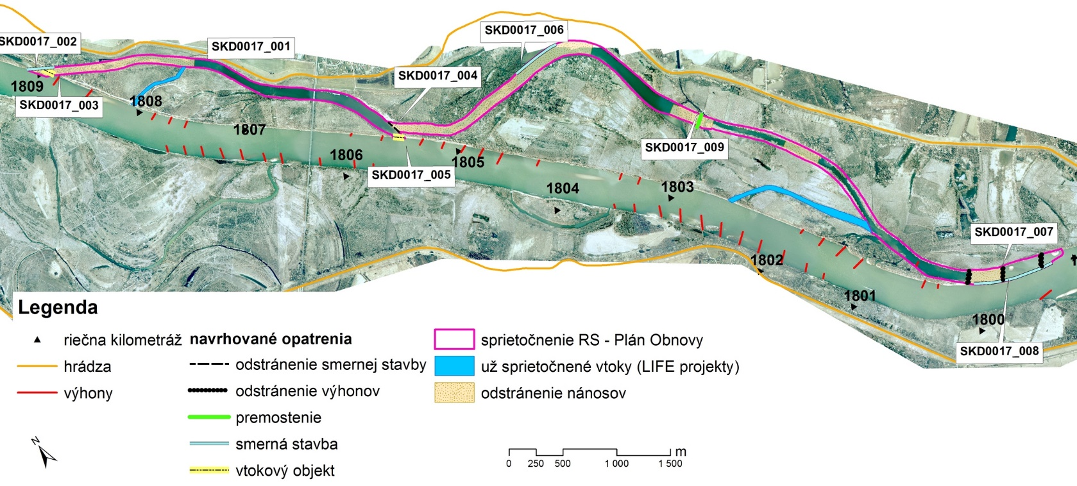
Complementary actions
Recovery and Resilience Fund
Coordination: Ministry of Environment
Implementation of RBMP measures
Goal in Slovakia: restoration of 97 km of rivers and water retention measures (lateral connectivity)
Danube and Morava top priorities (studies done, detailed planning ongoing)
Implementation till end of 2026
Financing: ca 62 M EUR
Legislative changes, manuals
To support river restoration and eliminate legal obstacles
Large infrastructure projects on the Danube: fishpasses Cunovo and Gabcikovo on the Danube river; Cunovo to be implemented ca 2028
Measures to support restoration of lateral and longitudinal connectivity –
New Programme Slovakia (2021-2027)- funds available for mobilised projects
Development plan of public freshwater system and public sewage system of the Slovak republic 2021-2027
Source: VÚVH studies

Slide 18
Activities on the Danube

Slide 19
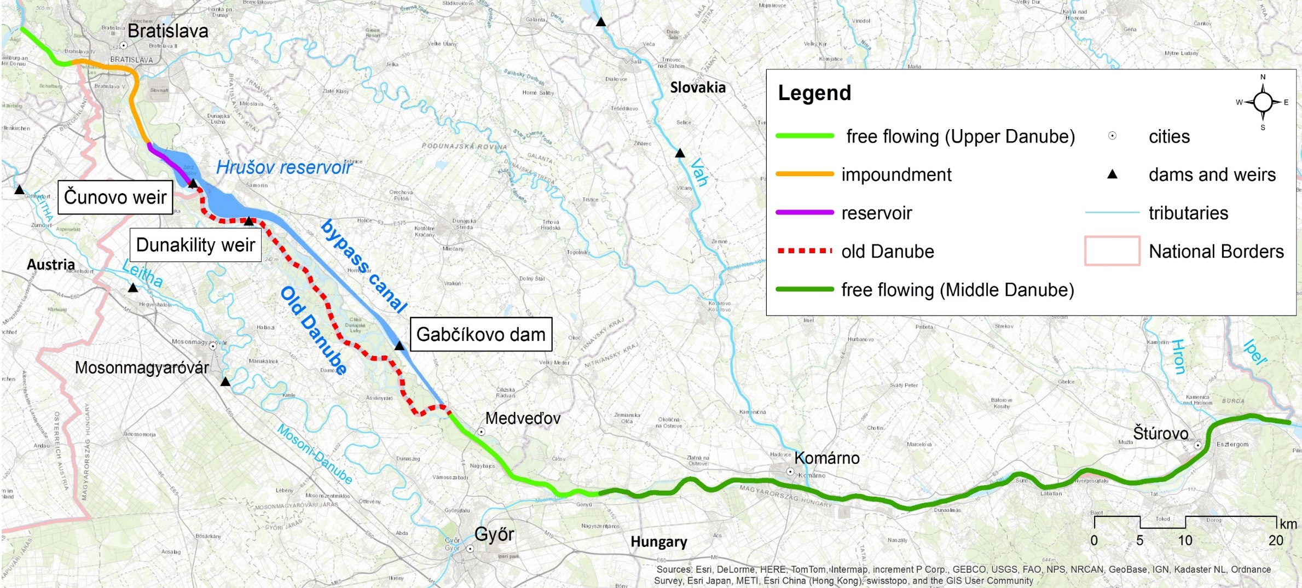
Re-establishment of migration routes for sturgeon species on the Danube river and re-connection of its floodplain habitats
SKD0016 – NAT
SKD0017- HMWB
+bottom sill
SKD0018 – NAT
Ecological status/potential: 3 (moderate)
Slovak section of the Danube river -172 km

Slide 20
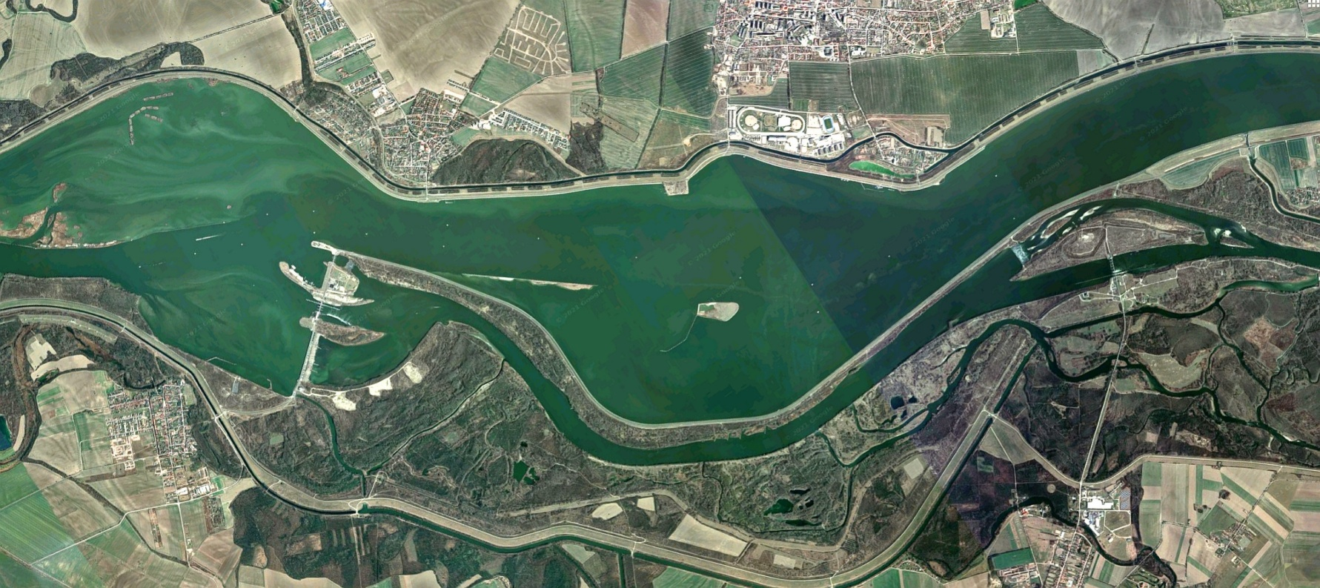
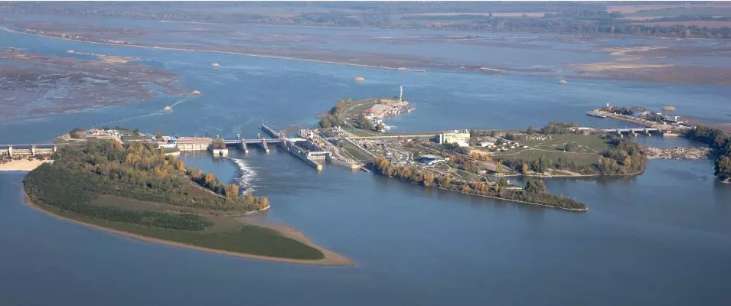
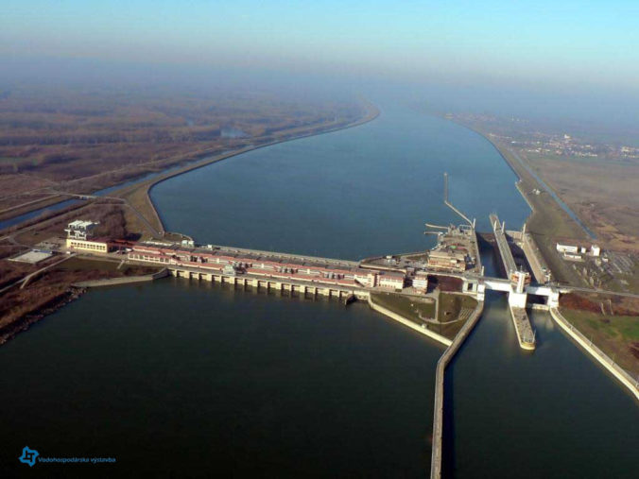
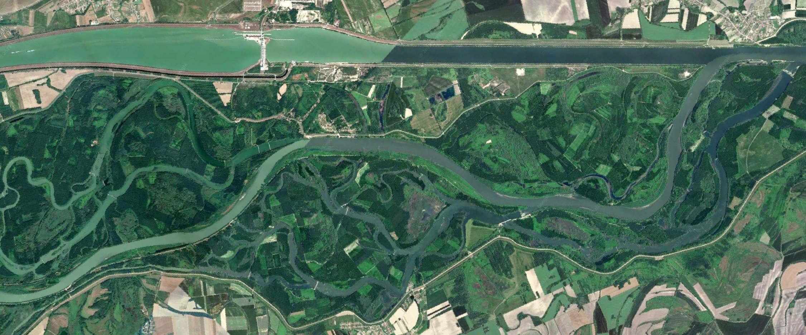
Barriers on the Danube and on the canal
Čunovo
80%Q
20%Q
Dunakiliti dam (HU)+ bottom sill (SK/HU)
Čunovo dam
HPP Gabčíkovo
80%Q
20%Q
HPP Gabčíkovo

Slide 21
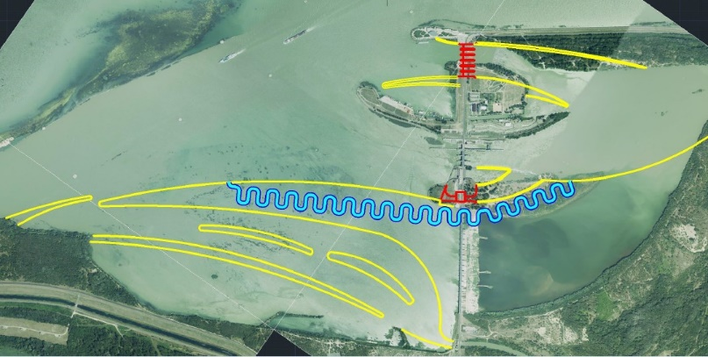
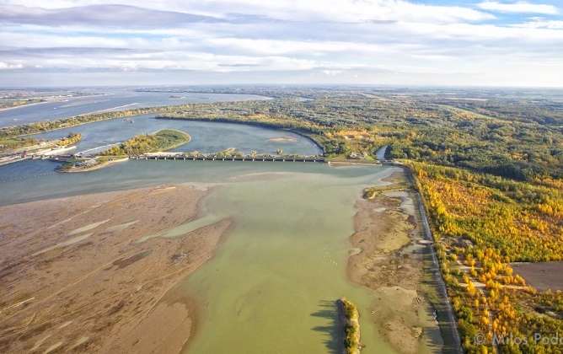
Cunovo dam – fishpass variants+sediment measures, also small HPP to be constructed
Gabcikovo/Cunovo fish passes – feasibility study, modelling, technical parameters, ichtyological surveying and cooperation with experts

Slide 22
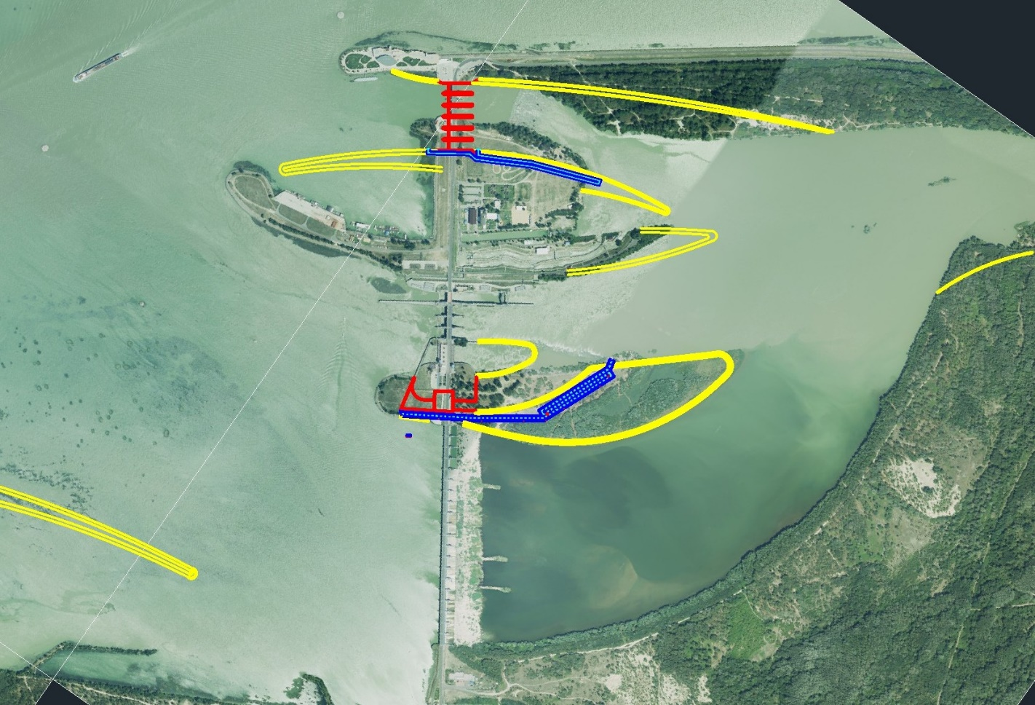
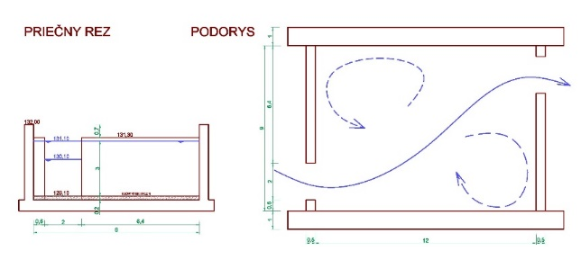
Reconstruction of Čunovo dam- plan
Goals: improve fish migration, sediment management, hydropower, flood management
1. Construction of HPP Čunovo II (12 MW)
Fishpass near Čunovo II (giant sturgeon, sterlet) – till 2027-28
2. Reconstruction of Bypass weir (3x 6 gates x 24m) + second fishpass for slow migratory species
3. Sediment management measures (bedload and suspended load) – usmernenie prúdenia v zdrži, zníženie usadzovania plavenín
Bypass weir
Middle weir
HPP Čunovo II
Floodplain weir

Slide 23
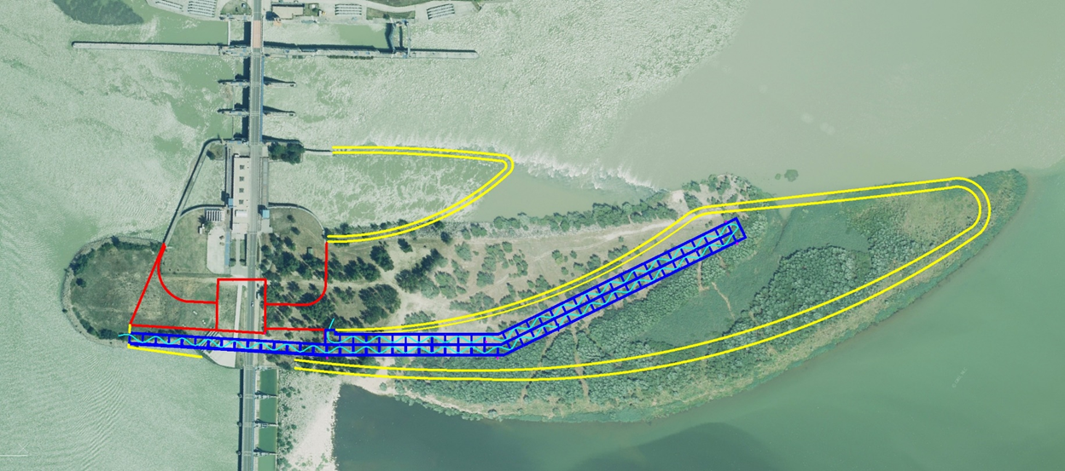
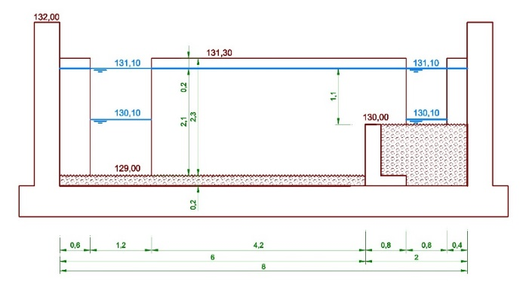
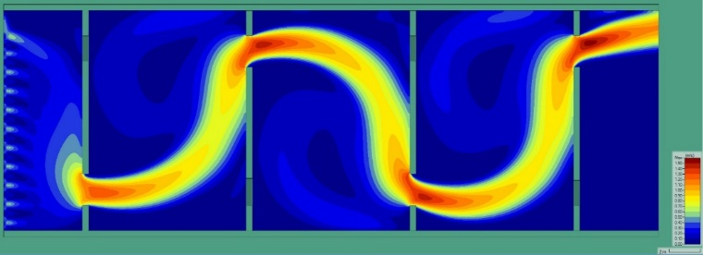
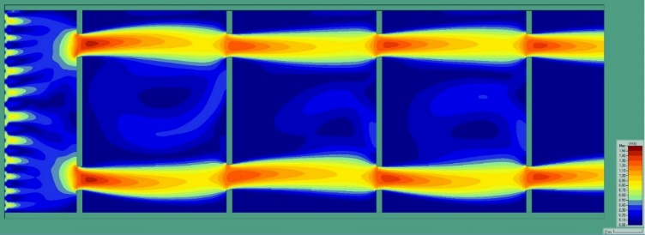
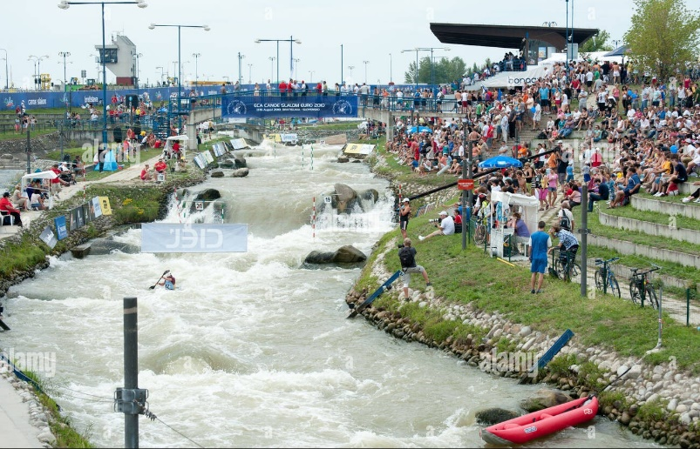
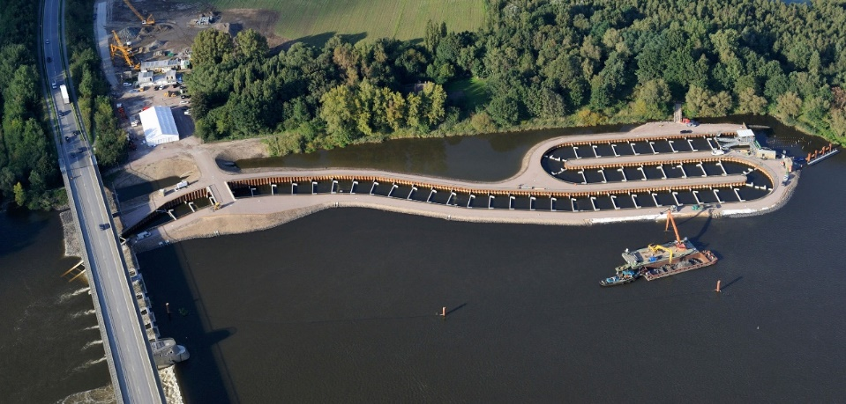
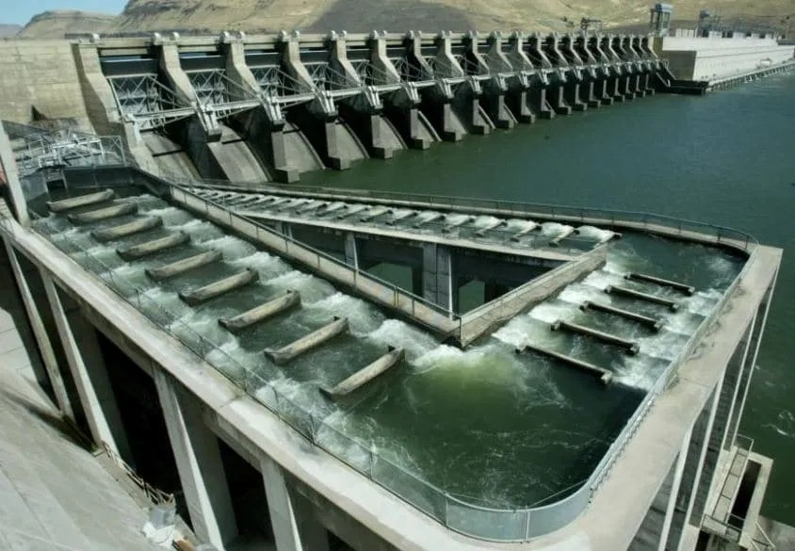
Construction of HPP Čunovo II (12 MW)
Fishpass near Čunovo II (giant sturgeon - huso huso, sterlet - acipenser ruthenus, barbus barbus, aspius aspius...)
Technical fish ladder: 83 chambers, 10 cm water level difference, 1,35 m/s 14x10 m, 855 m
Biocorridor (variant discussed): 6150 m

Slide 24
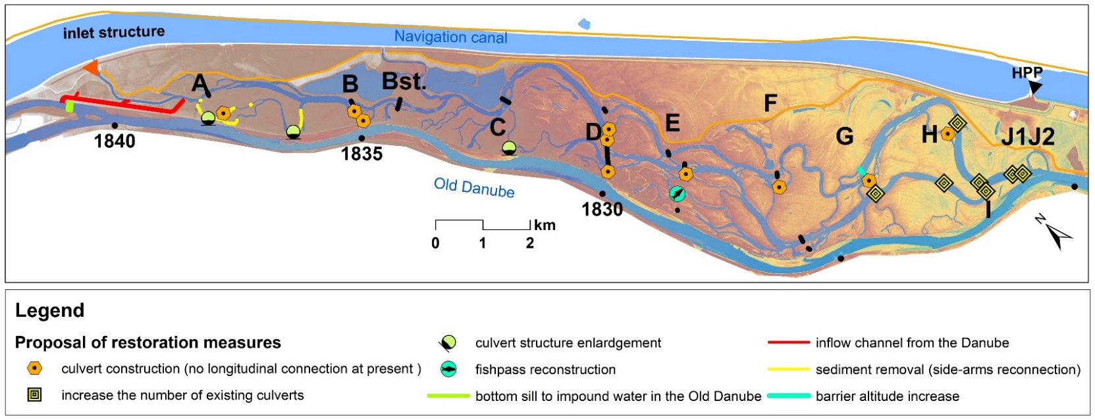



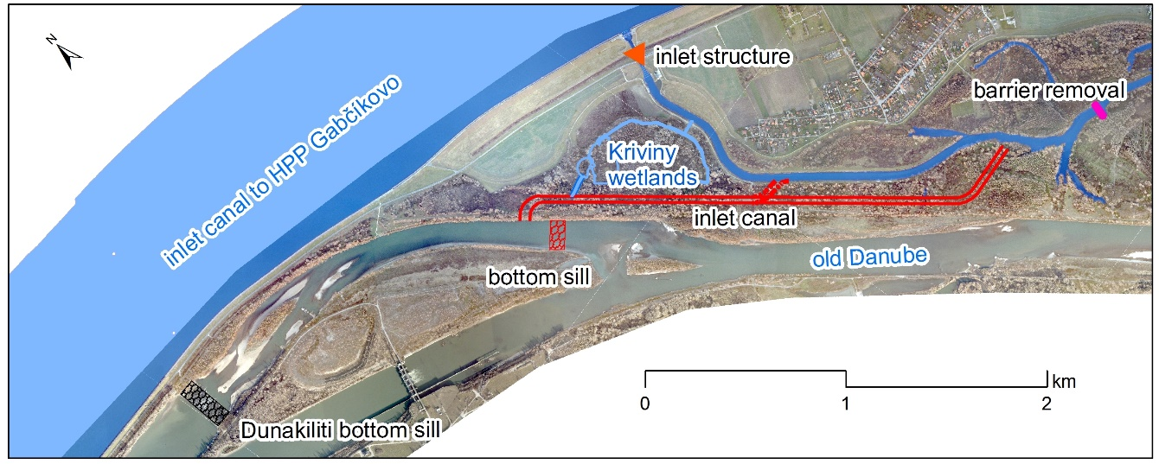
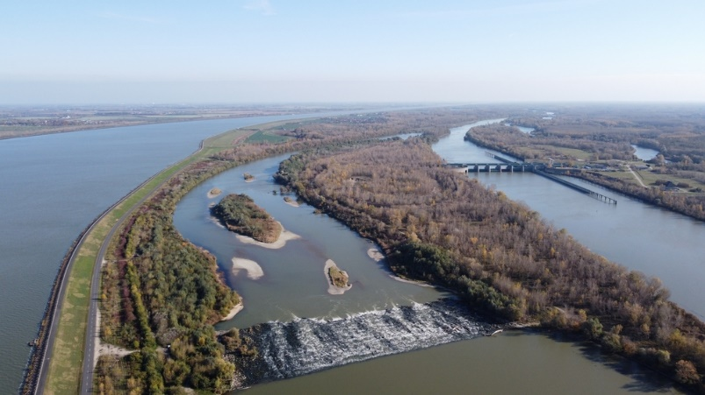
LIFE14 NAT/SK/001306
C2 (2022)
Dunakiliti dam (HU)
Dunakiliti bottom sill

Slide 25
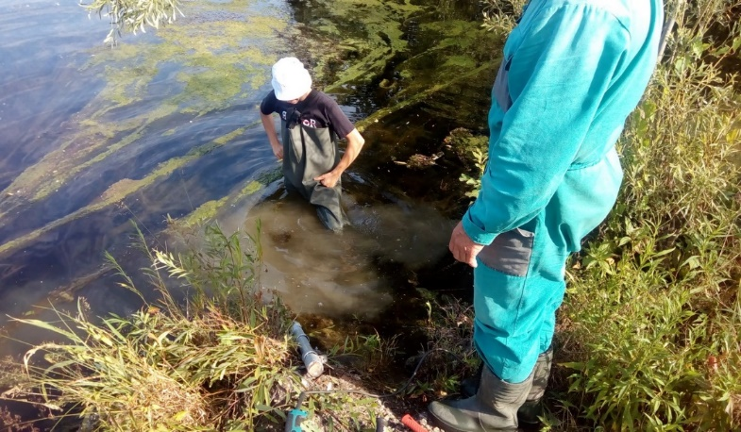
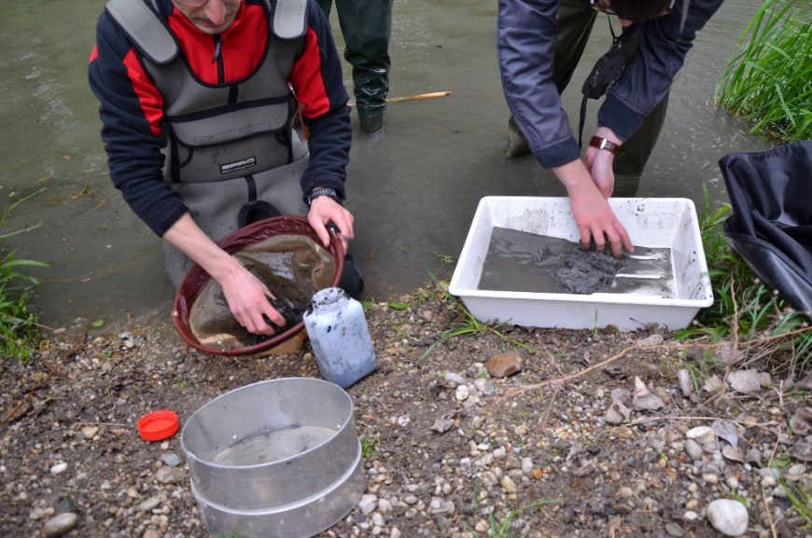
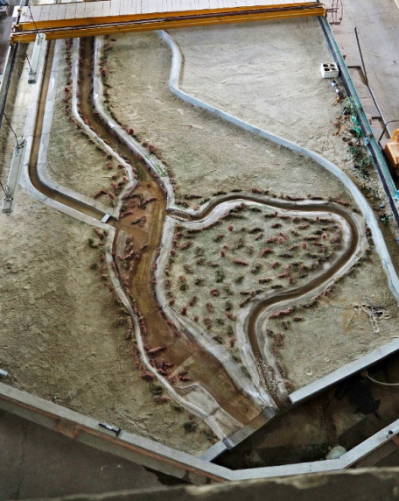
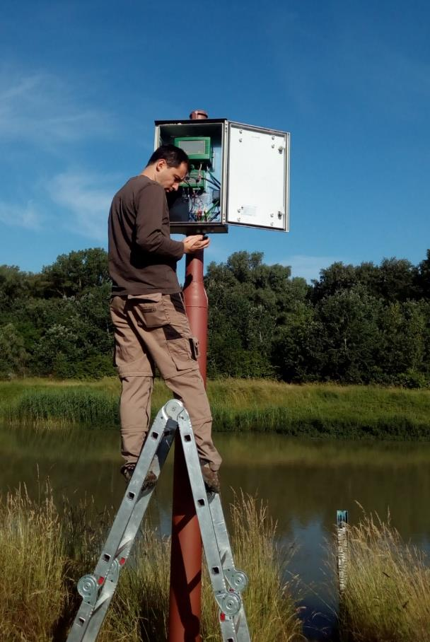
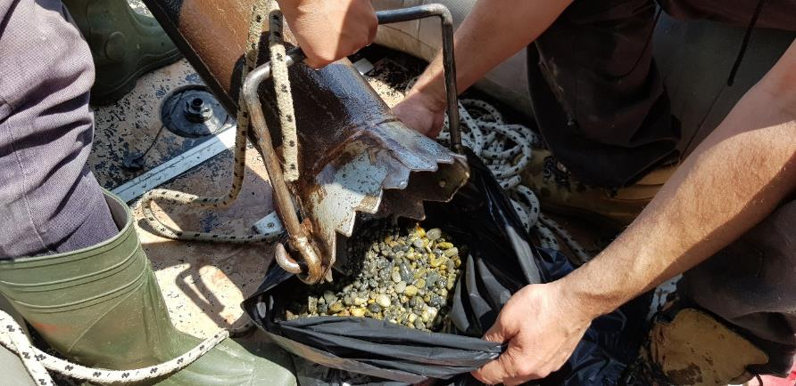
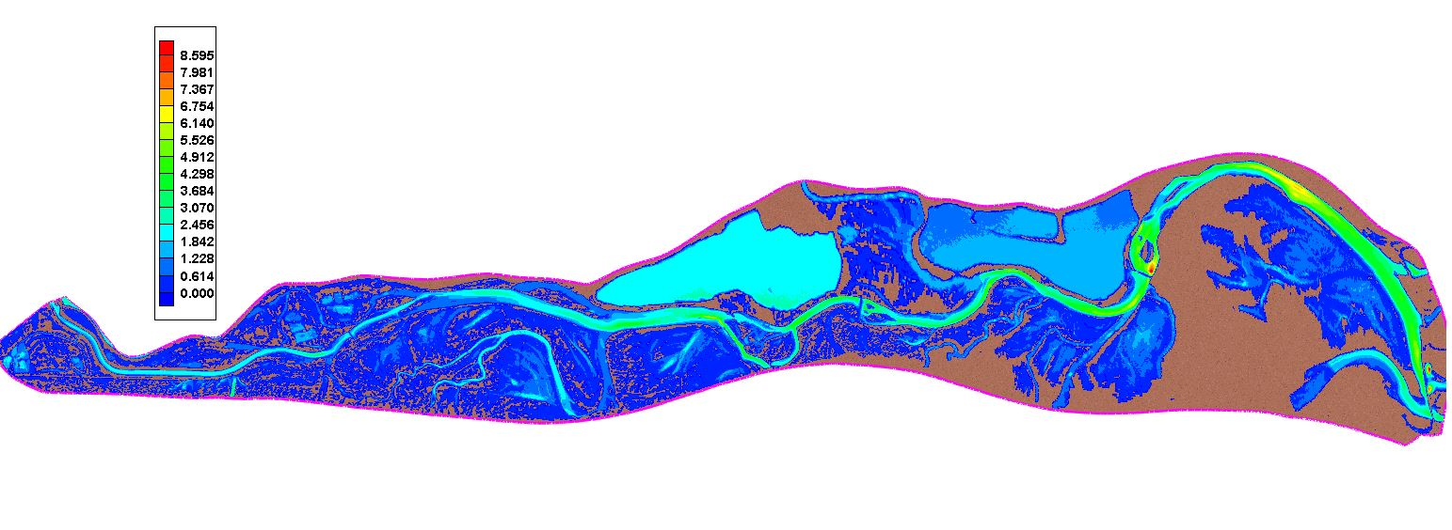
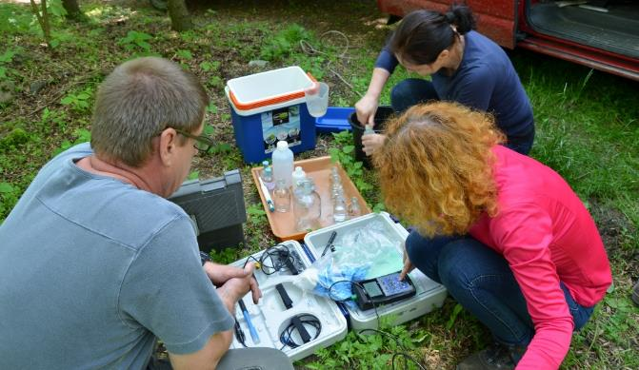
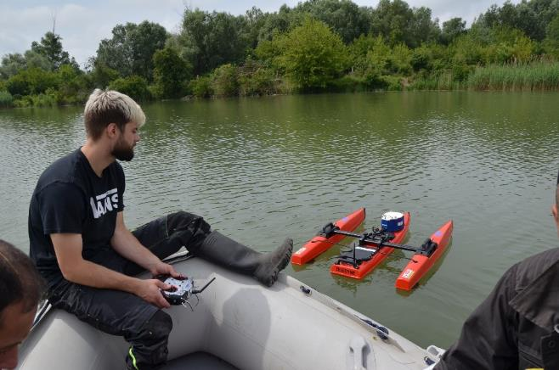
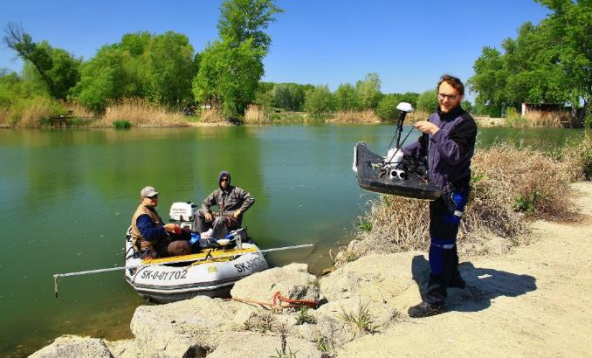



Hydromorphological and hydrobiological monitoring of the side arm system+modelling (2015-present)

Slide 26
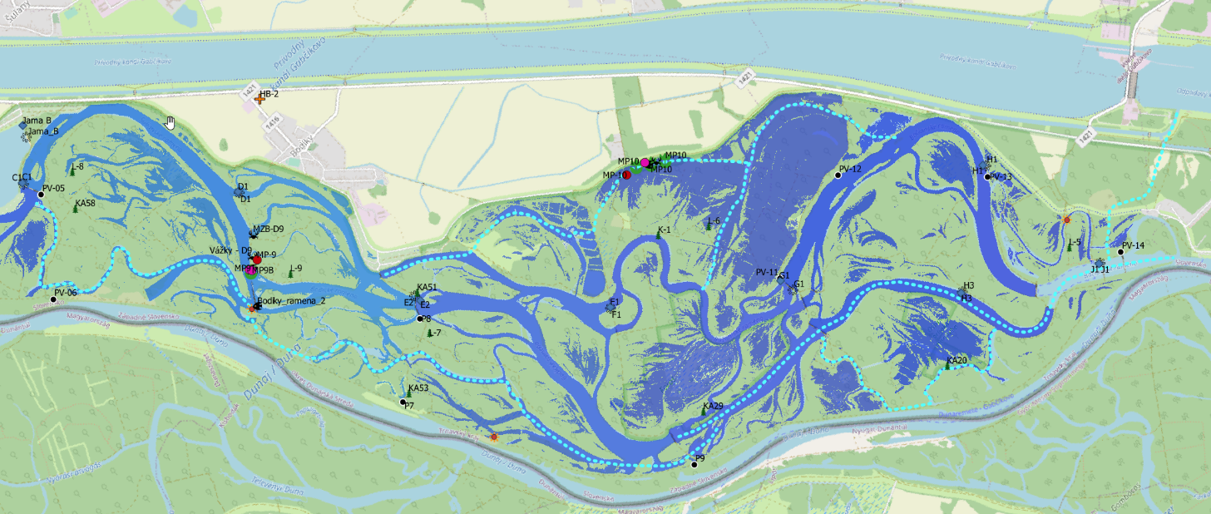




Danube sidearm system (SK side) – Gabčíkovo HPP
Biocorridors for fish migration- free flowing, without impoundments, gravel bed
HPP Gabčíkovo
Variant 1: technical fishpass
Variant 2: biocorridor
Variant 1:
Spád: 21 metrov
Prevýšenie: 0,10 m
Dĺžka: 2100 metrov
Počet bazénov: 210
Hĺbka vody: 2,5 metra
Šírka bazénov: 8 metrov
Dĺžka bazénov: 9 meter
Rýchlosť v štrbine: 1,40 m/s
Prietok: 5,0 m³/s
Za VE - rybovod v násype
Pred VE - akvadukt na stĺpoch
Remove barriers
+reconstruction of flood protection dyke

Slide 27


WP4: Nature and biodiversity friendly fishing management and active measures to support prospects of target umbrella fish species
Task T.4.2. In situ strengthening of natural populations of Danubian sturgeons using eggs incubation in the wild
Task T.4.3. Juveniles re-stocking as an in situ conservation measure for reinforcement of the sturgeon’s populations in the Slovak part of the Danube
Task T.4.4. Nature and biodiversity friendly fishing management

Slide 28
WP6: Monitoring of the impact of the project actions
Task T.6.3 Monitoring of the ichthyocoenoses in the target river catchments (Danube, Belá) (2023-2030)
Task T.6.4 Telemetric surveys of passability of the Danube for fish in the Slovak Republic (2023-2031 ) - key species acipenser ruthenus, aspius aspius, barbus barbus, silurus glanis, Leuciscus idus, abramis brama
Task T.6.5 Verification of sturgeon natural reproduction in the Slovak part of the Danube using ichthyoplankton collection nets – method used in US and Canada

Slide 29
Thank you for attention
www.livingrivers.sk
Contact: katarina.mravcova@vuvh.sk

