Slide 1


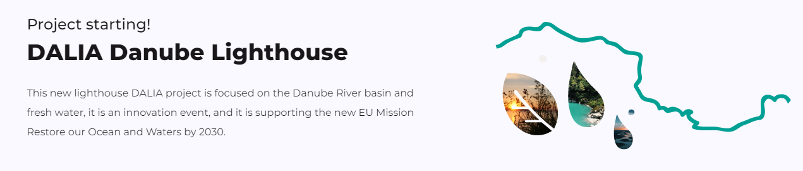
DALIA
Danube Lighthouse Innovation Action
2023-2026

Slide 2
Goals (extract)
Demonstrator Pilot Sites development
Review current freshwater restoration assessment frameworks and relevant guidance and standards
To design and build prosperous user-centred solutions

Slide 3
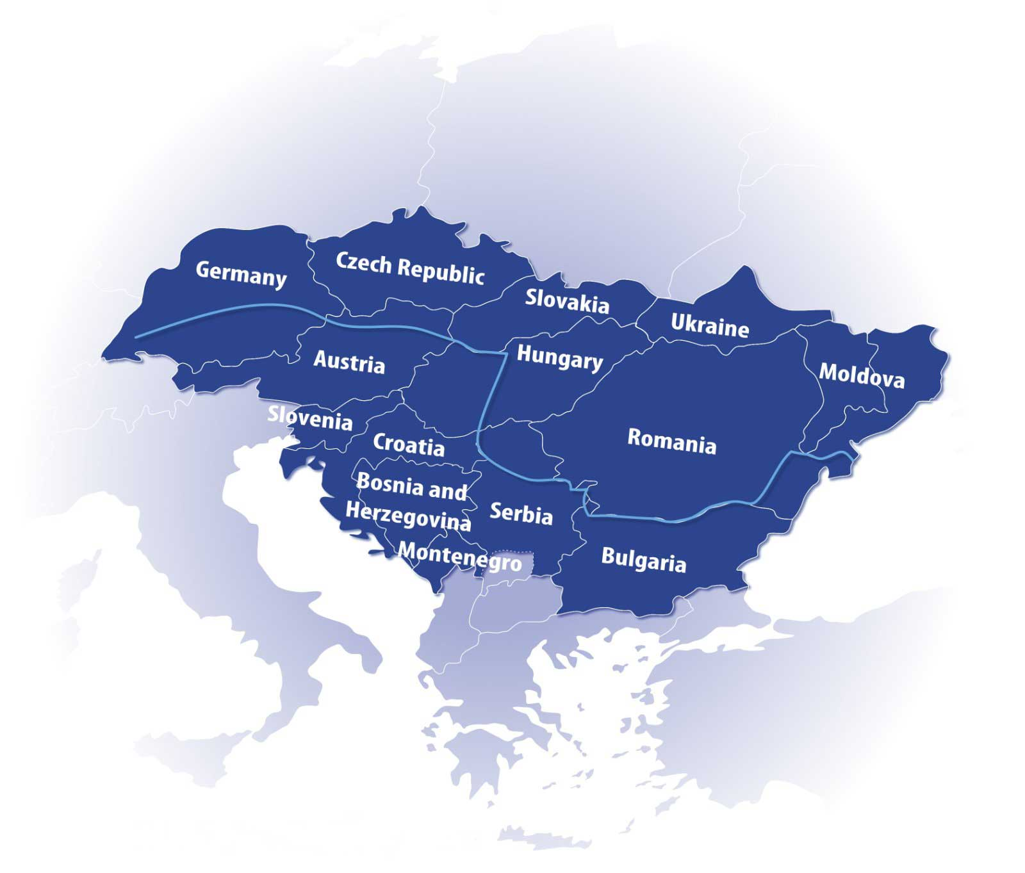
Demonstration Pilot Sites (DPS)

Slide 4
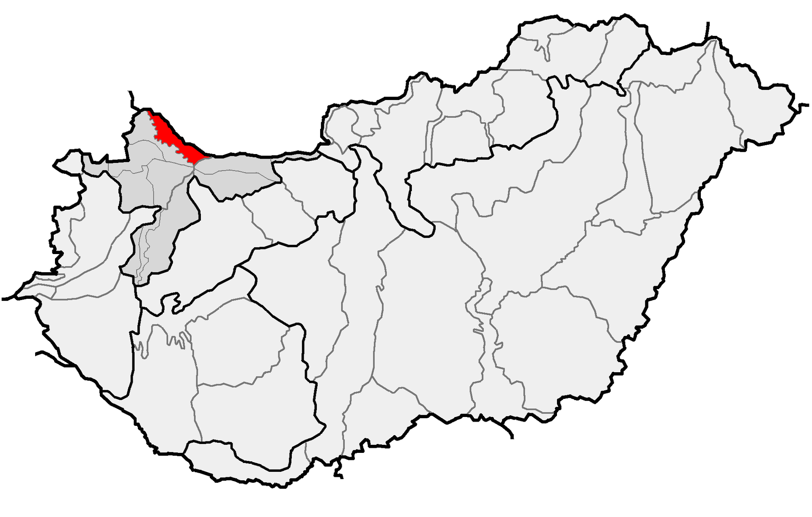
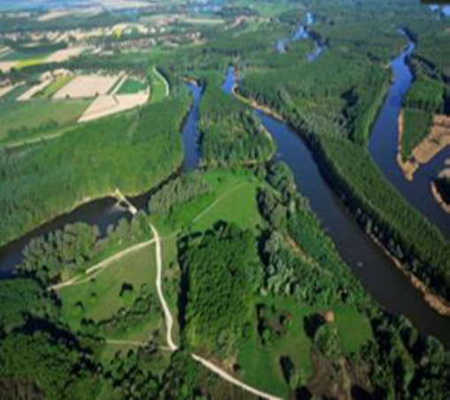
DPS 1 Szigetköz, Hungary
Represents
the best practices support of comprehensive water, environmental, and agricultural policy planning
„Region-revitalization of the ecological system”

Slide 5
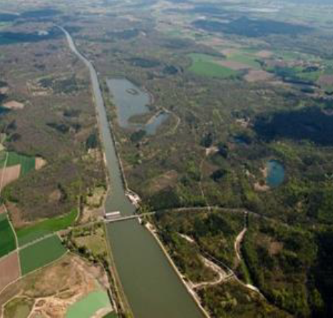
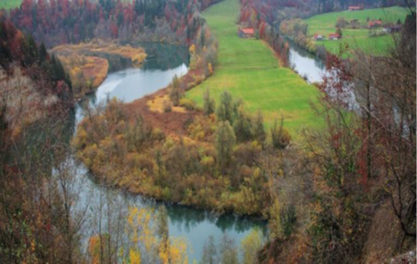
DPS 2 Neuburg and Ingolstadt, Germany
Represent
best practice support to increase biological consistency to create near–natural dynamics of water.
„Reconnected floodplain of the Upper Danube”

Slide 6
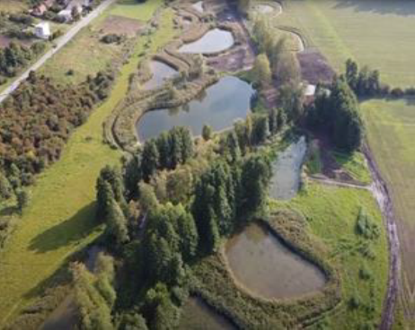
DPS 3 Dyje sub-catchment, Czech Republic
Represents
the best practice support of comprehensive water and environment management.
„Solution will be based on hydrology and water balance models calculated with climate scenario. Possible measures will be proposed both in the catchment area and on the watercourse.

Slide 7
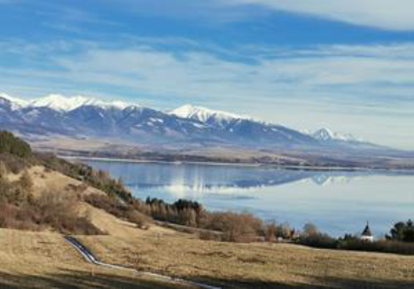
DPS 4 Vah River, Slovakia
Represents
the best practice support of flashflood management and sustainable rehydration of the topmost sub-catchment.
„Upper catchment of Vah River rehydration”

Slide 8
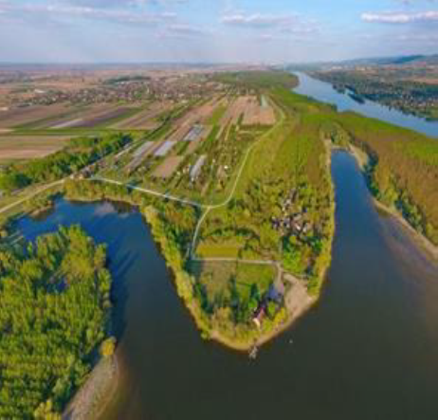
DPS 5 Begečka Jama National Park, Serbia
Represents
the best practice support of sustainable solutions for ecosystem monitoring and restoration.
„Monitoring and propose nature-based solutions against pollution and sediment inflow from arable land”

Slide 9
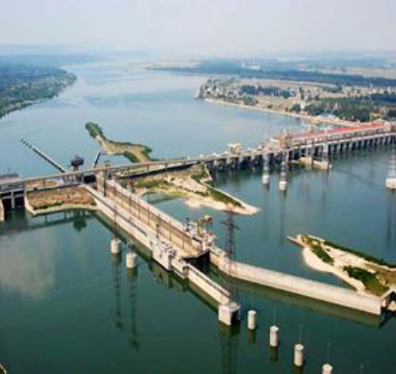
DPS 6 Iron Gates, Romania
Represents
the best practice support of sustainable biodiversity of the Danube River Basin.
„Strugeon migration by-pass Iron Gates I.II.”

Slide 10
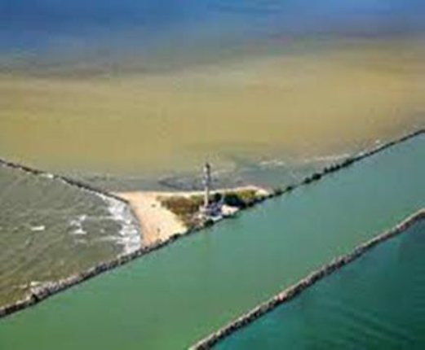
DPS 7 Danube delta, Romania
Represents
the best practice support to the improvement of monitoring system and knowledge of sediment flow spilled in the Black Sea.
„Sediment deposition phenomenon causes various serious problems”

Slide 11
DPS 8 Bodrog River, Hungary
Represents
the best practice support against macro plastic pollution.
„Plastic Cup” River Cleaning competition.
Monitoring data and other river saving data open and will be integrated to: https://tisztatiszaterkep.hu/

Slide 12
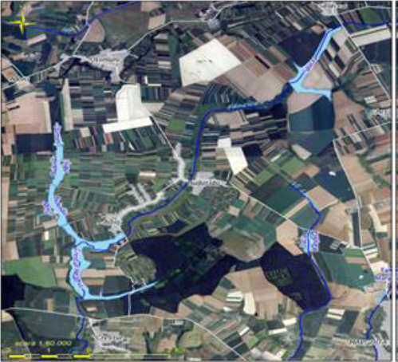
DPS 9 Aba Crisuri Water Basin, Romania
Represents
the best practice support to achieve good ecological status.
„Reconnecting natural water flow of Ier menders and reduce pollution.”

Slide 13


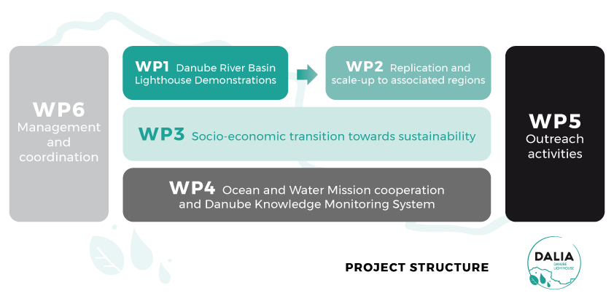

Slide 14

OUTCOMES
Results of 9 innovative pilot sites
Replication strategies for the pilots
Involvement of 10 associated regions
DALIA Knowledge hub
Training materials
Dissemination materials for sustainable and innovative solutions

Slide 15

Main project features
22 expert organizations – including universities, authorities, SMEs and NGOs – from 8 different Danube EU and Associated countries
innovation actions are supported by the 9 Demonstration Pilot Sites (DPS) in the 6 countries in the Danube River basin area
Call: HORIZON-MISS-2021-OCEAN-02
Topic: 02 - Danube river basin lighthouse – restoration of fresh and transitional water ecosystems
Budget: 8,499,236.00 €

Slide 16
Key Objectives
An iterative process enabling each stakeholder to intervene in the co-design process with researchers
Adaptation of a participatory approach for co-design and co-creation needs analysis with stakeholders
Review current freshwater restoration assessment frameworks and relevant guidance and standards
Demonstrator Pilot Sites development
To design and build prosperous user-centred solutions that can interoperate effectively with people and the water management and restoration systems, adopting disruptive business models

Slide 17
Partners
1 |  | OVF | ORSZAGOS VIZUGYI FOIGAZGATOSAG
2 |  | CCSS | CESKE CENTRUM PRO VEDU A SPOLECNOST
3 |  | THU | TERMESZETFILM.HU TUDOMANYOS FILMMUHELY EGYESULET
4 |  | CZU | CESKA ZEMEDELSKA UNIVERZITA V PRAZE
5 |  | BIOEAST HUB | BIOEAST HUB CR, Z. U.
6 |  | PaW | OBCIANSKE ZDRUZENIE MVO L'UDIA A VODA KOSICE
7 |  | KUEI | KATHOLISCHE UNIVERSITAT EICHSTATT-INGOLSTADT
8 |  | SZE | SZECHENYI ISTVAN EGYETEM
9 |  | TGM WRI | Vyzkumny ustav vodohospodarsky T.G. Masaryka, v.v.i.
10 |  | BIOPOLUS | BIOPOLUS INTEZET NONPROFIT ZRT.
11 |  | UDJG | UNIVERSITATEA DUNAREA DE JOS DIN GALATI
12 |  | NIHWM | INSTITUTUL NATIONAL DE HIDROLOGIE SI GOSPODARIRE A APELOR
13 |  | UNSFA | UNIVERZITET U NOVOM SADU, POLJOPRIVREDNI FAKULTET NOVI SAD
14 |  | XIA | EXPRESS INNOVATION AGENCY VMV NONPROFIT ZARTKORUEN MUKODO RESZVENYTARSASAG
15 |  | CWBA | ADMINISTRATIA BAZINALA DE APA CRISURI
16 |  | INCDPM | Institutul National de Cercetare-Dezvoltare pentru Protectia Mediului Bucuresti
17 |  | FAU | FRIEDRICH-ALEXANDER-UNIVERSITAET ERLANGEN-NUERNBERG
18 |  | IRI | INSTITUT ZA RAZVOJ I INOVACIJE - IRI
19 |  | BRCCI | BULGARIAN-ROMANIAN CHAMBER OF COMMERCE AND INDUSTRY ASSOCIATION
20 |  | ASE | ACADEMIA DE STUDII ECONOMICE DIN BUCURESTI
21 |  | F6S | F6S NETWORK IRELAND LIMITED

Slide 18
Demonstration Pilot Sites
DPS 1: Hungary: Szigetköz region-revitalization of ecological system
DPS 2: Germany: Reconnected floodplain of the Upper Danube
DPS 3: Czech Republic: Dyje sub-catchment of the Danube River catchment
DPS 4: Slovakia: Springs Reborn - Upper Catchment of Vah River Rehydration
DPS 5 Serbia: Begečka jama – Sustainable solutions for ecosystem monitoring and restoration
DPS6: Romania: Sturgeon migration by-pass Iron Gates I and II
DPS 7: Romania: Danube delta
DPS 8: Hungary: Bodrog river
DPS9: Romania: Aba Crisuri Water Basin

