Slide 1

Drought and Water Scarcity – project idea
Working version Working version Working version Working version Working version
Project name: Addressing Water Scarcity through Integrated Water Resources Management in the Danube Region
Acronym: WaterScarcity
Project duration: 30 months
Indicative budget: 1,2 – 1,4 mil EUR
Partnership: Local, regional, national public bodies/ bodies governed by public law; international organisations; private non-profit bodies; minimum 3 partners from 3 different Danube Region countries,
Possible financing EU mechanism: Danube Region Programme, Interreg Central Europe

Slide 2
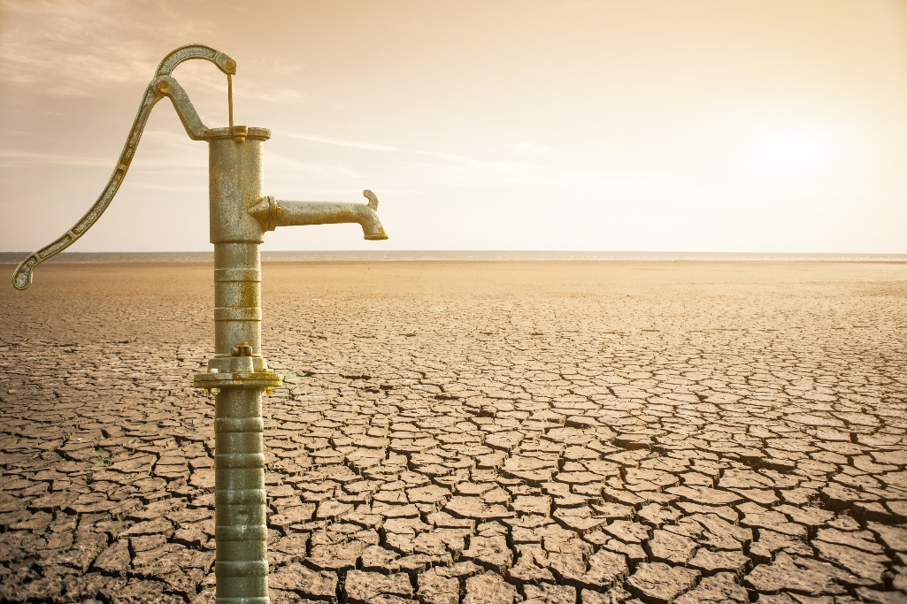
Drought and Water Scarcity – project idea
Working version Working version Working version Working version Working version
Project objective:
Transnational approach to address water scarcity due to drought caused by climate change.
The project will focus on regions affected and potentially affected by drought and water scarcity related to climate change (based on climate change scenarios) to address water scarcity and water quality change through the design of the most appropriate prevention and adaptation measures (e.g. water retention measures) and a transnational approach to water scarcity management (drought/water scarcity management plans). Validation of these drought/water scarcity management plans by local/regional authorities or territorial units will put the project results into practice with the possibility of replication in other territories.

Slide 3
Drought and Water Scarcity – project idea
Working version Working version Working version Working version Working version
Areas of research:
Overview of the legal framework on water management with a focus on drought and water scarcity
Overview of drought assessment methods and selection of an appropriate single common classification for determining drought severity for water scarcity management purposes
Identification of regions already affected and potentially affected by drought and water scarcity (based on climate change scenarios, chronological series of streamflows, and trends in groundwater levels and spring yields)
Inventory and analysis of available water resources and prospective water demands for different purposes (e.g. critical infrastructure, drinking water supply, agriculture, industry, energy, water transport, ecosystems) in regions affected by drought/water scarcity.
Identification and characterisation of areas where water scarcity is linked to changes in water quality, in particular water quality degradation related to wastewater discharge.

Slide 4
Drought and Water Scarcity – project idea
Working version Working version Working version Working version Working version
Project activities:
Preparation of transnational guidelines for water scarcity management (including water quality changes) and drought/water scarcity management plans
Implementation of drought/water scarcity management plans in pilot sites by local/regional authorities or territorial units
Identification of additional units/regions where drought/water scarcity management plans can be applied/replicated
Propose policy recommendations based on the experience of the pilot sites to tackle water scarcity

