Slide 1




Priority Area 4 WATER QUALITY
To restore and maintain the quality of waters
25th Steering Group Meeting
23-24 May 2023, Bratislava

Slide 2
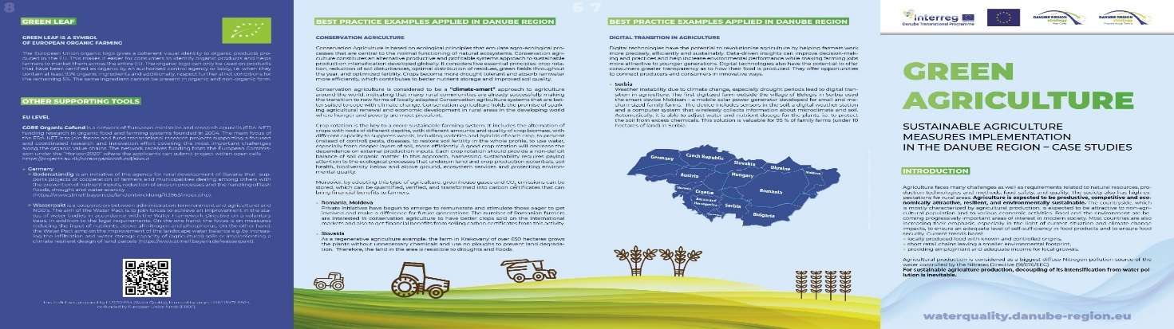
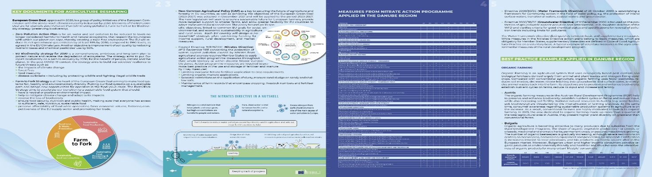
Brochure on green agriculture
In 2022 PA 4 elaborated a brochure on measures minimising water pollution from agricultural production - Sustainable agriculture measures implementation in the Danube Region - case studies
https://waterquality.danube-region.eu/brochure-about-green-agriculture/
Agricultural production is considered as a biggest diffuse pollution source of the Nitrogen in water. For sustainable agriculture production, it is inevitable to decouple intense farming from water pollution.
Besides introduction formulating the set of scene, this brochure provides overall information on key documents for agriculture shaping, measures from Nitrate Action Programme applied in the Danube Region and best practice examples applied in the Danube Region - namely organic farming, conservation agriculture, digital transition in agriculture.
Material is reader friendly, clear, simple and concise to provide the recipient with the basic knowledge from the relevant topic.

Slide 3
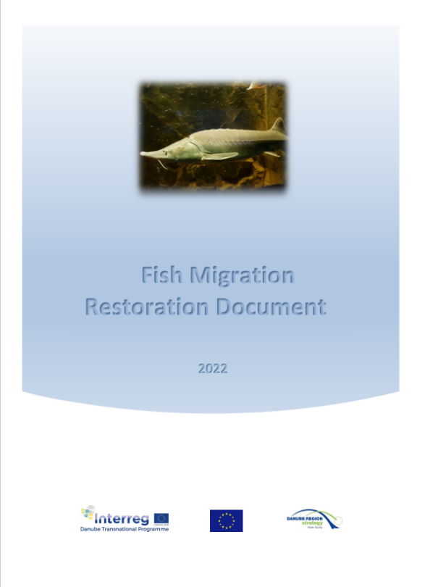
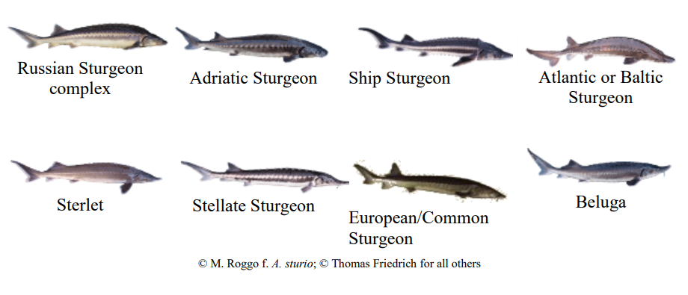
Fish Migration Restoration Document
The key aspect to allow fish migration in the Danube River is the maintenance and restoration of the environment and biodiversity where valuable fish species, including sturgeon, exist.
It serves as the knowledge base for the discussion on possibilities to design/construct fish passes in the Danube River (2022).
IUCN Red List of Threatened Sturgeons
https://waterquality.danube-region.eu/fish-migration-restoration-document/

Slide 4
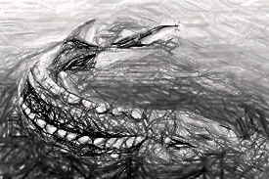
Fish Migration Restoration Document
Content
1. Introduction
Strategic documents overview (WFD, Habitats Directive, Natura 2000, EU Red List of Threatened Species, EU Species Action
Plan, Pan-European Action Plan for Sturgeons),
Overview of different types of migration behavior
Spawning migration: migration for the purposes of reproduction
Feeding migration: for seeking food resources or minimizing competition
Refuge migration: for seeking refuge from unfavorable conditions
4. River ecosystems
4.1 Four- dimensional nature of lotic (running water) ecosystems
Longitudinal, lateral, vertical, time dimensions
4.2 Flood pulse concept
Negative impacts of human induced changes on fish migration
Construction of barriers, limited dispersion, changed character of upstream river, impact on flow
regime caused by large dams, hydropeaking, channelizing of rivers, lateral connectivity spans
Danube River ichtyocenoses overview
also other fish species than sturgeon (barbel, common bream), umbrella species

Slide 5
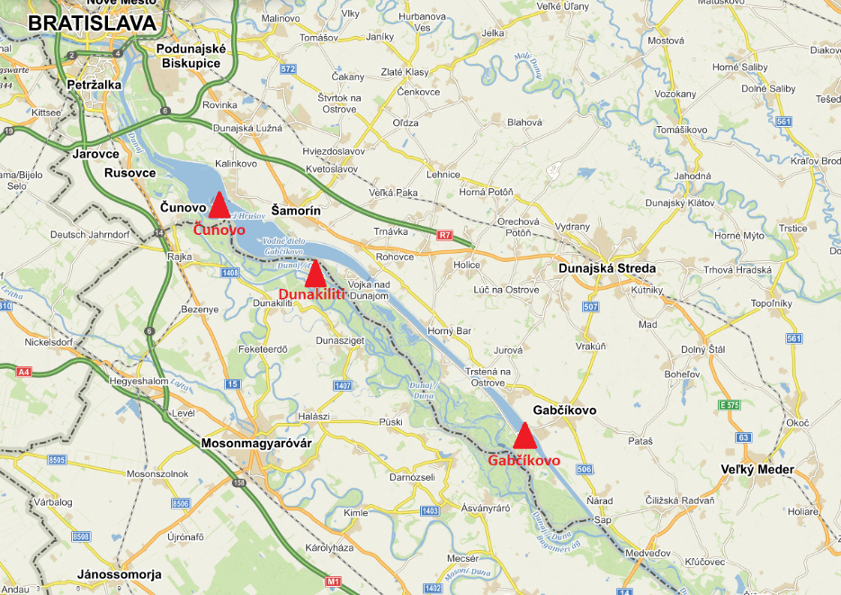
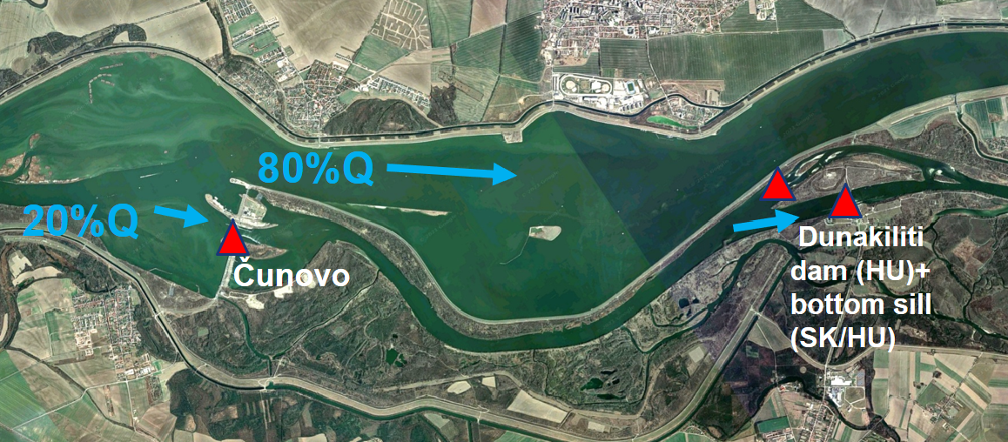
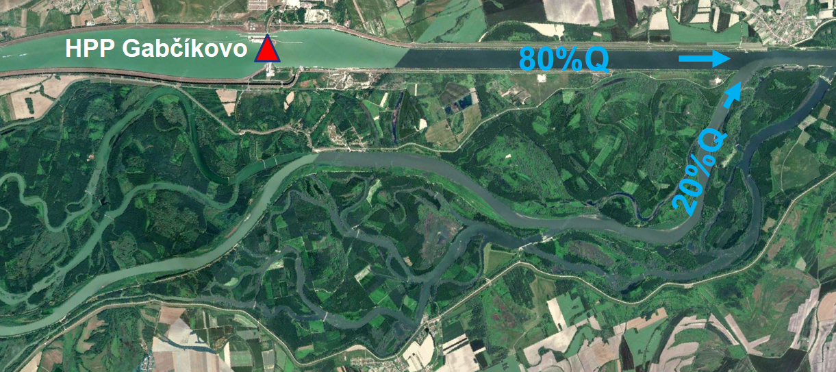
Fish Migration Restoration Document
7. Case study
7.1 Description of existing barriers in the Middle Danube
7.2 Design of target fish species and derived parameters of fish passes
7.3 Design of the fish pass at the Čunovo HPP
7.4 Design of the fish pass at the Dunakiliti HPP and the stone dam
7.5 Design of the fish pass to the Gabčíkovo HPP
8. Next steps
9. References

Slide 6
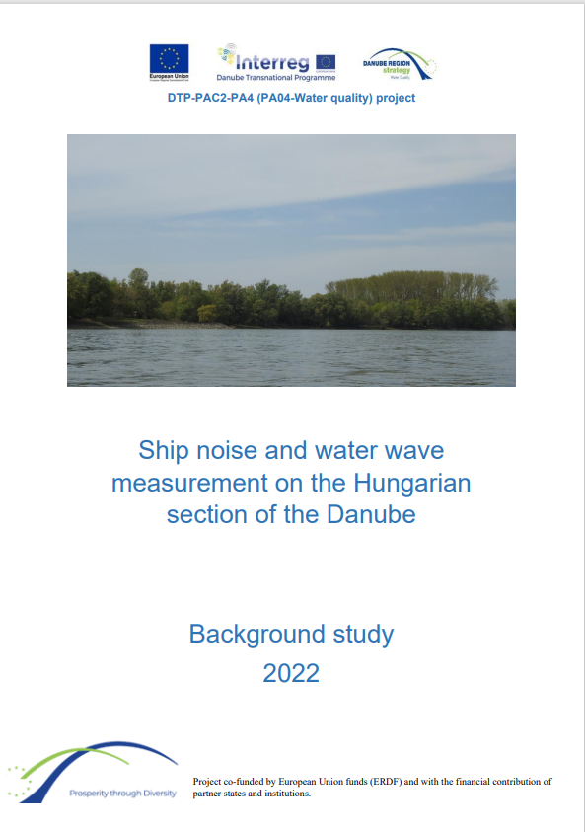
Background Study
Ship noise and water wave measurement on the Hungarian section of the Danube
Background study
investigates the effect of noise and waves caused by shipping on the fish species living in the affected aquatic environment provided on-site measurements
gives an opportunity to get an idea of the impact of intensive ship traffic on spawning and fish-nursery sites, on breeding and migrating fish stocks.
The investigation is linked to the planned interventions of the Hungarian TEN-T inland waterway development (improving the navigability of the Danube) program
Study was transposed to e-learning tool - animated film
https://waterquality.danube-region.eu/ship-noise-and-water-wave-measurement-on-the-hungarian-section-of-the-danube/

Slide 7

Animated Film
Animated film briefly demonstrates that, in addition to the already known negative human effects (e.g. oil pollution, plastic pollution, nutrient pollution, pollution from hazardous substances, negative effects caused by hydromorphological interventions – hydropower plants block the waterways), the increasing ship traffic and corresponding noise and wave pollution can also cause serious damage to fish populations.
https://waterquality.danube-region.eu/why-is-it-a-challenge-to-be-a-migratory-fish-species

Slide 8
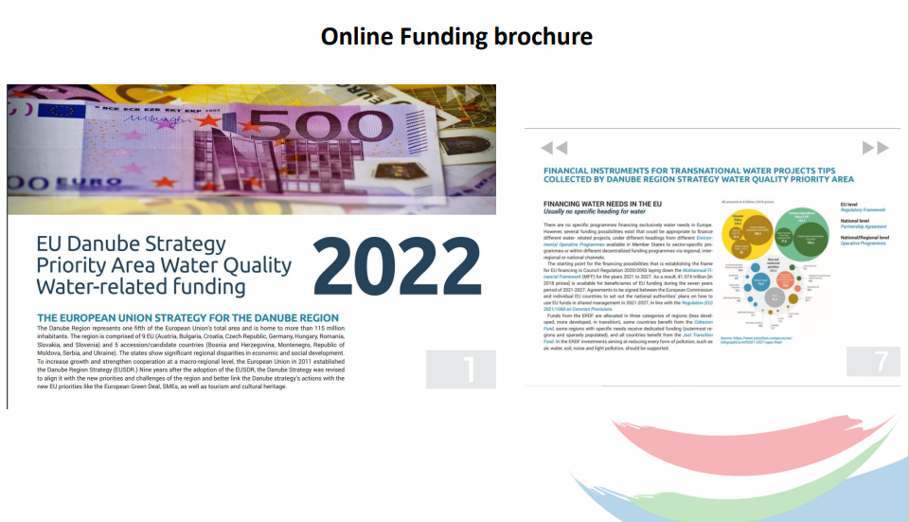
Projects Funding brochure
https://waterquality.danube-region.eu/financing-water-projects-online-brochure-completed/

Slide 9
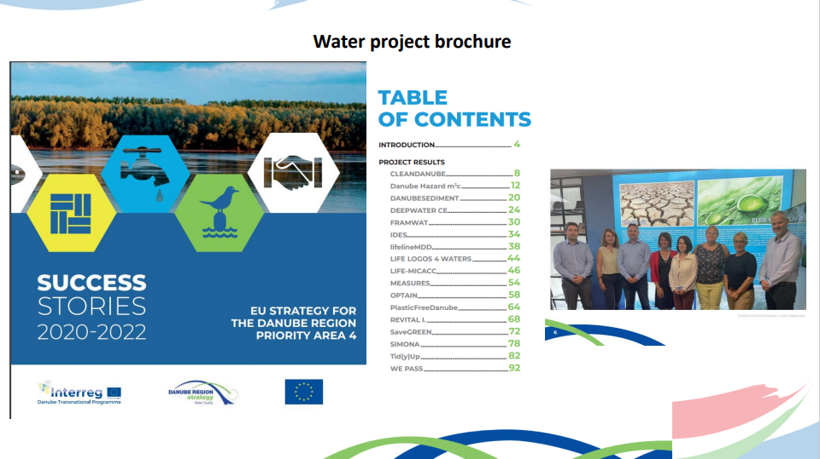
Water projects
https://waterquality.danube-region.eu/water-success-stories-2020-2022-brochure-completed/

Slide 10
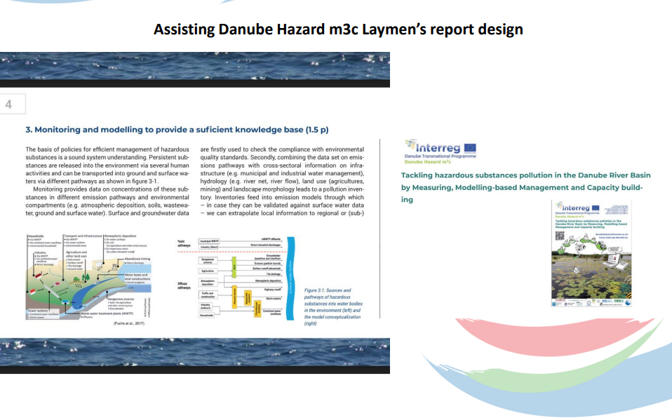
Danube Hazard m3c – Laymen´s Report

Slide 11
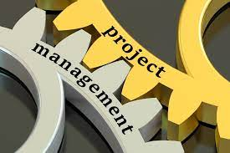
Projects
Participation in the kick-off meeting of the project Water4all (13 October 2022 online);
Supporting Danube Water Balance project preparation, which was submitted to DRP call.
Letters of Recommendation issued by PA4 in 2022 for projects as a sign of MRS support and clear confirmation that the projects are fully relevant and related to the Danube Region having cross border nature:
MapRiverPlastic (macroplastic), What-A-Way (sustainable services at local waterways), DANUBELIGHT (water innovation), WETNUBE (demonstrations of wetland and floodplain restorations), RESTORIVER (restoration of urban riversides), AquaticPlastic (plastic waste reduction), Danube Water Balance (Danube model and data repository)
LIFE21-IPE-SK-LIFE Living Rivers „Implementation of the river basin management plan in selected river sub-basins in Slovakia“ – feasibility study on Gabčíkovo fish pass (2027)
Kick Off meeting – 23/5/2023, Bratislava

Slide 12

Events in 2022
24th PA 4 SG meeting – 22-23 November 2022, Budapest
25th River Symphosium- 29-30 November 2022, Vienna
Danube Hazard Final Conference – 30 November 2022
NC-PAC meeting– 1-2 December 2022 (Slovenia)
DSTF General Assembly – online, 5-6 December 2022
Ukraine and Baltic Sea Region – online conference, 8. December 2022
Danube Youth Camp – 14. December 2022, Vienna
Trilateral Meeting –2 March 2023, Bratislava
Meeting with DYC members – 7 March 2023, online
PAC meeting - 16-17 March 2023, Maribor
Meeting with DG MARE - 27 March 2023, online
Workshop of V4 „Towards a better understanding of drought impacts and risks in water management sector“ – 4 April 2023 (on-line)
4th EU Macro-Regional Strategies Week (EU MRS Week) - 24-28.4.2023, Brussels, hybrid
ICPDR 57th RBM Expert Group Meeting – 26-27 April 2023, Zagreb, hybrid
Internal meeting of EUSDR Priority Area Coordinators on the Seed Money Facility - 5 May 2023, online
Joint meeting of ERDF & CF managing authorities - 10 May 2023, online
25th PA 4 SG meeting – 23-24 May 2023, Bratislava
https://waterquality.danube-region.eu/

Slide 13
PA4 plans in 2023 (PA4 DRP project 2023-2028)
Youth involvement baseline study – prepared by 30 June 2023
Summer School – youth camp on the need for water retention, conservation and sustainable management for agricultural use in the context of ongoing climate change; July 2023
Migratory fish meeting – autumn 2023
New Drinking Water Directive – workshop on knowledge sharing arising from the new obligations; autumn 2023
Educational online activities – PA7 online stream with a scientist
https://waterquality.danube-region.eu/

Slide 14
Thank you for your attention
https://waterquality.danube-region.eu/

