Slide 1
EUSDR - PA 4 - Steering Group
23 May 2023, Bratislava
Roberta Zobbi – European Commission DG MARE;
Mission ocean and waters

Slide 2
Mission Restore our Ocean and Waters by 2030 Objectives
Protect and restore marine and freshwaters ecosystems and biodiversity
Protect at least 30% and strictly protect 10% EU’s sea areas
Prevent and eliminate pollution of our oceans, Seas and waters
Make the blue economy carbon- neutral and circular
Net zero maritime emissions
Zero carbon aquaculture,
Reduce by at least 50% plastic litter
Restore 25.000 km free flowing rivers
Marine nature restoration targets (incl. degraded seabeds, coastal ecosystems)
Reduce by at least 30% microplastics
Reduce by at least 50% nutrient losses, chemical pesticides
Low carbon multipurpose use of marine space
ENABLERS
Digital Ocean and Waters Knowledge system
Public mobilization and engagement
Notes:
Mission objectives
With a 2030 horizon, we target three main objectives:
protecting 30% of the EU’s sea area, restoring marine ecosystems and achieving 25.000 km of free-flowing rivers;
preventing and eliminating pollution by reducing plastic litter at sea, nutrient losses and use of chemical pesticides by 50%;
making the blue economy climate-neutral and circular with zero-net maritime emissions.
We will also have enablers to make all of this possible.
We are developing a European Digital Twin Ocean that builds on the European infrastructures and services we already have, like Copernicus and the European Marine Observation Network.
The Twin Ocean will be a game changer for marine and freshwaters knowledge – allowing a quantum leap in research, policy making, sustainability and our understanding of the role of oceans in our society.
The other enabler is citizens’ engagement and citizen science.
Citizens are a crucial part of the green transition.
Participatory approaches and citizen science initiatives are proposed at various stages of the Mission’s life-cycle to allow citizens to get involved and take action. And as I see, there is huge interest from the wider public for this.
To give as example, we have the Plastic Pirates initiative and the responsible seafood consumption campaigns.

Slide 3
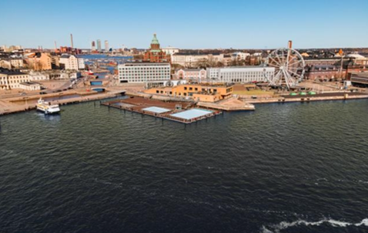
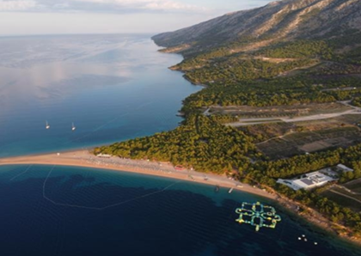
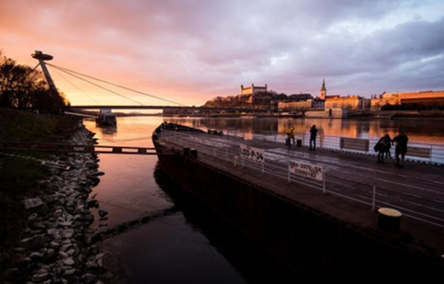
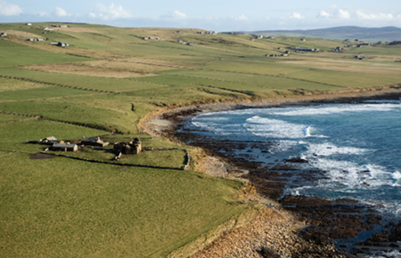

Mission lighthouses: sites to pilot, demonstrate, develop and deploy the Mission activities across EU seas and river basins
Baltic & North sea basin
Mediterranean sea basin
Make the blue economy carbon- neutral and circular
Prevent and eliminate pollution of our ocean, seas and waters
Danube river basin
Atlantic & Arctic coast
Protect and restore marine and freshwaters ecosystems and biodiversity
Notes:
Mission Lighthouses
The Mission has a strong regional dimension through the concept of “lighthouses” in four sea/river basins:
The Atlantic and Arctic basin;
The Baltic and North Sea basin;
The Mediterranean Sea basin; and
The Danube River basin.
The Mission lighthouses are site to develop, test and deploy transformative and innovative solutions to achieve the objectives of the Mission.
The Mission follows the principle of “leaving no one behind” and applies an impact-driven approach.
For this, we have embedded the concept of “associated regions” in all relevant Mission activities.
The aim is to provide financial support to showcase the feasibility, replicability and deployment of innovative solutions developed by the projects funded through the Mission.

Slide 4
Stemming from Horizon Europe → a new way of organising research and innovation around big themes
    Calls for proposals, HE instruments
Going beyond – a federating initiative
    Societal buy-in
    Bringing in funds from outside HE
    Synergies with other programmes

Slide 5
Mission Work Programme: main features
Follows the impact-driven logic of Horizon Europe and European Missions
Supports major EU policy objectives: EU Biodiversity Strategy 2030, EU Action Plan toward Zero pollution, the Communication on a Sustainable Blue Economy, The Nature restoration Law
Innovation Actions and the main implementation modality going beyond the R&I constituency
  Demonstrate the technical, economic and/or societal viability of innovative solutions in a (near to) operational environment (validation, testing, demonstration, prototyping, piloting, and market replication activities) - TRL 5 to 7
  Involvement of at least 5 «associated regions» to showcase the feasibility, replicability and scale-up of innovative solutions
  Citizens’ engagement and users’ involvement
  MS/ACs, regional/local authorities political engagement
  Ideally building on previous successful projects
Notes:
The Mission Work Programme
Practically, Missions Ocean and waters is rooted in Horizon Europe, the European Framework Programme for research and innovation (R&I), with overall a total budget more than €90 billion of funding available over 7 years (2021-2027).
Through the Mission work programme and its related calls for proposals, we provide many opportunities to researchers, regional and local authorities, the business sector and the citizens to:
join efforts to develop and test innovative solutions to safeguard our marine and freshwater resources;
increase resilience; and
exploit the socio-economic potential of the ocean in a sustainable way.
The Mission WP follows the impact-driven logic of Horizon Europe and supports major EU policies under the Green Deal.
Our WP is mainly implemented via Innovation Actions to test and demonstrates innovative solutions on the field.
To achieve the impact we are seeking, we need to go beyond the R&I constituency. This is way, we ask funded projects to involve many different types of stakeholders: end-users, citizens and local communities, national, regional and local authorities.
We count on your support to make sure that fisheries and maritime stakeholders are involved in the Mission projects and can benefit from R&I activities to address specific challenges.

Slide 6
Associated Regions
WP 2021
8 Innovation Actions w. AR
40 Associated Regions
WP 2022
6 Innovation Actions w. AR
30 Associated Regions
The financial support to third parties may only be awarded to local and/or regional authorities from an ‘associated region’.
To address the impact-driven approach of the Mission and the nature of Innovation Actions, proposals are expected to work with and engage at least 5 ‘associated regions’ to showcase the feasibility, replicability and scale up of the solutions developed within the projects in other areas.
‘Associated regions’ are understood as areas with similar ecosystems (e.g. neighbouring regions and/or regions in a different river basin) and/or less-developed regions, to build capacity to implement the innovative solutions to restore freshwater ecosystems. The proposals should ensure that the associated regions are located in Member States/Associated countries other than those that are part of the project consortium. An “associated region” must benefit from the Financial Support to Third Parties provided under this topic only once.

Slide 7
Mission work programme 2021-2022-2023: coverage of topics and support actions
CALL CLOSED - EUR 114 million | Grant Agreement signed
117 M€ EU funding
CALL CLOSED - EUR 117.9 million | GAP on-going
CALL – EUR 118.7 million | WP adopted on 6 December 2022
Calls open! Deadline: 20 September 2023
2021
2022
2023
Notes:
So far, we have published two sets of calls for proposals for research and innovation projects in the marine and maritime domains, with a total budget of around EUR 230 million. The Mission calls for 2023, with a budget of the order of EUR 100 million, have been published in January 2023 and are now open till the 20 September 2023.
Several topics are basin-specific. However, this does not prevent any organisation from other Member States or associated regions to take part in projects.
The only requirement is that they join with at least three Member States and/or Associated Countries from the basin.

Slide 8
Management of sediments in the Danube river-Black sea system
CSAs:
Danube river basin; Atlantic and Arctic basin
Freshwater ecosystems Danube river
Waste-free European rivers
Chemicals
Prevent and eliminate pollution
EUR 77.9 million
Blue Parks 1,2,3
Protect and Restore ecosystems
EUR 179.8 million
Nature-inclusive concepts for offshore wind mills
Natural lakes
Nutrients in the landscape-sea-river system
Repurposing offshore aged/unused infrastructures
Wetlands and marshes and biodiversity
Joint with Mission Soil
Landscape water retention
Litter, plastics and microplastics
CSA Mediterranean basin
Fishing gears
Threats to biodiversity
Joint with Mission Climate adaptation/ Mission Soil
Resilience to climate change
Integration of inland waters - roadmap
Citizen engagement
EUR 11 million
Low impact aquaculture
Community-driven business models: regenerative ocean farming
Integration of socio-ecological models
Integration of biodiversity
Underlying models and public
infrastructure
European Digital Twin Ocean
EUR 34 million
Make Blue Economy neutral and circular
EUR 51 million
Choose your fish
Blue Schools
Citizen science
Ocean and Arts
Young generations and seas
Plastic pirates
Greening fishing fleets
e-DNA library of species
Sustainable algae-based products
CSA Baltic and North Sea basin
Notes:
An overview of the priorities addressed up to now is presented in this slide:
an important share of the Mission budget has been allocated to projects addressing the restoration of marine and freshwaters ecosystems. We have launched the Blue Park initiative to support the establishment of MPAs; we have addressed sediment management, wetlands and marshes ecosystems, as well as the threats to marine and freshwater biodiversity, resilience to climate change and issues relating to landscape water retention.
to prevent and eliminate pollution we have launched calls addressing litter, plastic, microplastics, chemicals and nutrients; we support research and innovation for low environmental impact fishing gears; we had a specific topic for waste-free European rivers and for nature-inclusive concept for off-shore wind mills; we are supporting a study to assess option for repurposing off-shore aged/unused platforms.
Under the Blue Economy we have published topics addressing low-impact aquaculture and multipurpose use of marine space, the greening of small-scale fishing fleets, the development of algae-based products and applications; we are testing community driven business models for regenerative ocean farming.
Projects for the development of the European Digital Twin Ocean are addressing its underlying public infrastructure as well as the integration of different models into the DTO.
Many activities have been launched to support citizen engagement, addressing different segment of our society: the young generations through the Blue Schools and a foresight study on their relation with the sea; consumers through “Choose your fish” campaigns addressing sustainability of our choices; the artistic sector…
But this is not enough to really impact the scale of the challenges we face.
We therefore need to leverage and align all possible actions and funding from many different sources.

Slide 9
Mission 2021-2023 HE Work Programme
European Blue Parks
Danube river basin lighthouse
Atlantic & Arctic sea basin lighthouse
2021 WP (call closed): Topic: European Blue Parks (IA, 17million EUR, 2 grants)
2022 WP (call ongoing): Topic: Protection and restoration solutions for degraded coastal and marine habitats (IA, 17million EUR, 2 grants)
2021 WP (call closed): Topics: Danube river basin lighthouse: restoration of fresh and transitional waters ecosystems (IA, 17 million EUR, 2 grants) + coordination and support action (3 million EUR)
2022 WP (call ongoing): Topic: Protection and restoration of wetlands, flood plains, coastal wetlands and salt marshes and their biodiversity (IA, 17 million EUR)
2021 WP (call closed): A&A lighthouse: restoration of marine and coastal ecosystems and increased climate resilience (IA, 17 million EUR) + coordination and support action (3 million EUR)
2022 WP (call ongoing): Joint topic with Mission Climate Adaptation: Joint demonstration for coastal resilience in the Arctic and Atlantic sea basin (IA, 20 million EUR, 1 grant)
2023 WP: Topic: restoration and protection of marine habitats (IA, 17 million EUR, 2 grants)
2023 WP: Topic: Demonstration of effective and sustainable management of sediments in the Danube river-Black sea system (IA, 17 million EUR, 2 grants)
2023 WP: Topic: Addressing climate change and human activities threats to biodiversity (IA, 16 million EUR, 2 grants)

Slide 10
Mission 2023 WP – Cross-basin topics
WP 2023: European natural lakes: demonstration of integrated approaches for protection and restoration of natural lake ecosystems and their biodiversity
IA, 15 million EUR, 3 grants, TRL 5-7
Associated regions, grants to third parties, focus on demonstration of protection and restoration of natural lake ecosystems.
Mission Climate adaptation, Mission Ocean & waters and Mission Soil Deal for Europe – Joint demonstration of an integrated approach to increasing landscape water retention capacity at regional scale
IA, 15 million EUR, 1 grant, TRL 5-7
Associated regions, cascaded grants, multi-actor approach
Demonstrate socio-ecological approaches and nature-based solutions to increase landscape and soil water retention capacity

Slide 11
Mission 2021-2023 HE Work Programme
Baltic & North sea basin lighthouse
Mediterranean sea basin lighthouse
2021 WP (call closed): Topics: Mediterranean basin lighthouse: Actions to prevent, minimise and remediate litter and plastic pollution (IA, 16 million EUR, 2 grants) + coordination and support action (3 million EUR)
2021 WP (call closed): Topics: Low impact marine aquaculture and multi-purpose use of marine space (IA, 16 million EUR) + coordination and support action (3 million EUR)
2022 WP (call ongoing): Topic: Bringing sustainable algae-based products and solutions to the market (IA, 17 million EUR)
2022 WP (call ongoing): Topic: Actions to prevent, minimise and remediate chemical pollution (IA, 17 million EUR, 2 grants)
2023 WP: Joint demonstration of approaches and solutions to address nutrient pollution in the landscape-river-sea system in the Mediterranean sea basin (IA, 16 million EUR, 2 grants)
2023 WP: Green and energy-efficient small-scale fishing fleets (IA, 12 million EUR, 3 grants)

Slide 12
WP 2021- 2023: Cross-basin topics
WP 2022: Marine litter and pollution – Smart and low environmental impact fishing gears (call ongoing)
IA, 10 million EUR, 4 grants
Identify a set of suitable innovative smart and sustainable solutions and test and demonstrated them in real conditions
WP 2022: Prevent and eliminate litter, plastics and microplastics: Innovative solutions for waste-free European rivers (call ongoing)
IA, 10 million EUR, 1 grant
Select and test in situ innovative and cost-effective solutions to prevent/eliminate litter/plastic/microplastic from European rivers (TRL 7-8), Associated regions/grants to third parties

Slide 13
WP 2021-2023 Cross-basin topics
WP 2023: Innovative nature-inclusive concepts to reconcile offshore renewables with ocean protection
RIA, 4.5 million EUR, 1 grant, TRL 3-4
Multi-disciplinary approaches for development of nature-inclusive concept design of offshore renewable energy devices
WP 2023: Analysis of the obstacles and opportunities for repurposing aged/unused offshore infrastructures
RIA, 1.4 million EUR, 1 grant, TRL 4-5
Analysing options to decommissioning offshore platforms, identifying possible business models and assessing related implications for policy/decision making and for public acceptance

Slide 14
Mission 2021-2023 HE Work Programme
Digital Ocean & Water knowledge system portfolio
2021 WP (calls closed): Topics: Underlying models for the European Digital Twin Ocean (IA, 7 million EUR) + EU Public Infrastructure for the European Digital Twin Ocean (GIB, 3 million EUR)
2022 WP (calls ongoing): Topics: Integration of biodiversity monitoring data into the Digital Twin Ocean (IA, 10 million EUR) + Towards a European DNA library of marine and freshwater species (CSA, 2 million EUR)
2023 WP:
Integration of socio-ecological models into the Digital Twin Ocean (RIA, EUR 10 million EUR/3 grants)
Roadmap for the integration of inland waters into the Digital Twin Ocean (CSA, EUR 2 million EUR/1 grant)

Slide 15
Mission 2021-2023 HE Work Programme
Citizen mobilisation & engagement portfolio
2021 WP (calls closed): Topics: Relation of young generations with the sea and water: values, expectations, and engagement (RIA, foresight, 1 million EUR) + Piloting citizen science in marine and freshwater domains (CSA, 1 million EUR) + Europeanisation of Plastic Pirates Citizen Science Initiative (GIB, 2 million EUR)
2022 WP (calls ongoing): Topics: Student and school activities for the promotion of education on ‘blue’ sustainability and the protection of marine and freshwater ecosystems (CSA, 3 million EUR, grants to third parties) + Towards local community-driven business models: regenerative ocean farming (CSA, 3 million EUR/3 grants)
WP 2023:
- Choose your fish: campaign for responsible consumption of products from the sea (CSA, EUR 2 million /1 grant)
- Ocean & water and arts: the contribution of the creative sectors to Mission Ocean and waters (CSA, EUR 2 million/1 grant, grants to third parties up to EUR 50 000 per entity)

Slide 16





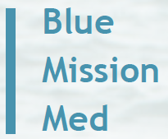




Mission Implementation Platform
Mission Board

Slide 17
Mission Coordination and Support Actions and Implementation Platform
  Coordination, cooperation and joint activities and tools between the CSAs and with the Implementation Platform are crucial!
  “Governance and networking” : Mobilisation of regional actors, networking opportunities, liaise with relevant projects; interface regional strategies and programmes
  Communication, monitoring and contribution to the Mission implementation: citizens’ engagement and users’ involvement; support associated region involvement in projects; monitoring of the implementation at basin level together with the Implementation Platform
  Foster innovation ecosystem at basin level: promote demos and testing initiatives; support access to finance; liaise with the Implementation Platform in relation to a “one stop shop” bringing together different sources of funding
  Technical expertise and know-how: catalogue of services supporting upscaling, replication and deployment of solutions; disseminate information of projects and their outcomes, liaise with the Implementation Platform
Notes:
The Mission Work Programme
Practically, Missions Ocean and waters is rooted in Horizon Europe, the European Framework Programme for research and innovation (R&I), with overall a total budget more than €90 billion of funding available over 7 years (2021-2027).
Through the Mission work programme and its related calls for proposals, we provide many opportunities to researchers, regional and local authorities, the business sector and the citizens to:
join efforts to develop and test innovative solutions to safeguard our marine and freshwater resources;
increase resilience; and
exploit the socio-economic potential of the ocean in a sustainable way.
The Mission WP follows the impact-driven logic of Horizon Europe and supports major EU policies under the Green Deal.
Our WP is mainly implemented via Innovation Actions to test and demonstrates innovative solutions on the field.
To achieve the impact we are seeking, we need to go beyond the R&I constituency. This is way, we ask funded projects to involve many different types of stakeholders: end-users, citizens and local communities, national, regional and local authorities.
We count on your support to make sure that fisheries and maritime stakeholders are involved in the Mission projects and can benefit from R&I activities to address specific challenges.

Slide 18
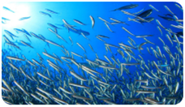
Mission Charter
Our joint commitment to restore our ocean and waters
Join forces for a transformational change for a healthy ocean and waters
A simple, inclusive, efficient and inspirational framework to enhance cooperation to deliver on Mission objectives
Open to any (public or private) interested parties
Actions can cover R&I, Knowledge & Data, Citizen engagement, Upscaling/deployment of solutions, Education & Training
Notes:
The Mission charter
For these reasons, in July 2022, we have launched a Mission Charter: our joint commitment to restore our ocean and waters
The Charter is accessible online and open to any public or private interested parties. Up to now we have received almost 300 submissions and we assess them regularly to check the relevance for the Mission.

Slide 19
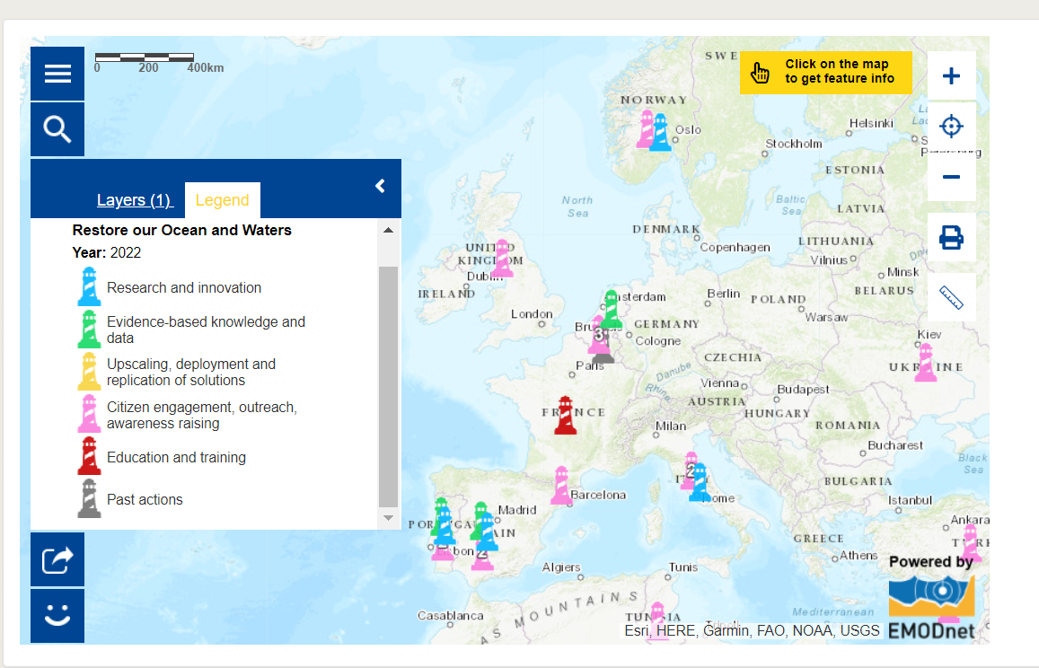
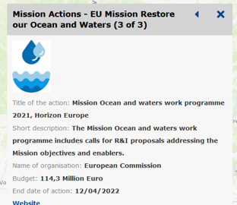
Your action in Mission Atlas
Notes:
All you have to do is go online, on the Maritime Forum page relating to the Charter and submit your action(s) and make a difference for the health of our ocean and waters and of our blue economy.
Actions under the Mission Charter can be:
Your research and innovation national/transnational programmes and projects.
Your actions to generate marine and freshwaters knowledge, to share the data and to feed them into the Digital Twin Ocean.
Your ways to upscale solutions and to support well-functioning ecosystems for finance, investments, infrastructures, talents, or regulations.
Your public outreach programmes, like campaigns on ocean/freshwaters literacy or youth initiatives;
and your education and training schemes: for new generations to respect our ocean and waters and work in harmony with nature; and for older generations to be re-skilled into jobs that do not harm our waters.

Slide 20
#MissionOcean
#EUmissions
#HorizonEU

