Slide 1
GWP Central and Eastern Europe Activities
Sabina Bokal, GWP CEE
EUSDR Priority Area 4, 25th Steering Group Meeting
23 May 2023

Slide 2


Regional cooperation
Established working relationships with River Basin Organizations
ICPDR - Danube Art Master 2022, observers, Public Participation EG
Tisza Group –participating in their fundraising efforts – LAREDAR, CRICCOM-D and JOINTISZA 2.0
Sava Commission – GWP Slovenia is now involved in their work on behalf of CEE, co-organizing Sava day celebration
HELCOM/Baltic Commission – Observer status renewed in April 2023
Celebration of the Sava Day
»Let's work with nature!«
Thursday, 1st of June 2023 – online
From 12:00 until 14:30
Other organizations:
World Bank/IAWD - MoU still active, discussions on drought work in the CEE region
European Centre for River Restoration – observer
Open Rivers Programme – member of the Programme Advisory Group

Slide 3

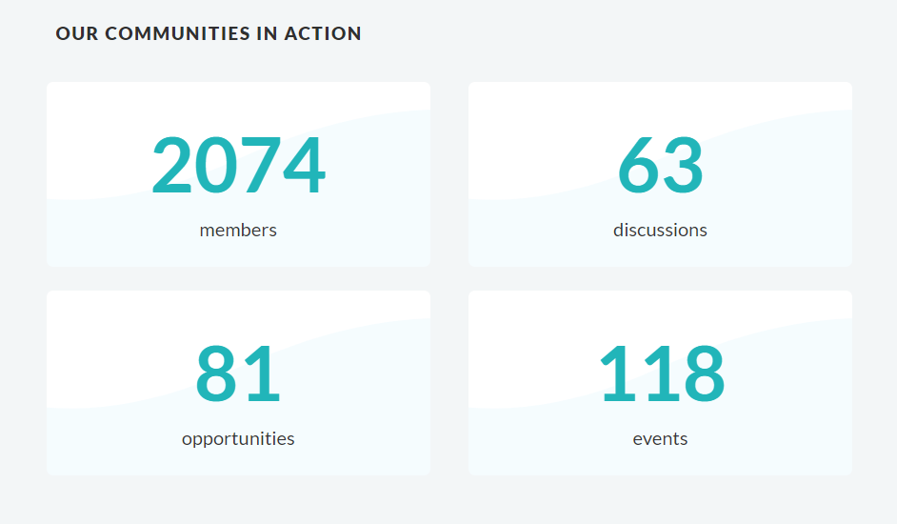
IWRM Action Hub
Learn
Explore
Connect
It is a global knowledge platform that:
Offers a comprehensive knowledge repository on IWRM with 86 Tools, 25+ Case Studies, 1300+ Resources
Facilitates sharing knowledge and expertise on implementation experiences
Cultivates Communities of Practice
Connects water practitioners around the globe
Brings together and supports actors to implement IWRM

Slide 4
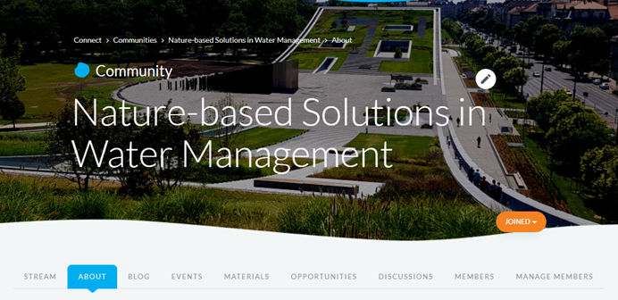
Community of Practice on NBS in Water Management
The community of practice for nature-based solution in water management is an opportunity to build on a wider recognition of NBS and will help increase the capacity and knowledge of its members.
It is a learning tool that can host different articles, blogs, discussions, interviews, webinars, opportunities, and other interactive activities related to NBS.
Launched 25/10: blogs, news, events, discussions
Most visited community in the IWRM action hub
Currently more than 60 members
Organization of two webinars:
  NBS in CEE region (December 2022 – more than 50 participants)
  NBS for youth (March 2023 – in cooperation with Sava River Commission)
Included in Interreg Danube PAC Call for EUSDR
Presentation on the 9th Danube Participation Day
New activities in 2023
  Cooperation with IWA
  Webinar on NBS in drought/flood management
www.iwrmactionhub.org/group/naturebasedsolutions/about

Slide 5
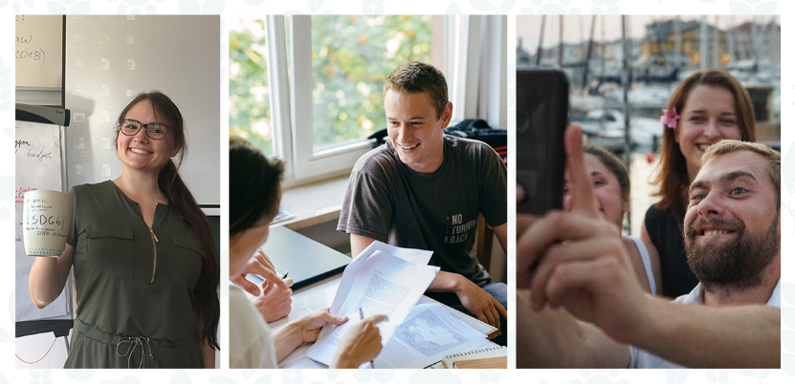

Summer School 2023
Healthy and Resilient Catchments – From Science to Action
2-8 July 2023 in Prague, Czechia
Develop scenarios for NSWRM planning according to stakeholder priorities and considering the environmental factors.
Apply a step-by-step science-based analysis of NSWRM.
Get insights into the governance aspect of NSWRM implementation.
Experience real-life situations by working with a specific location, challenges, and with local stakeholders.
Present the solutions at a multi-stakeholder forum for feedback and evaluation.
Group work and team skills
Stakeholder engagement
Problem based learning
Empowerment approach

Slide 6

Projects relevant for EUSDR PA4
OPTAIN: OPTimal strategies to reTAIN and re-use water and nutrients
HuT: The Human-Tech Nexus
Building a Safe Haven to cope with Climate Extremes
Danube4All: Restoration of the Danube river basin waters for
ecosystem and people from mountains to coast
SlovakAid: Integrated Drought Management System and
Measures to Mitigate the Impact of the Climate Change in Kosovo
Visegrad: Knowledge transfer on drought issues due to climate change for Armenia

Slide 7
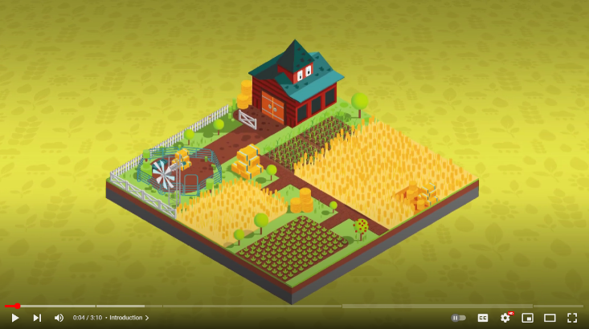

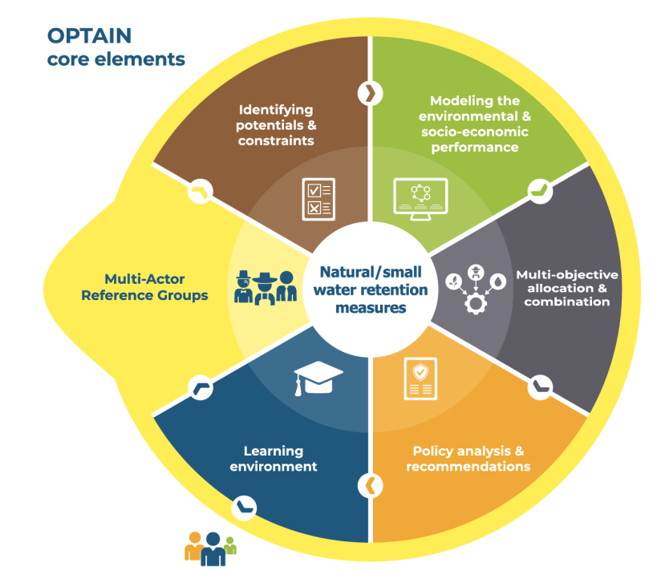
Optimal strategies to retain and re-use water and nutrients
New promo video
Horizon 2020 Research & Innovation project
21 Partners in 15 countries, 14 case studies
Duration: September 2020 – September 2025
Project coordination: Helmholtz Centre for Environmental Research – UFZ
GWP CEE: Co leads WP on Multi-Actor Reference Groups adn Dissemination & Communication
Catalogue of measures: past, present and novel NSWRMs in agriculture and water management and tailored indicators for their assessment
Environmental and economic models capable to evaluate the performance of NSWRM on the farm and catchment level
Implementation schemes for NSWRM - most effective implementation, multi-objective allocation and combination of NSWRM
recommendations for actors and policy makers and incentives to encourage a more efficient NWRM implementation
Interactive Learning environment co-created together with stakeholders
Notes:
Identify local conflicts: Drawing on the expertise of a diverse range of actors, OPTAIN will identify current and future climate-change-related conflicts in water and nutrient management for a representative set of 14 case studies.
Catalogue of measures: OPTAIN will identify and document past, present and novel NSWRMs in agriculture and water management and develop tailored indicators for their assessment.
Environmental and economic models: Using a large variety of datasets, OPTAIN will set-up models capable to evaluate the performance of NSWRM on the farm and catchment level.
Implementation schemes for NSWRM: OPTAIN will explore most effective implementation, multi-objective allocation and combination of NSWRM. It will illustrate trade-offs and synergies among multiple objectives and identify optimal compromise solutions from actors’ perspective.
Policy analysis and recommendations: OPTAIN will formulate general and case study specific recommendations for actors and policy makers and incentives to encourage a more efficient NWRM implementation.
Interactive Learning environment: platform (co-created together with stakeholders) to present OPTAIN improvements for supporting actors in their choices to implement natural small water retention measures

Slide 8

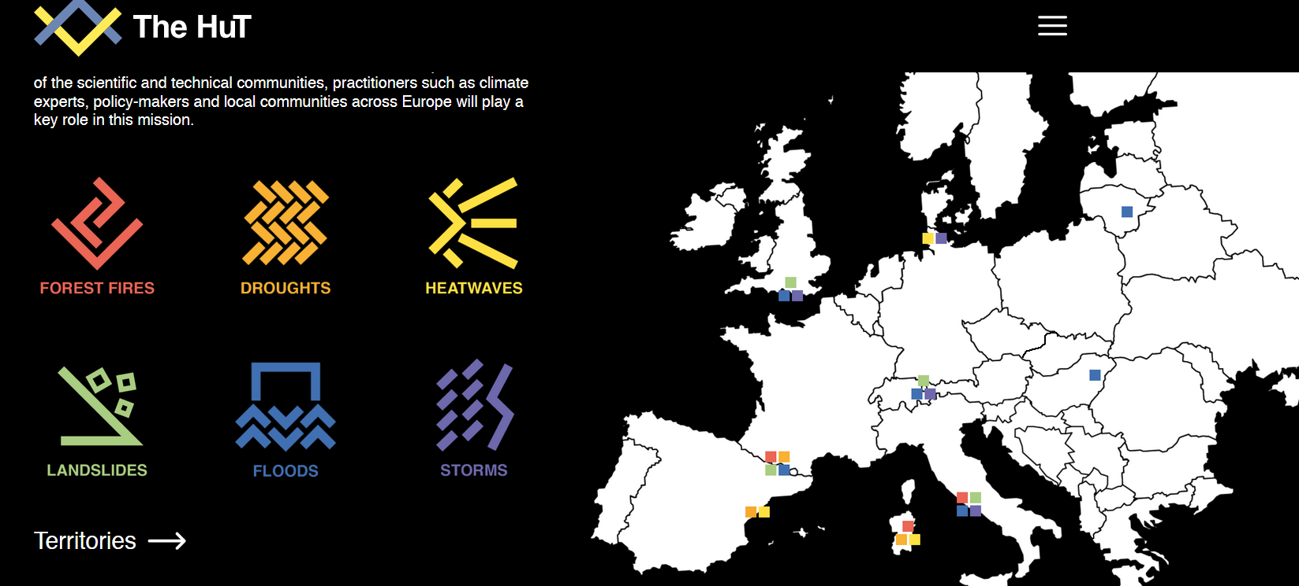
The Human-Tech Nexus
Building a Safe Haven to cope with Climate Extremes
HE-101073957
25 partners, Coordinator: Unversity of Salerno (IT)
Duration: Oct 2022- Sep 2026,
GWPCEE leads WP Transferability and scalability (14 partners, 6 deliverables)
Disaster risk reduction innovation for multiple-hazards influencing water quality and quantity (droughts, floods, landslides) across technical, human and governance nexus
Innovative solutions are being developed and transferred between different pilot areas across Europe (incl. Danube region)
Strong local and international nexus forums for transfer and scaling innovation being developed using innovative approaches from social science and art (e.g., ECCA conference June 2023)

Slide 9

Danube4All: Restoration of the Danube river basin waters for ecosystem and people from mountains to coast
Horizon Europe IA. Call: HORIZON-MISS-2021-OCEAN-02
5 years – start January 2023
25 partners, LP BOKU
www.danube4allproject.org
GWP CEE role: communication and stakeholders´ engagement
Development of Restoration Action Plan for the Danube river basin
GWP CEE activities in 2023:
Mapping citizen science initiatives in Danube Region
First step in setting Regional Danube Water Museum Network, as part of the Global Water Museum Network --> webinar on the 5th of June 10-12 CET (detailed information on the website)
Webinars for experts on different river restauration aspects in Danube Basin

Slide 10


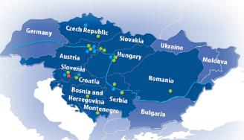
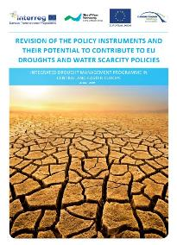
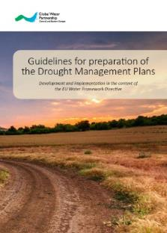

Drought included in RBMP 2021 Update for Danube river
Drought projects in Armenia and Kosovo
10 years of IDMP in CEE
Web-based tool for drought monitoring & early warning across Danube Region
www.droughtwatch.eu
2022/23
Slovak National Drought Action Plan
2020
2021
2019
IDMP CEE starts
2017
2018
Danube Drought Strategy
Danube Drought Conference
Over 30 national dialogues (2013-2015)
Task Force established
2016
How to Communicate Drought in a changing climate? (Guide)
Training on Integrated Drought management for Drin basin countries
2015
2012
2013
DriDanube project starts
2011
2014
Over 40 organizations from CEE join initative
Guidelines for Preparation of the Drought Management Plans
Inception report
to collect regional interest and needs
Increased capacity of the key actors to implement the process of preparing a DMP
Notes:
Her you can see our timeline with a major achievements or outputs through the years.
Now we have two smaller projects running in Armenia and Kosovo

Slide 11


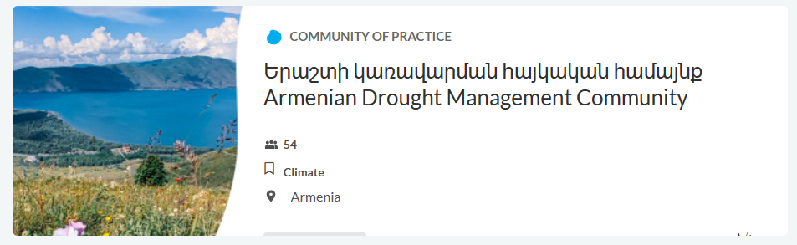
Drought projects in Armenia and Kosovo
Integrated Drought Management System and
Measures to Mitigate the Impact of the Climate Change in Kosovo
Knowledge transfer on drought issues due to climate change for Armenia
Armenian Community of Practice on Drought
Study Visit – Bratislava (SHMI, GWP CEE, Czech Globe) and in Ljubljana (ARSO, DMCSEE and GWP SLO)
Training in Armenia
Draft Action Plan for the Drin River Pilot Basin
A set of drought mitigation measures
Drought Management Platform
National consultative dialogue
Training for water management experts and farmers
Notes:
Main goal of the CoP is to support transfer of knowledge and lessons learned gained trough Visegrad cooperations to experts from Armenia, aiming for integrated drought management!

Slide 12

Thank you for your attention
www.gwpcee.org

