Slide 1
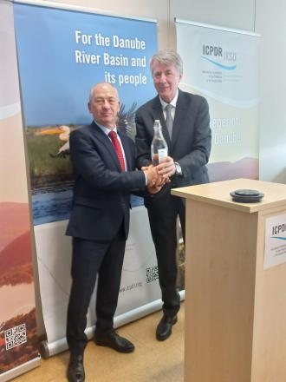
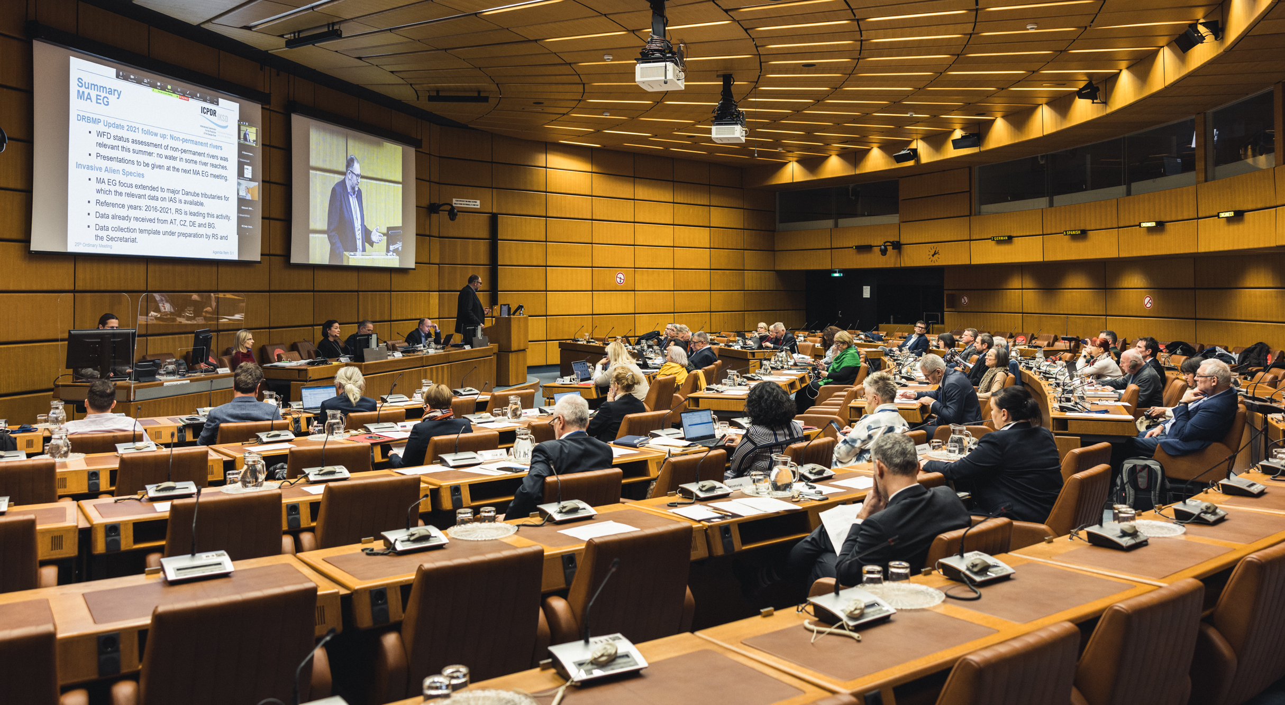
Current activities of the ICPDR
Progress in the EUSDR PA4 related activities

Slide 2
River basin management 1)
ICPDR Chairperson’s meeting on 25-26 January 2023
  Expectations to the water balance project, cooperation of EGs and TGs
  Roadmap for the next management cycle (WFD legal requirements, experiences of previous reports, discussion on the upcoming reports)
  Interim report on the JPM implementation (2024):
  Keeping a short technical report format, targeting the public
  No data collection with templates through DanubeGIS
  Focusing on positive messages, demonstrating best case examples preferably with transboundary impacts
  Promoting basin-wide initiatives and projects implemented
  Showing local/regional/national/bilateral best examples on measure implementation (to be collected from the countries)
  First discussions and collection of information in the EGs and TGs

Slide 3
River basin management 2)
  Interim overview on the Significant Water Management Issues (2025)
  Addressing the same SWMIs as for the previous report in 2019
  First draft of the SWMIs overview to be prepared by the RBM EG in autumn 2024
  4th Danube River Basin Management Plan (2027):
  Elaborating the next version of the DRBMP with an easier to understand language and more pictures & info graphics
  A short summary of key messages to be prepared to better present the “highlights” of the plan
  Revision and simplification of data collection process
  Discussions in EGs and TGs on possible ways and options to shorten “their” respective text of the DRBMP (key figures, detailed annexes)

Slide 4
Hydropower & Sturgeon
Next Hydropower Workshop in 2024
Draft concept developed focusing on impacts on biodiversity, innovative technologies and operation issues in time of increasing drought periods
Questionnaire on the application of the Hydropower Guiding Principles in the Danube countries to discover update needs (emerging issues)
Hydropower stakeholder mapping to be performed before the Workshop
We Pass 2 project activities
Preparation of “heat maps” (aggregation) for fish species by overlaying fish tracks and hydraulic conditions at different flows
Overview of different options and variants for fish passage upstream of Iron Gates II and their combination
Stakeholder meeting on 4 & 5 May 2023 (operators, national experts)
Next steps: 3D fish telemetry in the reservoir in summer 2023, preliminary design of preferred options

Slide 5
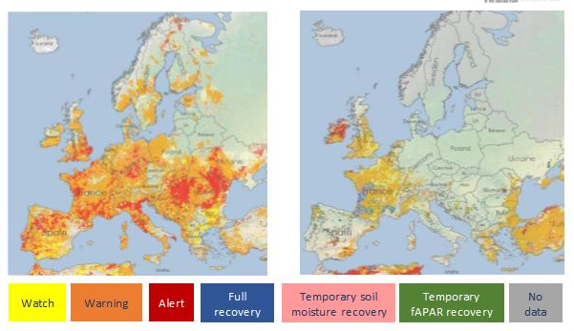
Droughts and low water level 1)
No targeted activities so far to assess and manage droughts and low water level situations at the basin-wide level
Severe drought events with significant impacts observed in the last decade and recently, affecting water uses
Alert and warning conditions across the basin (summer 2022) and in RO and BG (winter 2023)
August 2022
March 2023
Combined Drought Indicator

Slide 6
Droughts and low water level 2)
OM-25: drought and low water considered as important for further action by the ICPDR
Request of Hods to organize a moderated workshop on the drought topic
Internal ICPDR Workshop on Drought and Low Water Levels to be organized in Belgrade/Serbia on 16 June 2023
Main goals of the workshop:
Understand and identify DRB transboundary needs regarding droughts and low water levels
Put forward possible actions on the basin-wide level
Determine the role of the ICPDR
Structure: setting the scene on EU policies and regional approaches; national presentations on transboundary needs and actions; discussion on common goals and next steps

Slide 7

Wastewater, chemicals & plastics
Implementing the ICPDR-World Bank wastewater initiative:
planned workshops on rural and small-scale wastewater treatment, circular economy aspects and the revised UWWTD
Supporting the finalization of the Danube Hazard m3c project:
hazardous substances pollution inventory
updated chemical emission model for selected substances
technical manual on monitoring and modelling
policy guidance supporting effective management and control of hazardous substances pollution, basis of a recommendation paper
Developing a recommendation paper on plastic pollution based on the findings of the Tid(y)Up project

Slide 8
Nutrients and agriculture
Future nutrient emission modelling:
  Shifting the focus on management scenarios
  Increasing the spatial resolution of the emission pattern
  Maintaining an input data summary as a living document
  Follow-up on sustainable agriculture:
  putting emphasis on the drought issue combined with nutrients and pesticides
  stakeholder mapping to identify dialogue partners from the agricultural sector
  drafting a concept note and roadmap for the next 2-3 years
  discussing pilot events to support the dialogue (science-policy exchange; best practices on drought and nutrient management)

Slide 9

Meetings & Events
21st ICPDR Standing Working Group Meeting
Belgrade, 15 June 2023
ICPDR Workshop on Droughts
Belgrade, 16 June 2023
39th PM EG meeting
online, end of September 2023
58th RBM EG Meeting
Munich, 19-20 October 2023

Slide 10





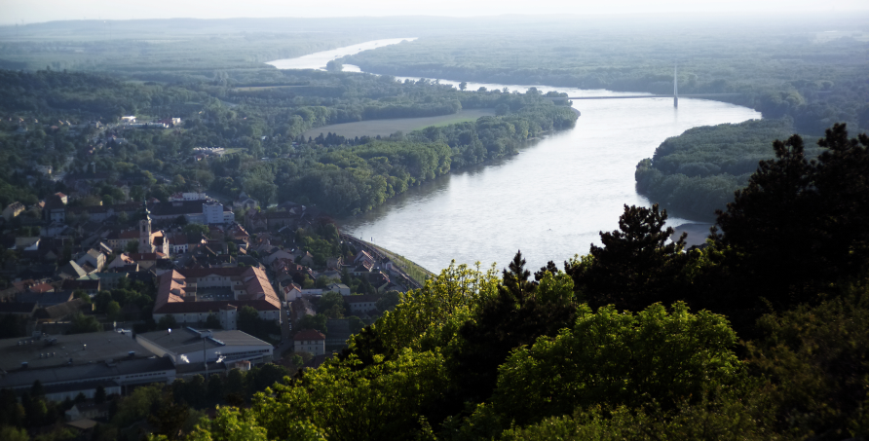

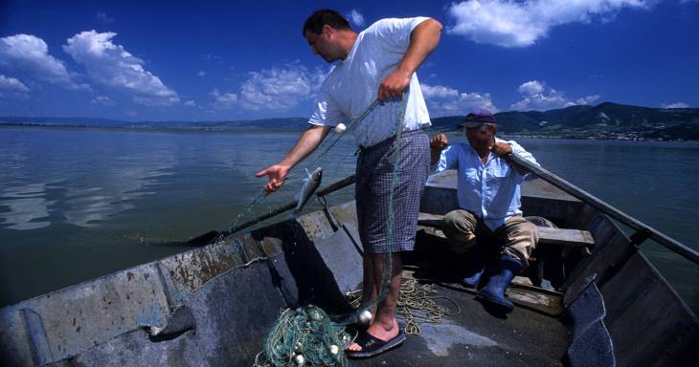
Thank you for your attention!
For more information please visit the ICPDR website:
http://www.icpdr.org

Slide 11
Projects under preparation
JDS 5
Water Balance
Hazardous substances 2
Plastic pollution 2
Sediment 2

