Slide 1


International Sava River Basin Commission Update of Activities
25th meeting of EUSDR PA4
Samo Grošelj, Deputy Secretary

Slide 2

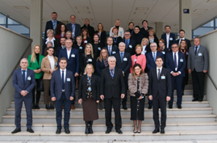
9th Meeting of the Parties
More than 40 participants
High level delegation from the Parties
Representatives of the Partners of the Sava Commission
Montenegro
European Commission
UNECE, UNESCO, WMO
ICPDR, Danube Commission, Scheldt Commission, INBO
Message for the youth from the basin (Sava Youth Parliament)
Message for the challenges ahead- World Bank
Declaration from the 9th Meeting of the Party adopted

Slide 3




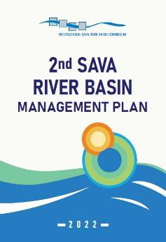
River Basin Management
from 9th MoP Declaration
Acknowledging the progress in the implementation of the EU WFD and EU FD and calling for a further common planning approach
Approve the second Sava River Basin Management Plan as a major achievement in regional cooperation, leading towards the fulfilment of main objectives of the FASRB (Establishment of sustainable water management)
Express gratitude to all other institutions and individuals who contributed to the development of the Sava RBMP
Welcoming the main achievements in the implementation of measures envisaged in the first plan, commit to implement the PoM foreseen in 2nd Sava RBMP

Slide 4
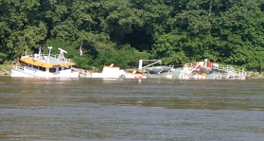
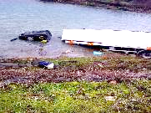
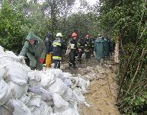

Water Contingency Management in the Sava River Basin (WACOM)
Main objective: reduction of environmental risks related to accidental pollution and floods, especially those which have or might have transboundary impact in SRB
Scope: To develop operational framework for activation of Protocols on Emergency situations, Prevention of Pollution Caused by Navigation, Flood Protection
Timeframe: July 2020-December 2022
Notes:
Osnovne informacije o projektu
Glavni cilj:
smanjenje okolišnih rizika povezanih sa slučajnim onečišćenjem i poplavama, posebno onih koji imaju ili bi mogli imati prekogranični utjecaj na sliv rijeke Save
Djelokrug:
Razviti operativni okvir za aktiviranje Protokola o izvanrednim situacijama, o sprječavanju onečišćenja uzrokovanog plovidbom te Protokola za zaštitu od poplave
Vremenski okvir: 1.7.2020.-31.12.2022.
Budžet: 1,570,581.00 EUR
Budžet ISRBC-a: 214,820,00 EUR
Proračunska linija: Projekt je sufinanciran sredstvima Europske unije (ERDF, IPA) do 85%, a 15% je doprinos projektnog partnera

Slide 5
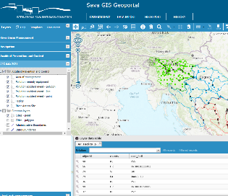
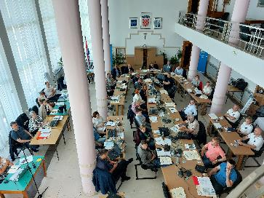
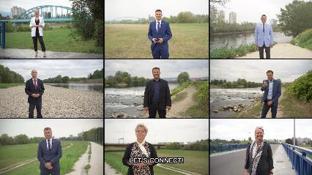
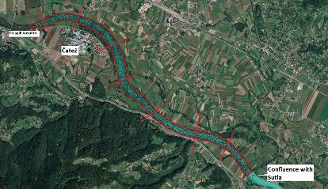
Water Contingency Management in the Sava River Basin (WACOM)
Main achievements :
Establishment of model of oil slick propagation
Development of Incident Command System Tools (Transnational Incident Coordination Tool and Situational Awareness Tool)
Upgrade Sava GIS with APC and NAV modules
Execution of Tabletop Exercises (water management, civil protection and navigation sectors)
Development of strategies for emergency response (Sava STEER)
Communication activities (newsletters, articles in newspapers and bulletins, video, workshops, conferences, presentations at > 50 events, Sava Youth Parliament etc.)
Notes:
Osnovne informacije o projektu
Glavni cilj:
smanjenje okolišnih rizika povezanih sa slučajnim onečišćenjem i poplavama, posebno onih koji imaju ili bi mogli imati prekogranični utjecaj na sliv rijeke Save
Djelokrug:
Razviti operativni okvir za aktiviranje Protokola o izvanrednim situacijama, o sprječavanju onečišćenja uzrokovanog plovidbom te Protokola za zaštitu od poplave
Vremenski okvir: 1.7.2020.-31.12.2022.
Budžet: 1,570,581.00 EUR
Budžet ISRBC-a: 214,820,00 EUR
Proračunska linija: Projekt je sufinanciran sredstvima Europske unije (ERDF, IPA) do 85%, a 15% je doprinos projektnog partnera

Slide 6
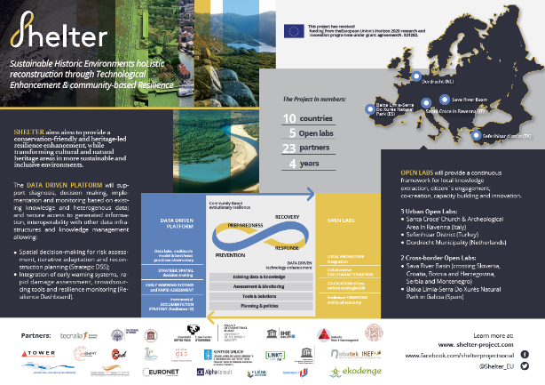

SHELTER- Sustainable Historic Environments hoListic reconstruction through Technological Enhancement and community-based Resilience
23 Project Partners from 14 countries, 5 case studies (Open Labs)
Timeframe: June 2019 - May 2023
Final Conference was held in Venice on April 27-28, 2023
Scope: SAVA Open lab- protection of Cultural Heritage in prevention, preparedness, response and recovery phases of flood risk management
Data on CH laying in flood-prone areas​ collected
Sava GIS​ improved and CH data integrated
Performing of flood impact analyses on the CH sites within flood-prone areas - testing
Network between different sectors relevant for the project activities​ established
Exchange of knowledge within the Sava Open Lab and peer-learning between other OLs​ performed
Notes:
Osnovne informacije o projektu
Glavni cilj:
smanjenje okolišnih rizika povezanih sa slučajnim onečišćenjem i poplavama, posebno onih koji imaju ili bi mogli imati prekogranični utjecaj na sliv rijeke Save
Djelokrug:
Razviti operativni okvir za aktiviranje Protokola o izvanrednim situacijama, o sprječavanju onečišćenja uzrokovanog plovidbom te Protokola za zaštitu od poplave
Vremenski okvir: 1.7.2020.-31.12.2022.
Budžet: 1,570,581.00 EUR
Budžet ISRBC-a: 214,820,00 EUR
Proračunska linija: Projekt je sufinanciran sredstvima Europske unije (ERDF, IPA) do 85%, a 15% je doprinos projektnog partnera

Slide 7
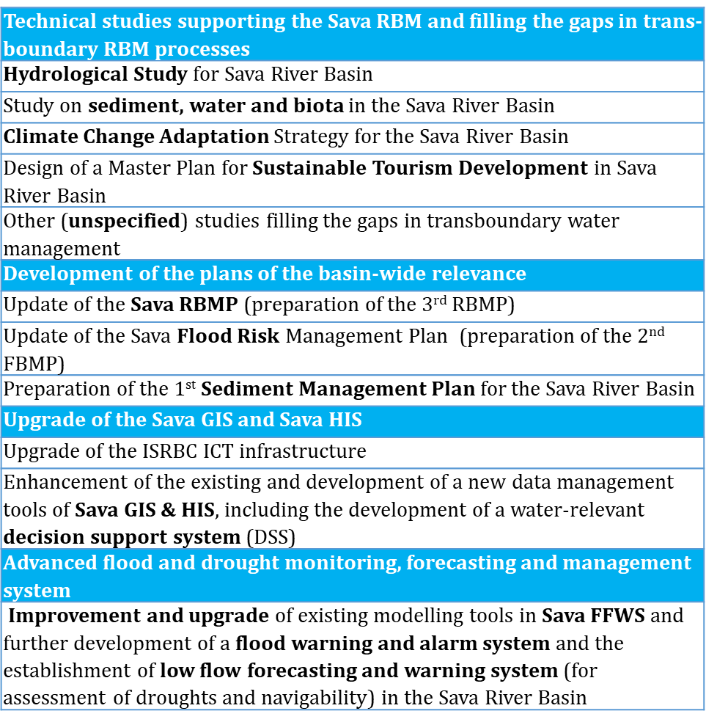
The Sava Drina Integrated Development Programme - SDIP
Effectiveness 29 November 2022
ToRs for the Regional studies in preparation
from 9th MoP Declaration
Bearing in mind that the Joint Plan of Actions for the Sava River Basin (JPA), prepared by the Sava Commission in 2017 with the support of the World Bank, outlines the path towards sustainable development and growth in the region and aims to serve as a catalyst for further enhancement of the cooperation, we acknowledge the exceptional work invested in the successful preparation of the related regional component of the Sava and Drina River Corridors Integrated Development Program (SDIP), and commit ourselves to provide all necessary resources and support to the Sava Commission in implementation of the activities planned by the SDIP- Phase I

Slide 8
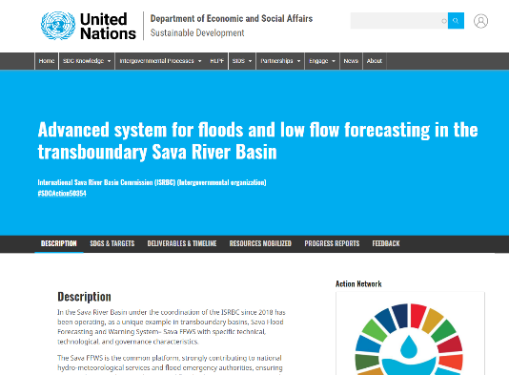
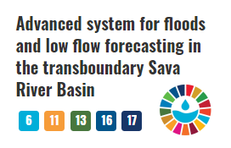
Steps towards SDGs-Committment of the ISRBC
The initiative will significantly contribute to:
Further strengthening of the well-established transboundary cooperation mechanism of the ISRBC in the Sava River Basin
Strengthening the resilience and adaptive capacity to water related climate- hazards and natural disasters
Contributing to the awareness-raising and human and institutional capacity on water related climate change adaptation measures
Enabling risk reduction of human lives' loss, damages of properties and infrastructure, detrimental impacts on environment and cultural heritage, economic losses, and will increase resilience of communities, and wellbeing of the whole society
Promoting the use of advanced and innovative information technologies
Creating possibilities to knowledge, information and experience transfer among wider or different regions creating the possibilities for integration within the framework of macro-regional strategies and dissemination of the lessoned learnt with other international basins.

Slide 9

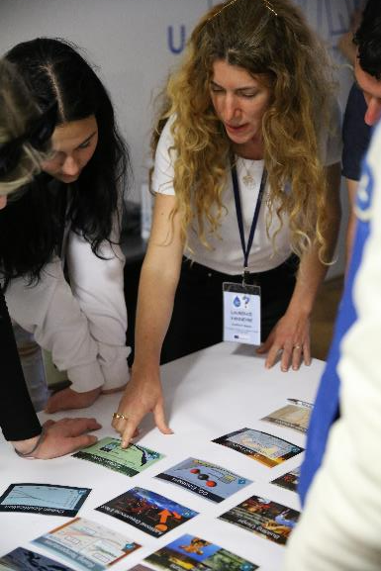
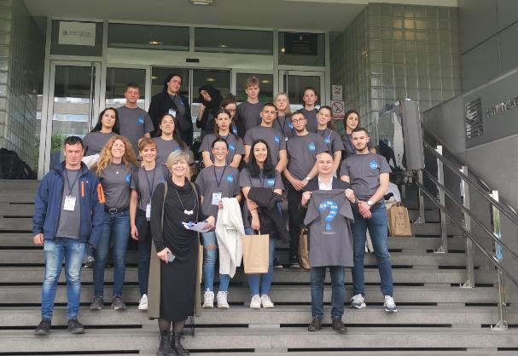
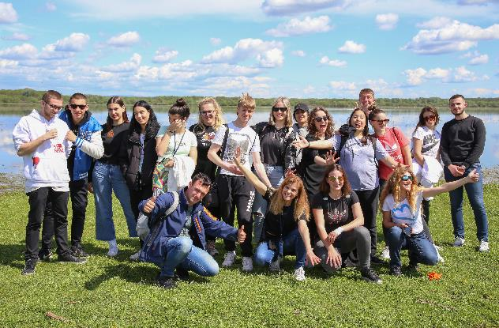
Cooperation and involvement of the youth
ISRBC – Scheldt commissions cooperation
Project: Can you hear our rivers?
2-years project (March 2022 – February 2024)
Supported by Erasmus+ and the European Union
Theme: Climate Change Impact on Sava and Scheldt River Basins
Study trip to Ghent in September 2022 and to Croatia in April 2023 (each time 20 participants from 7 countries)

Slide 10

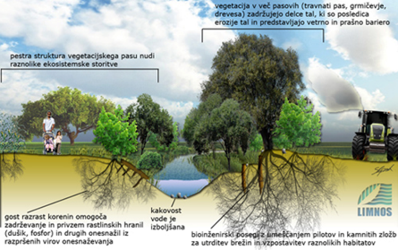
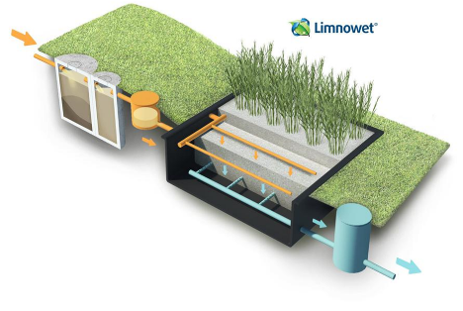
Cooperation and involvement of the youth
Sava Youth Parliament
11th SYP to be held in Ljubljana (SI) - end of September/beginning of October 2023​
Theme: Let’s work with nature!​
Organized in cooperation with GWP CEE and University of BG​
Timeline:​
Competition for secondary schools and youth associations - from March until May​
Webinar on NBS- held on 30th March 2023 (explain Nature Based Solutions)​
Event of celebration of Sava Day (1st of June) the teams will present their work – online ​
Announcement of the selected teams at the ISRBC webpage – beginning of September

Slide 11

Thank you for your attention!

