Slide 1
Danube Sturgeon Task Force Update on Activities
Beate Striebel-Greiter, WWF CEE
on behalf of
DSTF Executive Committee
https://dstf.info/

Slide 2
Who is the DSTF?
Created by EUSDR PA06 (Biodiversity) in 2011/2012
Membership: sturgeon experts and enthusiasts
links with national water & nature managers, ICPDR and European Commission and international NGOs
Adoption of Rules of Procedure (2018)
Election of an Executive Committee (2019; 2022)
Not a project management organisation and has no funds, budget or financial management.
DSTF depends on members voluntarily donating their time and on contributions in kind from organisations such as EUSDR PA06,
WWF and BOKU University in Vienna

Slide 3
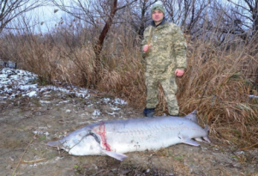
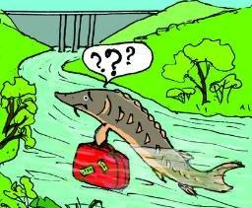
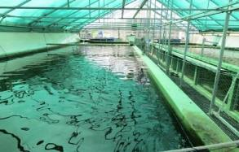
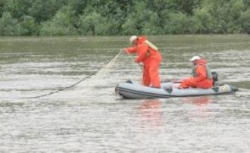
MAIN DSTF PRIORITIES
Prevention of poaching or by-catch of wild sturgeons in fresh and marine waters
Establishment and operation of conservation hatcheries and restocking of sturgeons in the Danube
Establishment of an effective system for sturgeon population monitoring
Restore and maintain ecological migration corridors and habitats, including removal of obstacles to migration

Slide 4
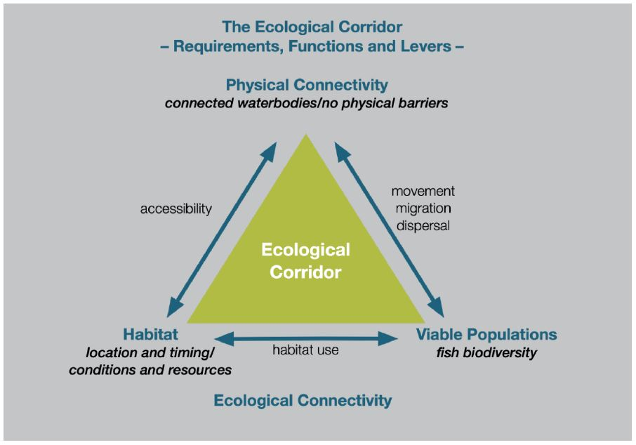

https://www.interreg-danube.eu/approved-projects/measures
Notes:
The INTERREG „Measures“ project has worked with this concept of the ecologcial corridor, which depicts that a functional corridor is more than just a connection between 2 points. It is the sum of the different habitat characteristics a species needs during ist life cycle, including spawning places, feeeding areas, wintering sites. It is is also the accessibility of all these habitats for the sturgeon – this is the physical connectivity and the last element often forgotten is the actual species population tht moves along this corridor and uses the habitats. All these three elements are equally important for a functional ecologcial corridor.

Slide 5
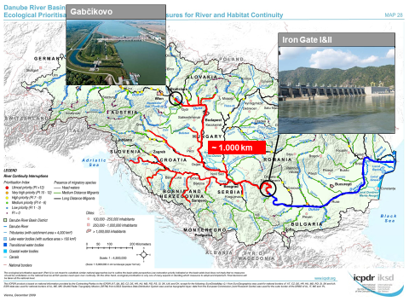
Priorities for physical connectivity
Iron Gates – passage solution would double the available river stretch for sturgeon adressed by WePass projects through monitoring studies, modelling and technical design variants
Gabcikovo & Cunovo dams – passage solutions adressed by SK LIFE project
Notes:
Once Iron Gates become passable
the access to free flowing river stretch will double the current stretch of the Lower Danube.
several countries will need to share the responsibility of an Ecological Corridor management for migratory sturgeon
we are supposed to get preliminary designs and costings for fish passage facilities at the Iron Gate in 2024 and that now is really the time to consider what should happen upstream of the Iron Gate, including at Gabcikovo.
WePass project – Feasibility for passage solution ongoing – phase2 will end in March2024
(1)Migratory fish movement monitoring using 3D fish telemetry
(2)Hydraulic modelling-Flow measurements
(3)Identification of fish migration options -Additional surveys & studies (topographical survey, geospatial restrictions, geotechnical conditions, groundwater …)-Upstreamfish passage options at both Iron Gate Dams-Fish protection and downstream passage options incl. fish hazard/ turbine survival modelling
(4)Preliminary design(s) of identified preferred fishway(s) incl. cost estimate

Slide 6
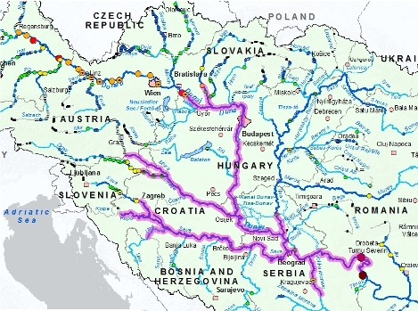
Once Iron Gates become passable
the access to free flowing river stretch will double the current stretch of the Lower Danube.
several countries will need to share the responsibility of an Ecological Corridor management for migratory sturgeon
Notes:
we are supposed to get preliminary designs and costings for fish passage facilities at the Iron Gate in 2024 and that now is really the time to consider what should happen upstream of the Iron Gate, including at Gabcikovo. once fish passage facilities at Iron Gate become operational widening very significantly for operational ecological corridors in the Danube Basin. with the long lead times for fish passage on major dams, consideration of fish passage options at Gabcikiovo should start now. The photo also under pins the point that nobody can do it alone as access will become open to a multitude of countries.

Slide 7
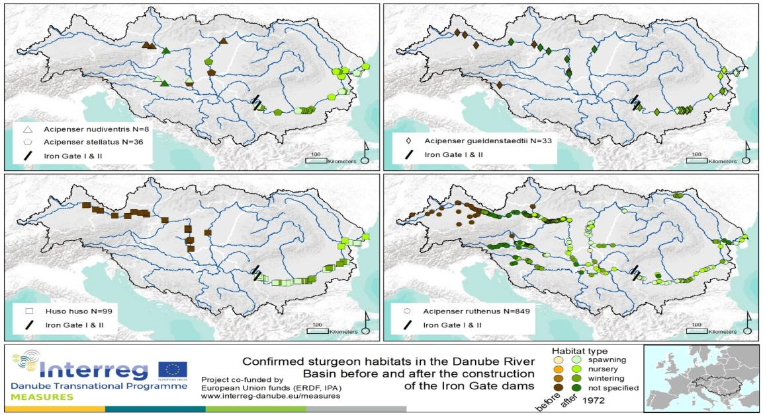
Habitats
MEASURES
First basin wide compilation of sturgeon habitats
Best knowledge available → integrated in RBMP
Verifications and additions neceesary
Notes:
A recent project that has dealt with the concept of the ecological corridor is the MEASURES project which was funded by the DTP programme, with partners from almost all Danube countries, lead by the BOKU University in Vienna.
The MEASURES project has collected all available documented information (historical and recent) to identify different habitat types for different sturgeon species along the Danube.
Available data was collected to map sturgeon habitats
(spawning, nursing, wintering, not specified)
Still not a complete picture, will need additions
Not a picture of the distrubitions of the species
Best basis available
→ was integrated in RBMP 2021

Slide 8

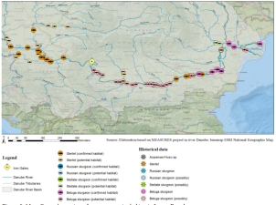
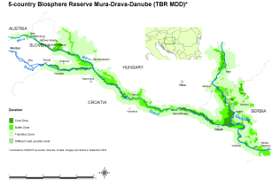
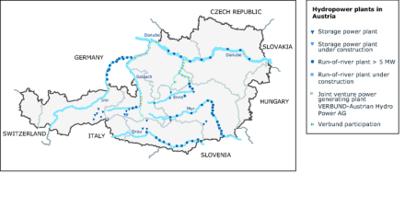
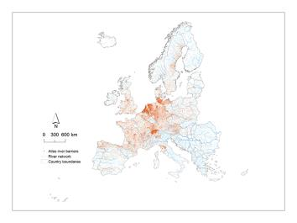
Next steps …
EU service contract: „Supporting Conservation and Protection Actions to Implement the Pan-European Sturgen Action Plan”
1) Map sturgeon habitats
2) Overlap existing protected areas
Identify critical habitats & gaps in protection
3) Map existing barriers (river structures)
Identify priorities for needed solutions
4) Map planned infrastructure development projects
Visualise conflicts
Maps and other project results will be presented and discussed at stakeholder meetings end of 2024 in 5 EU regions with 11 key sturgeon rivers
(1) Baltic Sea; (2) North-East Atlantic; (3) Medditerean; (4) Upper/Middle Danube; (5) Lower Danube/Black Sea
EEA (2012)
Elguea (2020)
wwf.panda.org
amber.eu
8
Notes:
Maps with 4 Layers will be produced in 5 sturgeon regions in Europe with 11 priority rivers
(1) Baltic Sea; (2) North-East Atlantic; (3) Medditerean; (4) Upper/Middle Danube; (5) Lower Danube/Black Sea
Sources: https://www.eea.europa.eu/data-and-maps/figures/hydropower-plants-in-Austria
https://amber.international/european-barrier-atlas/uropa.eu/data-and-maps/figures/hydropower-plants-in-Austria
https://wwf.panda.org/wwf_news/?363633/mdd-nominated
Elguea, A. (2020). A comprehensive assessment of potential habitats of sturgeon species in the River Danube.

Slide 9
https://www.interreg-danube.eu/approved-projects/measures

Slide 10
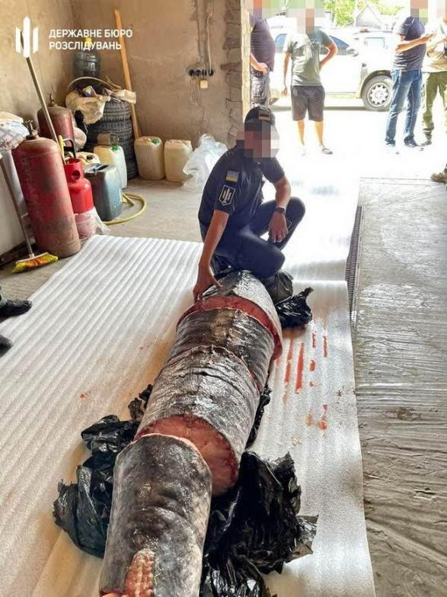
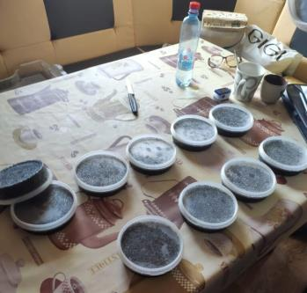
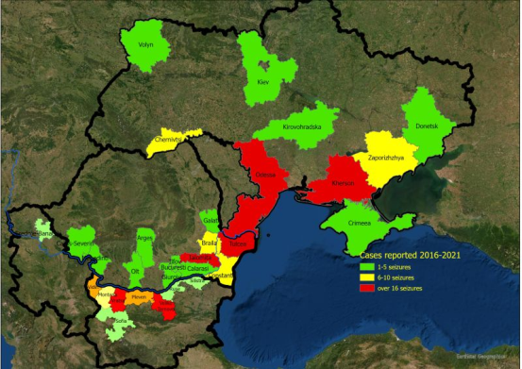
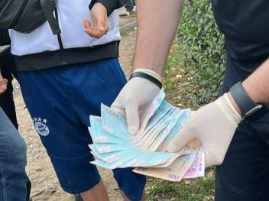
Stop poaching and by-catch
Fishing bans for sturgeon exist
Poaching continues at similar levels over recent years
Stricter enforcement required
By-catch at river and sea
largely unknown!
→ GFCM Black Sea pilot project
Notes:
Up to Dec 2021 are a total of 271 cases :
Bulgaria- 104 cases
Romania- 99
Ukraine- 68 (official data only received as of 2018)
The 57 cases recorded throughout 2021 include the seizure of a minimum of 178 individual sturgeon and 154 illegal hook (more than 5km).

Slide 11
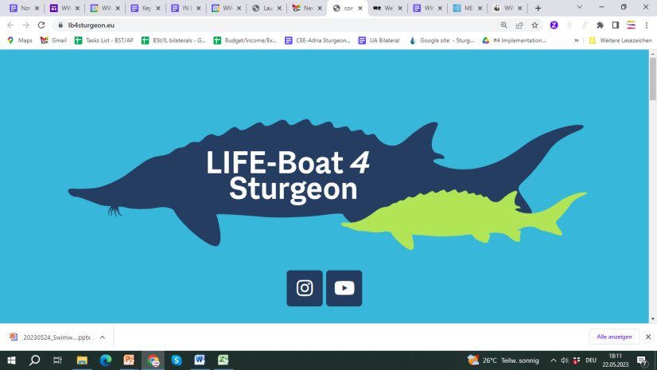
Conservation breeding and release programms
So far restocking activities not coordinated and no exchange of information
LIFE Boat (2022-2030) as starting point for coordinated Danube wide approach;
1,6 Million fish will be released
More info soon available on:
https://lb4sturgeon.eu/

Slide 12
Avoid flying blind: The importance of population monitoring
DSTF Position Paper
Monitoring is a prerequisite for management decisions:
on fishing regulations (effects of catch allowance with size limits, termination or prolongation of fishing bans, impacts of IUU or by-catch)
measures to restore river continuity, including dam removal, design and functionality of fish passages solutions
Basis for environmental impact assessments, complying with no-harm principles
Identification & restoration of critical habitats
on supportive conservation breeding and release measures
Ultimatively to assess success or failiure of conservation measures and populations status (Habitats Directive)
We need coherent, comparable data in the Danube Basin and the Black Sea
We need a regular exchange of data of shared populations
Notes:
Monitoring is a prerequisite of knowing if we are doing the right things .

Slide 13
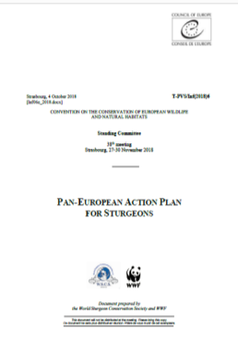
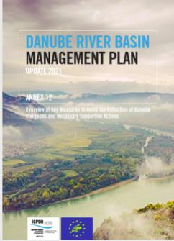
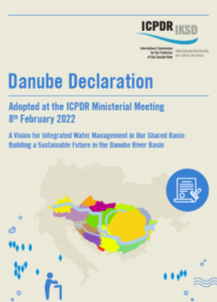
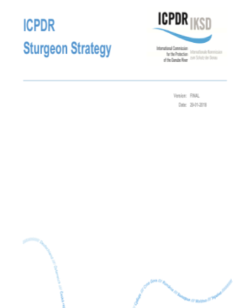
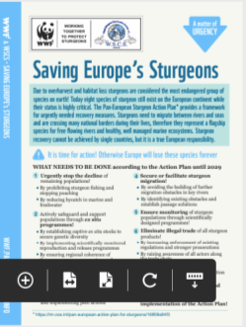

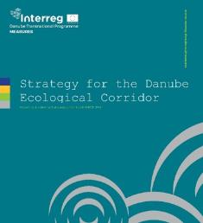
Strategies in place
Pan European Action Plan for Sturgeon adopted by Bern Convention (2018) and endrosed as EU Species Action Plan under the EU Habitats Directive (2019)
Danube RBMP includes sturgeon measures and ICPDR Ministerial declaration (2022) include commitment to PANEUAP
DTP funded project MEASURES – Strategy for ecological corridor conservation (2021)
ICPDR Sturgeon Strategy (2018)
DSTF/ESUDR Sturgeon 2020 (2016)
Notes:
One could say Danube countries have expressed their support to the PANEUAP 3 times!
There are enough strategeic papers on regional or international level as frameworks avaailable.
Yet implementation is lacking on national level.

Slide 14
What is missing?
Translation of the regional and international plans & strategies into national action
  Priority setting
  Clear responsiblities
  Timining
  Evaluation Steps
  Transboundary Cooperation
Increase the communication and cooperation between different stakeholders from all sectors
We need to break up silos between stakeholders in particular
between water management – nature conservation – fisheries.
between river and sea basin
Foster exchange between countries.
In the Danube no country can save sturgeon alone!
Notes:
A lot of good strategies have been written and agreed on European or Danube basin level – so what is missing?
The translation of these strategies into national action. How can this be best done? Involve all statekholders and actors from the different sectors, set priorities based on national circumstances, calirfy the responsibilities and ensure coordination of the responsible actors. BUT in the Danube Basin there will remain a need for transboundary cooperation. Populations are shared an no country can save sturgeon alone!

Slide 15

Thank you for your attention !
www.dstf.info
info@dstf.info

