Slide 1
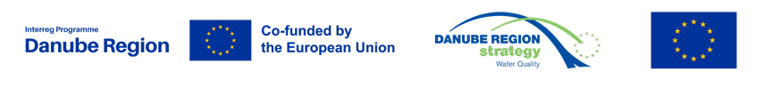
Information on water related calls and alignment of funding
EUSDR PA4 25th SG meeting
23-24 May 2023 Bratislava
Zsuzsanna Kocsis-Kupper PA4HU

Slide 2
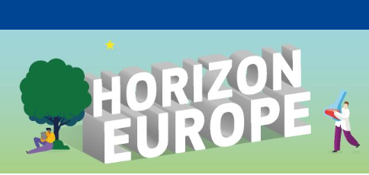
UPCOMING water- related calls
Ocean & water and arts: the contribution of creative sectors to Mission Ocean and watersHORIZON-MISS-2023-OCEAN-01-11
European natural lakes: demonstration of integrated approaches for protection and restoration of natural lake ecosystems and their biodiversityHORIZON-MISS-2023-OCEAN-01-04
Roadmap towards the integration of inland waters into the Digital Twin OceanHORIZON-MISS-2023-OCEAN-01-09
Danube river basin lighthouse – Demonstration of effective and sustainable management of sediments in the Danube river-Black sea system HORIZON-MISS-2023-OCEAN-01-02
Deadline date | 20 September 2023 17:00:00 Brussels time

Slide 3
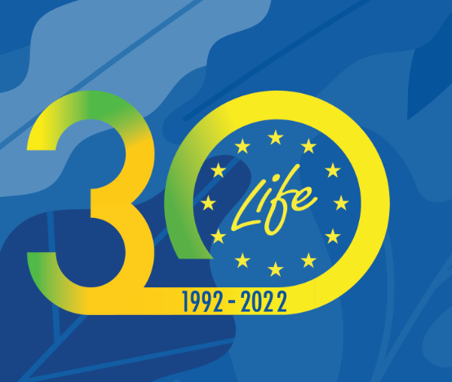
LIFE programme

Slide 4

The new LIFE programme 2021-2027 has a budget of €5.4 billion and is divided into four sub-programmes:
Nature and biodiversity
Circular economy and quality of life
Climate change mitigation and adaptation
Clean energy transition
More detailed information on the LIFE programme is available on the LIFE Website.
LIFE 2023 Calls for proposals ARE OPEN: Call 2023 budget: 611 million €
https://cinea.ec.europa.eu/programmes/life/life-calls-proposals_en#life-calls-for-proposals-2023
The LIFE National Contact Points can guide applicants. Also, the LIFE Units in DG Environment and CINEA can offer advice on project concepts. Please write to CINEA-LIFE-ENQUIRIES@ec.europa.eu

Slide 5
LIFE Calls for proposals 2023
The LIFE Call for proposals 2023 have been published on the Funding & tender opportunities portal on 18 April. The calls for Clean energy transition were published on 11 May.
Find on the EU info daysEN••• all presentations and recordings from the event, which took place on 25 and 26 April 2023.
A dedicated virtual information session on the specificities of the calls for Clean energy transitionEN••• will take place on 1 June 2023.
Opening and submission dates
Standard Action Projects (SAPs) for circular economy and quality of life and nature and biodiversity sub-programmes: Opening: 18 April – Closing: 6 September 2023
Standard Action Projects (SAPs) climate change mitigation and adaptation sub-programme:
Opening: 18 April – Closing: 21 September 2023
LIFE Action Grants for clean energy transition sub-programme:
Opening: 11 May (expected) – Closing: 16 November 2023 (expected)
Strategic Integrated Projects (SIPs):
Concept notes: Opening: 18 April – Closing: 5 September 2023
Full proposals: Closing: 5 March 2024
Technical Assistance preparation for SIPs and SNAPs:
Opening: 2 May – Closing: 7 September 2023
Technical Assistance Replication:
Opening: 18 April – Closing: 27 July 2023

Slide 6
TA-R: LIFE Technical Assistance for Replication (i)NOVELTY
•Preparation for facilitating the up-scaling and replication of results from other projects funded by the LIFE Programme, its predecessor programmes or other EU funding programmes
•For the LIFE23 Call only proposals in the field of ‘Environment’ (i.e. ‘Nature and Biodiversity’ and ‘Circular Economy and Quality of Life’)
•The TA-R projects could co-finance the activities necessary:
•(1) to prepare or remove impediment to the up-scaling and/or replication of the results of previous LIFE projects or of other Union programmes, as long as they contribute to the objectives of the LIFE programme.
•(2) to facilitate the access of an action contributing to the LIFE objectives, to other financial instruments.
•it should exceed the replication/transfer efforts and objectives foreseen in the preceding LIFE project and/or it should address issues emerging during a LIFE project that could not be solved during its duration, despite being extremely relevant for the success and sustainability of the project’s results. In case of proposals based on other EU-funding programmes, similar criteria will be applied.
•Only proposals in the field of ‘Environment’ (i.e. ‘Nature and Biodiversity’ and ‘Circular Economy and Quality of Life’)–for the LIFE23 call •60% co-funding; Call budget 6.5 M€; Opening April 2023
•Deadline for submission: 27 July 2023 •Grant Agreement signature: foreseen around February -March 2024

Slide 7
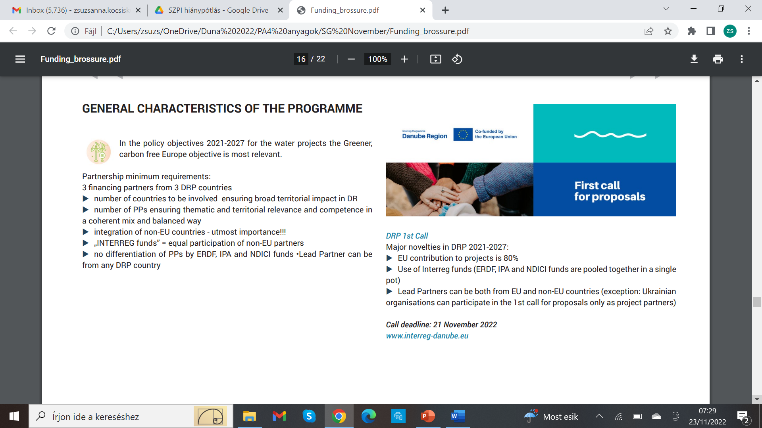
DRP call was closed, 290 project proposals submitted altogether

Slide 8
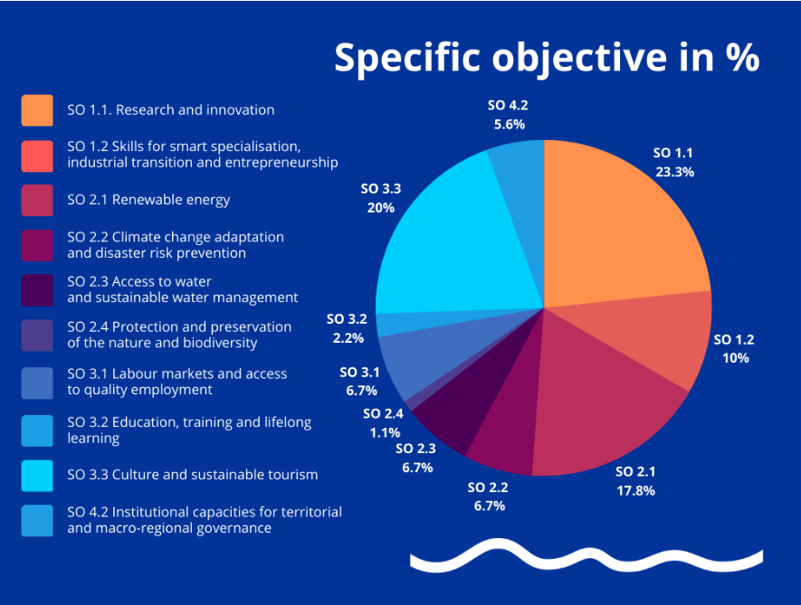


90 PROJECTS INVITED TO THE SECOND STEP OF THE 1ST CALL FOR PROPOSALS
The Monitoring Committee of the new Danube Region Programme on 20 April 2023 approved 90 projects to be invited to develop the full application form in the second step.
The programme received a total of 290 expressions of interest during the first call for proposals.

Slide 9
Water-related (2.3) Proposals succeeded to the next step:
DRP02001562.3 Danube Water Balance General Directorate of Water Management HU
DRP0200037 2.3 Tethys TU Wien AT
DRP0200235 2.3 AQUATIC PLASTIC Filmjungle.eu Society HU
DRP0200029 2.3 DanubeSediment_Q2 University of Natural Resources and Life
Sciences, Vienna AT
DRP0200392 2.3 AgriNitro Geological Survey of Slovenia SI
DRP0200442 2.3 MicroDrink Croatian Geological Survey HR

Slide 10
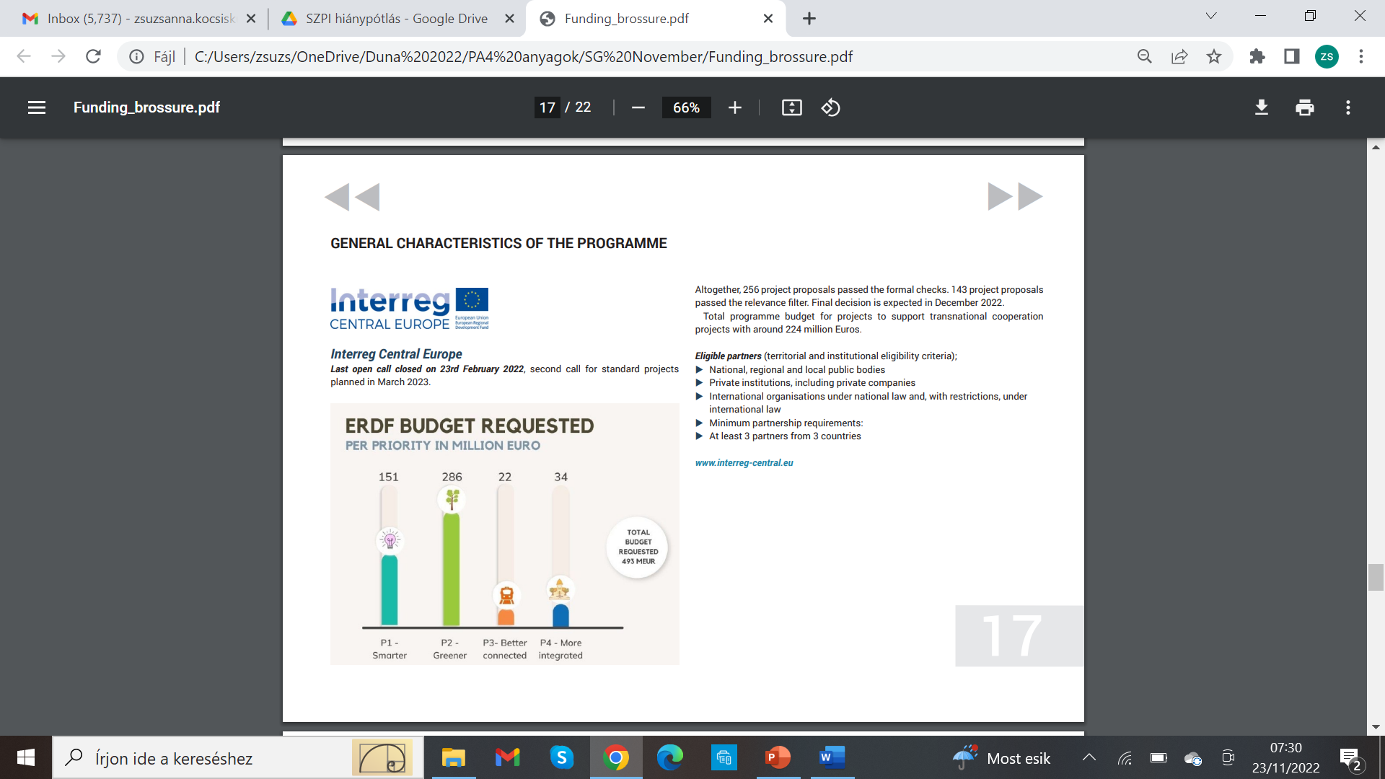
Interreg Central second call for proposals closed on 17 May 2023.
210 project proposals were submitted.
A third call for proposals is planned in the second half of 2024. Details of the call will be further discussed and decided by the monitoring committee in mid-October 2023.

Slide 11
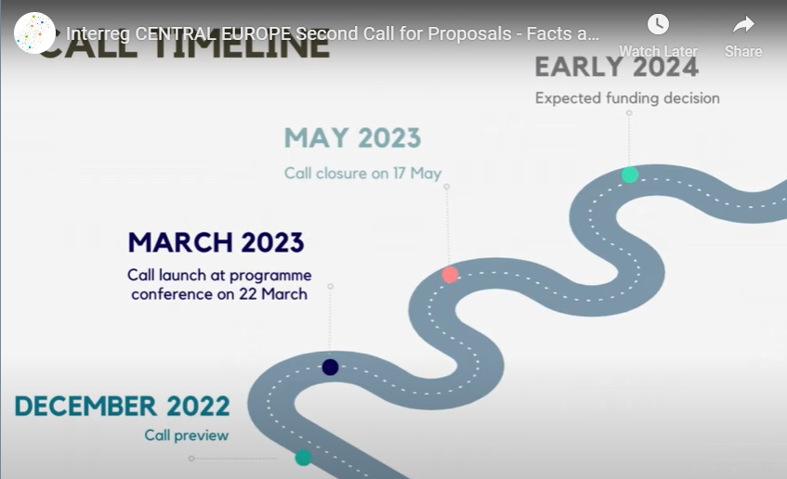
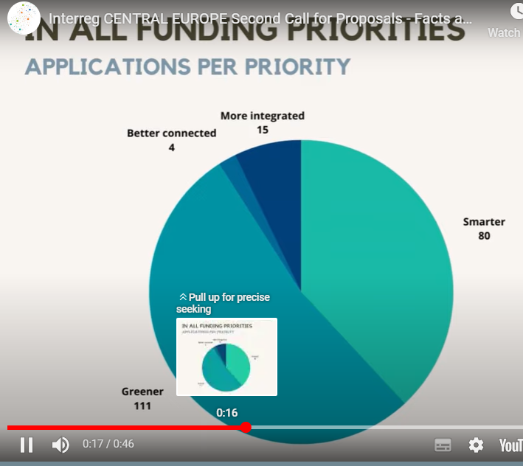
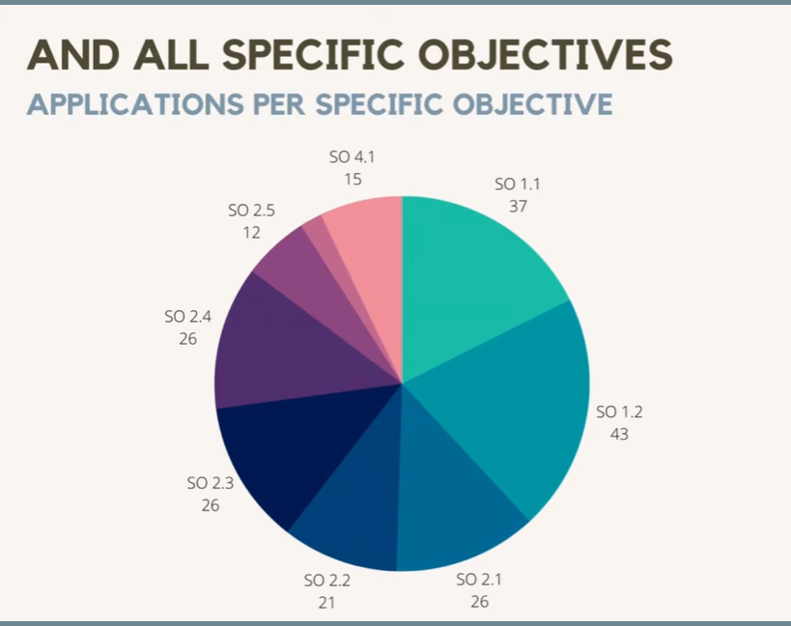



Slide 12
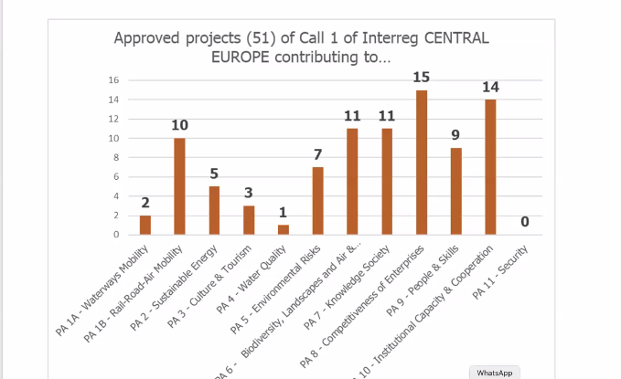

Slide 13
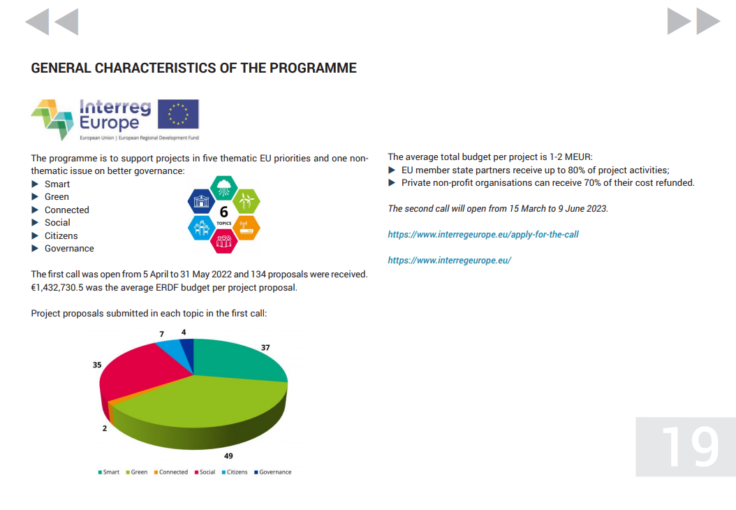
The second call assistance
The second call for project proposals is open from 15 March to 9 June 2023. https://www.interregeurope.eu/

Slide 14
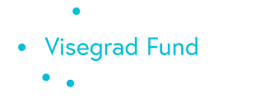
International Visegrad Fund
Advancing ideas for sustainable regional cooperation in Central Europe
Deadlines
There are three regular calls for applications open 30 days before the deadlines of submission on 1 February, 1 June, 1 October.
Applications
No matter where your organization is from, you can apply for grants if your project develops active cooperation with organizations from at least 3 Visegrad countries. Only a single project application per applicant can be submitted at a time, but you can re-apply once all your previous projects financed by the Fund have been concluded.
V4 AND V4+ PROJECTS focus on Regional Development,
Environment and Tourism
Procedure completely online, opens 3 times a year! https://www.visegradfund.org/

Slide 15

EMBEDDING discussions planned:
The session “A smarter Danube Region” on Tuesday, 13 June 2023 from 10.00 to 12.00 CET will focus on the following topics:
# educational activity
# water management
# environmental protection
connecting to EUSDR PA 4 Actions 6 and 7 and PA 7 Actions 4 and 6 in relation to PO 2 and PO 4 of the Cohesion Policy framework.
Thank you for your attention!

